Slide 1

Business Survey
Session Four
Business Foundations
  A Changing World 11th Edition
    O.C. Ferrell, Geoffrey Hirt, and Linda Ferrell; McGraw Hill Education; New York, NY 2018
      ISBN: 978-1-259-68523-1

Slide 2
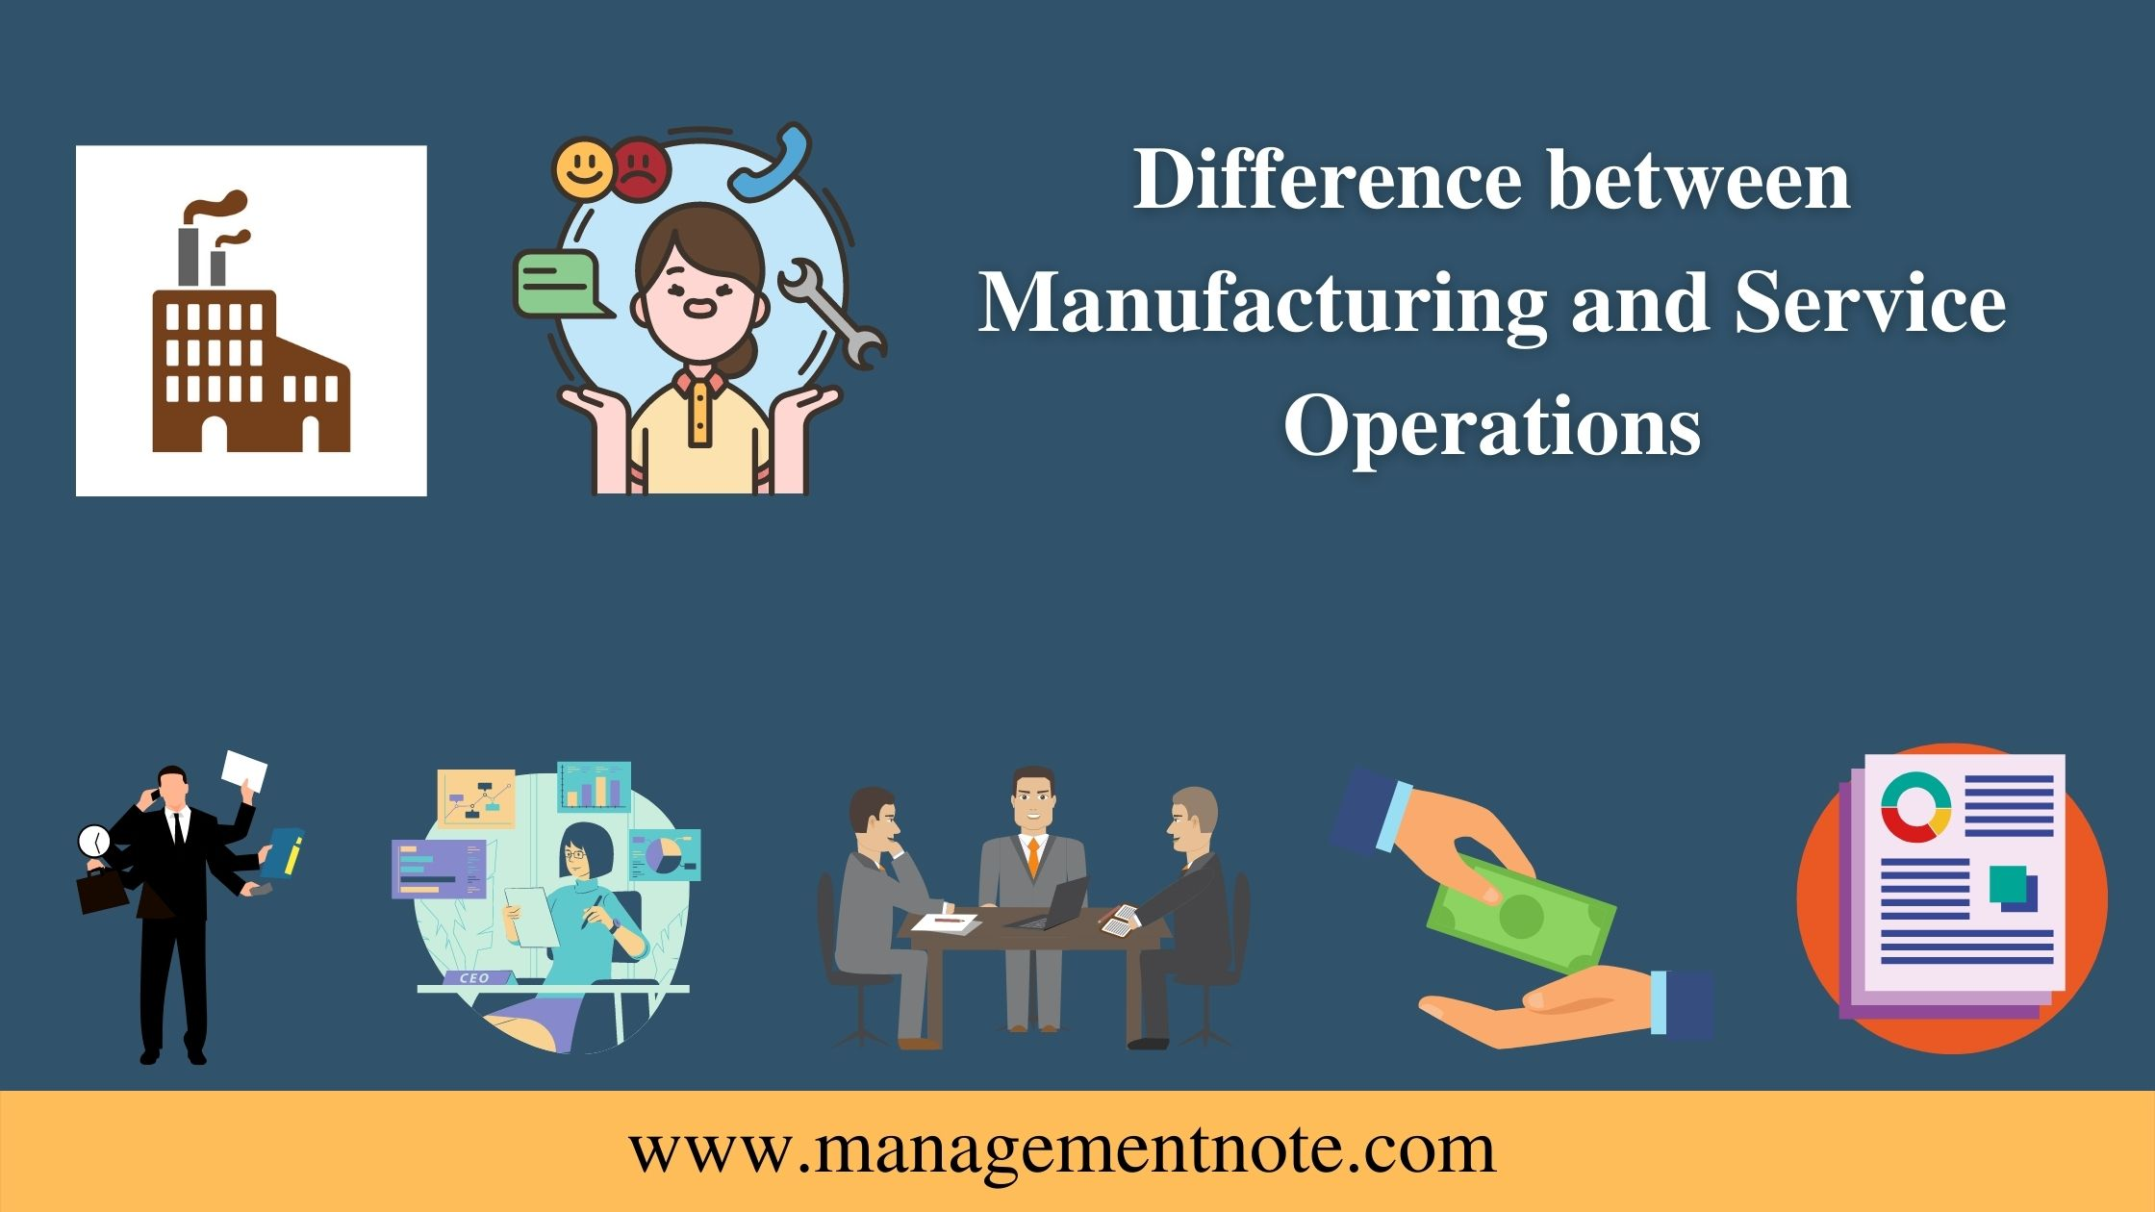
Part Three: Managing for Quality and Competitiveness
Chapter Eight: Managing Service and Manufacturing Operations

Slide 3
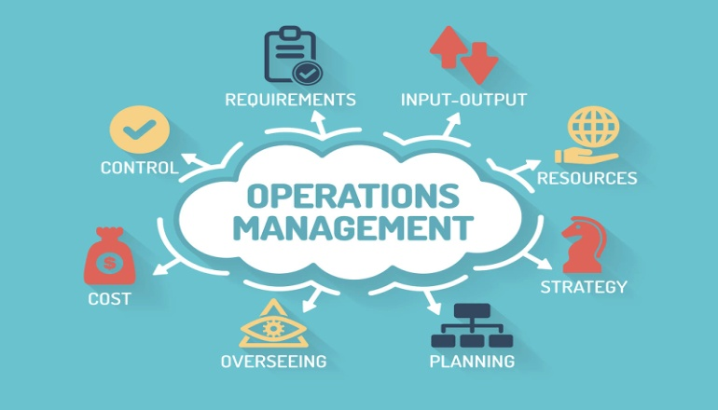
Introduction
All organizations create products – goods, services, or ideas for customers. Thus, organizations share a number of similarities relating to how they transform resources into the products we consume.
  Even organizations in unrelated industries take similar steps in creating goods or services. For example, the way Subway assembles a sandwich and the way GMC assembles a truck are similar (both use automation and assembly line). These similarities are the result of operations management.

Slide 4
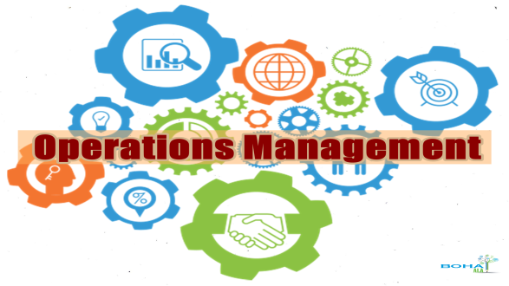
The Nature of Operations Management
Operations Management (OM), the development and administration of the activities involved in transforming resources into goods and services, is of critical importance.
  Operations managers oversee the transformation process and the planning and designing of operations systems, managing logistics, quality, and productivity.
    Quality and productivity have become fundamental aspects of operations management because a company that cannot make products of the quality desired by consumers, using resources efficiently and effectively, will not be able to remain in business.

Slide 5
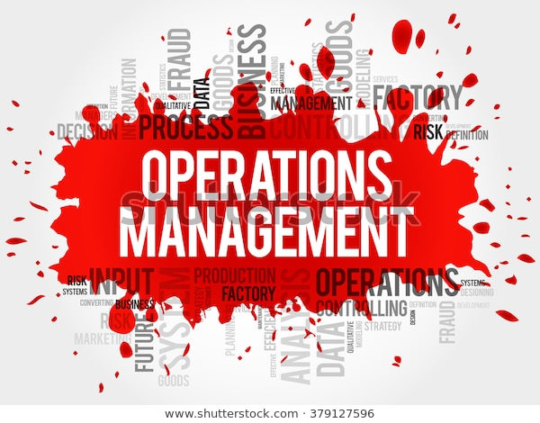
The Nature of Operations Management
Production and Manufacturing
Historically, operations management has been called “production” or “manufacturing” primarily because of the view that it was limited to the manufacture of physical goods.
  The change from “production” to “operations” recognizes the increasing importance of organizations that offer ideas.
  Additionally, the term operations represents an interest in viewing the operations functions as a whole rather than simply an analysis of inputs and outputs.
    OM is the “core” of most organizations because it is responsible for the creation of the organization’s goods and services.

Slide 6
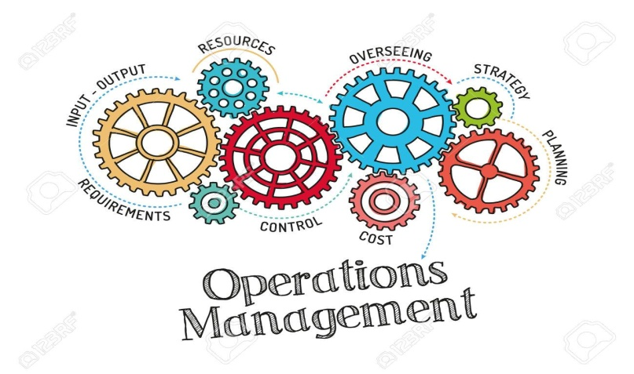
The Nature of Operations Management
Interchangeable
OM includes a wide range of organizational activities and situations outside of manufacturing, such as health care, food service, banking, entertainment, education, transportation, and charity.
  We use the terms manufacturing and production interchangeably to represent activities and processes used in making tangible products, and we use the broader term operations to describe the processes used in making both tangible and intangible products.

Slide 7
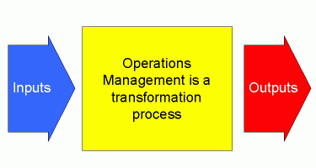
The Transformation Process
Inputs and Outputs
The heart of operations management is the transformation process through which “Inputs” (resources such as labor, money, materials, and energy) are converted into “Outputs” (goods, services, and ideas).
  The transformation process combines inputs in predetermined ways using different equipment, administrative procedures, and technology to create a product.
    To ensure that this process generates quality products efficiently, operations managers control the process by taking measurements (feedback) at various points in the process and compare them to established standards and benchmarks.

Slide 8
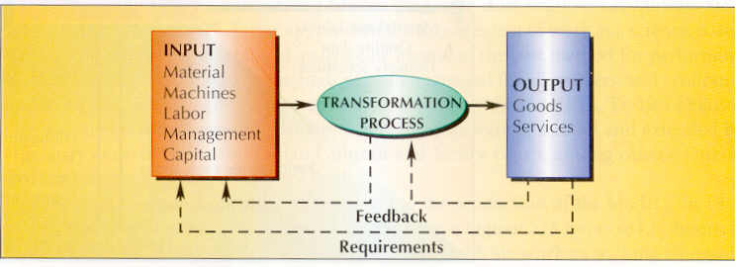
Operations Management in Service Businesses
Different types of transformation processes take place in organizations that provide services.
  (x) An airline transforms inputs such as employees, time, money, and equipment through processes such as booking flights, flying airplanes, maintaining equipment, and training crews, etc. The output of these processes is flying passengers and/or packages to their destinations. In a non-profit like Habitat for Humanity, inputs such as money, materials, information, and volunteer time and labor are used to transform raw materials into homes for families in need.
    Unlike tangible goods, services are effectively actions or performances that must be directed toward consumers who use them.

Slide 9

Operations Management in Service Businesses
There is a significant customer-contact component to most services.
  Regardless of the level of contact, service businesses strive to provide a standardized process, and technology offers an interface that creates an automatic and structured response.
  The ideal service provider will be high tech and high touch.
    Service organizations must build their operations around good execution, which comes from hiring and training excellent EEs, developing flexible systems, customizing services, and maintaining adjustable capacity to deal with fluctuating demand.

Slide 10
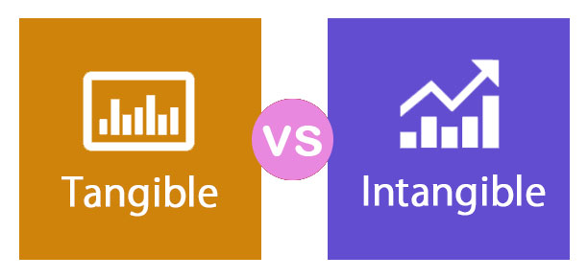
Operations Management in Service Businesses
Businesses that manufacture tangible goods and those that provide services or ideas are similar yet different.
  They differ in several respects:
    Intangibility
    Inseparability of Production and Consumption
    Perishability
    Customization
    Customer contact

Slide 11

Characteristics of Services
Intangibility
  Going to a concert or sports event such as a baseball game
Inseparability of Production and Consumption
  Going to a chiropractor; air travel; veterinary services
Perishability
  Seats at a speaker’s presentation
Customization
  Haircut; legal services
Customer Contact
  Restaurants; direct selling such as Tupperware parties.

Slide 12
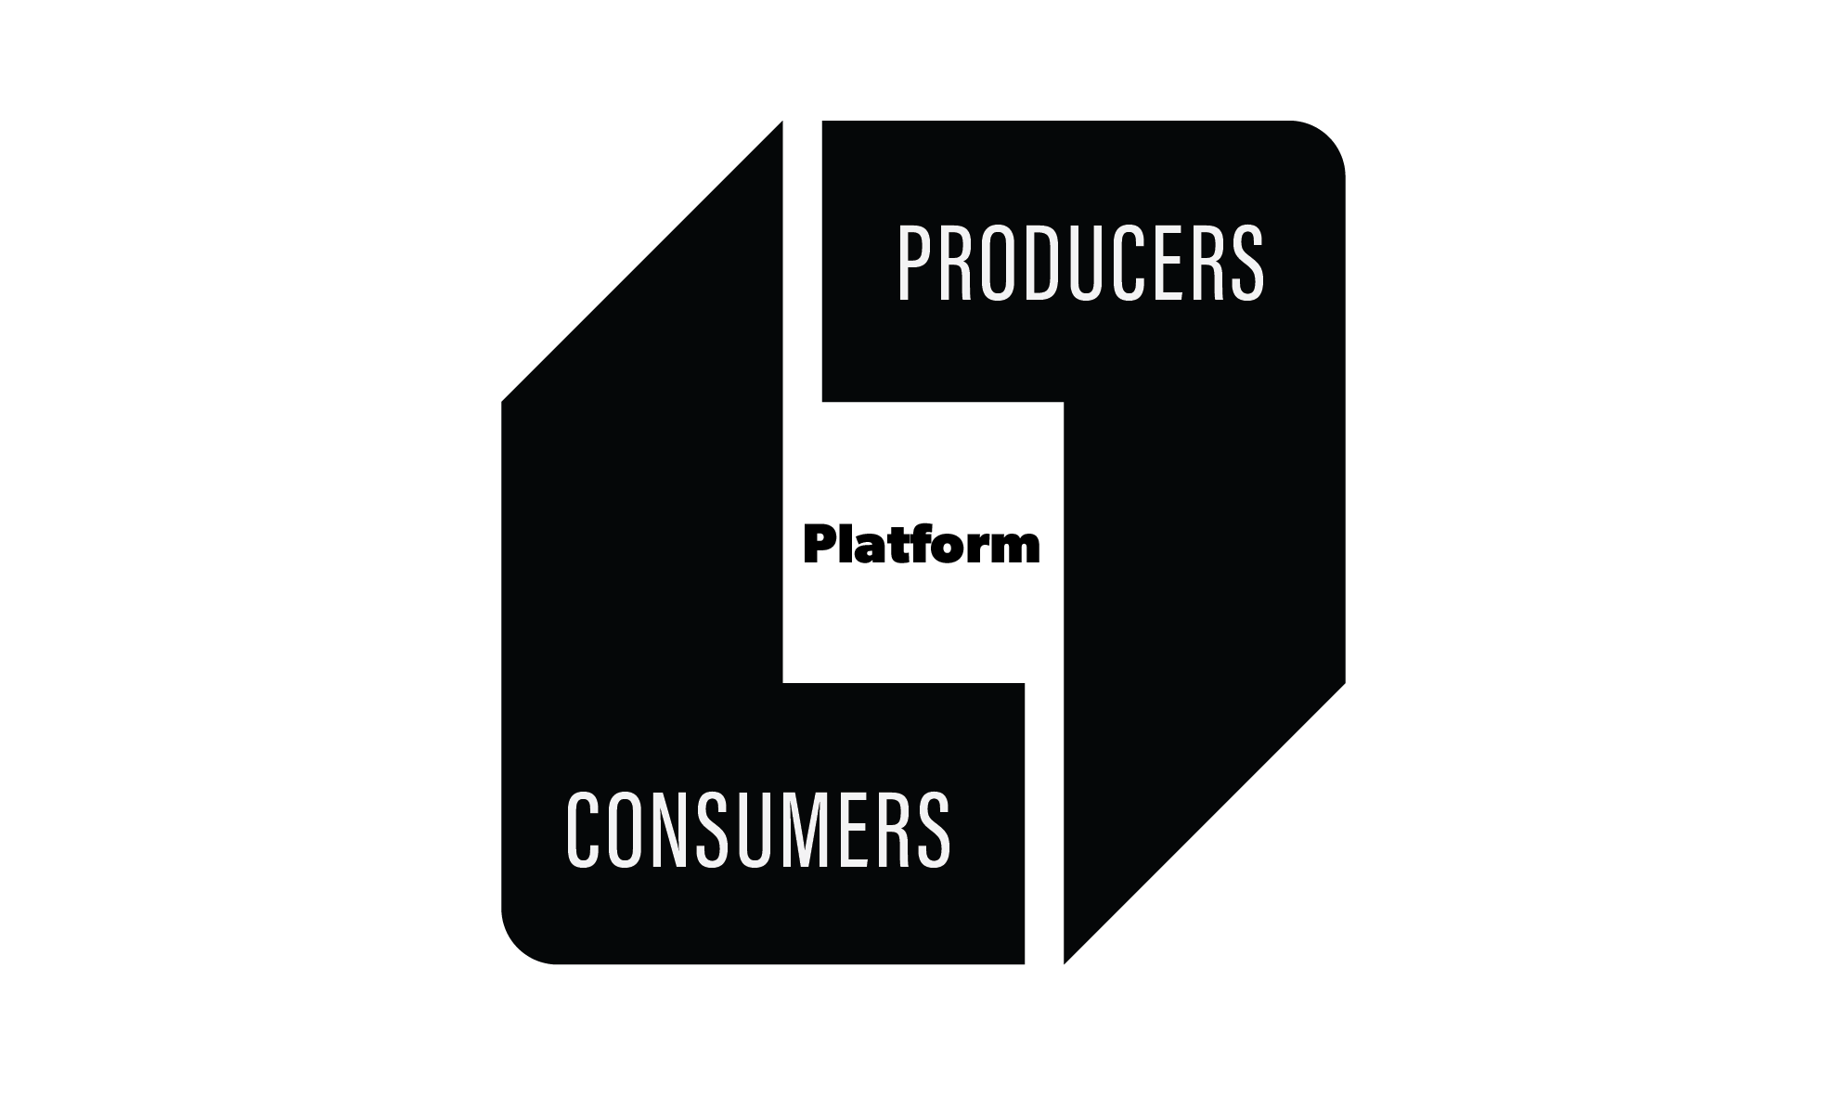
Nature and Consumption of Output
Manufacturers and service providers differ in the nature and consumption of their output.
  For example, the term manufacturer implies a firm that makes tangible products. A service provider, on the other hand, produces more intangible outputs such as U.S. Postal Service delivery of priority mail or a business stay in a Hyatt hotel.
    The very nature of a service provider’s product requires a higher degree of customer consumption. The quality of the service experience is often controlled by a service-contact employee.
    Manufacturing occurs in an isolated area, away from the customer.

Slide 13

Uniformity of Inputs
Manufacturers typically have more control over the amount of variability of the resources they use than do service providers.
  For example a customer calling Fidelity Investments is likely to require different services due to differing needs, whereas many of the tasks required to manufacture a Ford Focus are the same across each unit of output.
    Consequently, the products of service organizations tend to be more “customized.” A haircut is much more likely to incorporate your specific desires (customization) than is a bottle of shampoo.

Slide 14

Uniformity of Output
Because of the human element inherent in providing services, each service tends to be performed differently.
  Consequently, human and technological elements associated with a service can result in a different day-to-day or even hour-to-hour performance of that service. Moreover, no two customers are exactly alike in their perception of the service experience.
    In manufacturing, the high degree of automation available allows manufacturers to generate uniform outputs and, thus, the operations are more effective and efficient.

Slide 15
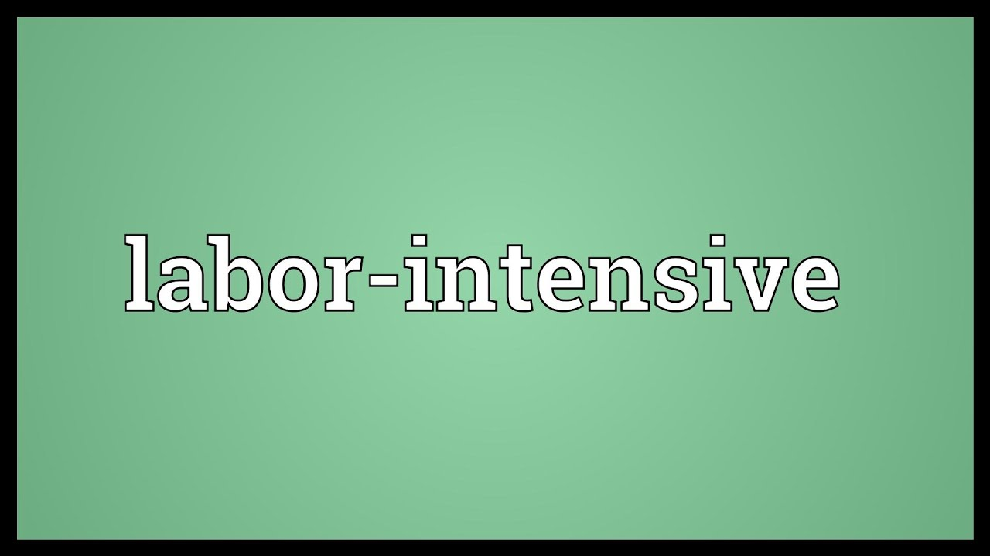
Labor Required
Service providers are generally more labor-intensive (require more labor) because of the high level of customer contact, perishability of the output (must be consumed immediately), and high degree of variation of inputs and outputs (customization).

Slide 16
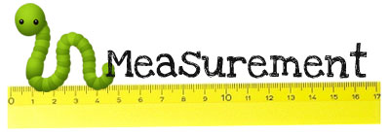
Measurement of Productivity
For manufacturers, measuring productivity is fairly straightforward because of the tangibility of the output and its high degree of uniformity.
  For the service provider variations in demand, variations in service requirements from job to job, and the intangibility of the product make productivity measurement more difficult.
    Most organizations are a combination of both manufacturing and service provision, with both tangible and intangible qualities embodied in what they produce.

Slide 17

Measurement of Productivity
We consider “products” to include both tangible physical goods and intangible service offerings.
  It is the level of tangibility of its principal product that tends to classify a company as either manufacturer or service provider.
    From an OM standpoint, this level of tangibility greatly influences the nature of the company’s operational processes and procedures.

Slide 18

Planning and Designing Operations Systems
Before a company can produce any product, it must first decide what it will produce and for what group of customers.
  It must then determine the processes it will use to make these products as well as the facilities it needs to produce them.
    These decisions comprise operations planning.

Slide 19
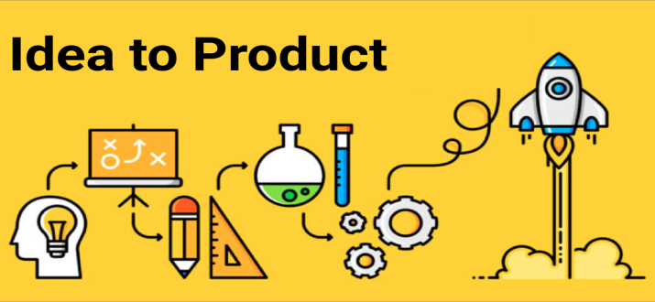
Planning the Product
Before making any product, a company must 1st determine what consumers want and then design a product to satisfy that want.
  Most companies use social media and marketing research to determine the kinds of goods and services to provide and the features they must possess.
    Marketing research can also help gauge the demand for a product and how much consumers are willing to pay for it.

Slide 20

Planning the Product
Once management has researched and developed an idea for a product that customers will buy, it must then plan how to efficiently produce the product.
  Planning does not stop with a blueprint for a product or a description of a service; it must also work out efficient production of the product to ensure that enough is available to satisfy customer demand.
    Operations managers must plan for the types and quantities of materials needed to produce the product, the skills and quantity of people needed to make the product, and the actual processes through which the inputs must pass through in their transformation to outputs.

Slide 21
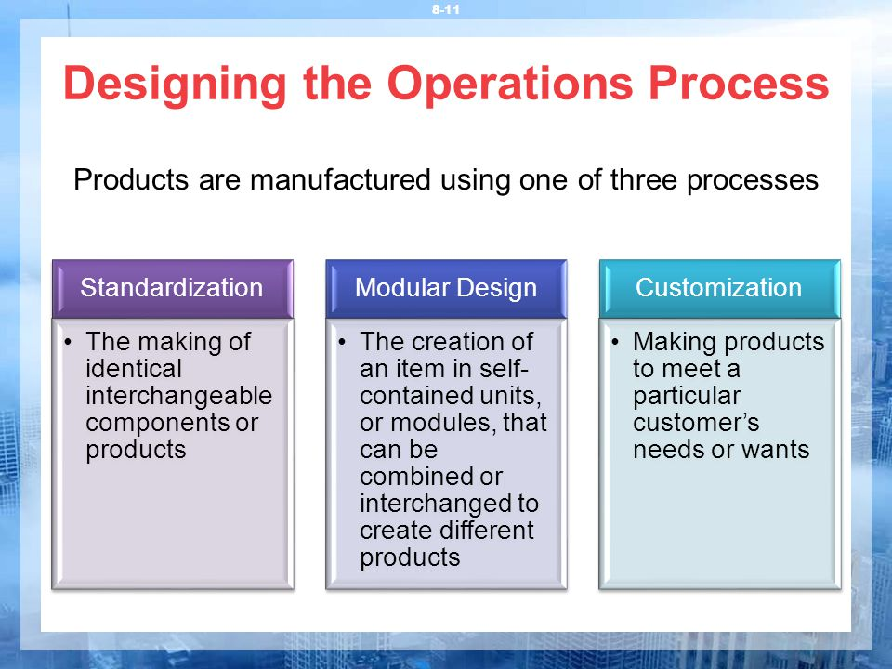
Designing the Operations Processes
Before a firm can begin production, it must first determine the appropriate method of transforming resources into the desired product.
  Often, consumers’ specific needs and desires dictate a process.
    Products are designed to be manufactured by 1 of 3 processes: (1) standardization, (2) modular design, or (3) customization.

Slide 22

1. Standardization
Standardization is making identical, interchangeable components or even complete products.
  Standardization speeds up production and quality control and reduces production costs. It provides consistency so that customers who need certain products to function uniformly all the time will get a product that meets their expectations.
    Standardization becomes more complex on a global scale, because different countries have different standards for quality, but the International Organization for Standardization (ISO) developed a list of global standards that companies can adopt to assure stakeholders that they are complying with the highest quality, environmental, and managerial guidelines.

Slide 23

Standardization
ISO 14000
  A comprehensive set of environmental standards that encourages a cleaner and safer world by promoting a more uniform approach to environmental management and helping companies attain and measure improvements in their environmental performance.
ISO 19600
  A comprehensive set of guidelines for compliance management that address risks, legal requirements, and stakeholder needs.

Slide 24

2. Modular Design
Modular Design involves building an item in self-contained units, or modules, that can be combined or interchanged to create different products.
  Because many modular components are produced as integrated units, the failure of any portion of a modular component usually means replacing the entire component.
    Modular design allows products to be repaired quickly, thus reducing the cost of labor, but the component itself is expensive, raising the cost of repair materials.

Slide 25
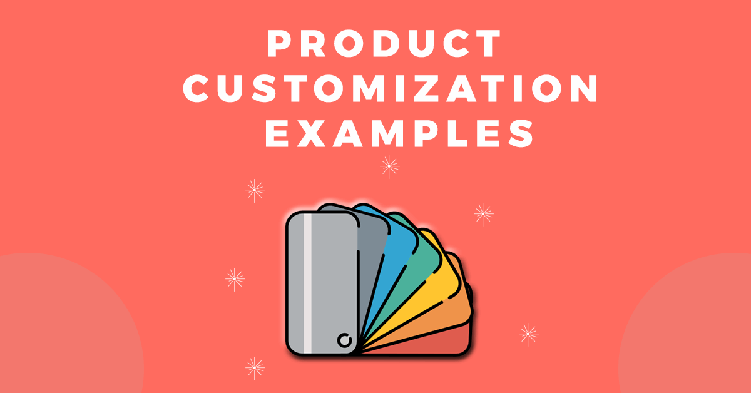
3. Customization
Customization is making products to meet a particular customer’s needs or wants.
  Products produced in this way are generally unique.
    For both goods and services, customers get to make choices and have options to determine the final product.

Slide 26
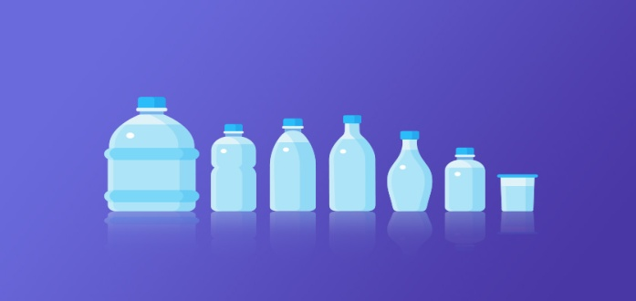
Planning Capacity
Planning the operational processes for the organization involves two important areas: (1) capacity planning and (2) facilities planning.
  The term Capacity basically refers to the maximum load that an organizational unit can carry or operate. The unit of measurement may be a worker or a machine, a department, a branch, or even an entire plant.
    Maximum capacity can be stated in terms of the inputs or outputs provided. For example, a restaurant might state capacity in terms of the maximum number of customers it can serve with quality.

Slide 27
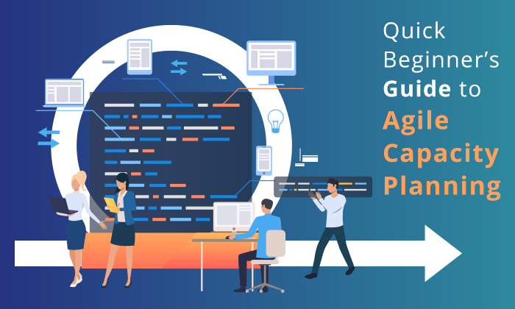
Planning Capacity
Efficiently planning the organization’s capacity needs is an important process for the operations manager.
  Capacity levels that fall short can result in unmet demand, and consequently, lost customers. On the other hand, when there is more capacity available than needed, operating costs are driven up needlessly due to unused and often expensive resources.
    To avoid such situations, organizations must accurately forecast demand and then plan capacity based on these forecasts.

Slide 28
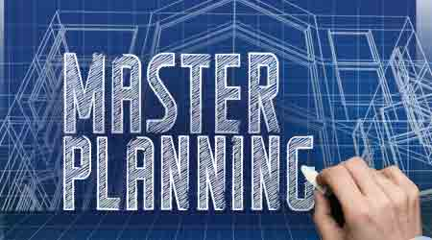
Planning Facilities
Once a company knows what process it will use to create its products, it then can design and build an appropriate facility in which to make them.
  Companies must decide where to locate their operations facilities, what layout is best for producing their particular product, and even what technology to apply to the transformation process.
    Many firms are developing both a traditional organization for customer contact and a virtual organization.

Slide 29

Facility Location
Where to locate a firm’s facilities is a significant question because, once the decision has been made and implemented, the firm must live with it due to the high costs involved.
  When a company decides to relocate or open a facility at a new location, it must pay careful attention to factors such as proximity to market, availability of raw materials, availability of transportation, availability of power, climatic influences, availability of labor, community characteristics (quality of life), taxes and inducements.
    The facility-location decision is complex because it involves the evaluation of many factors, some which cannot be measured with precision.

Slide 30
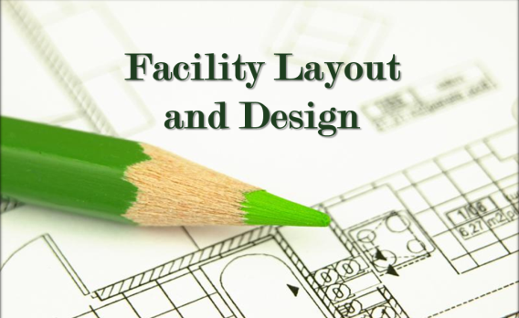
Facility Layout
Arranging the physical layout of a facility is a complex, highly technical task. Although many companies use a combination of layout designs, there are three basic layouts:
  Fixed Position Layout
    A company using a fixed-position layout brings all resources required to create the product to a central location.
  Process Layout
    Firms that use a process layout organize the transformation process into departments that group related processes.
  Product Layout
    The product layout requires that production be broken down into relatively simple tasks assigned to workers, who are usually positioned along an assembly line.

Slide 31

Technology
Every industry has a basic, underlying technology that dictates the nature of its transformation process.
  Two developments that have strongly influenced the operations of many businesses are computers and robotics.
  The operations function makes great use of computers in all phases of the transformation process.
    Computer-Assisted Design (CAD), for example, helps engineers design components, products, and processes. Computer-Assisted Manufacturing (CAM) uses specialized computer systems to actually guide and control the transformation processes.

Slide 32

Technology
Other areas where technology is making a difference:
  Flexible Manufacturing computers can direct machinery to adapt to different versions of similar operations.
  The use of drones in business operations is vastly changing the technology landscape. Amazon’s intention is to use drone aircraft to deliver packages to customers in as little as 30 minutes, saving approximately $2 per shipment.
  Robots are also becoming increasingly useful in the transformation process, and they are continuously evolving.
    When all these technologies and more are integrated, the result is computer-integrated manufacturing (CIM), a complete system that designs products, manages machines and materials, and controls the operations function.

Slide 33
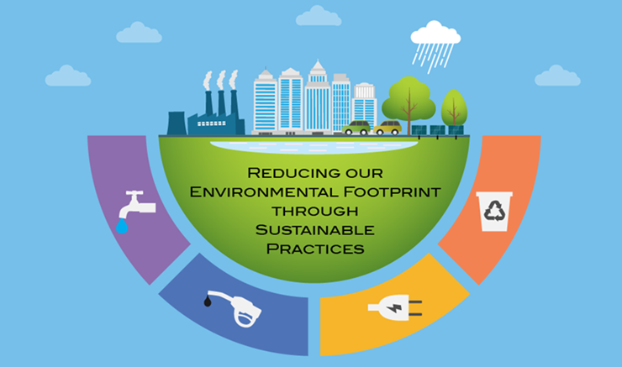
Sustainability and Manufacturing
Manufacturing and operations systems are moving quickly to establish environmental sustainability and minimize negative impact on the natural environment.
  Sustainability deals with conducting activities in such a way as to provide for the long-term well-being of the natural environment, including all biological entities.

Slide 34

Sustainability and Manufacturing
Sustainability issues are becoming increasingly important to stakeholders and consumers, as they pertain to the future health of the planet.
  Some sustainability issues include pollution of the land, air, and water, climate change, waste management, deforestation, urban sprawl, protection of biodiversity, and genetically modified foods.

Slide 35

Sustainability and Manufacturing
Green operations and manufacturing can improve a firm’s reputation along with customer and employee loyalty, leading to improved profits.
  Much of the movement to green manufacturing and operations is the belief global warming and climate change must decline. It is estimated that eco-friendly buildings use 60 to 90 percent less energy than conventional buildings.
    Green products produced through green operations and manufacturing are our future.

Slide 36
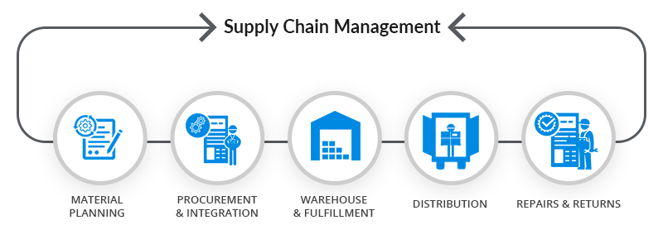
Managing the Supply Chain
A major focus of operations is Supply Chain Management, which refers to connecting and integrating all parties or members of the distribution system in order to satisfy customers.
  Also called logistics, supply chain management includes all activities involved in obtaining and managing raw materials and component parts, managing finished products, packaging, and getting them to customers.
    The supply chain integrates firms such as raw material suppliers, manufacturers, retailers, and ultimate consumers into a seamless flow of information and products.

Slide 37
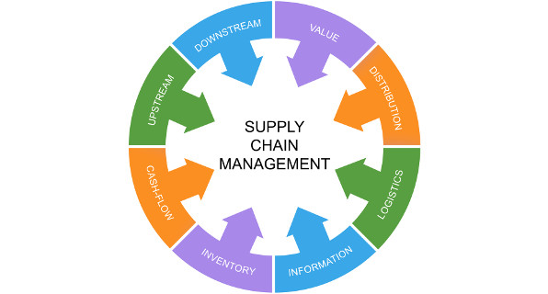
Managing the Supply Chain
Some aspects of logistics (warehousing, packaging, and distributing) are closely linked with marketing.
  In this section, we look at purchasing, managing inventory, outsourcing, and scheduling, which are vital tasks in the transformation of raw materials into finished goods.
    To illustrate logistics, consider a hypothetical small business – called Rushing Water Canoes, Inc. – that manufactures aluminum canoes, which it sells primarily to sporting goods stores and river-rafting expeditions.

Slide 38

Purchasing
Purchasing, also known as procurement, is the buying of all the materials needed by the organization.
  The purchasing department aims to obtain items of the desired quality in the right quantities at the lowest possible cost.
    Rushing Water Canoes, for example, must procure not only aluminum and other raw materials, and various canoe parts and components, but also machines and equipment, manufacturing supplies (oil, electricity, and so on), and office supplies in order to make its canoes.
      People in the purchasing department locate and evaluate suppliers of these items.

Slide 39

Purchasing
Not all companies purchase all of the materials needed to create their products.
  Often times, they can make some components more economically and efficiently than can an outside supplier. On the other hand, firms sometimes find that it is uneconomical to make or purchase an item, and instead arrange to lease it from another organization.
    Whether to purchase, make, or lease a needed item depends on cost, as well as on product availability and supplier reliability.

Slide 40

Managing Inventory
Once the items needed to create a product have been procured, some provision has to be made for storing them until they are needed.
  Every raw material, component, completed or partially completed product, and piece of equipment a firm uses – its Inventory – must be accounted for, or controlled.
    There are three basic types of inventory: (1) finished goods, (2) works in progress, and (3) raw materials needed for product.

Slide 41
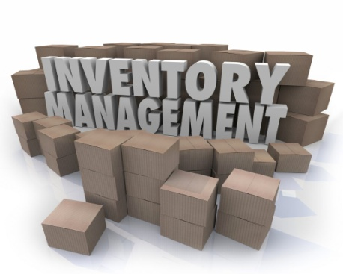
Managing Inventory
Inventory Control is the process of determining how many supplies and goods are needed and keeping track of quantities on hand, where each item is, and who is responsible for it.
  Operations management must be closely coordinated with inventory control.
    The production of televisions, for example, cannot be planned without some knowledge of the availability of all the necessary materials, also each item in inventory – any type of inventory – carries with it a cost (i.e.) storage space, insurance, etc.

Slide 42
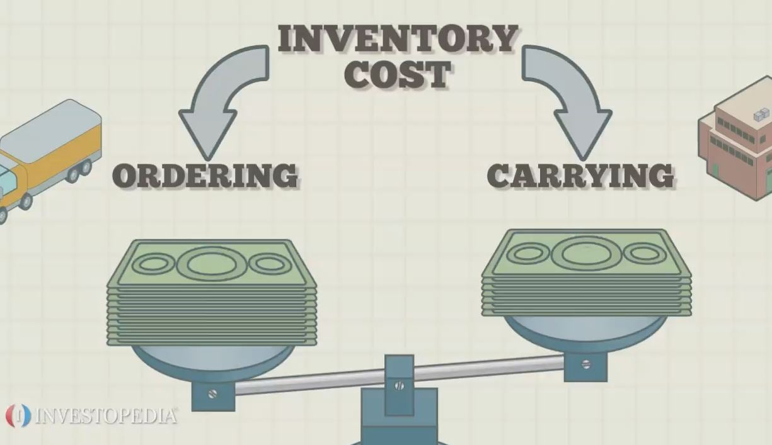
Managing Inventory
The Economic Order Quantity Model
To control the of items maintained in inventory, managers need to determine how much of each item they must order.
  One popular approach is the Economic Order Quantity (EOQ) Model, which identifies the optimum number of items to order to minimize the cost of managing: ordering, storing, and using the needed items.

Slide 43
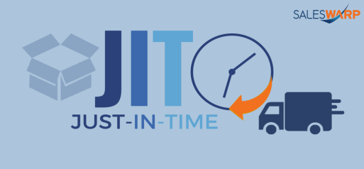
Managing Inventory
Just-in-Time Inventory Management
Another popular technique is Just-in-Time Inventory Mgmt., which eliminates waste by using smaller quantities of materials that arrive “just in time” for use in the transformation process and, therefore, require less storage space and other inventory management expense.
  JIT minimizes inventory by providing an almost continuous flow of items from suppliers to the production facility.
    For this approach to be effective, the supplier must be extremely reliable and relatively close to the production facility.
    The downside to this approach is the risk of something affecting timely delivery and disrupting production. For this reason, many economists suggest that businesses store components that are essential for production and diversify their supply chains.

Slide 44
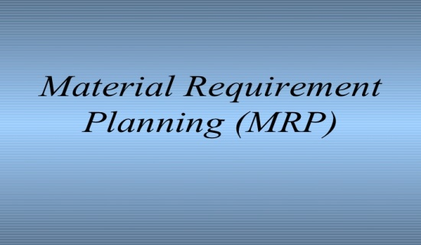
Managing Inventory
Material-Requirements Planning
Another inventory management technique is Material Requirements Planning (MRP), a planning system that schedules the precise quantity of materials needed to make the product.
  The basic components of MRP are a master production schedule, a bill (list) of materials, and an inventory status file.
    The manager will need to determine the quantity of these items already held in inventory (to avoid ordering excess materials) and then develop a schedule for ordering and accepting delivery of the right quantity of materials to satisfy the firm’s needs.

Slide 45

Outsourcing
Increasingly, outsourcing has become a component of supply chain management in operations.
  Outsourcing refers to the contracting of manufacturing or other tasks to independent companies, often overseas.
    Many companies elect to outsource some aspects of their operations to companies that can provide these products more efficiently, at a lower cost, and with greater customer satisfaction.

Slide 46

Outsourcing
Often times, though, companies outsourcing face heavy regulations, high transportation costs, inadequate facilities, and unpredictable supply chain execution.
  Therefore, suppliers need to provide useful, timely, and accurate information about every aspect of the quality requirements, schedules, and solutions to dealing with problems.
    Companies that hire suppliers must also make certain that their suppliers are following company standards; failure to do so could lead to criticism of the parent company.

Slide 47
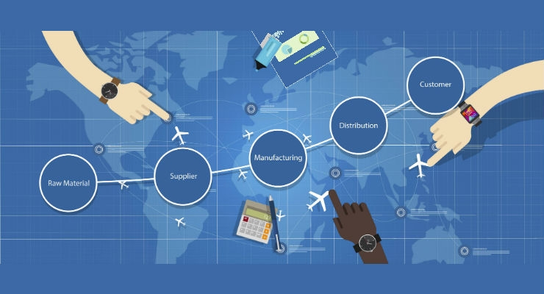
Outsourcing
Outsourcing allows companies to free up time and resources to focus on what they do best and to create better opportunities to focus on customer satisfaction.
  Many executives view outsourcing as an innovative way to boost productivity and remain competitive against low wage offshore factories.
    However, outsourcing may create conflict with labor and negative public opinion when it results in U.S. workers being replaced by lower-cost workers in other countries.

Slide 48

Routing and Scheduling
After all materials are procured and their use determined, managers must then consider the routing, or sequence of operations through which the product must pass.
  For example, before employees at Rushing Water Canoe can form aluminum sheets into a canoe, the aluminum must be cut to size. Likewise, the canoe’s floatation material must be installed before workers can secure the wood seats.
    The sequence depends on the product specifications developed by the engineering department of the company.

Slide 49

Routing and Scheduling
Once management knows the routing, the actual work can be scheduled.
  Scheduling assigns the work to be done to departments or even specific machines, workers, or teams.
    One popular method for scheduling is the Program Evaluation and Review Technique (PERT), which identifies all the major activities or events required to complete a project, arranges them in a sequence or path, determines the critical path, and estimates the time required for each event.

Slide 50
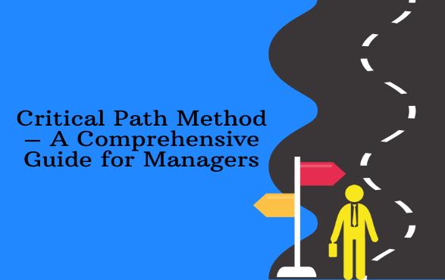
Scheduling
Critical Path
  The path that requires the longest time from start to finish is called the Critical Path because it determines the minimum amount of time in which the process can be completed.
  If any of the activities on the critical path for production of the Big Mac fall behind schedule, the sandwich will not be completed on time, causing customers to wait longer than they usually would.
    Producing a McDonald’s Big Mac, for example, involves removing meat, cheese, sauce, and vegetables from the refrigerator; grilling hamburger patties; assembling the ingredients; placing the completed Big Mac in its package; and serving it to the customer. The cheese, pickles, onions, and sauce cannot be put on before the hamburger patty is completely grilled and placed on the bun.

Slide 51
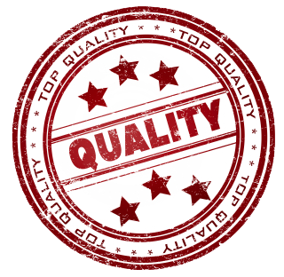
Managing Quality
Quality, like cost and efficiency, is a critical element of operations management, as defective products can quickly ruin a firm.
  Quality reflects the degree to which a good or service meets the demands and requirements of customers.
    Determining quality can be difficult because it depends on customers’ perceptions of how well the product meets or exceeds their expectations. It is especially difficult to measure quality characteristics when the product is a service. A company has to determine exactly what quality characteristics it considers important and then define them in terms they can be measured.

Slide 52
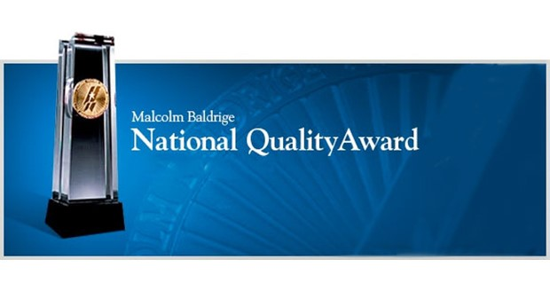
Managing Quality
The Malcolm Baldrige National Quality Award is given each year to companies that meet rigorous standards of quality.
  The Baldrige criteria are (1) leadership, (2) information and analysis, (3) strategic planning, (4) human resource development, (5) process management, (6) business results, (7) customer focus and satisfaction.
    The criteria have become a worldwide framework for driving business improvement.

Slide 53
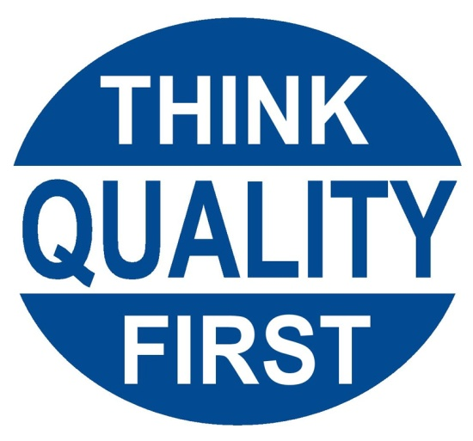
Quality Control
Quality is so important that we need to examine it in the context of operations management.
  Quality Control refers to the processes an organization uses to maintain its established quality standards.
    Quality has become a major concern in many organizations, particularly in light of intense foreign competition and increasingly demanding customers.

Slide 54
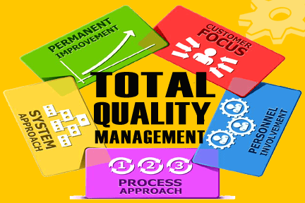
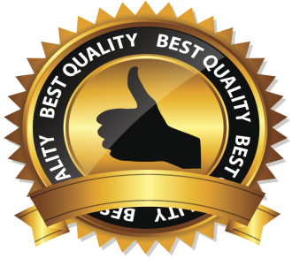
Total Quality Management (TQM)
To regain a competitive edge, a number of firms have adopted a total quality management approach.
  Total Quality Management (TQM) is a philosophy that uniform commitment to quality in all areas of the organization will promote a culture that meets customers’ perception of quality.
    It involves coordinating efforts to improve customer satisfaction, increasing EE participation, forming and strengthening supplier partnerships, and facilitating an organizational culture of continuous quality improvement.

Slide 55
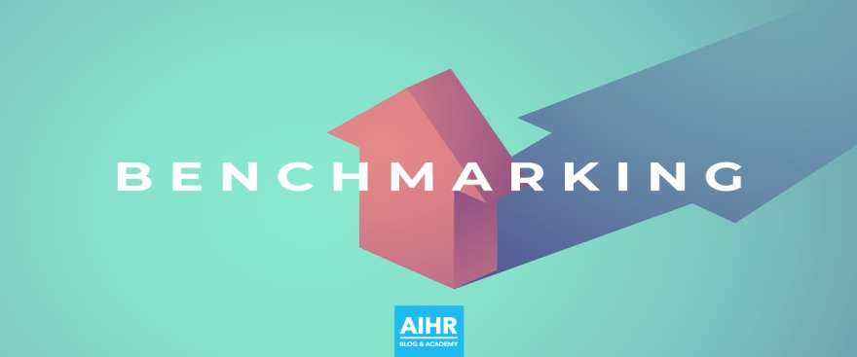
Benchmarking
Continuous improvement of an organization’s goods and services is built around the notion that quality is free; by contrast, not having high-quality goods and services can be very expensive, especially in terms of dissatisfied customers.
  A primary tool of the continuous improvement process is Benchmarking, the measuring and evaluating of the quality of the organization’s goods, services, or processes as compared with quality produced by the best performing companies in the industry.
    Benchmarking lets the organization know where it stands competitively in its industry, giving it a goal to aim for over time.

Slide 56

Inspection
Inspections reveal whether a product meets quality standards.
  Some product characteristics may be discerned by simple inspection techniques (i.e.) weighing the content of cereal boxes or measuring time it takes the customer to get their food. Other inspection techniques are more elaborate (i.e.) using machines to test the hinges on a car door.
    Organizations normally inspect purchased items, work-in-process, and finished items.

Slide 57

Sampling
An important question related to inspection is how many items should be inspected.
  Whether to inspect 100 % of the output or only part of it is related to the cost of the inspection process, the destructiveness of the process (some tests last until the product fails), and the potential cost of product flaws in terms of human lives and safety.
    In such cases, it is usually desirable to test only a sample of the output. If the sample passes inspection, the inspector may assume that all the items in the lot from which the sample was drawn would also pass inspection.

Slide 58

Integrating Operations and Supply Chain Management
Managing operations and supply chains can be complex and challenging due to the number of independent organizations that must perform their responsibilities in creating product quality.
  Managing supply chains requires constant vigilance and the ability to make tactical changes.
    Managing the various partners involved in supply chains and operations is important because many stakeholders hold the firm responsible for appropriate conduct related to product quality, integrity and social responsibility.

Slide 59


