Slide 1

SHINE Mentor
Survey of Business

Slide 2

Meeting Information
SHINE Mentor: Survey of Business
  October 1st through May 13th
    Thursdays from 6:30 to 8:30 PM
  SHINE Boys and Girls Center
    1100 South 13th Avenue, Yuma, Arizona 85364

Slide 3

Contact Information
Coach Mike
  Michael Morrissey, AWC Associate Faculty
  Executive Director, Housing Authority City of Yuma – AHDC/SHINE
    420 South Madison Avenue; Yuma, AZ 85364
    Work: (928) 782-3823 x.128; Cell: (928) 920-2085
    Michaelm@hacy.org or michael.morrissey@azwestern.org
Coach Luz
  Luz Acosta, SHINE Program Manager
    Work: (928) 318-5800; Cell (928) 261-8635
    luza@hacy.org
Coach Claudia
  Claudia Zavala, SHINE Service Coordinator
    Work (928) 919-1818; Cell (928) 580-4773
    czavala@hacy.org

Slide 4



Introductions
Pick a Partner (from a distance :)…
  Someone You Don’t Already Know
Learn the following:
  Name
  High School – Grade
  School Activities – Hobbies – Interests
  College and/or Career Goals
  Other Interesting Facts
Introduce Partner to the Class

Slide 5




Course Information
BUA 100: Survey of Business
  Business Foundations: A Changing World (11th Edition)
    O.C. Ferrell, Geoffrey Hirt, and Linda Ferrell; McGraw-Hill Education, New York, NY 2018
      ISBN: 978-1-259-68523-1

Slide 6

Expectations
Attend All Classes and Be On-Time
Participate in Class Discussion and Group Projects
Complete Weekly Assignments and Maintain Journal
Complete Projects, Presentations, Essays, Quizzes & Exams
Facilitate Workshops and Capstone Project

Slide 7



Grading Policy
Attendance and Participation (25%)
  10 Points each week for attendance and participation
    5 Points if late to class
Weekly Assignments (25%)
  10 Points each week for completing weekly assignments
    5 Points for incomplete or late assignments
Class Projects (25%)
  Projects may include Essays, Presentations, Workshops Etc.
Final Exam (Capstone Project) (25%)
  There will be a Final Exam (Capstone Project)
Extra Credit
  There will be opportunities for extra credit
    Points earned will be added to Final Grade

Slide 8

Course Goals
This course will cover the following:
  The Dynamics of Business and Economics
  Business Ethics and Social Responsibility
  Business in a Borderless World
  Options for Organizing Business
  Small Business, Entrepreneurship, and Franchising
  The Nature of Management
  Organization, Teamwork, and Communication
  Managing Service and Manufacturing Operations
  Motivating the Workforce
  Managing Human Relations
  Customer-Driven Marketing
  Dimensions of Marketing Strategy
  Digital Marketing and Social Networking
  Accounting and Financial Statements
  Money and the Financial System
  Financial Management and Securities Market

Slide 9


Part One: Business in a Changing World
Chapter One: The Dynamics of Business and Economics
  Chapter Outline:
    The Nature of Business
    The Economic Foundations of Business
    The American Economy
    Can you learn Business in a Classroom?

Slide 10


Part One: Business in a Changing World
Chapter Two: Business Ethics and Social Responsibility
  Chapter Outline:
    Business Ethics and Social Responsibility
    The Role of Ethics in Business
    The Nature of Social Responsibility
    Unemployment

Slide 11

Part One: Business in a Changing World
Chapter Three: Business in a Borderless World
  Chapter Outline:
    The Role of International Business
    International Trade Barriers
    Trade Agreements, Alliances, and Organizations
    Getting Involved in International Business
    International Business Strategies

Slide 12
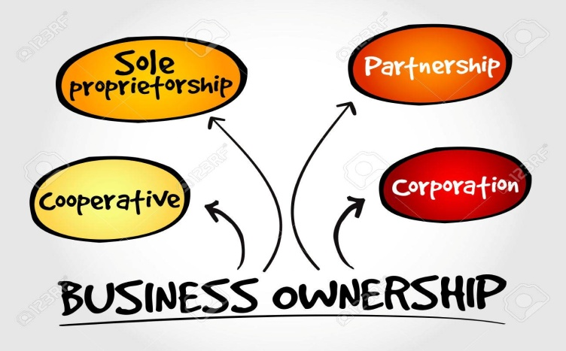
Part Two: Starting and Growing a Business
Chapter Four: Options for Organizing Business
  Chapter Outline:
    Sole Proprietorships
    Partnerships
    Corporations
    Other Types of Ownership
    Trends in Business Ownership

Slide 13

Part Two: Starting and Growing a Business
Chapter Five: Small Business, Entrepreneurship, and Franchising
  Chapter Outline:
    The Nature of Entrepreneurship and Small Business
    Advantages of Small Business Ownership
    Disadvantages of Small Business Ownership
    Starting a Small Business
    The Future for Small Business
    Making a Big Business Act Small

Slide 14

Part Three: Managing for Quality and Competitiveness
Chapter Six: The Nature of Management
  Chapter Outline:
    The Importance of Management
    Management Functions: Plan-Organize-Staff-Direct-Control
    Types of Management: Levels and Areas
    Skills Needed by Managers
      Technical-Conceptual-Analytical-Human Relations
    Leadership
    Decision Making
    Management in Practice

Slide 15
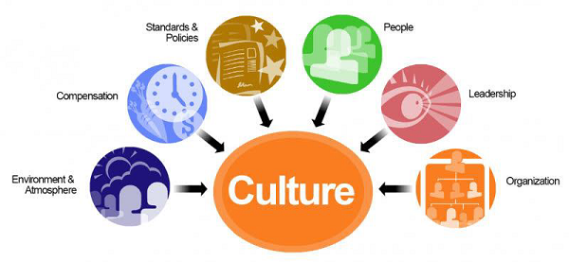

Part Three: Managing for Quality and Competitiveness
Chapter Seven: Organization, Teamwork, and Communication
  Chapter Outline:
    Organizational Culture
    Developing Organizational Structure
    Assigning Tasks
    Assuming Responsibility
    Forms of Organizational Structure
    Roles of Groups and Teams in Orgs.
    Communicating in Orgs.

Slide 16
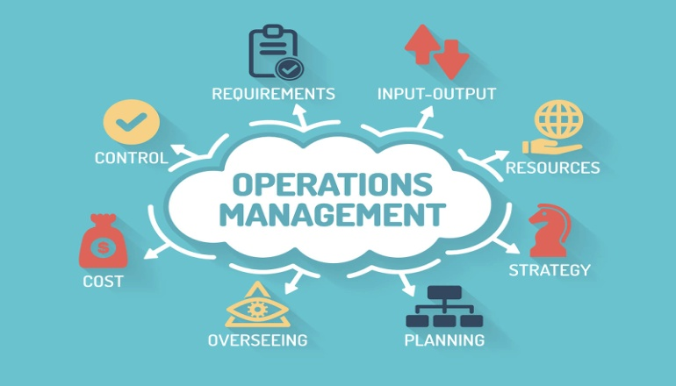
Part Three: Managing for Quality and Competitiveness
Chapter Eight: Managing Service and Manufacturing Operations
  Chapter Outline:
    The Nature of Operations Management
    Planning and Designing Operations Systems
    Managing the Supply Chain
    Managing Quality
    Integrating Operations and Supply Chain Mgmt.

Slide 17


Part Four: Creating the Human Resource Advantage
Chapter Nine: Motivating the Workforce
  Chapter Outline:
    Nature of Human Relations
    Historical Perspectives on Employee Motivation
    Theories of Employee Motivation
    Strategies for Motivating Employees

Slide 18



Part Four: Creating the Human Resource Advantage
Chapter Ten: Managing Human Resources
  Chapter Outline:
    The Nature of Human Resource Management
    Planning for Human Resource Needs
    Recruiting and Selecting New Employees
    Developing the Workforce
    Compensating the Workforce
    Managing Unionized Employees
    The Importance of Workforce Diversity
    Trends in Management of the Workforce

Slide 19

Part Five: Marketing: Developing Relationships
Chapter Eleven: Customer-Driven Marketing
  Chapter Outline:
    Nature of Marketing
    Developing a Marketing Strategy
    Marketing Research and Information Systems
    Buying Behavior
    The Marketing Environment
    Importance of Marketing to Business and Society

Slide 20
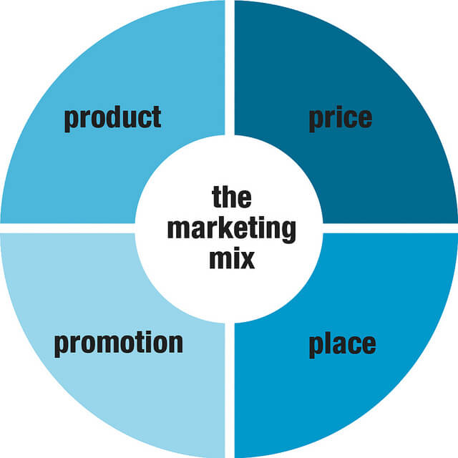
Part Five: Marketing: Developing Relationships
Chapter Twelve: Dimensions of Marketing Strategy
  Chapter Outline:
    The Marketing Mix
    Product Strategy
    Pricing Strategy
    Distribution Strategy
    Promotion Strategy
    Importance of Marketing Strategy

Slide 21

Part Five: Marketing: Developing Relationships
Chapter Thirteen: Digital Marketing and Social Networking
  Chapter Outline:
    Growth and Benefits of Digital Communication
    Using Digital Media in Business
    Digital Media and the Marketing Mix
    Types of Consumer-Generated Marketing and Digital Media
    Using Digital Media to Reach Consumers
    Using Digital Media to Learn about Consumers
    Legal and Social Issues in Internet Marketing
    Digital Media’s Impact on Marketing

Slide 22
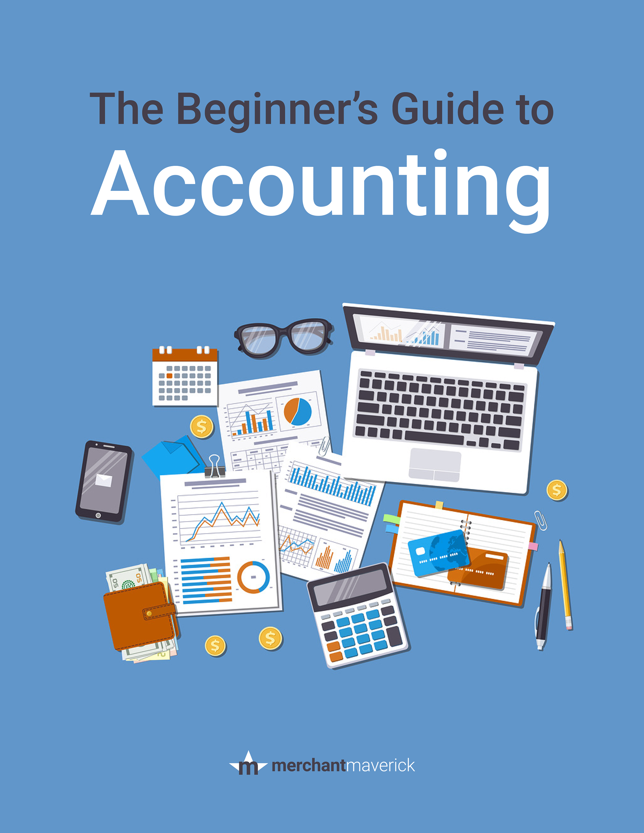
Part Six: Financing the Enterprise
Chapter Fourteen: Accounting and Financial Statements
  Chapter Outline:
    The Nature of Accounting
    The Accounting Process
    Financial Statements
    Ratio Analysis: Analyzing Financial Statements
    Importance of Integrity in Accounting

Slide 23

Part Six: Financing the Enterprise
Chapter Fifteen: Money and the Financial System
  Chapter Outline:
    Money in the Financial System
      Functions-Characteristics-Types
    The American Financial System
      Federal Reserve-Banking

Slide 24

Part Six: Financing the Enterprise
Chapter Sixteen: Financial Management and Securities Market
  Chapter Outline:
    Managing Current Assets and Liabilities
    Managing Fixed Assets
    Financing with Long-Term Liabilities
    Financing with Owner’s Equity
    Investment Banking
    The Securities Market

Slide 25



Team Building Exercise
Build a Tower
  Connect Spaghetti and Marshmallows (Toothpick-Jelly Beans)
    Tallest and most sturdy tower wins
Analyze and Discuss Activity
  Human Relations
  Management
  Leadership

Slide 26


