Slide 1
Fundamentals of Management Session One

Slide 2
Part One: Introduction
Chapter One: Managers and Management
Tell Who Managers Are and Where They Work.
Define Management.
Describe What Managers Do.
Explain Why It’s Important to Study Management.
Describe the Factors That Are Reshaping and Redefining Management.

Slide 3
Manager
An organization is a deliberate arrangement of people brought together to accomplish some specific purpose.
All managers share one common element: They work in an organizational setting.

Slide 4
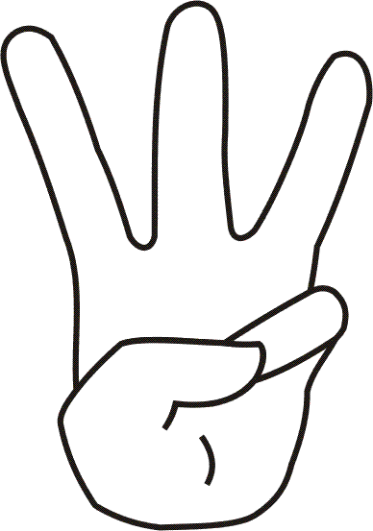
Organization
Three Characteristics All Organizations Share:
They have a distinct purpose.
Typically expressed as a goal or set of goals.
People in an organization work to achieve those goals.
By making decisions and engaging in work activities.
They are structured in some way that defines and limits the behavior of its members.
Guided by rules, regulations, and policies.
This structure is the setting in which managers manage.

Slide 5
Manager
Managers direct and oversee the activities of other people in the organization so organizational goals can be accomplished.
A manager’s job isn’t about personal achievement – it is about helping others do their work.

Slide 6
Classical Approach
The Classical Approach suggests that beginning around the turn of the 20th Century, the discipline of management began to evolve as a unified body of knowledge.
Rules and principles were developed from ancient civilization to modern times.
Scientific Management (Frederick Taylor)
The use of scientific methods to determine the “one best way” for a job to be done.
General Administrative Theory (Henri Fayol and Max Weber)
A view of organizational practices based on what managers do, and what constituted good management.
Principles of Management (Henry Fayol)
Fundamental rules of management that could be applied to all organizations.

Slide 7
Principles of Management
Principles of Management (Henri Fayol)
Division of Work
Specialization increases output by making employees more efficient.
Authority
Managers must be able to give orders.
Discipline
Employees must obey and respect the rules that govern the organization.
Unity of Command
Every employee should receive orders from only one superior.
Unity of Direction
Each group of organizational activities that have the same objective should be directed by one manager using one plan.
Subordination of Individual Interests to the General Interest
The interests of any one employee or group of employees should not take precedence over the interests of the organization as a whole.
Remuneration
Workers must be paid a fair wage for their services.

Slide 8
Principles of Management (Cont.)
Centralization
Managers should find the optimum degree to which subordinates are involved in decision-making. Manager (Central). Employees (Decentralization).
Scalar Chain
The line of authority from top management to the lowest ranks.
Order
People and materials should be in the right place at the right time.
Equity
Managers should be kind and fair to their subordinates.
Stability of Tenure of Personnel
High employee turnover is inefficient. Managers should have recruitment process in place.
Initiative
Employees who are allowed to originate and carry out plans will exert high levels of effort.
Esprit de Corps
Promoting team spirit will build harmony and unity within the organization.

Slide 9
Behavioral Approach
The Behavioral Approach focuses on the actions of workers.
How do you motivate and lead employees in order to get high levels of performance?
From the Hawthorne Studies to Maslow’s Hierarchy of Needs to Organizational Behavior…

Slide 10
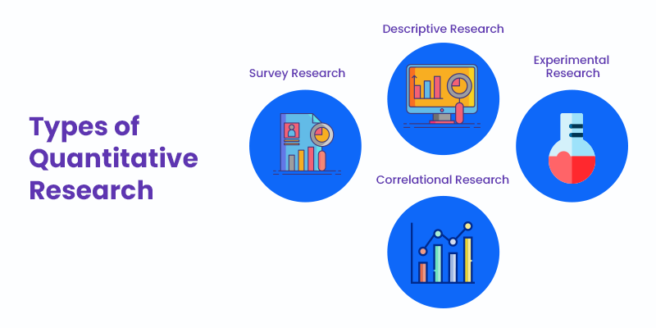
Quantitative Approach
The Quantitative Approach focuses on several quantitative techniques, which provide tools for managers to make their job easier.
This approach uses the application of statistics, optimization models, information models, computer simulations, and other quantitative techniques involving management activities.

Slide 11
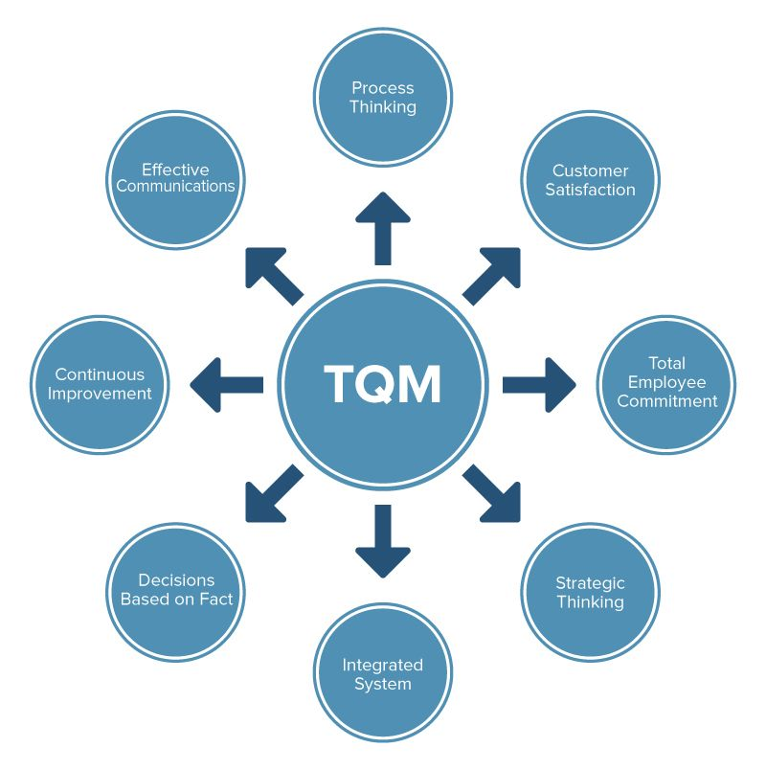
Quantitative Approach
Total Quality Management (TQM) is a management philosophy devoted to continual improvement and responding to customer needs and expectations.

Slide 12
Contemporary Approach
Contemporary Approaches look at what is happening in the external environment outside the organization.
Organizations function as open systems, which means they are influenced by and interact with their environments.

Slide 13
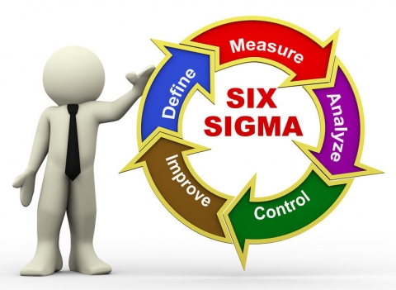
Management
Management is the process of getting things done, effectively and efficiently, with and through other people.
A process refers to a set of ongoing and interrelated activities.

Slide 14
Management
Efficiency is doing a task correctly and getting the most output from the least of input.
“Doing things right.”
Effectiveness is doing work tasks that help the organization reach its goals.
“Doing the right things.”

Slide 15
Ways to Look at What Managers Do
Four Functions Approach
Planning
Includes defining goals, establishing strategy, and developing plans to coordinate activities.
Organizing
Includes determining what tasks to be done, who is to do them, how tasks are to be grouped, who reports to whom, and who will make decisions.
Leading
Includes motivating employees, directing the activities of others, selecting the most effective communication channel, and resolving conflicts.
Controlling
Includes monitoring performance, comparing it with goals, and correcting any significant deviations.

Slide 16
Ways to Look at What Managers Do
Management Roles Approach
Managerial Roles
Specific categories of behavior often grouped around interpersonal relationships, information transfer, and decision making.
Interpersonal Roles
Involving people (subordinates and persons outside the org.) and other duties that are ceremonial and symbolic in nature.
Decisional Roles
Entailing making decisions or choices.
Informational Roles
Involving collecting, receiving, and disseminating information.

Slide 17
Ways to Look at What Managers Do
Skills and Competencies Needed to Manage Others
Conceptual Skills
Analyzing and diagnosing complex situations to see how things fit together and to facilitate making good decisions.
Interpersonal Skills
Working well with other people both individually and in groups by communicating, motivating, mentoring, delegating, etc.
Technical Skills
Job-specific knowledge, expertise, and techniques needed to perform work tasks.
Political Skills
Building a power base and establishing the right connections to get needed resources for their groups.

Slide 18
Political Skill
Political Skill is Determined By:
A person’s networking ability.
Interpersonal Influence
Social Astuteness
Apparent Sincerity
People try to influence the distribution of advantages and disadvantages within the organization in their favor.
Those who are politically skilled are more effective in their use of influence tactics, and are capable of doing it without others aware.

Slide 19
Managers
As Managers Move Up in the Organization, They Do More Planning and Less Direct Overseeing of Others
All managers, regardless of level, make decisions.
All managers plan, organize, lead, and control.

Slide 20
Profit vs. Non-Profit
All Managers Manage Regardless of Type of Organization
The most important difference between the Profit and Non-Profit is how performance is measured.
Profit (the “bottom line”) is an unambiguous measure of a business organization’s effectiveness.
Non-Profit organizations don’t have a universal tool of measurement. Making a profit for owners is not the primary focus.

Slide 21
Globalization of Management Concepts
Studies Suggest Management Concepts are Not Universal
Most concepts defined in the book apply to the United States and other English-Speaking countries.
Managers will have to modify concepts to be efficient and effective in Non-English Speaking Countries, or those whose economic, political, social, or cultural environments different from free-market democracies.

Slide 22
Managers
Managers play a crucial role in employee satisfaction and engagement.
Good managers are important because organizations need their skills and abilities, especially in today’s uncertain, complex, and chaotic environment. They’re critical to getting things done.

Slide 23
A Great Boss
Things a great boss can do:
Inspire you professionally and personally.
Energize you and your coworkers to do things together that you couldn’t do alone.
Provide you feedback on how you are doing.
Provide coaching and guidance with problems.
Change your life.

Slide 24
Management
In today’s world, managers are dealing with changing workplaces, a changing workforce, changing technology, and global uncertainties.
Managers everywhere are likely to have to manage in changing circumstances, and the fact is… how managers manage is changing.

Slide 25
Change
Four Specific Changes that are Increasingly Important to Organizations and Managers Everywhere:
Customers
Employee attitudes and behaviors play a big role in customer satisfaction. Delivering quality customer service is essential.
Innovation
Success in business today demands innovation, which means doing things differently, exploring new territory, and taking risks.
Social Media
Businesses are turning to social media not just as a way to connect with customers, but also as a way to manage their human resources and tap into their innovation and talent.
Managers are struggling with the guidelines needed for employee use as they attempt to navigate the power and peril of social media.
Sustainability
The concept of managing in a sustainable way has widened corporate responsibility not only to manage in an efficient and effective way, but also to respond strategically to a wide range of environmental and social challenges.

Slide 26
Managers Matter
Managers Matter to Organizations.
The most important variable in employee productivity is the relationship between employees and their direct supervisors.
The employee’s relationship with their manager is the largest factor in employee engagement.
Employee engagement is when employees are connected to, satisfied with, and enthusiastic about their jobs.

Slide 27
Part One: Introduction
Chapter Two: The Management Environment
Explain What the Internal Environment Is and Why It’s Important.
Discuss How the External Environment Affects Managers.
Define What Organizational Culture Is and Explain Why It’s Important.
Describe How Organizational Culture Affects Managers.

Slide 28
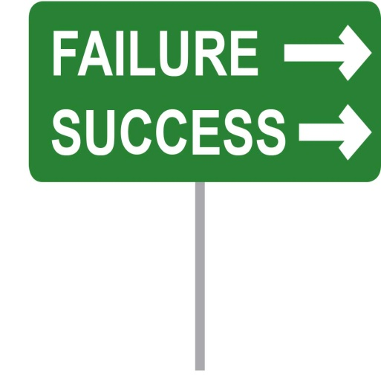
Management Environment
No successful organization, or its managers, can operate without understanding the dynamic external environment that surrounds it.

Slide 29
Components of the External Environment
Political/Legal
Political Conditions and Stability: Nationally and Worldwide
Federal, State, and Local Laws, as well as, Country and Global Laws
Demographics
Trends in Population Characteristics: Age, Race, Gender, Education Levels, Geo Location, Family Composition
Economic
Interest Rates, Inflation, Employment, Unemployment, Income levels
Socio-Cultural
Societal and Cultural Factors: Values, Attitudes, Trends, Traditions, Lifestyles, Beliefs, Patterns of Behavior
Technological
Scientific or Industrial Innovations
Global
Issues (i.e. Volcano, Instability, Terrorism) Associated with World Economy

Slide 30
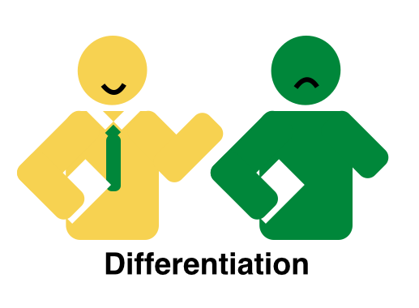
External Environment
Knowing what the various components of the external environment are and examining certain aspects of that environment is important.
However, understanding how the environment affects managers is equally as important.

Slide 31
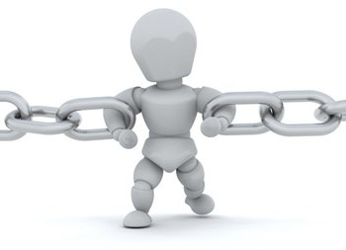
External Environment
Three Ways the External Environment Constrains and Challenges Managers:
Through its impact on jobs and employment.
Through the environmental uncertainty that is present.
Through the various stakeholder relationships that exist between an organization and the external constituencies.

Slide 32
Jobs and Employment
One of the most powerful constraints managers face is the impact of such changes on jobs and employment.
Both in poor conditions and in good conditions.
Not only do changes in external conditions affect the types of available jobs, they affect how those jobs are created & managed.
For instance, many employers are using flexible work arrangements with tasks done by freelancers hired on an as-needed basis, or by temporary workers who work full-time but are not permanent employees.

Slide 33
Environmental Uncertainty and Complexity
Environmental uncertainty is the degree of unpredictable change and complexity in an organization’s environment.
Environmental complexity looks at the number of components in an organization’s environment and the extent of the knowledge that the organization has about those components.

Slide 34
Stakeholder Relationships
The nature of stakeholder relationships is another way in which the environment influences managers.
Stakeholders are constituencies in an organization’s environment that are affected by that organization’s decisions and actions.
These groups have a stake in or are significantly influenced by what the organization does. In turn, these groups can influence the organization.
Customers - Social and Political Action Groups – Competitors - Trade and Industry Associations – Governments – Media – Suppliers – Communities – Shareholders – Unions – Employees

Slide 35
Stakeholder Relationships
Managers of high performing companies tend to consider the interests of all major stakeholder groups as they make decisions.
Because an organization depends on external groups as sources of inputs (resources) and as outlets for outputs (goods and services), managers should consider the interests of stakeholders as they make decisions.

Slide 36
Organizational Culture
Each of us has a unique personality that influences the way we act and interact. An organization has a personality, too: we call it culture.

Slide 37
7 Dimensions of Organizational Culture
1. People Orientation
Degree to which MGMT decisions take into account the effects on people in the ORG.
2. Team Orientation
Degree to which work is organized around teams rather than individuals.
3. Aggressiveness
Degree to which employees are aggressive and competitive rather than cooperative.
4. Stability
Degree to which organizational decisions and actions emphasize maintaining the status quo.
5. Innovation and Risk Taking
Degree to which employees are encouraged to be innovative and take risks.
6. Attention to Detail
Degree to which EE’s are expected to exhibit precision, analysis, and attention to detail.
7. Outcome Orientation
MGMT focus on results or outcomes rather than on how these outcomes are achieved.

Slide 38
Culture
Founders project an image of what the organization should be and what it’s values are.
Founders “impose” their vision on employees.
Organizational members create a shared history that binds them into a community and reminds them of “who we are.”

Slide 39
Culture
Ways in which employees learn the Culture:
Organizational Stories
Narrative tales of significant events or people.
Corporate Rituals
Repetitive sequences of activities that express and reinforce important organizational values and goals.
Material Symbols or Artifacts
Layout of facilities, how employees dress, size of offices, material perks provided to executives, furnishings, and so forth.
Language
Special acronyms; unique terms to describe equipment, key personnel, customers, suppliers, processes, products.

Slide 40
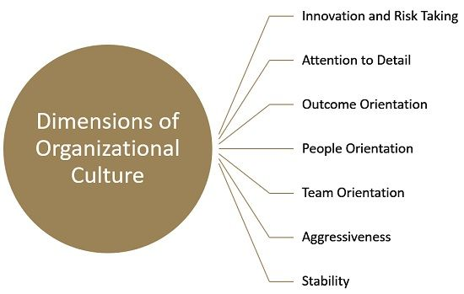
Culture
The culture establishes for managers appropriate and expected behavior.

Slide 41
Managerial Decisions Affected by Culture Four Functions Approach
1. Planning
The degree of risk that plans should contain.
Whether plans should be developed by individuals or teams.
The degree of environmental scanning in which MGMT will engage.
2. Organizing
How much autonomy should be designed into employee’s jobs?
Whether tasks should be done by individuals or in teams.
The degree to which department managers interact with each other

Slide 42
Managerial Decisions Affected by Culture Four Functions Approach
3. Leading
Degree to which managers are concerned w/ EE job satisfaction.
What leadership styles are appropriate?
Whether disagreements, even constructive ones, be eliminated.
4. Controlling
Whether to impose external controls or allow EE to control actions.
What criteria should be emphasized in EE performance evaluations?
What repercussions will occur from exceeding one’s budget?

Slide 43
Understanding Culture
An organization’s culture is a system of shared meaning.
When you understand your organization’s culture, you know, whether it encourages teamwork, rewards innovation, etc.
Understanding the culture allows you to know what behaviors are likely to be rewarded and which are likely to be punished.

Slide 44
Understanding Culture
Ways you can learn about an organization’s culture
Do background work.
Observe the physical surroundings.
Make note about those with whom you met.
How would you characterize the style of the people you met?
Look at the organization’s Human Resources Manual.
Ask questions of the people with whom you meet.

Slide 45
Part One: Introduction
Chapter Three: Integrative Managerial Issues
Explain globalization and its impact on organizations.
Discuss how society’s expectations are influencing managers and organizations.
Discuss the factors that lead to ethical and unethical behavior in organizations.
Describe how the workforce is changing and its impact on the way organizations are managed.

Slide 46
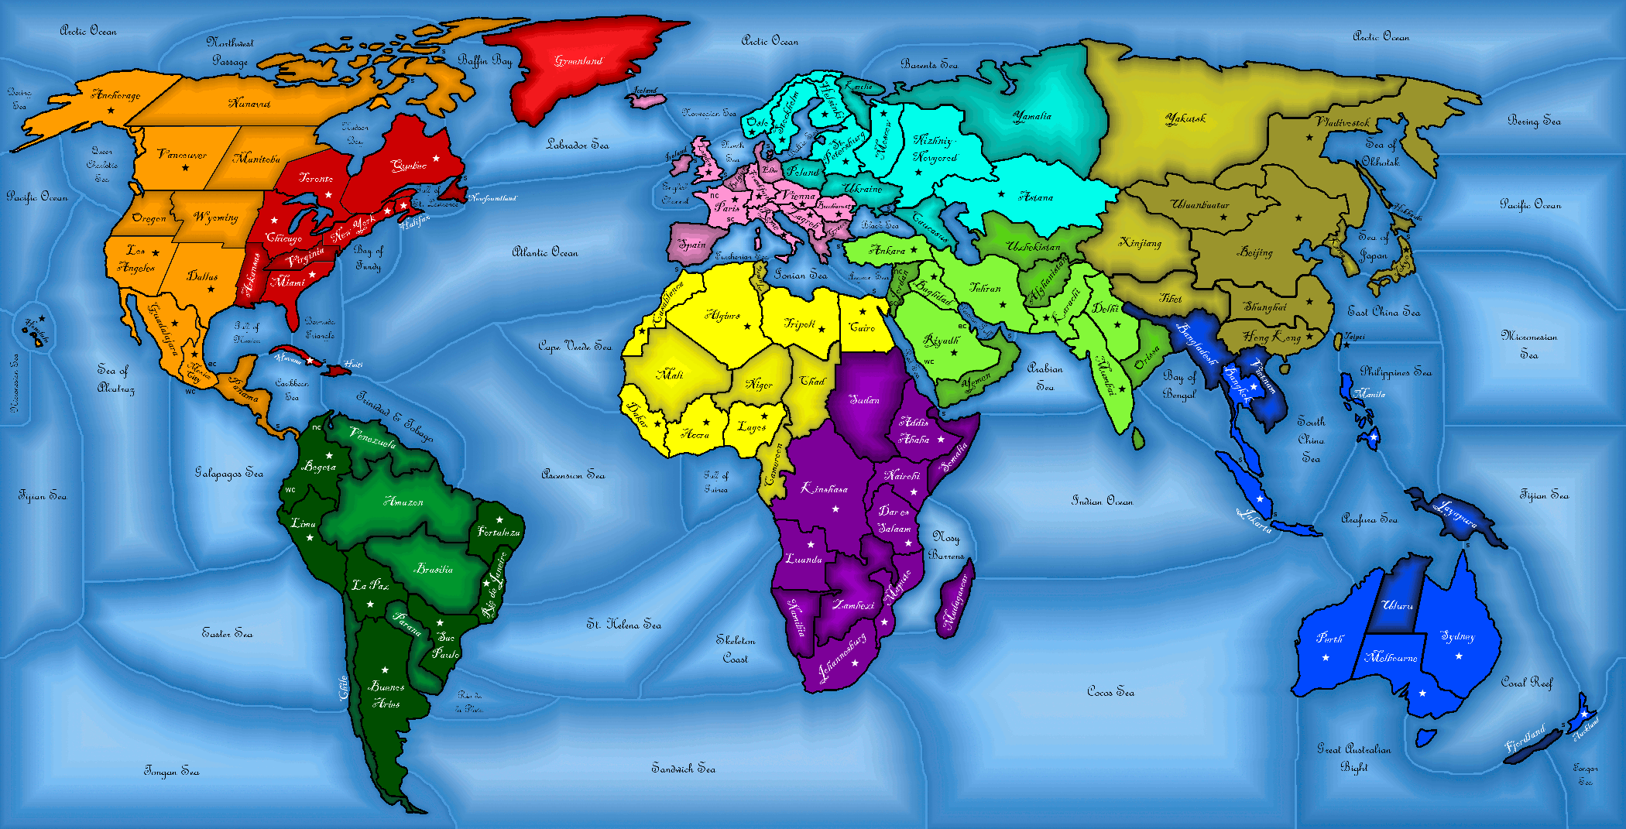
Globalization
The world is still a global village – a world where goods and services are produced and marketed worldwide – but, how managers do business in that global village is changing.
To be effective in this boundary-less world, managers need to adapt to this changed environment, as well as, be more understanding of cultures, systems, and techniques that are different from their own.

Slide 47
Globalization
Organizations are considered global if they exchange goods and services with consumers in other countries.
Marketplace globalization is the most common approach.
However, many organizations use managerial and technical employee talent from other countries, and an organization may use financial resources outside its home country.

Slide 48
Globalization
Ways in which organizations go global?
Global Sourcing
Purchasing materials or labor from around the world.
Exporting
Making products domestically and selling them abroad.
Importing
Acquiring products made abroad and selling them domestically.
Licensing
An agreement which allows another to make or sell its products, or use its technology.
Franchising
An agreement which allows another to use its name and operating methods.
MNC (Multi-National Corporation)
Any type of international company that maintains operations in multiple countries.
Multi-Domestic Corporation
An MNC that decentralizes MGMT and other decisions to local countries where it does business
Transnational (Borderless) Organization
An MNC where artificial geographic boundaries are eliminated.
Global Corporation
An MNC that centralizes management and other decisions in the home country.

Slide 49
Direct Investment in Globalization
Three types of direct investments organizations can make in globalization:
Global Strategic Alliance
A partnership between an organization and foreign company partner(s) in which both share resources and knowledge in developing new products or building production facilities.
Joint Venture
A specific type of strategic alliance in which the partners agree to form a separate, independent organization for some business purpose.
Foreign Subsidiary
A direct investment in a foreign country that involves setting up a separate and independent facility or office.

Slide 50
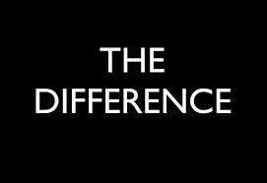
Globalization
A global world brings new challenges for managers, especially in managing in a country with a different national culture.
A specific challenge comes from the need to recognize the differences that might exist and then find ways to make interactions effective.

Slide 51
Parochialism
Parochialism is a narrow focus in which managers see things only through their own eyes and from their own perspectives.
Managers don’t recognize that people from other countries have different ways of doing things or that they live differently from Americans.
This view can’t succeed in a global village.

Slide 52
Differences
The most important and challenging differences for managers to understand are those related to a country’s social context or culture.
All countries have different values, morals, customs, political and economic systems, and laws; all of which can affect how a business is managed.

Slide 53
Five Dimensions of National Culture
Five dimensions of national culture:
1. Power Distance
The degree to which people in a country accept that power in institutions and organizations is distributed unequally.
2. Individualism vs. Collectivism
Individualism is the degree to which people in a country prefer to act as individuals rather than members of groups.
3. Achievement vs. Nurturing
The degree to which values such as assertiveness, the acquisition of money and material goods, and competition are more important than relationships and concern for the welfare of others.

Slide 54
Five Dimensions of National Culture
Five dimensions of national culture:
4. Uncertainty Avoidance
This dimension assesses the degree to which people in a country prefer structured over unstructured situations and are willing to take risks.
5. Long-Term vs. Short-Term Orientation
The degree to which people look to the future and value thrift and persistence, or value the past and present and emphasize respect for tradition and fulfilling social obligations.

Slide 55
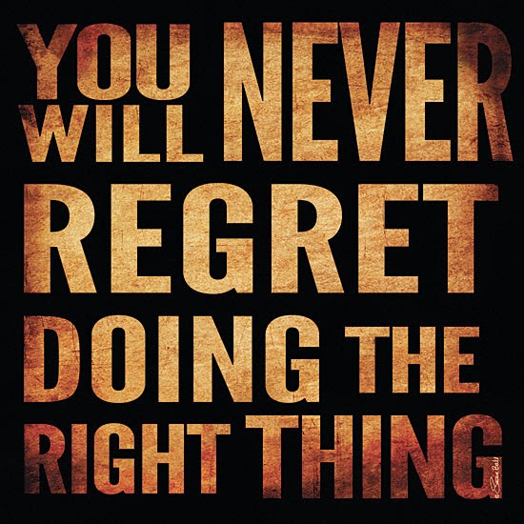
Social Responsibility
Society expects organizations and managers to be responsible and ethical and to give something back.
Social Responsibility is an organization’s intention, beyond its legal and economic obligations, to do the right things and act in ways that are good for society.
This definition assumes that a business (1) 0beys the law, (2) pursues economic interests, and (3) is a moral agent.
In its effort to do good for society, it must differentiate right from wrong.

Slide 56
Obligation and Responsiveness
Social Obligation refers to the activities a business engages in to meet certain economic and legal responsibilities. It does the min. that the law requires, and only pursues social goals to the extent that they contribute to its economic goals.
Social Responsiveness refers to the activities a business engages in to respond to some social need.
Managers are guided by social norms and values and make practical, market-oriented decisions about their actions (i.e.) Pollution Standards - On-Site Childcare Facilities - Etc..

Slide 57
Social Involvement
Despite minimal positive financial correlation between social involvement and economic performance, researchers have concluded that managers can afford to be, and should be, socially responsible.

Slide 58
Sustainability
Sustainability is a company’s ability to achieve its business goals and increase long-term shareholder value by integrating economic, environmental, and societal opportunities into its business strategies.
The idea of practicing sustainability affects many aspects of business, from the creation of products and services to their use and subsequent disposal by consumers.

Slide 59
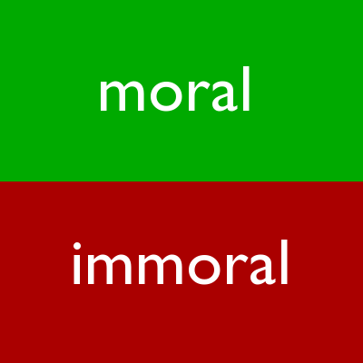
Ethics
Ethics commonly refers to a set of rules or principles that defines right and wrong conduct.
Right and wrong behavior, though, may at times be difficult to determine.

Slide 60
Ethics
Perspectives on how managers make ethical decisions:
The Utilitarian View of Ethics
Ethical decisions are made solely on the basis of their outcomes or consequences. The goal of utilitarianism is to provide the greatest good for the greatest number.
The Rights View of Ethics
Individuals are concerned with respecting and protecting individual liberties and privileges such as the right of free consent, the right of privacy, the right of free speech, etc.
The Theory of Justice View of Ethics
An individual imposes and enforces rules fairly and impartially. The goal of this approach is to be equitable, fair, and impartial in making decisions.

Slide 61
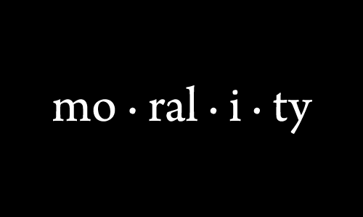
Ethics
Factors included in making ethical decisions involve an individual’s morality, values, personality, and experiences; the organizations’ culture; and ethical issue being faced.
People who lack a strong moral sense are much less likely to do the wrong things if they are constrained by rules, policies, job descriptions, or strong cultural norms that discourage such behaviors.

Slide 62
Ethics
Three Ways Managers Encourage Ethical Behavior:
Code of Ethics
A formal document stating the organization’s values and ethical standards it expects employees to follow. Shared values such as honesty, fairness, respect, responsibility, and caring are embraced worldwide.
Ethical Leadership
Managers must be good ethical role models both in words and in actions.
Ethics Training
Evidence shows that teaching ethical problem-solving can make an actual difference in ethical behaviors; that training has increased an individual’s level of moral development; and that, if nothing else, training increases awareness of ethical issues in business.

Slide 63
Ethical Leadership
Ways you can be an Ethical Leader
Be a good role model by being ethical and honest.
Tell the truth…ALWAYS.
Don’t hide or manipulate information.
Be willing to admit your failures.
Share your personal values by communicating them to employees.
Stress the organization’s or team’s important shared values.
Use the reward system to hold everyone accountable to values.

Slide 64
Ethical Leadership
What You Can Do:
Know Your Values
Think Before You Act
Consider All Consequences
Apply the “Publicity Test”
What would your friends or family think if your actions were highlighted in the news?
Seek Opinions from Others
What Your Organization Can Do:
Create a Formal Ethics Code
Set and Ethical Culture
Ensure Managers are Role Models
Offer Ethics Workshops
Appoint an Ethics “Advisor”
Protect Employees Who Report Unethical Practices

