Slide 1
Business Survey Session Six
Business Foundations
A Changing World 11th Edition
O.C. Ferrell, Geoffrey Hirt, and Linda Ferrell; McGraw Hill Education; New York, NY 2018
ISBN: 978-1-259-68523-1

Slide 2
Part Five: Marketing: Developing Relationships
Chapter Eleven: Customer-Driven Marketing

Slide 3
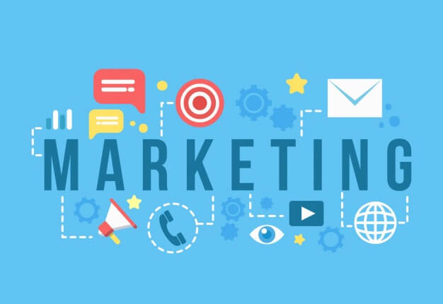
Introduction
Marketing involves planning and executing the development, pricing, promotion, and distribution of ideas, goods, and services to create exchanges that satisfy individual and organizational goals.
These activities ensure that the products consumers want to buy are available at the price they are willing to pay and that consumers are provided with information about product features and availability.
Organizations of all sizes and objectives engage in these activities.

Slide 4
Nature of Marketing
A vital part of any business undertaking, marketing is a group of activities designed to expedite transactions by creating, distributing, pricing, and promoting goods, services, and ideas.
These activities create value by allowing individuals and organizations to obtain what they need and want.
A business cannot achieve its objectives unless it provides something that customers value, and is conveniently available, competitively priced, and uniquely promoted.

Slide 5
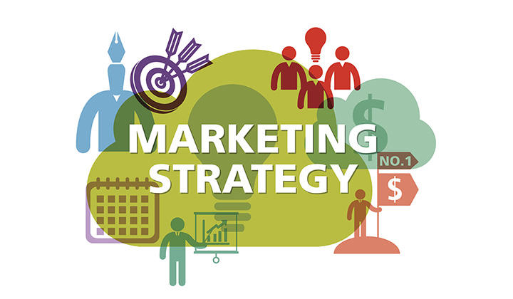
Nature of Marketing
Marketing is an important part of a firm’s overall strategy. Other functional areas of the business – such as operations, finance, and all areas of management – must be coordinated with marketing decisions.
Marketing has the important function of providing revenue to sustain a firm. Only by creating trust and effective relationships with customers can a firm succeed in the long run.
Businesses try to respond to consumer wants and needs and to anticipate changes in the environment.

Slide 6
Nature of Marketing
It is important to note what marketing is not: It is not manipulating consumers to get them to buy products they do not want. It is not just selling and advertising.
Marketing is a systematic approach to satisfying customers.
Marketing focuses on the many activities – planning, pricing, promoting, and distributing products – that foster exchanges.
Marketing is essential and provides important benefits in making products available to consumers.

Slide 7
The Exchange Relationship
At the heart of all business is the exchange, the act of giving up one thing (money, credit, labor, goods) in return for something else (goods, services, ideas).
Businesses exchange their goods, services, or ideas for money or credit supplied by customers in a voluntary exchange relationship.
The buyer must feel good about the relationship, or the exchange will not continue.

Slide 8
The Exchange Relationship
Buyers and sellers must be able to communicate about the “something of value” available to each.
Each participant must be willing to give up their respective “something of value” to receive the “something” held by other.
You are willing to exchange your “something of value” –your money or credit – for goods or services you value more than your own cash or credit potential.

Slide 9
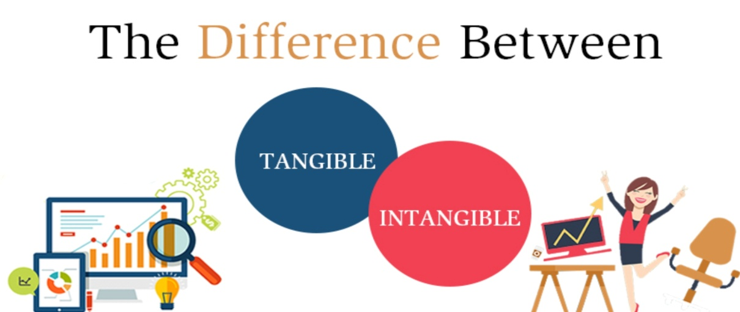
The Exchange Relationship
When you think of marketing products, you may think of tangible things, but what most consumers want is a way to get a job done, solve a problem, or gain some enjoyment.
You may purchase a vacuum cleaner not because you want a vacuum cleaner but because you want clean carpets.
The intangible “something of value” may be capability gained from using a product or the image evoked by it, or even the brand name.

Slide 10
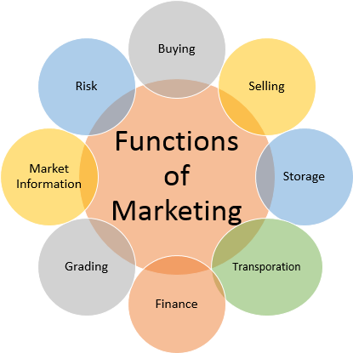
Functions of Marketing
Marketing focuses on a complex set of activities that must be performed to accomplish objectives and generate exchanges. These 8 activities include:
1. Buying
A marketer must understand buyers’ needs and desires to determine what products to make available.
2. Selling
Marketers usually view selling as a persuasive activity that is accomplished through promotion (advertising, personal selling, sales promotion, publicity, and packaging).
3. Transporting
Transporting is the process of moving products from the seller to the buyer. Marketers focus on transportation costs and services.
4. Storing
Like transporting, storing is part of the physical distribution of products and includes warehousing goods. Warehouses hold some products for lengthy periods for time utility (i.e. seasonal product storage, such as orange juice).

Slide 11
Functions of Marketing
Marketing focuses on a complex set of activities that must be performed to accomplish objectives and generate exchanges. These 8 activities include:
5. Grading
Standardizing products by dividing them into subgroups and displaying and labeling them so that consumers clearly understand their nature and quality. Some standards are set by the federal government.
6. Financing
For many products, especially large items such as automobiles, refrigerators, and new homes, the marketer arranges credit to expedite the purchase.
7. Market and Research
Through research, marketers ascertain the need for new goods and services.
8. Risk Taking
Risk is the chance of loss associated with marketing decisions.

Slide 12
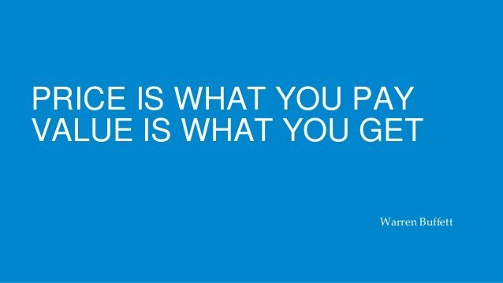
Creating Value with Marketing
Value is an important element of managing long-term customer relationships and implementing the marketing concept.
Value is a customer’s subjective assessment of benefits relative to costs in determining the worth of a product. Customer Value = Customer Benefits – Customer Costs
Customer benefits include anything a buyer receives in an exchange, including the experience alone.
Customer costs include anything a buyer must give up to obtain the benefits the product provides (i.e. monetary price, time and effort to find product, risks with its use and durability, etc.).

Slide 13
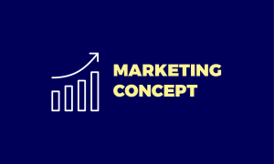
The Marketing Concept
A basic philosophy that guides all marketing activities is the Marketing Concept, the idea that an organization should try to satisfy customers’ needs through coordinated activities that also allow it to achieve its own goals.
According to the marketing concept, a business must find out what consumers desire and then develop the good, service, or idea that fulfills their needs or wants.
The business must then get the product to the customer.

Slide 14
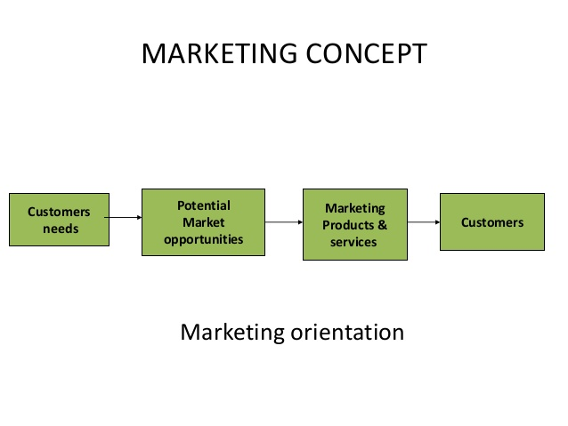
The Marketing Concept
To remain competitive, companies must be prepared to add or adapt their product lines to satisfy customers’ desires, particularly during fads or trends.
Each business must determine how best to implement the marketing concept, given its own goals and resources.
Trying to determine customers’ true needs is increasingly difficult because no one fully understands what motivates people to buy.

Slide 15
The Marketing Concept
To implement the marketing concept, a firm must have good information about what consumers want, adopt a consumer orientation, and coordinate its efforts throughout the entire organization; otherwise, it may be awash with goods, services, and ideas that consumers do not want or need.
Successfully implementing the marketing concept requires that a business view the customer’s perception of value as the ultimate measure of work performance and improving value, and the rate at which this is done, as the measure of success.

Slide 16
The Marketing Concept
Everyone in the organization must know what customers want, and know they are selling ideas, benefits, philosophies, and experiences – not just goods and services.
Orville Wright said that an airplane is “a group of separate parts flying in close formation.”
Companies should strive for a team effort to deliver the right goods or services to customers. A breakdown at any point in the organization – whether it be in production, purchasing, sales, distribution, or advertising – can result in lost sales, lost revenue, and dissatisfied customers.

Slide 17
Evolution of the Marketing Concept
The marketing concept may seem like the obvious approach to running a business and building relationships with customers. However, businesspeople are not always focused on customers when they create and operate businesses. Many companies fail to grasp the importance of customer relationships and fail to implement customer strategies.
A firm’s marketing department needs to share information about customers and their desires within the organization.

Slide 18
Market Orientation
A Market Orientation requires organizations to gather information about customer needs, share that information throughout the entire firm, and use it to help build long-term relationships with customers.
Top executives, operations mangers, marketing managers, and customers all become mutually dependent and cooperate in developing and carrying out a market orientation.
Operation managers must communicate with marketing managers to share information important to understanding the customer.

Slide 19
Market Orientation
Trying to assess what customers want, which is difficult to begin with, is further complicated by the rate at which trends, fashions, and tastes can change.
Businesses today want to satisfy customers and build meaningful long-term relationships with them.
It is more efficient and less expensive for the company to retain existing customers and even increase the amount of business each customer provides the organization than to find new customers.
Most companies’ success depends on increasing the amount of repeat business; therefore, the relationship with customer is key.

Slide 20
Market Orientation
Customer relationship management (CRM) is important in a market orientation because it can result in loyal and profitable customers.
Without loyal customers, businesses would not survive; therefore, achieving the full profit potential of each customer relationship should be the goal of every marketing strategy.
In short, profits are obtained through relationships by acquiring new customers, enhancing the profitability of existing customers, and extending the duration of customer relationships.
Communication is Key.

Slide 21
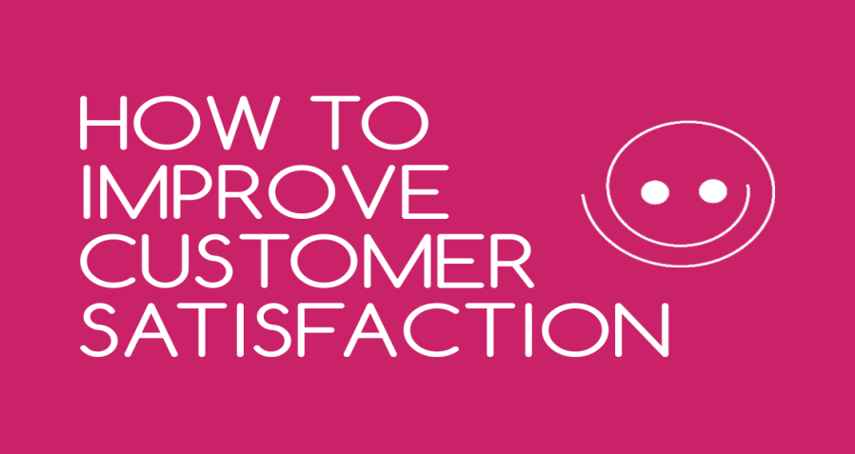
Market Orientation Communication
Communication remains a major element of any strategy to develop and manage long-term customer relationships.
Regardless of the medium through which communication occurs, customers should ultimately be the drivers of the marketing strategy because they understand what they want.
Customer relationship management systems should ensure that marketers listen to customers in order to respond to their needs and concerns and build long-term relationships.

Slide 22
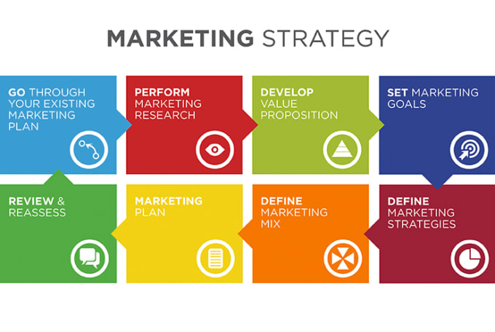
Developing a Marketing Strategy
To implement the marketing concept and customer relationship management, a business needs to develop and maintain a Marketing Strategy, a plan of action for developing, pricing, distributing, and promoting products that meet the needs of specific customers.
This definition has two major components: (1) selecting a target market and (2) developing an appropriate marketing mix to satisfy the target market.

Slide 23
1. Selecting a Target Market
A Market is a group of people who have a need, purchasing power, and the desire and authority to spend money on goods, services, and ideas.
A Target Market is a more specific group of consumers on whose needs and wants a company focuses its marketing efforts. Target markets can be further segmented:
Business to Business Mktg – marketing products to customers who will use the product for resale or other products.
Business to Customer Mktg – marketing directly to consumer.

Slide 24
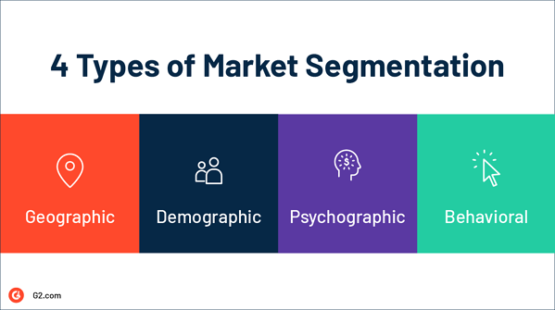
Selecting a Target Market
Marketing managers may define a target market as a relatively small number of people within a larger market, or they may define it as the total market.
Some firms use a Total-Market Approach, in which they try to appeal to everyone and assume that all buyers have similar needs and wants (i.e. sellers of salt and sugar).
Most firms, though, use Market Segmentation and divide the total market into groups of people.
A Market Segment is a collection of individuals, groups, or organizations who share one or more characteristics and have relatively similar product needs and desires.

Slide 25
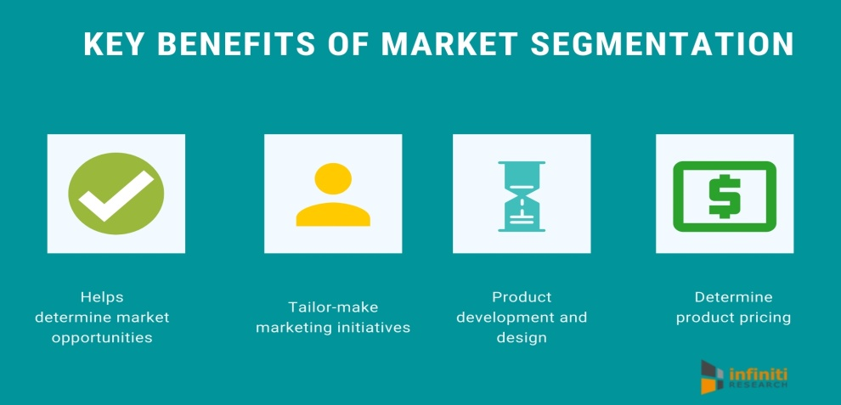
Market Segmentation
One of the challenges for marketers in the future will be to effectively address an increasingly racially diverse U.S.
Companies will have to learn how to most effectively reach these growing segments. Companies use market segmentation to focus their efforts and resources on specific target markets so that they can develop a productive marketing strategy.
Two common approaches to segmenting markets are the concentration approach and the multi-segment approach.

Slide 26
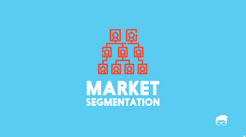
Market Segmentation Approaches
Concentration Approach
A market segmentation approach whereby a company develops one marketing strategy for a single market segment.
(i.e.) Porsche.
Multi-Segment Approach
A market segmentation approach whereby the marketer aims its efforts at two or more segments, developing a mktg strategy for each. Use different ads for different segments.
(i.e.) U.S. Post Office – Personalized Stamps
Niche marketing
A narrow market segment focus when efforts are on one small, well-defined group that has a unique, specific set of needs.
(i.e.) Freshpet - All-natural gourmet pet food.

Slide 27
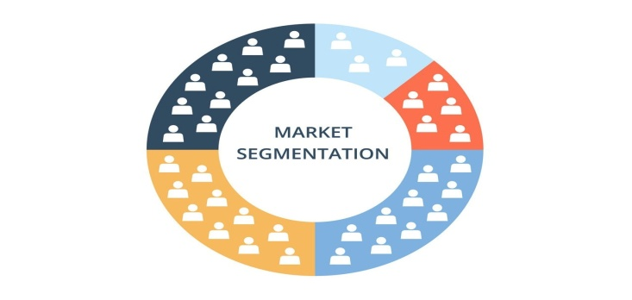
Market Segmentation Approaches
For a firm to successfully use a concentration or multi-segment approach to market segmentation, several requirements must be met:
Consumers’ needs for the product must be heterogeneous.
The segments must be identifiable and divisible.
The total market must be divided in a way that allows sales potential, cost, and profits of the segments to be compared.
At least one segment must have enough profit potential to justify developing and maintaining a special marketing strategy.
The firm must be able to reach the chosen market segment with a particular market strategy.

Slide 28
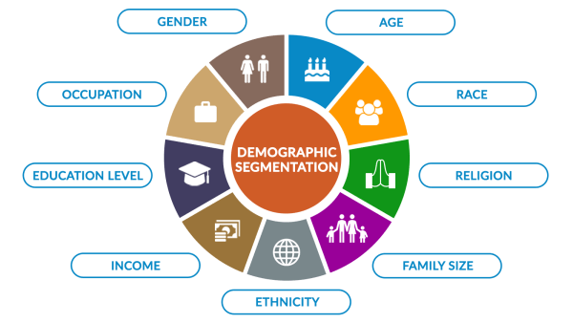
Market Segmentation Approaches
Firms segment markets on the bases of (4) variables:
1: Demographic
Age, sex, race, ethnicity, income, education, occupation, family size, religion, social class. These characteristics are often closely related to customers, product needs and purchasing behavior, and they can be readily measured.
(i.e. Secret deodorant for woman and Old Spice for men)

Slide 29
Market Segmentation Approaches
Firms segment markets on the bases of (4) variables:
2: Geographic
Climate, terrain, natural resources, population density, subcultural values. These influence consumer needs and product usage.
Climate influences consumer purchases of clothing, cars, heating and air conditioning, leisure activity equipment, etc.

Slide 30
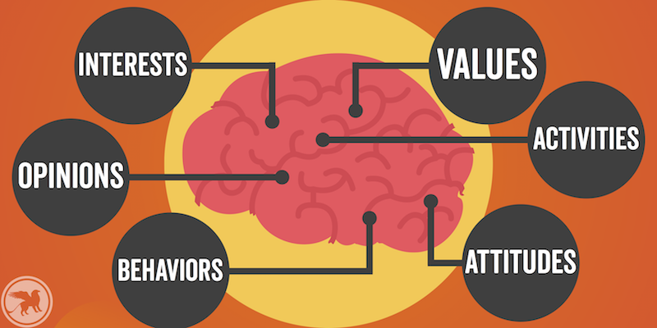
Market Segmentation Approaches
Firms segment markets on the bases of (4) variables:
3: Psychographic
Personality characteristics, motives, and lifestyles.
Soft-drink marketers provide their products in several types of packaging, including two-liter bottles and cases of cans, to satisfy different lifestyles and motives.

Slide 31
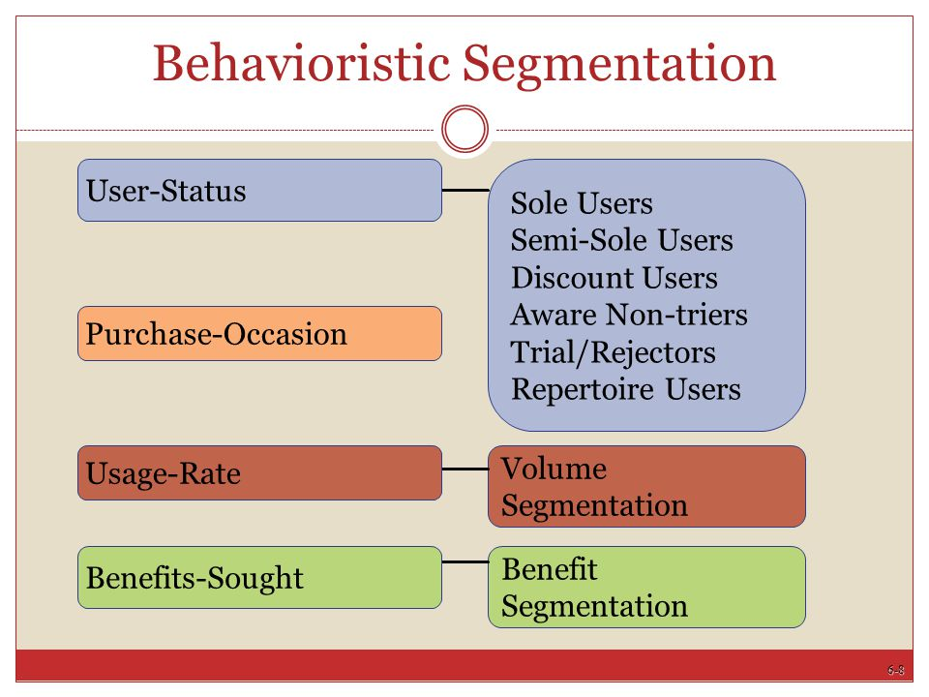
Market Segmentation Approaches
Firms segment markets on the bases of (4) variables:
4: Behavioristic
Some characteristic of the consumer’s behavior toward product. These characteristics commonly involve aspects of product use.
Low-fat, low-carb food products would target those who desire the benefits of a healthier diet.

Slide 32
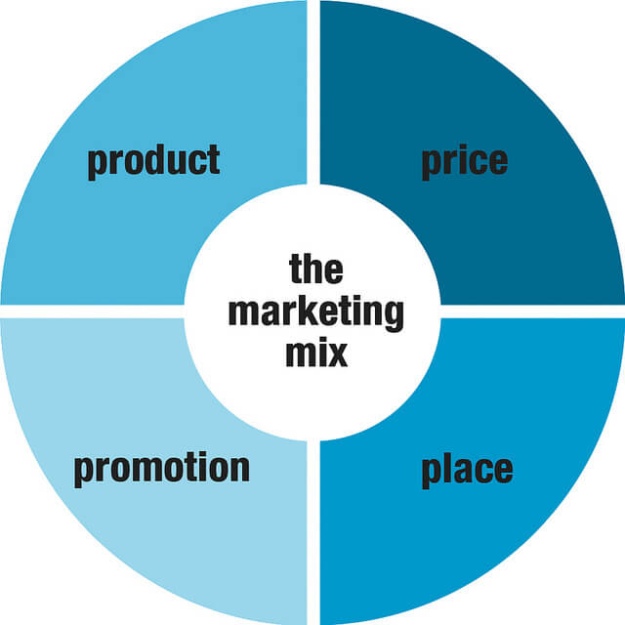
2. Developing a Marketing Mix
The second step in developing a marketing strategy is to create and maintain a satisfying marketing mix.
The Marketing Mix refers to four marketing activities – (1) product, (2) price, (3) distribution, and (4) promotion – that the firm can control to achieve specific goals within a dynamic marketing environment.
The buyer or target market is central focus of all mktg activities.

Slide 33
Developing a Marketing Mix Product
A product – whether (1) a good, (2) a service, (3) an idea, or some combination – is a complex mix of tangible and intangible attributes that provide satisfaction & benefits.
A product has emotional and psychological, as well as physical, characteristics that include everything that the buyer receives from the exchange.
A good is a physical entity you can touch.
A service is the application of human and mechanical efforts to people or objects to provide intangible benefits to customers.
Ideas include concepts, philosophies, images, and issues.

Slide 34
Developing a Marketing Mix Product
Products are among a firm’s most visible contacts with consumers.
If they do not meet consumer needs and expectations, sales will be difficult, and product life spans will be brief.
The product is an important variable – often the central focus – of the marketing mix; the other variables (price, promotion, distribution) must be coordinated with product decisions.

Slide 35
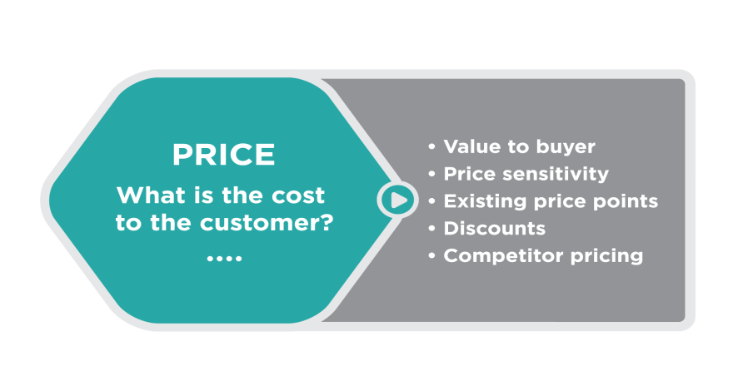
Developing a Marketing Mix Price
Almost anything can be assessed by a price, a value placed on an object exchanged between a buyer and a seller.
Although the seller usually establishes the price, it may be negotiated between the buyer and the seller. The buyer usually exchanges the purchasing power – income, credit, wealth – for the satisfaction or utility associated with a product.
Because price is the measure of value commonly used in an exchange, it quantifies value and is the basis of market exchange.

Slide 36
Developing a Marketing Mix Price
Marketers view price as much more than a way of assessing value, however.
It is a key element of the marketing mix because it relates directly to the generation of revenue and profits.
Prices can also be changed quickly to stimulate demand or respond to a competitor’s actions.

Slide 37
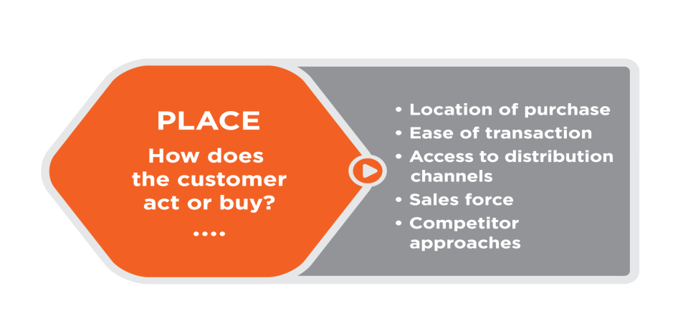
Developing a Marketing Mix Distribution
Distribution (often referred to as “place” because it helps to remember the marketing mix as the “4P’s”) is making products available to customers in quantities desired.
Intermediaries, usually wholesalers and retailers, perform many of the activities required to move products efficiently from producers to consumers or industrial buyers.
These activities involve transporting, warehousing, materials handling, and inventory control, as well as packaging and communication.

Slide 38
Developing a Marketing Mix Distribution
Critics who suggest that eliminating wholesalers and other middlemen would result in lower prices for consumers do not recognize that eliminating intermediaries would not do away with the need for their services.
Other institutions would have to perform those services, and consumers would still have to pay for them.
In the absence of wholesalers, all producers would have to deal directly with retailers or customers, keeping voluminous records and hiring extra people to deal with customers.

Slide 39
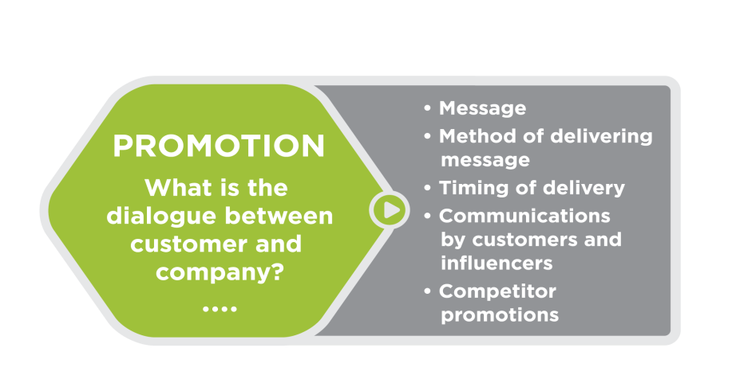
Developing a Marketing Mix Promotion
Promotion is a persuasive form of communication that attempts to expedite a marketing exchange by influencing individuals, groups, and organizations to accept goods, services, and ideas.
Promotion includes advertising, personal selling, publicity, and sales promotion.
The aim of promotion is to communicate directly or indirectly with individuals, groups, and organizations to facilitate exchanges.

Slide 40
Developing a Marketing Mix Promotion
When marketers use advertising and other forms of promotion, they must effectively manager their promotional resources and understand product and target-market characteristics to ensure that these promotional activities contribute to the firm’s objectives.
Most companies have set-up websites on the Internet to promote themselves and their products.
While traditional advertising media such as television, radio, newspapers, and magazines remain important, digital advertising and use of social media is less expensive and more expansive.

Slide 41
Marketing Research and Information Systems
Before marketers can develop a marketing mix, they must collect in-depth, up-to-date information about customer needs.
Marketing Research is a systematic, objective process of getting information about potential customers to guide marketing decisions.
Information might include data about the age, income, ethnicity, gender, and educational level of people in the target market, their preferences for product features, attitudes toward competitors’ products, and the frequency with which they use the product.

Slide 42
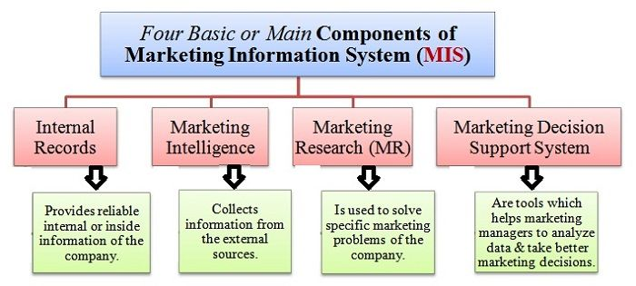
Marketing Research and Information Systems
A Marketing Information System is a framework for accessing information about customers from both inside and outside the organization.
Inside the organization, there is continuous flow of information about prices, sales, and expenses.
Outside the organization, data is readily available through private or public reports and census statistics, as well as, from other sources.
Computer networking technology provides a framework for companies to connect to useful databases and customers with instantaneous information about product acceptance, sales performance, and buying behavior.

Slide 43
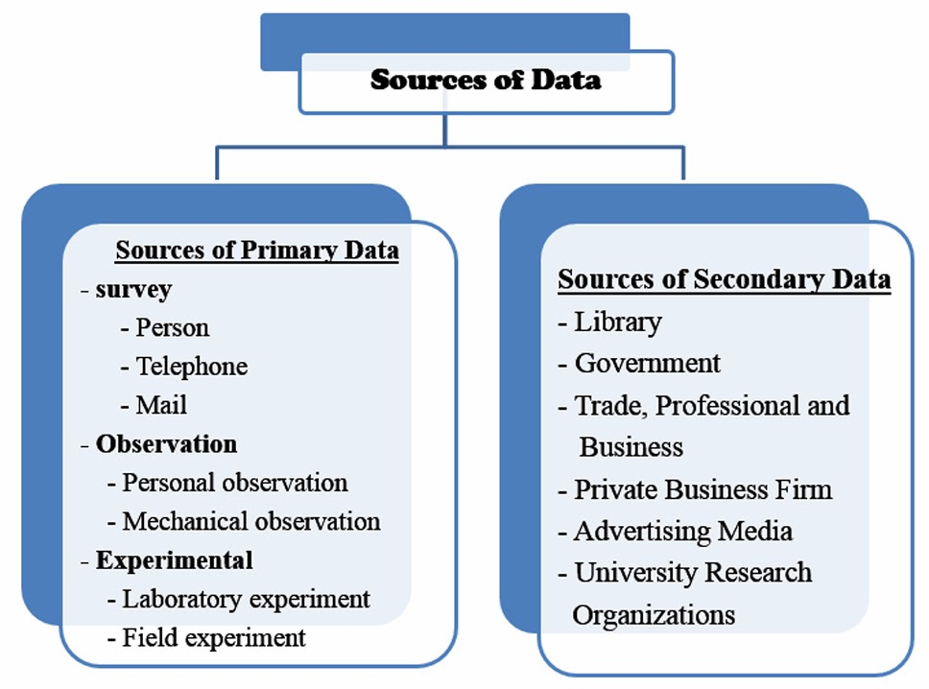
Marketing Research and Information Systems
Two types of data are usually available to decision makers.
1. Primary Data is marketing information that is observed, recorded, or collected directly from respondents.
Some methods for marketing research use passive observation of consumer behavior and open-ended questioning techniques.

Slide 44
Marketing Research and Information Systems
Two types of data are usually available to decision makers.
2. Secondary Data is information that is compiled inside or outside an organization for some purpose other than changing the current situation.
Marketers typically use information compiled by the U.S. census bureau and other government agencies, databases created by marketing research firms, as well as sales and other internal reports, to gain information about customers.

Slide 45
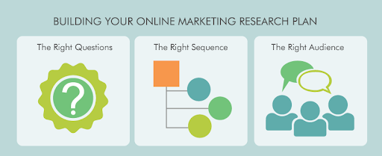
Online Marketing Research
The marketing of products and collecting of data about buying behavior – information on what people actually buy and how they buy it – represents marketing research of the future.
New information technologies are changing the ways businesses learn about their customers and market their products.
The evolving development of telecommunications and computer technologies is allowing marketing researchers quick and easy access to a growing number of online services and a vast database of potential respondents (i.e. digital media and social networking).

Slide 46
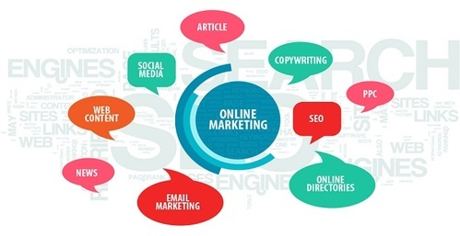
Online Marketing Research
Social network are a great way to obtain information from consumers who are willing to share their experiences about products and companies.
In a way, this process identifies those consumers who develop an identity or passion for certain products, as well as, those consumers who have concerns about quality or performance.
It is possible for firms to tap into existing online social networks and simply “listen” to what consumers have on their mind.
Online surveys are becoming important to market research.

Slide 47
Buying Behavior
Carrying out a marketing concept is impossible unless marketers know what, where, when, and how consumers buy; conducting marketing research into the factors that influence buying behavior helps marketers develop effective marketing strategies.
Buying Behavior refers to the decision processes and actions of people who purchase and use products. It includes the behavior of both consumers purchasing products for personal use and organizations buying products for business use.
Marketers analyze buying behavior because a firm’s marketing strategy should be guided by an understanding of buyers.

Slide 48
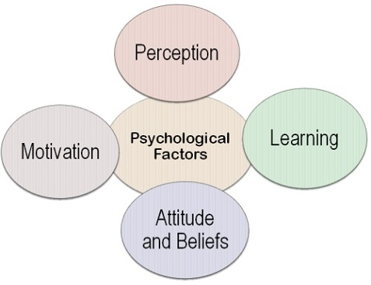
Buying Behavior
Psychological Variables of Buying Behavior, include:
Perception
The process by which a person selects, organizes, and interprets information received from is or her senses.
Motivation
An inner drive that directs a person’s behavior toward goals.
Learning
Changes in a person’s behavior based on information and experience.
Attitude
Knowledge and positive or negative feelings about something.
Personality
The organization of an individual’s distinguishing character traits, attitudes, or habits.

Slide 49
Buying Behavior
Social factors include Social Roles, which are a set of expectations for individuals based on some position they occupy.
A person may have many roles: father, husband, student, executive. Each of these roles can influence buying behavior.
In choosing which car to buy, a person’s buying power may be affected by the opinions and experiences of their family and friends and by the various roles they assume.

Slide 50
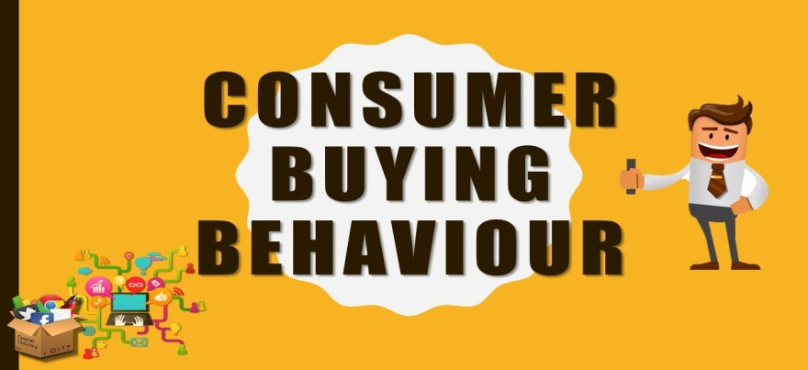
Buying Behavior
Other Social Factors of Buying Behavior, include:
Reference Groups
Groups with whom buyers identify and whose values or attitudes they adopt.
Social Classes
A ranking of people into higher or lower positions of respect.
Culture
The integrated, accepted pattern of human behavior, including thought, speech, beliefs, actions, and artifacts.

Slide 51
Understanding Buying Behavior
Although marketers try to understand buying behavior, it is extremely difficult to explain exactly why a buyer purchases a particular product.
They may not be able to determine accurately what is highly satisfying to buyers, but they know that trying to understand consumer wants and needs is the best way to satisfy them.

Slide 52
The Marketing Environment
A number of external forces directly or indirectly influence the development of marketing strategies:
Political, Legal and Regulatory Forces
Specific laws, for example, require that advertisements be truthful and that all health claims be documented. Etc…
Social Forces
The public’s opinions and attitudes toward issues such as living standards, ethics, the environment, lifestyles, and quality of life.
Competitive and Economic Forces
Competitive relationships such as those in the tech industry, unemployment, purchasing power, and general economic conditions.
Technological Forces
Computers and other tech advances that improve distribution, promotion, and new-product development.

Slide 53
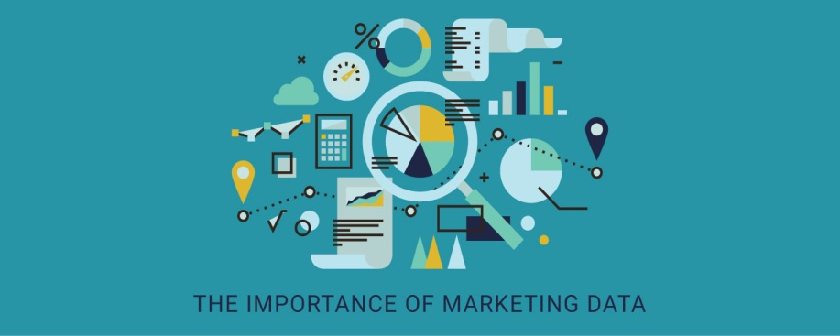
Importance of Marketing to Business and Society
Marketing is a necessary function to reaching consumers, establishing relationships, and creating revenue.
Marketing is essential in communicating the value of goods and services.
For consumers, marketing is necessary to ensure they get the products they desire at the right prices in the right quantities and at a reasonable price.
From the perspective of businesses, marketing is necessary in order to form valuable relationships with customers to increase profitability and customer support.

Slide 54
Business Survey

Slide 55
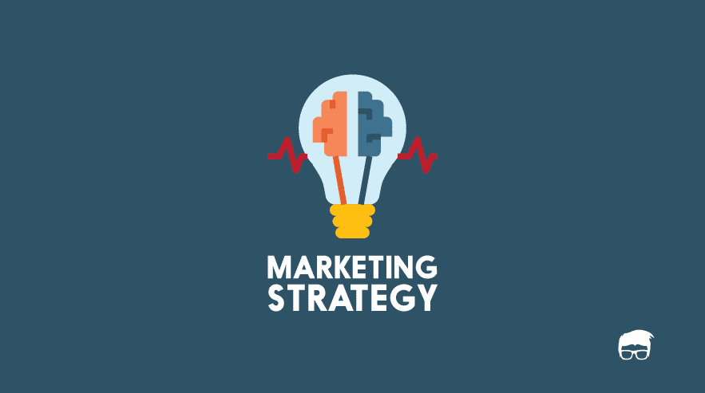
Part Five: Marketing: Developing Relationships
Chapter Twelve: Dimensions of Marketing Strategy

Slide 56
Introduction
The key to developing a marketing strategy is selecting a target market and maintaining a marketing mix that creates long-term relationships with customers.
Getting the right mix of product, price, promotion, and distribution is critical if a business is to satisfy its target customers and achieve its own objectives (implement the marketing concept).

Slide 57
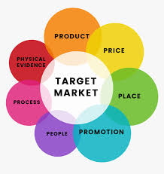
The Marketing Mix
The marketing mix is the part of a marketing strategy that involves decisions regarding controllable variables.
After selecting a target market, marketers have to develop and manage the dimensions of the marketing mix to give their firm an advantage over competitors.
Successful companies offer at least one dimension of value usually associated with a mktg mix element that surpasses all competitors in the marketplace in meeting customer expectations.
(i.e.) Walmart exceeds the competition in price.

Slide 58
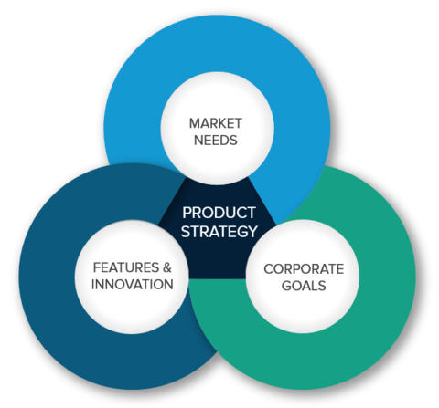
Product Strategy
The term product refers to goods, services, and ideas.
Because the product is often the most visible of the marketing mix dimensions, managing product decisions is crucial.

Slide 59
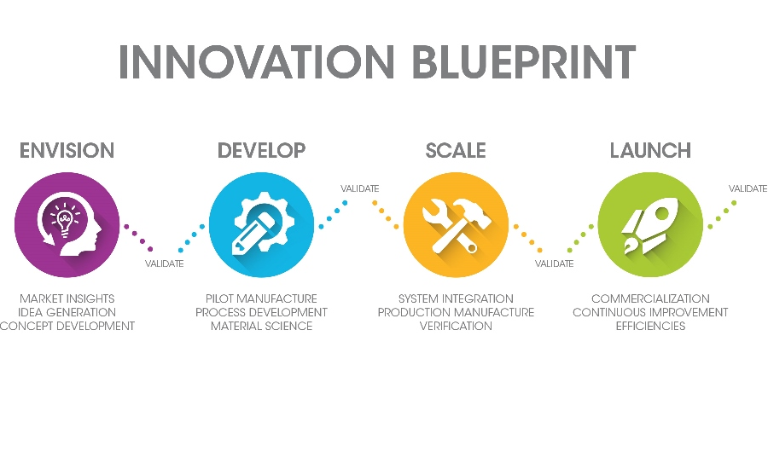
Developing New Products
Before introducing a new product, a business must follow a multistep process: (1) idea development, (2) the screening of new ideas, (3) business analysis, (4) product development, (5) test marketing, and (6) commercialization.
Each year, thousands of products are introduced, but few of them actually succeed. Even established firms launch unsuccessful products.
It can take considerable time to get a product ready for market.

Slide 60
Developing New Products 1. Idea Development
New ideas can come from marketing research, engineers, and outside sources such as advertising agencies, management consultants, and customers too.
Other sources are brainstorming and intra-company incentives or rewards for good ideas.
A research and development team create and test the product in laboratories and real-life applications (i.e. Nike sportswear) before being introduced to the market.

Slide 61
Developing New Products 2. New Idea Screening
Next step in developing a new product is idea screening. In this phase, a marketing manager should look at the organization’s resources and objectives and assesses the firm’s ability to produce and market the product.
Important aspects to be considered at this stage are consumer desires; the competition; technological changes; social trends; and political, economic, and environmental considerations.
There are two reasons new products succeed:
They meet a need or solve a problem better than other products.
They add variety to the product selection currently on the market.

Slide 62
Developing New Products 3. Business Analysis
Business analysis is a basic assessment of a product’s compatibility in the marketplace and its potential profitability.
Both the size of the market and competing products are often studied at this point.
The most important question relates to market demand: How will the product affect the firm’s sales, costs, and profits?

Slide 63
Developing New Products 4. Product Development
If a product survives the first three steps, it is developed into a prototype that should reveal the intangible attributes it possesses as perceived by the consumer.
Product development is often expensive, and few product ideas make it to this stage.
During product development, various elements of the marketing mix must be developed for testing.
Copyrights, advertising, packaging, labeling, and descriptions of a target market are integrated to develop overall marketing strategy.

Slide 64
Developing New Products 5. Test Marketing
Test marketing is a trial mini-launch of a product in limited areas that represent the potential market.
It allows a complete test of the marketing strategy in a natural environment, giving the organization opportunity to discover weaknesses and eliminate them before product is launched.
In exchange for free samples, consumers fill out surveys about their perceptions of the products.

Slide 65
Developing New Products 6. Commercialization
Commercialization is the full introduction of a complete marketing strategy and the launch of the product for commercial success.
During commercialization, the firm gears up for full-scale production, distribution, and promotion.

Slide 66
Classifying Products Consumer Products
Products are usually classified as either consumer products or industrial products.
Consumer Products are for household or family use; they are not intended for any purpose other than daily living.
They can be further classified as convenience products, shopping products, and specialty products on the basis of consumers’ buying behavior and intentions.

Slide 67
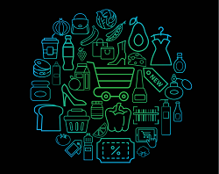
Classifying Products Consumer Products
Convenience Products
Beverages, granola bars, gasoline, and batteries, are bought frequently, without a lengthy search, and often for immediate consumption.
Consumers spend virtually no time planning where to purchase these products and usually accept whatever brand is available.
Shopping Products
Computers, smart-phones, clothing, and sporting goods, are purchased after the consumer has compared competitive products and “shopped around.”
Price, product features, quality, style, service, and image all influence the decision to buy.
Specialty Products
Motorcycles, designer clothing, art, and rock concerts, require even greater research and shopping effort.
Consumers know that they want and go out of their way to find it.

Slide 68
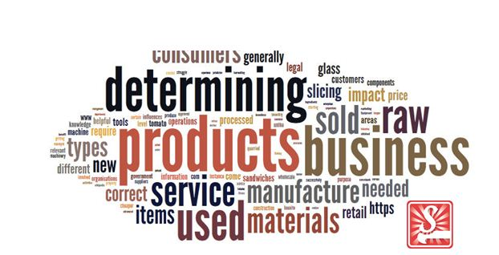
Classifying Products Business Products
Business Products are used directly or indirectly in the operation or manufacturing processes of businesses.
They are usually purchased for the operation of an organization or the production of other products; thus, their purchase is tied to specific goals and objectives.
They too can be classified into raw materials, major equipment, accessory equipment, component parts, processed materials, supplies, and industrial services.

Slide 69
Product Line and Product Mix
Product relationships within an organization are of key importance.
A Product Line is a group of closely related products that are treated as a unit because of a similar marketing strategy. For example, Colgate-Palmolive’s personal-care product line includes deodorant, body wash, bar soap, liquid soap, and toiletries for men or women.
A Product Mix is all of the products offered by an organization.

Slide 70
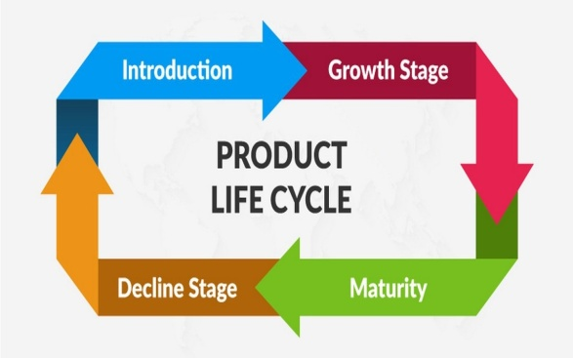
Product Life Cycle
Like people, products are born, grow, mature, and eventually die. Some products have very long lives.
There are four stages in the life cycle of a product: (1) introduction, (2) growth, (3) maturity, and (4) decline. The stage of a product helps to determine its marketing strategy.
In the personal computer industry, desktop computers are in the decline stage, laptop computers have reached the maturity stage, and tablet computers are currently in the growth stage. Manufacturers of these products are adopting different advertising and pricing strategies to maintain/increase demand.

Slide 71
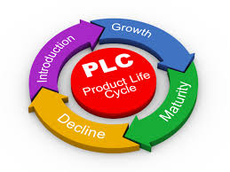
Product Life Cycle
1. Introductory Stage
Consumer awareness and acceptance of the product are limited, sales are zero, and profits are negative.
During this stage, marketers focus on making consumers aware of the product and its benefits.
2. Growth Stage
Sales increase rapidly and profits peak, then start to decline.
During this stage, the firm tries to strengthen its position in the market by emphasizing the product’s benefits and identifying market segments that want these benefits.

Slide 72
Product Life Cycle
3. Maturity Stage
Sales continue to increase at the beginning of the maturity stage, but then the sales curve peaks and starts to decline while profits continue to decline.
This stage is characterized by severe competition and heavy expenditures.
4. Decline Stage
Sales continue to fall rapidly. Profits also decline and may even become losses as prices are cut and necessary marketing expenditures are made.
As profit drops, firms may eliminate certain models or items.

Slide 73
Product Life Cycle
Product stages do not always go one way.
Some products that have moved to the maturity stage or the decline stage can still rebound through redesign or new uses for the product.
Originally, baking soda was only used for cooking, which meant it reached the maturity stage very quickly. However, once it was discovered that baking soda could be used as a deodorizer, sales shot up and bumped baking soda into the growth stage.

Slide 74
Identifying Products
Branding, packaging, and labeling can be used to identify or distinguish one product from others.
As a result, they are key marketing activities that help position a product appropriately for its target market.

Slide 75
Identifying Products Branding
Branding is the process of naming and identifying products.
A brand is a name, term, symbol, design, or combination that identifies a product and distinguishes it from other products. (i.e.) Xerox with photocopiers and Kleenex with tissues.
Protecting a brand name is important in maintaining a brand identity. The brand name is the part of the brand that can be spoken and consists of letters, words, and numbers (i.e. WD40).
A brand mark is the part of the brand that is distinctive in design (i.e. McDonald’s golden arches logo).
A trademark is a brand that is registered with the U.S. Patent Trademark Office and is legally protected from use by others.

Slide 76
Identifying Products Branding
Two major categories of brands are:
Manufacturer Brands
Brands that are initiated and owned by the manufacturer to identify products from the point of production to the point of purchase (i.e. Kellogg’s, Sony, and Chevron)
Private Distributor Brands
Brands, which may cost less than manufacturer brands, that are owned and controlled by a wholesaler or retailer. The name’s of private brands do not usually identify their manufacturer. (i.e. Walmart’s “Great Value”)

Slide 77
Identifying Products Branding
Another type of brand that has developed is Generic Products, which are products with no brand name at all.
They often come in plain simple packages that carry only the generic name of the product – peanut butter, tomato juice, aspirin, dog food, etc.
They appeal to consumers who may be willing to sacrifice quality or product consistency to get a lower price.

Slide 78
Identifying Products Branding
Companies use two basic approaches to branding multiple products.
In one, a company gives each product within its complete product mix its own brand name.
This branding policy ensures that the name of one product does not affect the names of others, and different brands can be targeted at different segments of the same market. (Pfizer – Dentyne and Listerine).
Another approach to branding is to develop a family of brands with each of the firm’s products carrying the same name or at least part of the name. (i.e. Gillette and Sara Lee).

Slide 79
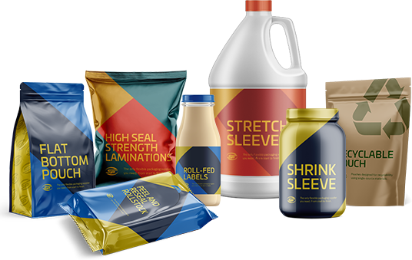
Identifying Products Packaging
The Packaging, or external container that holds and describes the product, influences consumers’ attitudes and their buying decisions.
Surveys have shown that consumers are willing to pay more for certain packaging attributes.
One of the attributes includes clearly stated nutrition and ingredient labeling, especially if it indicates whether or not the product is organic, gluten free, and environmentally friendly.
Recyclable and biodegradable packaging is also popular.

Slide 80
Identifying Products Packaging
A package can perform several functions, including protection, economy, convenience, and promotion.
Packaging can also be used to appeal to emotions (i.e.) pet food packaging appeals to the emotions of pet owners with illustrations of animals happily running, eating, and looking serene.
It is estimated that consumers’ eyes linger only 2.5 seconds on each product on an average shopping trip; therefore packaging should be designed to attract and hold consumers’ attention.

Slide 81
Identifying Products Labeling
Labeling, the presentation of important information on the package, is closely associated with packaging.
The content of labeling, often required by law, may include ingredients or content, nutrition facts (calories, fat, etc.), care instructions, suggestions for use (such as recipes), manufacturer’s address, phone number, website, and other useful information.
This information can have a strong impact on sales.
Labels of many products, particularly food and drugs, must carry warnings, instructions, certifications, or manufacturer’s info.

Slide 82
Identifying Products Product Quality
Quality reflects the degree to which a good, service, or idea meets the demands and requirements of customers.
Quality products are often referred to as reliable, durable, easily maintained, easily used, a good value, or a trusted brand name.
The level of quality is the amount of quality that a product possesses, and the consistency of quality depends on the product maintaining the same level of quality over time.

Slide 83
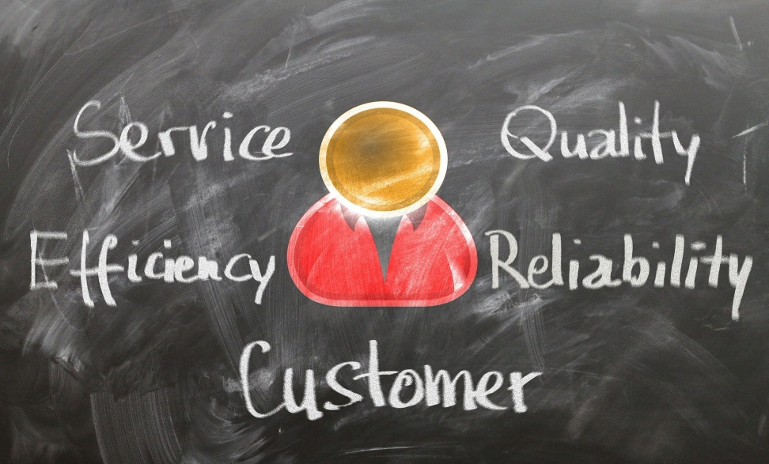
Quality of Service
Quality of service is difficult to gauge because it depends on customers’ perceptions of how well the service meets or exceeds their expectations.
In other words, service quality is judged by consumers, not the service providers. For this reason, it is quite common for perceptions of quality to fluctuate from time to time.

Slide 84
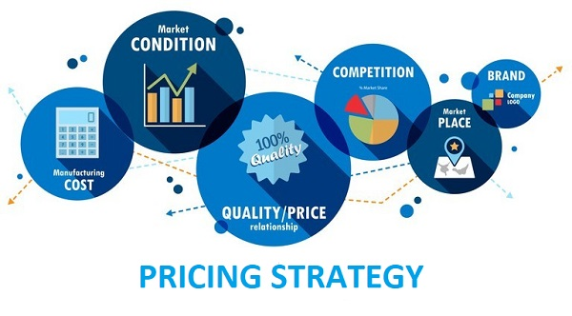
Pricing Strategy
Price is defined as the value placed on an object exchanged between a buyer and a seller.
Buyer’s interest in price stems from their expectations about the usefulness of a product or the satisfaction they may derive from it.
Because buyers have limited resources, they must allocate those resources to obtain the products they most desire. They must decide whether the benefits gained in an exchange are worth the buying power sacrificed.
Almost anything of value can be assessed by a price.

Slide 85
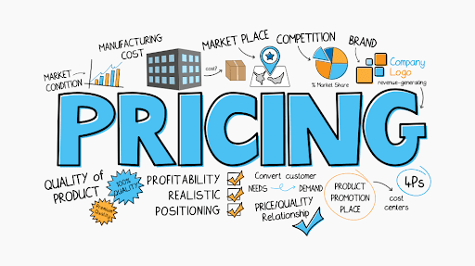
Pricing Strategy
Many factors influence the evaluation of value, including time constraints, price levels, perceived quality, and motivations to use available information about prices.
Consumers vary in their response to price: some focus solely on the lowest price, while others consider quality or the prestige associated with a product and its price.

Slide 86
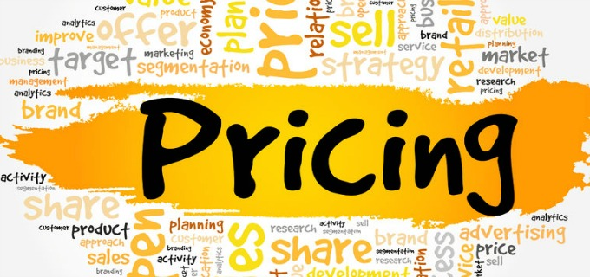
Pricing Strategy
Price is a key element in the marketing mix because it relates directly to the generation of revenue and profits.
In large part, the ability to set price depends on the supply of and demand for a product. For most products, the quantity demanded goes up as the price goes down, and as the price goes up, the quantity demanded goes down.
Changes in buyers’ needs, variations in the effectiveness of other marketing mix variables, the presence of substitutes, and dynamic environmental factors can influence demand.

Slide 87
Pricing Strategy
Pricing is probably the most flexible variable in the marketing mix. Although it may take years to develop a product, establish channels of distribution, and design and implement promotion, a product’s price may be set and changed in a few minutes.
Price also depends on the cost to manufacture a good or provide a service or idea, and although a firm may temporarily sell products below cost to match competition, to generate cash flow, or even increase market share, in the long run, it cannot survive by selling products below cost.

Slide 88
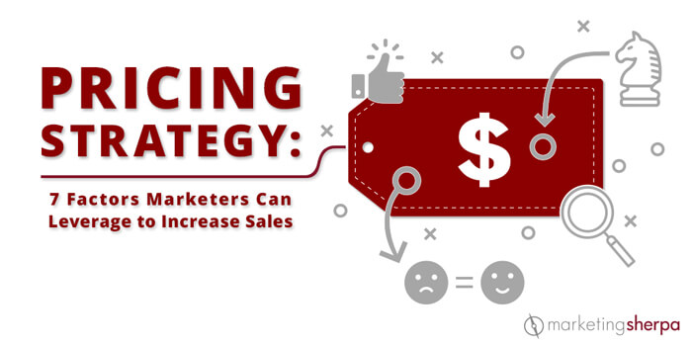
Pricing Objectives
Pricing objectives specify the role of price in an organization’s marketing mix and strategy.
They usually are influenced not only by marketing mix decisions but also by finance, accounting, and production factors.
Maximizing profits and sales, boosting market share, maintaining the status quo, and survival are four common pricing objectives.

Slide 89
Pricing Strategies
Setting the price for a new product is critical: the right price leads to profitability; the wrong price may kill the product.
In general, there are two basic strategies to setting the base price for a new product.
Price Skimming: Charging the highest possible price that buyers who want the product will pay.
Penetration Price: Charging a low price to help a product enter the market and gain market share rapidly.

Slide 90
Pricing Strategies
Psychological Pricing
Encourages purchases based on emotional rather than rational responses to the price.
The assumption behind even-odd pricing is that people will buy more of a product for $9.99 than $10 because it seems like a bargain.
The assumption behind symbolic-prestige pricing is that high prices connote high quality.
Reference Pricing
A type of psychological pricing in which a lower-priced item is compared to a more expensive brand in hopes that the consumer will use the higher price as a comparison price.
Price Discounting
Temporary price reductions, often employed to boost sales.
Quantity, seasonal, and promotional discounts are the most widely used.

Slide 91
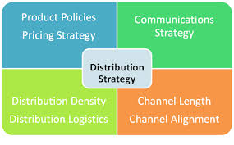
Distribution Strategy
The best products in the world will not be successful unless companies make them available where and when customers want to buy them.
Factors involved in a product’s success include distribution strategies, the intensity of market coverage, and the physical handling of products during distribution.

Slide 92
Distribution Strategy Marketing Channels
A Marketing Channel, or channel of distribution, is a group of organizations that move products from producers to customers.
Marketing channels make products available to buyers when and where they desire to purchase them.
Organizations that bridge the gap between a product’s manufacturer and the ultimate consumer are called “middlemen” or intermediaries. They create time, place, and ownership utility.
Two intermediary organizations are retailers and wholesalers.

Slide 93
Distribution Strategy Marketing Channels: Retailers
Retailers buy products from manufacturers and sell them to consumers for home and household use rather than for resale or for use in producing other products.
By bringing together an assortment of products from competing producers, retailers create utility.
Retailers arrange for products to be moved from producers to a convenient retail establishment (place utility), maintain hours of operation for their retail stores to make merchandise available when consumers want it (time utility), and assume the risk of ownership of inventories (ownership utility).

Slide 94
Distribution Strategy Marketing Channels: Retailers
Today, there are too many stores competing for too few customers, and as a result, competition among similar retailers has never been more intense. Additionally, retailers face challenges such as shoplifting.
As a result, many businesses have turned to non-store retailing to sell their products.
Direct Marketing: the use of non-personal media to communicate products, information, and the opportunity to purchase via media such as mail, telephone, or the Internet.
Direct Selling: the marketing of products to consumers through face-to-face sales presentations at home or in the workplace.

Slide 95
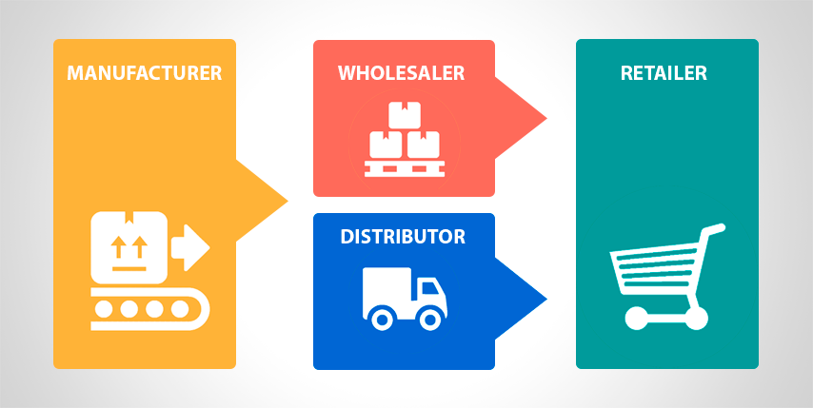
Distribution Strategy Marketing Channels: Wholesalers
Wholesalers are intermediaries who buy from producers and sell to retailers.
They usually do not sell in significant quantities to ultimate consumers.

Slide 96
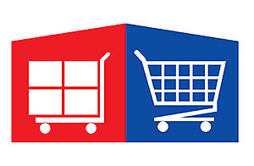
Distribution Strategy Marketing Channels: Wholesalers
Wholesalers are extremely important because of the marketing activities they perform, particularly for consumer products.
Wholesalers help consumers and retailers by buying in large quantities, then selling to retailers in smaller quantities.
By stocking an assortment of products, wholesalers match products to demand.

Slide 97
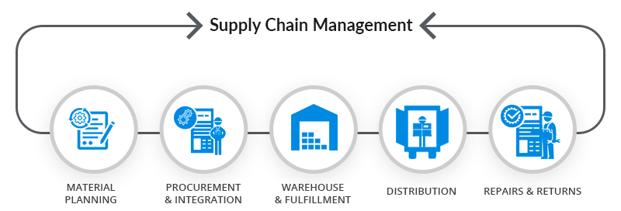
Distribution Strategy Supply Chain Management
In an effort to improve distribution channel relationships among manufacturers and other channel intermediaries, Supply Chain Management (SCM) creates alliances between channel members.
SCM connects and integrates all parties or members of the distribution system in order to satisfy customers.
It involves long-term partnerships among marketing channel members working together to reduce cost, waste, and unnecessary movement in the entire marketing channel to satisfy customers.

Slide 98
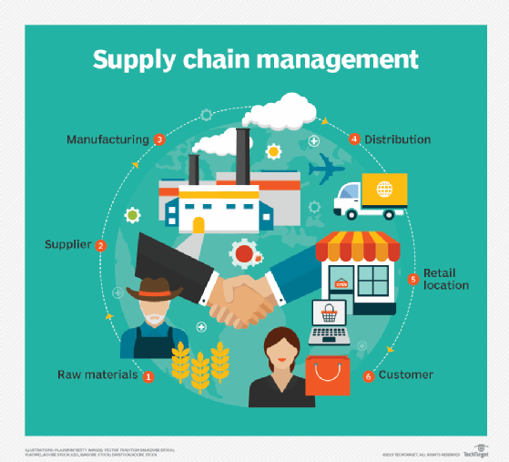
Distribution Strategy Supply Chain Management
Supply Chain Management goes beyond traditional channel members (producers, wholesalers, retailers, customers) to include all organizations involved in moving products from the producer to the ultimate customer.
Research shows that a disruption in the supply chain was viewed as the number-one crisis that could decrease revenue.

Slide 99
Distribution Strategy Physical Distribution
Physical Distribution includes all the activities necessary to move products from producers to consumers – inventory control, transportation, warehousing, and materials handling.
Physical distribution creates time and place utility by making products available when they are wanted, with adequate service and at minimum cost.
Both goods and services require physical distribution.

Slide 100
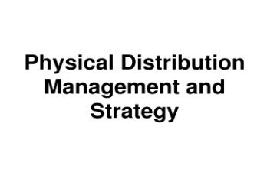
Distribution Strategy Importance of Distribution in a Marketing Strategy
Distribution decisions are among the least flexible in the marketing mix.
Products can be changed over time; prices can be changed quickly; and promotion is usually changed regularly. But, distribution decisions often commit resources and establish contractual relationships that are difficult to change.
As a company attempts to expand into new markets, it may require a complete change in distribution.
If a firm does not manage its marketing channel in an efficient manner and provide the best service, then a new competitor will evolve to create a more effective distribution system.

Slide 101
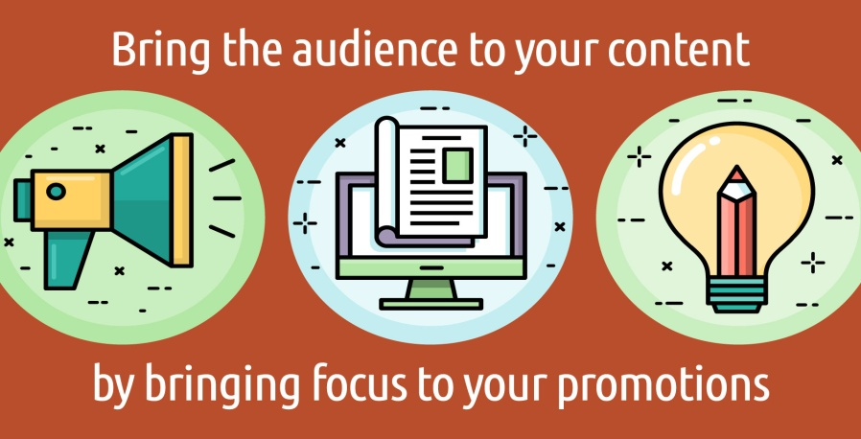
Promotion Strategy
The role of promotion is to communicate with individuals, groups, and organizations to facilitate an exchange directly or indirectly.
It encourages marketing exchanges by attempting to persuade individuals, groups, and organizations to accept goods, services, and ideas.
Promotion is used not only to sell products but also to influence opinions and attitudes toward an organization, person, or cause.

Slide 102
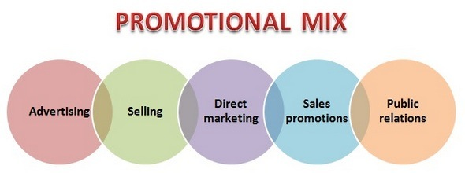
Promotion Strategy The Promotion Mix
Advertising, personal selling, publicity, and sales promotion are collectively known as the promotion mix because a strong promotion program results from careful selection and blending of these elements.
The process of coordinating the promotion mix elements and synchronizing promotion as a unified effort is called: Integrated marketing Communications (IMC).
When planning promotional activities, an integrated marketing communications approach results in the desired message.

Slide 103
Promotion Strategy Promotion Mix: Advertising
Advertising is a paid form of nonpersonal communication transmitted through a mass medium, such as television commercials or magazine advertisements.
An Advertising Campaign involves planning a series of advertisements and placing them in various media to reach a particular target audience.

Slide 104
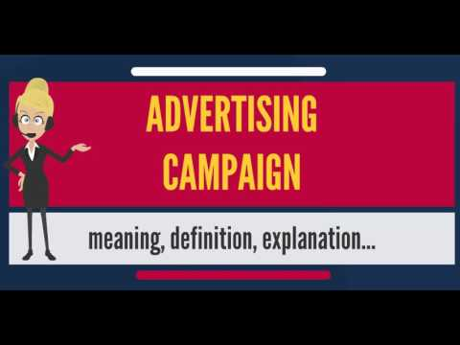
Promotion Strategy Advertising Campaign
The basic content and form of an advertising campaign are a function of several factors:
A product’s features, uses, and benefits affect the content of the campaign message and individual ads.
Characteristics of the people in the target audience – gender, age, education, race, income, occupation, lifestyle, and other attributes – influence both content and form.
To communicate effectively, advertisers use words, symbols, and illustrations that are meaningful, familiar, and attractive to people in the target audience.

Slide 105
Promotion Strategy Advertising Campaign
An advertising campaign’s objectives and platform also affect the content and form of its messages.
If a firm’s advertising objectives involve large sales increases, the message may include hard-hitting, high-impact language/symbols.
When campaign objectives aim at increasing brand awareness, the message may use much repetition of the brand name and words and illustrations associated with it.
Thus, the advertising platform is the foundation on which campaign messages are built.

Slide 106
Promotion Strategy Advertising Campaign
Advertising media are the vehicles or forms of communication used to reach a desired audience.
Print media include newspapers, magazines, direct mail, and billboards, while electronic media include television, radio, and Internet advertising. Choice of media influences the content and form of the message.
Effective outdoor displays and short broadcast announcements require concise, simple, messages.
Magazine and newspaper advertisements can include considerable detail and long explanations.

Slide 107
Promotion Strategy Promotion Mix: Personal Selling
Personal Selling is direct, two-way communication with buyers and potential buyers.
Personal selling is the most flexible of the promotional methods because it gives marketers the greatest opportunity to communicate specific information that might trigger purchase.
For many products, interaction between a salesperson and the customer is probably the most important promotional tool.
Only personal selling can zero in on a prospect and attempt to persuade that person to make a purchase.

Slide 108
Promotion Strategy Promotion Mix: Personal Selling
Personal Selling is a Six Step Process:
Prospecting
Identifying potential buyers of the product.
Approaching
Using a referral or calling on a customer without prior notice to determine interest in the product.
Presenting
Getting the prospect’s attention with a product demonstration.
Handling Objections
Countering reasons for not buying the product.
Closing
Asking the prospect to buy the product.
Following-Up
Checking customer satisfaction with the purchased product.

Slide 109
Promotion Strategy Promotion Mix: Publicity
Publicity is nonpersonal communication transmitted through mass media but not paid for directly by the firm.
A firm does not pay the media cost for publicity and is not identified as the originator of the message; instead, the message is presented in news story form.
A company can benefit from publicity by releasing to news sources newsworthy messages about the firm and its involvement with the public. Many companies have public relations departments to try to gain favorable publicity.

Slide 110
Promotion Strategy Promotion Mix: Sales Promotion
Sales Promotion involves direct inducements offering added value or some other incentive for buyers to enter into an exchange.
Sales pr0motions are generally easier to measure and less expensive than advertising.
The major tools of sales promotion are store displays, premiums, samples and demonstrations, coupons, contests and sweepstakes, refunds, and trade shows.

Slide 111
Promotion Strategy Promotion Mix: Sales Promotion
Sales promotion stimulates customer purchasing and increases dealer effectiveness in selling products.
It is used to enhance and supplement other forms of promotion.
Sampling a product may also encourage consumers to buy.

Slide 112
Promotion Strategies Push or Pull
In developing a promotion mix, organizations must decide whether to fashion a mix that pushes or pulls the product down to their customers.
Push Strategy
An attempt to motivate intermediaries to push the product down to their customers.
Pull Strategy
The use of promotion to create consumer demand for a product so that consumers exert pressure on marketing channel members to make it available.

Slide 113
Objectives of Promotion
The marketing mix a company uses depends on its objectives.
It is important to recognize that promotion is only one element of the marketing strategy and must be carefully tied to the goals of the firm, its overall marketing objectives, and the other elements of the marketing strategy.
Firms use promotion for many reasons, but typical objectives are to stimulate demand, to stabilize sales, and to inform, remind, and reinforce customers.

Slide 114
Promotional Positioning
Promotional Positioning uses promotion to change or reinforce an image of a product in buyers’ minds.
It is a natural result of market segmentation.
In both promotional positioning and market segmentation, the firm targets a given product or brand at a portion of the total market. A promotional strategy helps differentiate the product and makes it appeal to a particular market segment.
For example, to appeal to safety-conscious consumers, Volvo heavily promotes the safety and crashworthiness of its vehicles.

Slide 115
Importance of Marketing Strategy
Marketing creates value through the marketing mix.
For customers, value means receiving a product in which the benefit of the product outweighs the cost, or price paid for it.
For marketers, value means that the benefits (usually money) received from selling the product outweigh the costs it takes to develop and sell it.
This requires carefully integrating ALL the elements of the marketing mix into an effective marketing strategy.

Slide 116
Business Survey

Slide 117
Part Five: Marketing: Developing Relationships
Chapter Thirteen: Digital Marketing and Social Networking

Slide 118
Introduction
The Internet and information technology have dramatically changed the environment for business.
Marketer’s new ability to convert all types of communications into digital media has created efficient, inexpensive ways of connecting businesses and consumers and has improved the flow and the usefulness of information.
Businesses have the information they need to make more informed decisions, and consumers have access to a greater variety of products and more information about choices and quality.

Slide 119
Introduction
The defining characteristics of information technology in the 21st century is accelerating change.
New systems and applications advance so rapidly that it is almost impossible to keep up with the latest developments.
Social networking continues to advance as the channel most believe will dominate digital communications in the near future.

Slide 120
Growth and Benefits of Digital Communication
The Internet has created opportunities for businesses to forge relationships with consumers, target markets more precisely, and even reach previously inaccessible markets at home and around the world.
The Internet also facilitates business transactions, allowing companies to network w/ manufacturers, wholesalers, retailers, suppliers, and outsource firms to serve customers more quickly and more efficiently.
Digital communication offers a completely new dimension in connecting with others.

Slide 121
Using Digital Media in Business
Given almost instant communication with precisely defined consumer groups, firms can use real-time exchanges to create and stimulate interactive communication, forge closer relationships, and learn more accurately about consumer and supplier needs.
Because it is fast and inexpensive, digital communication is making it easier for businesses to conduct marketing research, provide and obtain price and product information, and advertise, as well as to fulfill their business goals by selling good and services online.

Slide 122
Using Digital Media in Business
Digital media can improve communication within and between businesses.
Communication is a key business function, and improving the speed and clarity of communication can help businesses save time and improve employee problem-solving abilities.
Digital media can be a communication backbone that helps to store knowledge, information, and records in management information systems so employees can access it when faced with a problem to solve. A well-designed system can reduce confusion, improve organization and efficiency, and facilitate clear communications.

Slide 123
Digital Media and the Marketing Mix
While digital marketing shares some similarities with conventional marketing techniques, a few valuable differences stand out.
Digital media make customer communications faster & interactive.
Digital media help companies reach new target markets easily, affordably, and more quickly than ever before.
Digital media help marketers utilize new resources in seeking out and communicating with customers.
One of the most important benefits of digital marketing is the ability of marketers and customers to easily share information.

Slide 124
1. Product Considerations
Like traditional marketers, digital marketers must anticipate consumer needs and preferences, tailor their goods and services to meet these needs, and continually upgrade them to remain competitive.
The connectivity created by digital media provides the opportunity for adding services and can enhance product benefits. The Internet provides a major resource for learning more about consumer wants and needs.
The ability to access information for any product can have a major impact on buyer decision making.

Slide 125
2. Distribution Considerations
The Internet is a new distribution channel for making products available at the right time, at the right place, and in the right quantities.
Marketer’s ability to process orders electronically and increase the speed of communication via the Internet reduces inefficiencies, costs, and redundancies while increasing speed throughout the marketing channel.
Convenience and constant availability are two major reasons consumers prefer to shop online.

Slide 126
3. Promotion Considerations
One of the best ways businesses can utilize digital media is for promotion purposes – whether they are increasing brand awareness, connecting with consumers, or taking advantage of social networks or virtual worlds to form relationships and generate positive publicity or “buzz” about their products.
Thanks to online promotion, consumers can be more informed than ever, including reading customer-generated content before making purchasing decisions.
Consumer consumption patterns are radically changing, and marketers must adapt their promotional efforts to meet them.

Slide 127
4. Pricing Considerations
Digital marketing can enhance the value of products by providing extra benefits such as service, information, and convenience.
Through digital media, discounts and other promotions can be quickly communicated.
As consumers have become better informed about their options, the demand for low-priced products has grown, leading to the creation of deal sites where consumers can compare prices.

Slide 128
Social Networking
A Social Network is a website where users can create a profile and interact with users, post information, and engage in other forms of web-based communication.
Social networks are a valued part of marketing because they are changing the way consumers communicate with each other and with businesses.
Sites such as Facebook and Twitter, etc. emerged as opportunities for marketers to build communities, provide product information, and learn about consumer needs.

Slide 129
Types of Consumer-Generated Marketing and Digital Media
While digital marketing has generated exciting opportunities for companies to interact with their customers, digital media are also more consumer-driven than traditional media.
Internet users are creating and reading consumer-generated content as never before and are having a profound effect on marketing in the process.

Slide 130
Types of Consumer-Generated Marketing and Digital Media
Two factors have sparked the rise of consumer-generated information:
The increased tendency of consumers to publish their own thoughts, opinions, reviews, and product discussions through blogs or digital media.
Consumers’ tendencies to trust other consumers over corporations.
Consumers often rely on the recommendation of friends, family, and fellow consumers when making purchasing decisions.

Slide 131
Social Networks
The increase in social networking across the world is exponential.
It is estimated that today’s adults spend approximately 42.1 minutes per day on Facebook alone.
As social networks evolve, both marketers and the owners of social networking sites are realizing the opportunities networks offer – an influx of advertising dollars for site owners and a large reach for the advertiser.

Slide 132
Social Networks
Social networking sites are useful for relationship marketing, or the creation of relationships that mutually benefit the business and customer.
Approximately 30% of consumers claim social media has some influence on their purchasing decisions.

Slide 133
Facebook
Facebook is the most popular social networking site in the world.
Facebook users create profiles, which they can make public or private, and then search the network for people with whom to connect. There are currently more than 1.5 billion users.
It has also acquired a number of companies as it expands into other services, including Instagram, WhatsApp, and Oculus.
It has a video feature that enables sharing/tagging of videos.
For this reason, many marketers are turning to Facebook to market products, interact with consumers, and gain free publicity.

Slide 134
Twitter
Twitter is a hybrid of a social networking site and a micro-blogging site that asks users one simple question: “What’s happening?”
Members can post answers of up to 140 characters, which are then available for their registered “followers” to read. Although 140 characters may not seem like enough for companies to send an effective message, shorter social messages appear more effective.
Twitter is also used to build (or rebuild) customer relationships.
It is also expanding into video with its recent acquisition of Vine.

Slide 135
Blogs and Wikis
Marketers recognize that the impact of consumer-generated material like blogs and wikis and their significance to online consumers increased a great deal.
Blogs (short for web logs) are web-based journals in which writers can editorialize and interact with other Internet users. More than ¾ of Internet users read blogs.
As blogging changes the face of media, smart companies are using it to build enthusiasm for their products and to create relationships with customers.
Tumblr has been called “ground zero of the viral Internet.”

Slide 136
Blogs and Wikis
Wikis are websites where users can add to or edit the content of posted articles.
One of the best known is Wikipedia, an online encyclopedia with more then 38 million entries in more than 290 languages on nearly every subject imaginable. Wikipedia is one of the 10 most popular sites on the web.
Like all digital media, wikis have advantages and disadvantages for companies. Monitoring relevant wikis provides companies with a better idea of how consumers feel about the company or brand.

Slide 137
Media Sharing
Businesses can also share their corporate messages in more visual ways through media sharing sites.
Media sharing sites allow marketers to share photos, videos, and podcasts. They are more limited in scope in how firms interact with consumers. They tend to be more promotional than reactive. The most popular media sharing sites include: YouTube, Vimeo, and Dailymotion; Instagram and Shutterfly.
Firms can promote their products, but they usually do not interact with consumers through personal messages or responses.
However, the popularity of these sites provides the potential to reach a global audience of consumers.

Slide 138
Media Sharing
Sites are emerging that take photo sharing to a new level.
Pinterest is a photo sharing bulletin board site that combines photo sharing with elements of bookmarking and social networking.
Marketers have found that an effective way of marketing through Pinterest is to post images conveying a certain emotion that represents their brand.
Companies are scanning photos and images on photo sharing sites to gather insights about how brands are being displayed or used.
The opportunities for marketers to use photo-sharing sites to gather information and promote brands appear to be limitless.

Slide 139
Media Sharing
Podcasts are audio or video files that can be downloaded from the Internet via a subscription that automatically delivers content to listening devices or personal computers.
Podcasting offers the benefit of convenience, giving users the ability to listen to or view content when-where they choose. The markets podcasts reach are ideal for marketers, and they impact consumer buying habits.
Listening to nutrition podcasts while in the grocery store increases the likelihood that shoppers will purchase healthier items.

Slide 140
Virtual Gaming
Games and programs allowing viewers to develop avatars that exist in an online virtual world have exploded in popularity. It is estimated that consumers spend 32% of their time with mobile apps on gaming activities.
Virtual games include Second Life, Everquest, Sim City, and the role-playing game World of Warcraft. These sites can be described as social networks with a twist.
By interacting with the public virtually, businesses hope to connect with younger generations of consumers in entirely new ways.

Slide 141
Mobile Marketing
As digital marketing becomes increasingly sophisticated, consumers are beginning to utilize mobile devices, like smartphones, as a highly functional communication method.
Mobile phones have become an important part of our everyday lives and can even affect how we shop.
It is estimated that shoppers who are distracted by their phones in-store increased their unplanned purchases by more than 12%.

Slide 142
Applications and Widgets
Applications are adding an entirely new layer to the marketing environment, as Americans are estimated to spend 85% of their time on smartphones using apps.
The most important feature of apps is the convenience and cost savings they offer to the consumer.
Certain apps allow consumers to scan a product’s bar code and compare it with the prices of identical products in other stores.
Mobile apps can enable customers to download in-store discounts.
Mobile payments are also gaining traction.

Slide 143
Applications and Widgets
Widgets are small bits of software on a website, desktop, or mobile device that perform a simple purpose, such as providing stock quotes or blog updates.
Marketers might use widgets to display news headlines, clocks, or games on their web pages.
Widgets are an innovative digital marketing tool to personalize web pages, alert users to the latest company information, spread awareness of the company’s products, and enhance relationship marketing between companies and customers.

Slide 144
Using Digital Marketing to Reach Consumers
Customer-generated communications and digital media connect consumers as never before. These connections let consumers share information and experiences w/o company interference, so they get more of the “real story” on product or company features.
In many ways, these media take some of the professional marketer’s power to control and dispense information and place it in the hand of the consumer.
While consumers use digital media to access more product information, marketers can use the same sites to get better and more targeted information about the consumer.

Slide 145
Using Digital Marketing to Reach Consumers
Marketers need to consider what proportion of online consumers are creating, conversing, rating, collecting, joining, or simply reading online materials.
As in traditional marketing efforts, they need to know their target market.
For instance, where spectators make up the majority of the online population, companies should post their own corporate messages through blogs and websites promoting their organization.

Slide 146
Using Digital Marketing to Learn about Consumers
Marketing research and information systems can use digital media and social networking sites to gather useful information about consumers and their preferences.
Sites such as Facebook and Twitter can be good substitutes for focus groups. Online surveys can serve as an alternative to mail, telephone, or personal interviews.
Crowdsourcing describes how marketers use digital media to find out the opinions or needs of the crowd (or potential markets).

Slide 147
Using Digital Marketing to Learn about Consumers
Consumer feedback is an important part of the digital media equation. Online ratings and reviews are estimated to influence the buying decisions of approx. 90% of U.S. consumers.
Most online shoppers search the Internet for ratings and reviews before making major purchase decisions.
Digital media forums allow businesses to monitor what customers are saying, and businesses have opportunities to communicate with their customers to address questions or complaints.

Slide 148
Legal and Social Issues in Internet Marketing
The extraordinary growth of information technology, the Internet, and social networks has generated many legal and social issues for consumers and businesses.
These issues include privacy concerns, the risk of identify theft and online fraud, and the need to protect intellectual property.
The U.S. Federal Trade Commission (FTC) compiles an annual list of consumer complaints related to the Internet and digital media.

Slide 149
Digital Media’s Impact on Marketing
To be successful in business, you need to know much more than how to use a social networking site to communicate with friends.
Developing a strategic understanding of how digital marketing can make business more efficient and productive is increasingly necessary.
If you are thinking about becoming an entrepreneur, then the digital world can open doors to new resources and customers.

