Slide 1
Fundamentals of Management Session Four

Slide 2
Part Three: Organizing
Chapter Eight: Managing Change and Innovation
Define organizational change, compare/contrast views on change process.
Explain how to manage resistance to change.
Describe what manages need to know about employee stress.
Discuss techniques for stimulating innovation.

Slide 3
Change
Organizational change is any alteration or adaption of an organization’s structure, technology, or people.
Changing Structure
Includes any change in authority relationships, coordination mechanisms, degree of centralization, job design, etc.
Changing Technology
Encompasses modifications in the way work is done or the methods and equipment used.
Changing People
Refers to changes in EE attitudes, expectations, perceptions, or behaviors.

Slide 4
Change
Both External and Internal forces constrain managers, and bring about the need for change.

Slide 5
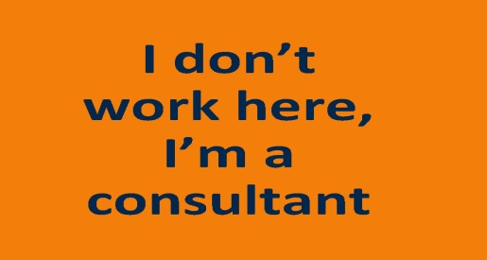
Change
People who act as catalysts and assume the responsibility for managing the change process are called Change Agents.
Change Agents can be any manager or any non-manager, including an outside consultant.
Consultants offer an objective perspective that insiders usually lack.
However, they may not understand the organization’s history, culture, operating procedures, and personnel.

Slide 6
Change
Calm Waters Metaphor
Envisions the organization as a large ship crossing a calm sea. Change appears to be the occasional storm, a brief distraction in an otherwise calm and predictable trip.
According to Lewin, successful change requires: (1) unfreezing the status quo, (2) changing to a new state, and (3) refreezing the new change to make it permanent.

Slide 7
Change
White-Water Rapids Metaphor
The organization is seen as a small raft navigating a raging river with uninterrupted white-water rapids.
In this metaphor, change is the status quo, and managing change is a continual process.
Managers who are overly structured or uncomfortable with change will not succeed in this environment.

Slide 8
Change
Stability and predictability of the calm waters metaphor doesn’t exist.
Disruptions in the status quo are not occasional and temporary, and they are not followed by a return to calm.
Many managers never get out of the rapids.

Slide 9
Implementing Planned Change
Efforts to assist organizational members with a planned change are referred to as Organizational Development.
In facilitating organization-wide changes, managers use OD to change attitudes and values of members, so they can adapt to and be more effective in achieving new direction.
When OD efforts are planned, organizational leaders are, in essence, attempting to change the organization’s culture.

Slide 10
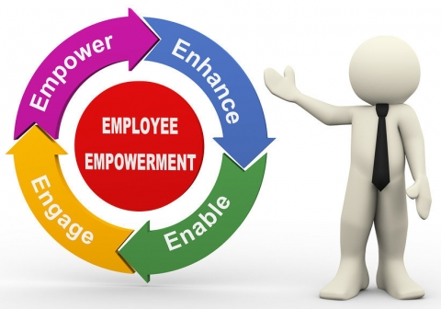
Implementing Planned Change
A fundamental concern of OD is its reliance on employee participation to foster an environment in which open communication and trust exist.
OD attempts to involve organizational members in changes that will affect their jobs and seeks their input about how the change is affecting them personally.

Slide 11
Implementing Planned Change
The more popular OD efforts in organizations rely heavily on group interactions and cooperation.

Slide 12
Implementing Planned Change
Tools to implement planned change, include:
Survey Feedback
Employees are asked their attitudes about and perceptions of the change they are encountering.
Process Consultation
Outside consultants help managers perceive, understand, and act on organizational processes they’re facing.
Team-Building
OD helps individuals become a team by working with them to set goals, develop positive interpersonal relationships, and clarify roles-responsibilities of each team member. Primary focus is to increase trust and openness.
Intergroup Development
Groups focus on becoming more cohesive by attempting to change attitudes, stereotypes, and perceptions that one group may have toward another group.

Slide 13
Resistance to Change
Managers should be motivated to initiate change because of concern with improving the organization’s effectiveness.
But, change isn’t easy in any organization. It can be disruptive and scary. And, people and organizations can build up inertia and not want to change.
People can change, however, if you make the change appealing!

Slide 14
Resistance to Change
Why do people resist organizational change?
Uncertainty
Change replaces the known with uncertainty, and we don’t like it.
Habit
We are creatures of habit, and we don’t want to have to consider the full range of options for the many decisions we often make.
Concern Over Personal Loss
Change threatens the investment we’ve made in the status quo. The more we invest, the more we resist.
Change is Not in the Organization’s Best Interests
We believe that the change is incompatible with the goals and interests of the organization.

Slide 15
Resistance to Change
Six Techniques for Reducing Resistance to Change:
1. Education and Communication
Can help reduce resistance to change by helping EE’s see the logic of the change effort.
Clears up misunderstandings.
May not work when mutual trust and credibility are lacking.
2. Participation
Involves bringing those individuals directly affected by the proposed change into the decision-making process.
Increase involvement and acceptance.
Time-consuming; has potential for a poor solution.

Slide 16
Resistance to Change
Six Techniques for Reducing Resistance to Change:
3. Facilitation and Support
Involve helping EE’s deal with the fear and anxiety associated with the change effort (i.e. counseling).
Can facilitate needed adjustments.
Expensive; no guarantee of success.
4. Negotiation
Involves exchanging something of value for an agreement to lesson the resistance to the change effort.
Can “buy” commitment.
Potentially high cost; opens doors for others to apply pressure.

Slide 17
Resistance to Change
Six Techniques for Reducing Resistance to Change:
5. Manipulation and Co-optation
Refers to covert attempts to influence others about the change.
May involve twisting or distorting facts to make change attractive.
Inexpensive; easy way to gain support.
Can backfire, causing change agent to lose credibility.
6. Coercion
Involves the use of direct threats or force against those resisting the change.
Inexpensive; easy way to gain support.
May be illegal; may undermine change agent’s credibility.

Slide 18
Stress
Change often creates stress for employees.
Stress is the response to anxiety over intense demands, constraints, or opportunities.
Not always bad; can be positive, especially when there is potential gain.
Often associated with:
Constraints – an obstacle that prevents you from doing what you desire
Demands – the loss of something desired
Opportunities – the possibility of something new

Slide 19
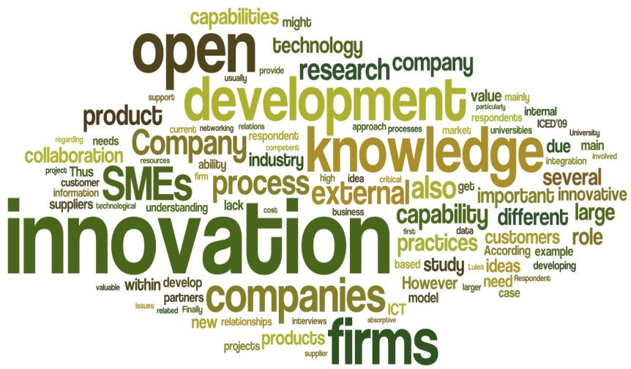
Innovation
Innovation is the key to continued success.
Success in business today demands innovation.
In the dynamic, chaotic world of global competition, organizations must create new products and services and adopt state-of-the-art technology if they’re going to compete successfully.

Slide 20
Innovation
Three Variables that Stimulate Innovation
1. Human Resource Variables:
High Commitment to Training and Development
Knowledge remains current.
High Job Security
Reduce fear of getting fired for making mistakes.
Creative People
Encourage people to become idea champions, actively and enthusiastically supporting new ideas, build support, overcome resistance, and ensure that innovations are implemented.

Slide 21
Innovation
Three Variables that Stimulate Innovation
2. Cultural Variables:
Acceptance of ambiguity
Less emphasis on objectivity and specificity.
Tolerance of the impractical
What may seem impractical often leads to innovative solutions.
Low external controls
Rules, regulations, policies, and controls must be minimized.
Tolerance of risk - Tolerance of conflict
Focus on ends
Goals are made clear, but the path to achievement may differ.
Open-system focus
Monitor environment and respond to changes as they occur.
Positive feedback
Provide needed feedback, encouragement, and support

Slide 22
Innovation
Three Variables that Stimulate Innovation
3. Structural Variables:
Organic structures
Facilitates flexibility and sharing of ideas.
Abundant resources
Provides building blocks for innovation.
High inter-unit communication
Helps break down barriers to innovation.
Minimal time pressure
More freedom and less worry leads to innovative solutions.
Work and nonwork support
Encouragement, open communication, readiness to listen, and useful feedback enhances creative performance.

Slide 23
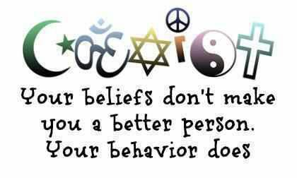
Part Four: Leading
Chapter Nine: Foundations of Individual Behavior
Identify the focus and goals of organizational behavior (OB).
Explain the role that attitudes play in job performance.
Describe different personality theories.
Describe perception and the factors that influence it.
Discuss learning theories and their relevance in shaping behavior.
Discuss contemporary issues in OB.

Slide 24
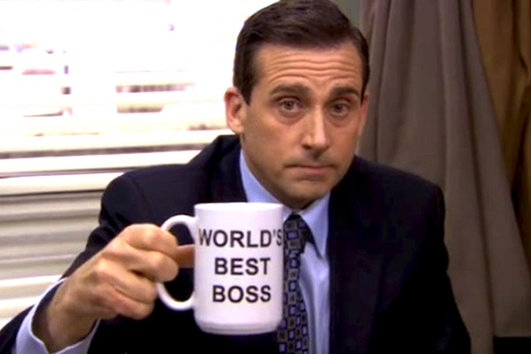
A Good Manager
A good manager works to get to know the unique individual characteristics of the people on his or her team to be able to effectively manage each of them.
A good manager treats all employees the same.

Slide 25
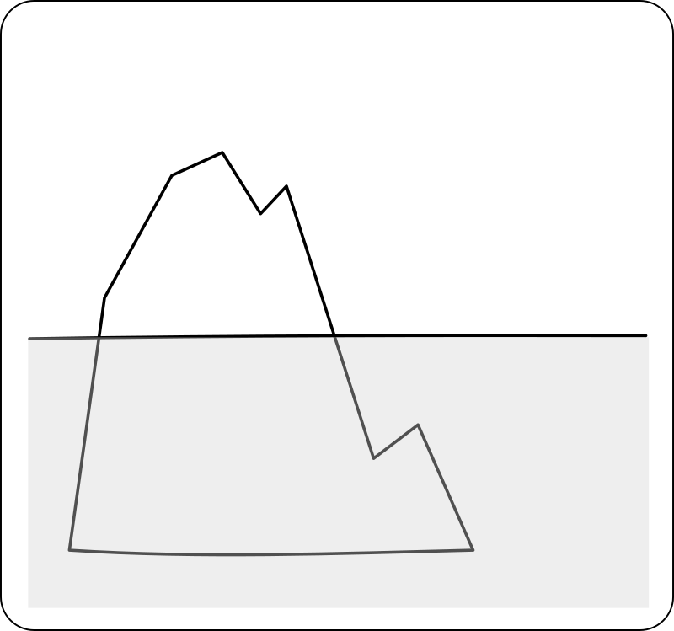
Organizational Behavior
Organizational Behavior is the study of the actions of people at work.
Visible Aspects
Strategies – Objectives – Policies and Procedures – Structure – Technology – Formal Authority – Chains of Command
Hidden Aspects
Attitudes – Perceptions – Group Norms – Informal Interactions – Interpersonal and Intergroup Conflicts

Slide 26
Goals of Organizational Behavior
The goals of Organizational Behavior are to explain, predict and influence behavior.
Managers need to be able to explain why EE’s engage in some behaviors rather than others, predict how EE’s will respond to various actions and decisions, and influence how EE’s behave.

Slide 27
Goals of Organizational Behavior
Six important EE behaviors that managers are concerned with explaining, predicting, and influencing include the following:
1: Employee Productivity
A performance measure of both work efficiency and effectiveness.
2: Absenteeism
The failure to show up for work.
Although absenteeism can’t be totally eliminated, excessive levels have a direct impact on the organization functioning.
3: Turnover
The voluntary and involuntary permanent withdrawal from an organization.
It can be a problem because of increased recruiting, selection, training costs, and work disruptions.

Slide 28
Goals of Organizational Behavior
Six important EE behaviors that managers are concerned with explaining, predicting, and influencing include the following:
4: Organizational Citizenship Behavior
Discretionary behavior that’s not part of an EE’s formal job requirements, but which promotes the effective functioning of the organization.
Is limited if EE is overloaded, stressed, or has work-family conflict.
5: Job Satisfaction
An EE’s general attitude toward his/her job.
Satisfied EE’s are more likely to show up for work, have higher levels of performance, and stay with an organization.
6: Workplace Misbehavior
Any intentional EE behavior that is potentially harmful to the organization or individuals within the organization.
Shows up as: deviance, aggression, antisocial behavior, and violence.

Slide 29
Attitude
What role do attitudes play in job performance?
Attitudes are evaluative statements, either favorable or unfavorable, concerning objects, people, or events.
They reflect how an individual feels about something.

Slide 30
Attitude
Three components of an Attitude.
Cognitive
This component of an attitude is made up of the belief’s, opinions, knowledge, and information held by a person.
I feel strongly that smoking is unhealthy.
Affective
This component is the emotional or feeling part of an attitude.
I don’t like people who smoke.
Behavioral
This component refers to an intention to behave in a certain way toward someone or something.
I will avoid hanging out with others who smoke.

Slide 31
Attitude
Looking at attitudes as being made up of three components helps to illustrate their complexity and helps us better understand what “precedes” someone’s response, reaction, or behavior.

Slide 32
Attitude
Attitudes managers have particular interest in, include:
Job Satisfaction
An EE’s general attitude toward the job.
Job Involvement
The degree to which an EE identifies with the job, actively participates in it, and considers performance for self-worth.
Organizational Commitment
Represents an EE’s orientation toward the organization in terms of loyalty to, identification with, and involvement in the organization.

Slide 33
Understanding Attitudes
Managers should be interested in their EE’s attitudes because they influence behavior.
Satisfied and committed EE’s have lower rates of turnover and absenteeism. And, satisfied EE’s perform better on the job.

Slide 34
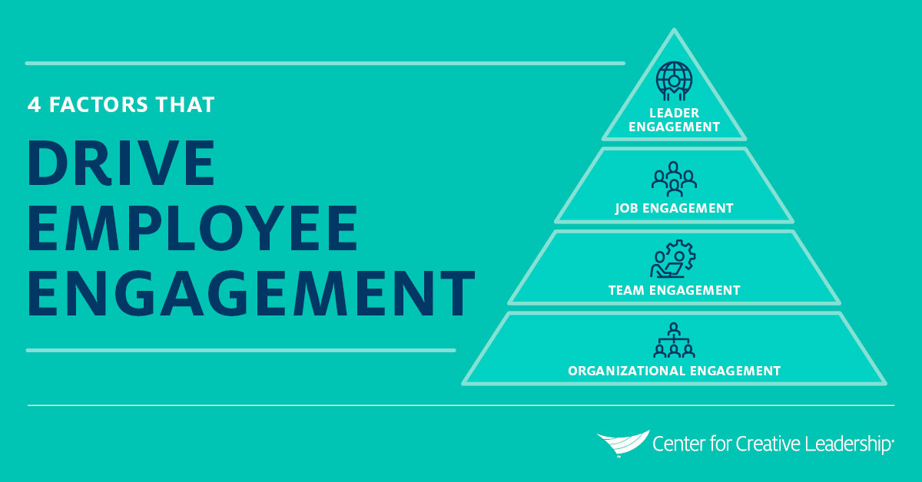
Employee Engagement
Employee Engagement – a concept associated with job attitudes – happens when employees are connected to, satisfied with, and enthusiastic about their jobs.

Slide 35
Employee Engagement
Top Five Factors Contributing to EE Engagement:
Respect
Type of Work
Work-Life Balance
Providing Good Service to Customers
Base Pay

Slide 36
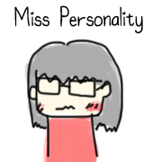
Personality
An individual’s Personality is a unique combination of emotional, thought, and behavioral patterns that affect how a person reacts to situations and interacts with others.
Just like attitudes, personality affects how and why people behave the way they do.
78 % of employers say that personality is the most important attribute in a job candidate.

Slide 37
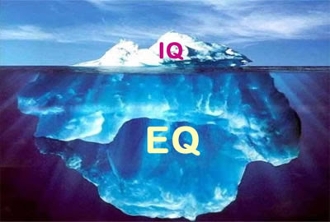
Emotional Intelligence
Emotional Intelligence refers to an assortment of non-cognitive skills, capabilities, and competencies that influences a person’s ability to cope with environmental demands and pressures.
People who understand their own emotions and are good at reading others’ emotions may be more effective in their jobs.

Slide 38
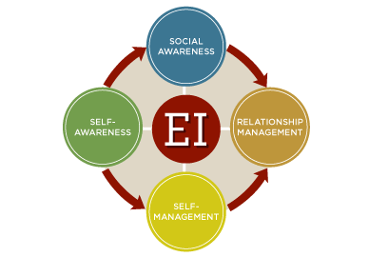
Emotional Intelligence
Emotional Intelligence is composed of five dimensions.
Self-Awareness
Being aware of what you’re feeling.
Self-Management
Managing you own emotions and impulses.
Self-Motivation
Persisting in the face of setbacks and failures.
Empathy
Sensing how others are feeling.
Social Skills
Adapting to and handling the emotions of others.

Slide 39
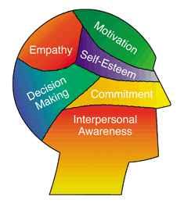
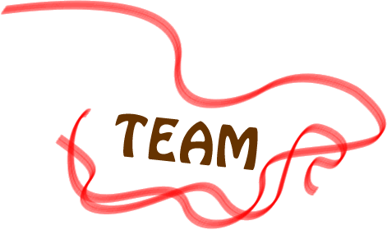
Emotional Intelligence
Emotional Intelligence skills are twice as important in contributing to excellence as intellect and expertise alone.
Emotional Intelligence, not academic IQ, characterizes high performers within an organization.
EI contributes to team effectiveness.

Slide 40
Personality and Jobs
Psychologist, John Holland, states that an employee’s satisfaction with his or her job, as well as, the likelihood of leaving that job, depends on the degree to which the individual’s personality matches the job environment.
His theory proposes that satisfaction is highest and turnover lowest when personality and occupation are compatible.

Slide 41
Personality and Jobs
Managers should be interested in their EE’s personalities, because those personalities influence their behavior in the following ways:
Job-Person Compatibility
Managers are likely to have higher-performing and more-satisfied EE’s if consideration is given to matching personalities with jobs.
Understanding Different Approaches to Work
By recognizing that people approach problem solving, decision making, and job interactions differently, a manager can better understand the approach and be more equipped in dealing with it.
Being a Better Manager
Being a successful manager and accomplishing goals means working well together with others - inside/outside organization.

Slide 42
Perception
Perception is a process by which we give meaning to our environment by organizing and interpreting sensory impressions.
Individuals may look at the same thing, but perceive it differently.

Slide 43
Perception
A number of factors operate to shape and sometimes distort perception. These factors can reside in:
The Perceiver
Personal characteristics; such as, attitudes, personality, motives, interests, past experiences, etc. influence the interpretation.
The Object or Target being perceived
Because targets are not looked at in isolation, the relationship of a target to its background influences perception (i.e. beauty); as does our tendency to group close and similar things together.
The Context of the Situation in which the perception is made
The time at which an object or event is seen can influence attention, as can location, lighting, temperature, and a other situational factors.

Slide 44
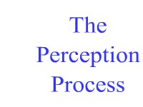
Perception
When we observe people, we attempt to develop expectations of why they behave in certain ways.
Our perception and judgment of a person’s actions, therefore, will be significantly influenced by the assumptions we make about the person’s internal state.

Slide 45
Attribution Theory
Attribution Theory explains how we judge people differently depending on how we attribute the behavior.
When we observe an individual’s behavior, we attempt to determine whether it was internally or externally caused.
Internal - behavior is believed to be under the control of the individual.
External - behavior results from outside causes. The person is seen as have been forced into the behavior by the situation.

Slide 46
Fundamental Attribution Error
When we make judgments about the behavior of other people, we have a tendency to underestimate the influence of external factors and overestimate the influence of internal or personal factors.
Individuals also tend to attribute their own success to internal factors such as ability or effort while putting the blame for failure on external factors such as luck (or an “unfair” test).

Slide 47
Perception
All of us use a number of shortcuts to judge others.
Selectivity
People assimilate certain bits and pieces of what they observe depending on their interests, background, experience, and attitudes.
Assumed Similarity
People assume that others are like them.
Stereotyping
People judge others on the basis of their perception of a group to which the others belong.
Halo Effect
People form an impression of others on the basis of a single trait, i.e. intelligence, enthusiasm, attractiveness, etc.

Slide 48
Understanding Perception
Managers should be interested in perception because it helps them understand EE behavior.
Managers need to recognize that their EE’s react to perceptions, not to reality.
If individuals perceive appraisals to be biased or wages low, they’ll behave as if those conditions actually exist.
EE’s organize and interpret what they see, so there is always the potential for perceptual distortion.
The message is clear – pay close attention to how EE’s perceive both their jobs and management actions.

