Slide 1
Fundamentals of Management Session Three

Slide 2
Part Three: Organizing
Chapter Six: Organizational Structure and Design
Describe six key elements in organizational design.
Identify the contingency factors that favor either the mechanistic model or the organic model of organizational design.
Compare and contrast traditional and contemporary organizational designs.
Discuss the design challenges faced by today’s organizations.

Slide 3
Structure
Once the organization’s goals, plans, and strategies are in place, managers must develop a structure that will best facilitate the attainment of those goals.

Slide 4
Organizational Design
Organizing is one of the primary functions of Management that creates structure and determines:
What needs to be done?
How will it be done?
Who will do it?

Slide 5
Organizational Design
Six Basic Elements of Organizational Structure
Work Specialization
Departmentalization
Authority and Responsibility
Span of Control
Centralization vs. Decentralization
Formalization

Slide 6
Work Specialization
Work Specialization is dividing work activities into separate job tasks, also known as, division of labor.
Individual employees “specialize” in doing part of an activity rather than the entire activity in order to increase work output.
Allows organizations to efficiently use the diversity of skills available.
However, despite efficiencies organizations must recognize limitations, such as: Boredom, fatigue, stress, low productivity, poor quality, increased absenteeism, and high turnover.

Slide 7
Departmentalization
Once it is decided what job tasks will be done by whom, common work activities need to be grouped together so work is done in a coordinated and integrated way.
Types of Departmentalization:
Functional
Groups employees based on work performed.
Product
Groups employees based on major product areas in the corporation.
Customer
Groups employees based on customers’ problems and needs.
Geographic
Groups employees based on location served.
Process
Groups employees based on the basis of work or customer flow.

Slide 8
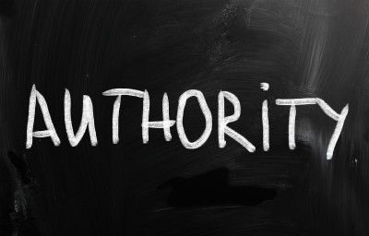
Authority and Responsibility
To understand Authority and Responsibility, you must be familiar with the Chain of Command – the line of authority extending from upper organizational levels to lower levels, which clarifies who reports to whom.
Authority refers to the rights inherent in a managerial position to give orders and expect the orders to be obeyed. It is relative to one’s position within the organization.
Responsibility is when managers delegate authority, they must allocate commensurate responsibility. When employees are given rights, they also assume a corresponding obligation to perform.

Slide 9
Unity of Command
Unity of Command is the belief that that each employee should report to only one manager.
An employee who has to report to two or more bosses might have to cope with conflicting demands or priorities.
However, strict adherence to this belief creates a degree of inflexibility that hinders an organization’s performance.

Slide 10
Authority vs. Power
Authority is aligned with the position one holds, but power is associated with one’s capacity to influence decisions.
The higher one is in the organization the greater the authority.
But, it is not necessary to have authority in order to wield power.
An exclusive focus on authority produces a narrow, unrealistic view of influence.
You do not have to be a manager to have power, and power is not perfectly correlated with one’s level in the organization.

Slide 11
Power
Five Sources or Bases of Power:
Coercive
Power based on fear.
Reward
Power based on the ability to distribute something that others value.
Legitimate
Power based on one’s position in the formal hierarchy.
Expert
Power based on one’s expertise, special skill, or knowledge.
Referent
Power based on identification with a person who has desirable resources or personal traits.

Slide 12
Management Skill Builder
Managers increase power by developing multiple sources of influence.
Managerial jobs come with the power of authority. But, sometimes that authority isn’t enough to get things done. And, other times you may not want to use your authority as a means of getting people to do what you want.
You may, for instance, want to rely more on your persuasive skills than the power of your title.

Slide 13
Management Skill Builder
You can increase your power in organizations by:
Taking on managerial responsibilities.
Gaining access to important information.
Developing an expertise that the organization needs.
Displaying personal characteristics that others admire.

Slide 14
Span of Control
Span of Control is the number of employees managed efficiently and effectively by one supervisor.
The most effective and efficient span depends on:
Employee experience and training (more they have, larger span)
Similarity of employee tasks (more similarity, larger span)
Complexity of those tasks (more complex, smaller span)
Physical proximity of employees (closer proximity, larger span)
Amount & type of standard procedures (more standardized, larger span)
Sophistication of information systems (more sophisticated, larger span)
Strength of organizations’ value system (stronger values, larger span)
Preferred managing style (more or less to manage)

Slide 15
Centralization vs. Decentralization
Managers should choose the amount of centralization or decentralization that will allow them to best implement their decisions and achieve organizational goals.
Centralization is the degree to which decision-making takes place at upper levels of the organization.
Decentralization is the degree to which lower-level managers provide input or make decisions.
Managers today believe that decisions need to be made by individuals closest to the problems, regardless of the organizational level.

Slide 16
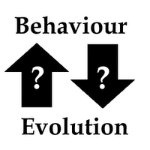
Formalization
Formalization refers to how standardized an organization’s jobs are and the extent to which employee behavior is guided by rules and procedures.
Highly formalized organizations have explicit job descriptions, numerous organizational rules, and clearly defined procedures covering work processes.
Where formalization is low, employees have more discretion in how they do their work.

Slide 17
Contingency Variables in Determining Structure
Strategy
Structure should facilitate goal achievement
Passionate pursuit of innovation – organic structure
Passionate pursuit of cost control – mechanistic structure
Size
A smaller organization with a more organic structure becomes more mechanistic if a significant number of new employees are added to it.
Technology
An organization with routine technology is typically mechanistic, but one with non-routine technology is more likely to be organic.
Environment
Stable environment – mechanistic structure
Dynamic or uncertain environment – organic structure

Slide 18
Organizational Design
Managers are finding that traditional organizational designs often aren’t appropriate for today’s increasingly dynamic and complex environment.
Organizations need to be lean, flexible, and innovative; that is, more organic.

Slide 19
Organizational Design Challenges
As managers look for organizational designs that will best support and facilitate employees doing their work efficiently and effectively, there are certain challenges they must contend with, such as:
Keeping Employees Connected.
Virtual and Network Organizations
Managing Global Differences in Org. Structures.
Understanding Cultural Implications
Designing Flexible Work Arrangements.
Telecommuting – Compressed Workweeks – Flextime
Job Sharing – Contingent Workforce
Building a Learning Organization.

Slide 20
Building a Learning Organization
The concept of a learning organization doesn’t involve a specific organizational design per se, but instead describes an organizational mind-set or philosophy that has significant design implications.
In a learning organization, employees are practicing knowledge management by continually acquiring and sharing new knowledge and are willing to apply that knowledge in making decisions or performing their work.
An organization’s ability to learn and to apply learning as they perform the work may be the only sustainable source of competitive advantage.

Slide 21
Characteristics of a Learning Organization
The Learning Organization has developed the capacity to continuously learn, adapt, and change.
Organizational Design
Boundaryless – Teams – Empowerment
Organizational Culture
Strong Mutual Relationships – Sense of Community – Caring – Trust
Information Sharing
Open – Timely – Accurate
Leadership
Shared Vision – Collaboration

Slide 22
Part Three: Organizing
Chapter Seven: Managing Human Resources
Describe the key components of the human resource management process and the important influences on that process.
Discuss tasks associated w/ identifying and selecting competent employees.
Explain how employees are provided with needed skills and knowledge.
Describe strategies for retaining competent, high-performing employees.
Discuss contemporary issues in managing human resources.

Slide 23
Human Resource Management
Once an organization’s structure is in place, managers have to find people to fill the jobs that have been created or to remove people from jobs, if circumstances require it.
Human Resource Management is a process that includes finding, interviewing, and assessing job applicants; helping new EEs assimilate; recommending training; and assessing employee performance.

Slide 24
Human Resource Management
The quality of an organization is determined by the quality of the people it employs.
Success for most organizations depends on finding the employees with the skills to successfully perform the tasks required to attain the company’s strategic goals.

Slide 25
Human Resource Management
The entire HRM process is influenced by the external environment.
Many of the factors discussed in Chapter Two directly affect all management practices, but their effect is keenly felt in managing the organization’s human resources, because whatever happens to an organization ultimately influences what happens to its employees.

Slide 26
Industrial-Organizational Psychology
Industrial-Organizational Psychology is defined as the scientific study of the workplace.
I/O Psychologists study organizational topics, such as, job performance, job analysis, performance appraisal, compensation, work/life balance, work sample tests, EE training, employment law, personnel recruitment and selection, and so forth.

Slide 27
HRM Process
The first phase of the HRM process involves three tasks:
Employment Planning
Recruitment and Downsizing
Selection

Slide 28
HRM Process
Employment Planning is the process by which managers ensure they have the right number and kinds of people in the right places at the right times, people who are capable of effectively and efficiently completing those tasks that will help the organization achieve its goals.
The process can be condensed into two steps:
Assessing current human resources and future resource needs.
Developing a plan to meet those needs.

Slide 29
Identify and Select Competent Employees
Employment Planning not only guides current staffing needs, but also projects future employee needs and availability.

Slide 30
Recruitment
Recruitment Sources
Internet
Reaches large numbers of people; can get immediate feedback
Generates many unqualified candidates
Employee Referrals
Knowledge about the organization provided by current employee; generates strong candidate, as referral reflects the recommender
May not increase the diversity and mix of employees
Company Web Site
Wide distribution; can be targeted to specific groups
Generates many unqualified candidates
College Recruiting
Large centralized body of candidates
Limited to entry-level positions
Professional Recruiting Organizations
Good knowledge of industry challenges and requirements
Little commitment to specific organization

Slide 31
Downsizing
Downsizing Options
Firing
Permanent involuntary termination
Layoffs
Temporary involuntary termination – short term
Attrition
Not filling openings created by voluntary resignation or retirements
Transfers
Moving employees horizontally or vertically throughout organization
Reduced Workweeks
Having employees working fewer hours – job share – furloughs
Early Retirements
Providing incentives for EE’s to retire before normal retirement date
Job Sharing
Having part-time employees share one full-time position

Slide 32
Identify and Select Competent Employees
The Selection Process seeks to predict which applicants will be “successful” if hired; that is, who will perform well on the criteria the organization uses to evaluate its employees.
A decision is correct when:
The applicant who was predicted to be successful (was accepted) later proved to be successful on the job.
The applicant who was predicted to be unsuccessful (was rejected) would not have been able to do the job if hired.

Slide 33
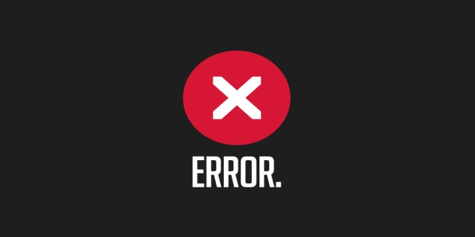
Selection
Selection techniques that result in reject errors can result in charges of discrimination, especially if applicants from protected groups are disproportionately rejected.

Slide 34
Selection
Selection techniques that result in accept errors have obvious costs to the organization:
Cost of training the employee
Costs generated or profits forgone because of EE incompetence
Cost of severance and subsequent cost of recruitment and selection

Slide 35
Reliability and Validity
The major intent of any selection activity is to reduce the probability of making accept errors or reject errors while increasing the probability of making correct decisions.
How?
By using selection procedures that are both reliable and valid.

Slide 36
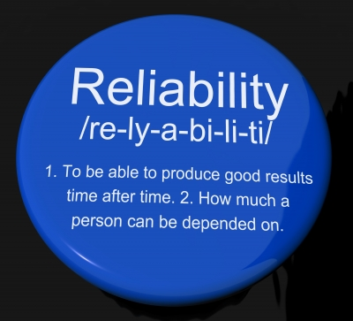
Reliability and Validity
Reliability addresses whether a selection device measures the same characteristic consistently.
Validity is based on a proven relationship between the selection device used and some relevant measure.
Law prohibits managers from using any selection device that cannot be shown to be directly related to successful job performance.

Slide 37
Selection Devices
Managers can use a number of selection devices to reduce accept and reject errors. The best known devices include:
Written Tests
Performance-Simulation Tests
Interviews

Slide 38
Realistic Job Preview
To increase job satisfaction among employees and reduce turnover, managers should consider a Realistic Job Preview (RJP).
An RJP includes both positive and negative information about the job and company.
Research indicates that applicants who have been given a RJP hold lower and more realistic job expectations and are better able to cope with the frustrating elements of the jobs.

Slide 39
Skills, Abilities, and Knowledge
New hires must be acclimated to the organization’s culture and be trained and given the knowledge to do the job in a manner consistent with the organization’s goals.
To achieve this, HRM uses Orientation and Training

Slide 40
Orientation
The major goals of orientation are to:
Reduce anxiety all new employees feel when they begin a new job.
Familiarize new employees with the job, the work unit, and the organization as a whole; and
Facilitate the transition

Slide 41
Training
Employee Training is a learning experience that seeks a relatively permanent change in EE’s by improving their ability to perform on the job.
Training involves changing skills, knowledge, attitudes, or behavior. This change may involve what employees know, how they work, or their attitudes toward their jobs, coworkers, managers, and the organization.
Managers are responsible for deciding when EE’s are in need of training and what form that training should take.

Slide 42
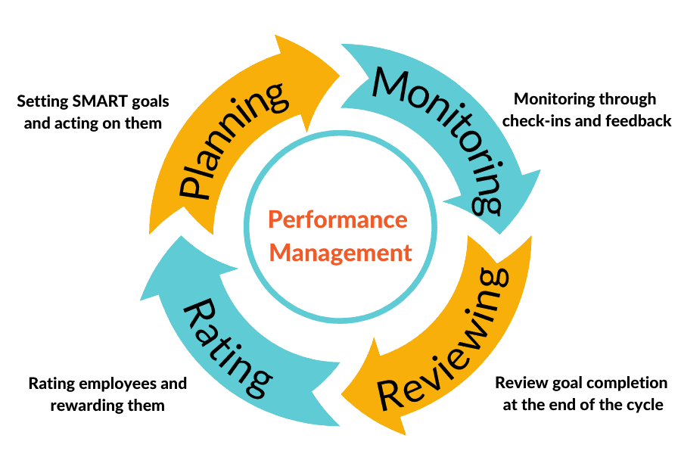
Performance Management
A Performance Management System is a system that establishes performance standards that are used to evaluate employee performance.
Desired EE performance levels determined by organization vs. Actual EE performance level measured and appraised by manager

Slide 43
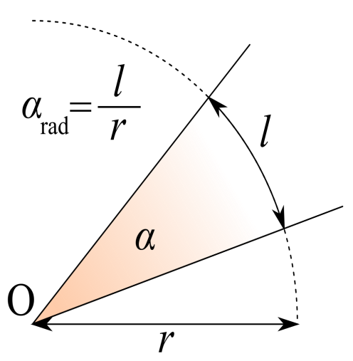
Performance Appraisal Methods
May evaluate EE performance against a set of established standards or absolute criteria, or compare EE performance with that of one or more individuals which is a relative, not absolute, measuring device.
Written Essay
Description of EE’s strengths and weaknesses
Critical Incidents
Examples of critical behaviors that were especially effective or ineffective
Adjective Rating Scales
Lists performance factors – quantity/quality – with numerical ratings
BARS
Rating scale plus examples of actual job behaviors
MBO
Evaluation of accomplishment of specific goals
360-Degree Appraisal
Feedback from full circle of those who interact with EE
Multiperson
Evaluation comparison of work group

Slide 44
Performance Appraisal Methods
Three approaches to Multiperson Comparison:
Group-order Ranking
Evaluator places EE’s into a particular classification – top third, middle third, bottom third; or whatever class desired.
Individual Ranking Approach
Evaluator lists employees in order from highest to lowest performance levels. Only one can be the best.
Paired Comparison Approach
Each EE is compared with every other EE in the comparison group and rated as either the superior or weaker member of the pair.

Slide 45
Performance Appraisal Methods
Regardless of the method of appraisal, it is important to provide EE with Feedback.
Be straightforward by focusing on specific behaviors
Be realistic
Focus your feedback on what can be changed.
Keep feedback impersonal
Be descriptive rather than judgmental. Do not criticize EE personally.
Keep feedback goal oriented
Know when to give feedback – make it well timed
Do not delay feedback (either positive or negative).
Ensure understanding
Watch your body language, tone of voice, and facial expressions
Nonverbal communication speaks louder than words.

Slide 46
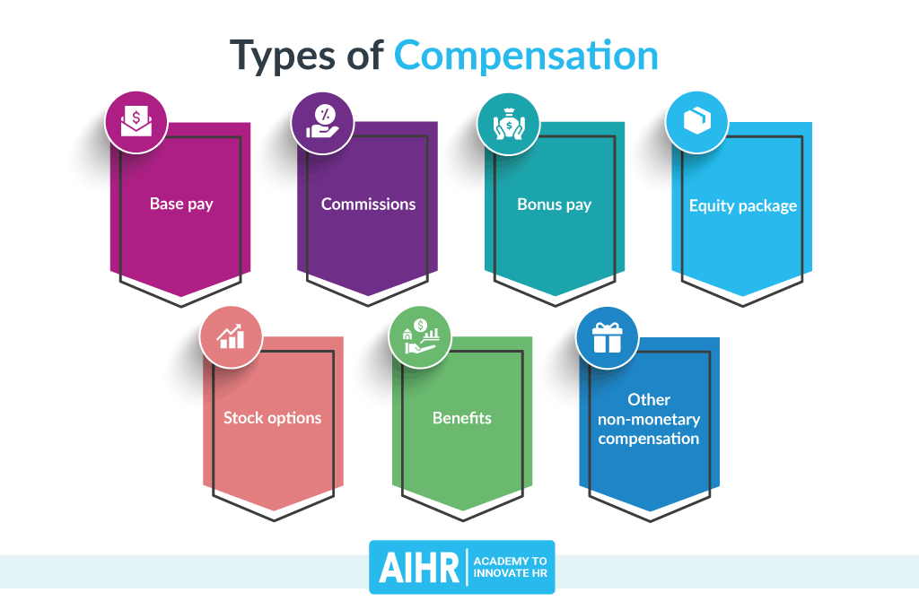
Compensation and Benefits
An effective and appropriate compensation system will:
Help attract and retain competent and talented individuals.
Impact strategic performance.
Keep employees motivated.

Slide 47
Contemporary HRM Issues
HR issues that today’s managers face include downsizing, workforce diversity, sexual harassment, and HR costs.

