Slide 1
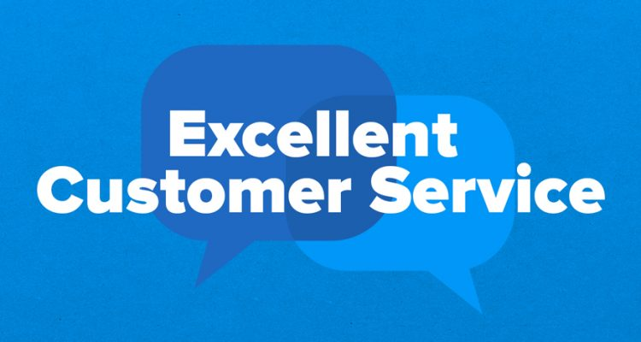
Customer Service Management Session Five
Customer Service
Skills for Success – 7th Edition
Robert W. Lucas; McGraw-Hill Education; New York, NY 2019
ISBN: 978-1-259-95407-8

Slide 2
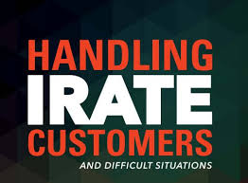
Part Three: Building and Maintaining Relationships
Chapter Seven: Service Breakdowns and Recovery
“Never underestimate the power of the irate customer.” - Joel Ross

Slide 3
What is a Service Breakdown?
Service breakdowns occur whenever any product or service fails to meet the customer’s expectations.
Service breakdowns occur daily in all types of organizations. They occur whenever the product or service delivered fails to meet customer expectations.
In some cases, the product or service delivered may function exactly as designed, but if the customer perceived that it should work another way, a breakdown occurs. Additionally, when a product or service fails to meet what the customer wants or needs or does not live up to advertised promises or standards, dissatisfaction and frustration result.

Slide 4
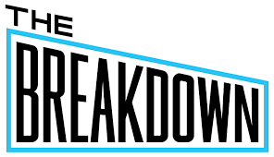
What is a Service Breakdown?
In addition to wants and needs, customer expectations can affect how service is delivered to and perceived by your customers.
Today’s customers are more discerning and better educated, have access to more up-to-date and accurate information, and are often more demanding than in the past. They have certain expectations about your products and services, and the way you will provide them.
Failure to fulfill some or all of these expectations can lead to dissatisfaction and possible confrontation and loss of business.

Slide 5
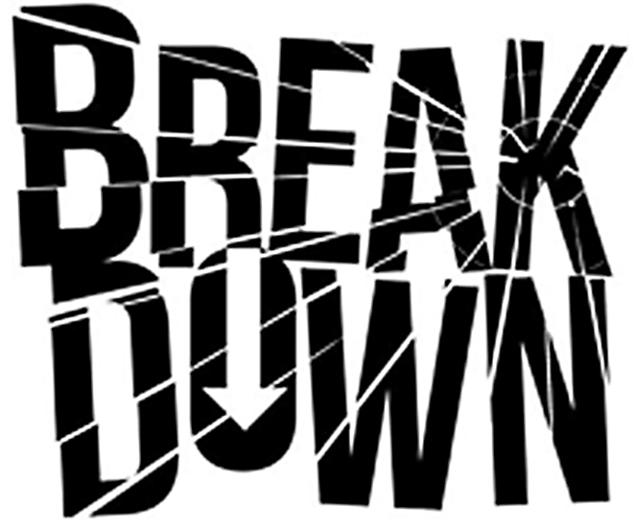
What is a Service Breakdown?
In short, a service breakdown is failure to meet customer wants, needs, and expectations.
Wants
Things that customer typically desire but do not necessarily need.
Needs
Motivators or drivers that cause customers to seek out specific types of products or services. These may be marketing-driven, based on advertising they have seen, or may tie directly to Abraham Maslow’s hierarchy of needs.
Expectations
The perceptions that customers have when they contact an organization or service provider about the kind, level, and quality of products and services they should receive.

Slide 6
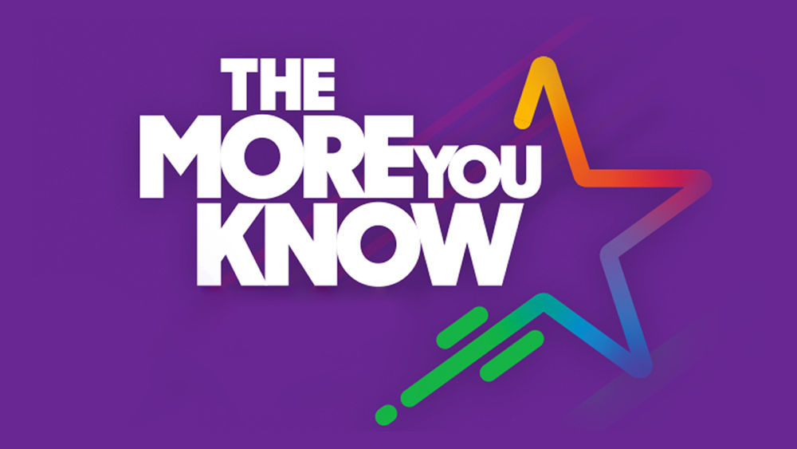
The Role of Behavioral Style
Behavioral preferences have a major effect on the interactions of people. The more you know about style tendencies, the better you will understand your customers.
Behavioral style preferences play a major part in how we interact.
Styles affect the types of things people want and value. If you and your products and services fail to meet those expectations, you can find yourself in the midst of a service breakdown and have to deal w/ an emotional situation that you might not be prepared to handle.
The more you know about behavioral style preferences, the easier it becomes to deal with people in a variety of situations.

Slide 7
Role of Behavioral Style
Everyone possesses one or a combination of the following four different behavioral styles:
Rational
Prefer one-on-one or small group interaction, are congenial and patient, avoid conflict, and dislike calling attention to themselves.
Inquisitive
Rarely volunteer feelings, ask “why” questions, desire facts and figures, and are formal, task-oriented, conservative, and punctual.
Decisive
Are decisive, directive, task and goal-focused, confident, and competitive; seek immediate gratification or results; and talk more than listen.
Expressive
Are open, laid back, flexible, positive, enthusiastic, and informal; prefer dealing with people; and easily share feelings and emotions.

Slide 8
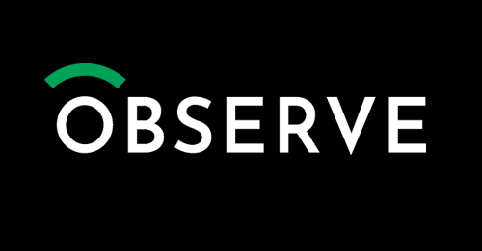
Role of Behavioral Style
Because customers can display various types of behavior from time to time, you should carefully observe their behavior and learn about each style as an indicator of the type of person with whom you are dealing.
Just remember that human beings are complex and react to stimuli in various ways, so adapt your approach as needed.
Do not use information you learn about styles as the definitive answer for resolving the situation. In addition, learn to deal with your emotions so that you can prevent or resolve heated situations that may arise when dealing w/ personalities different from yours.

Slide 9
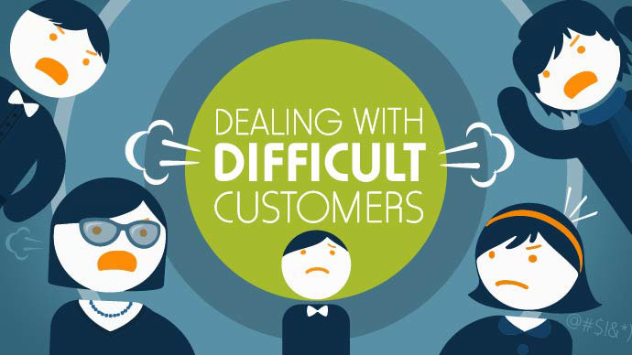
Difficult Customers
Ultimately, successful service is delivered through effective communication skills, positive attitude, patience, and a willingness to help the customer.
You may think of difficult customer contacts as those in which you have to deal with negative, angry, demanding, or aggressive people.
These are just a few of the types of potentially difficult interactions that you may encounter as a service representative.

Slide 10
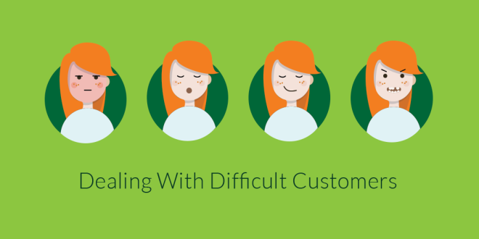
Difficult Customers
From time to time, you will provide assistance to customers who can be described in one or more of the following ways:
Talkative.
Dissatisfied with your service products.
Indecisive or lack knowledge about your product, service, or policies.
Rude or inconsiderate of others.
Internal customers with special requests.
Speak a primary language other than yours.
Elderly and need extra assistance.
Young and inexperienced, needing guidance in making good choice.
Have some type of disability or special needs.
Each of the above categories can be difficult to handle, depending on your knowledge, experience, and abilities.

Slide 11
Difficult Customers
A key to successfully serving all types of customers is to treat each person as an individual.
If you stereotype people, you will likely damage the customer-provider relationship and might even generate complaints to your supervisor or legal action against you and your organization based on perceived discrimination.
Avoid labeling people according to their behavior.
Do not mentally categorize people according to the way they speak, act, or look; and then treat everyone in a “group” the same.

Slide 12
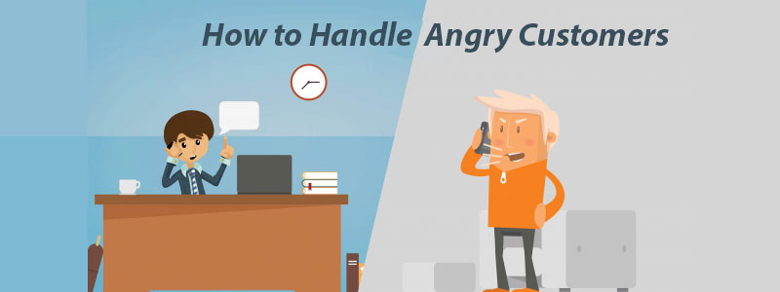
Difficult Customers
Your ability to focus on the situation or problem and not on the person will be a very important factor in your success.
Although you may not understand or approve of a person’s behavior, they are still your customer, so try to make the interaction a positive one, and if necessary ask for help.

Slide 13
Demanding or Domineering Customers
Customers might be demanding or domineering for a number of reasons. Many times, domineering behavior is part of a personality style or simply behavior that they have learned. In other instances, their behavior could be a reaction to past customer service encounters and an expectation that they now have about what should or should not occur.
A demanding customer may feel a need to be or stay in control, especially if they have felt out of control in the past.
Often, such people are insecure or have a behavioral style that lends itself to wanting to be in control or to “win.”

Slide 14
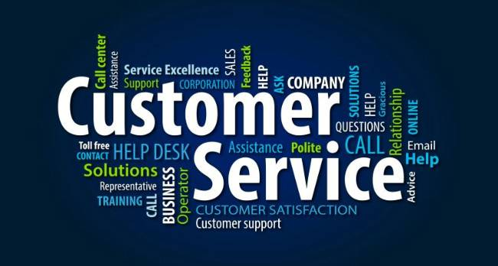
Demanding or Domineering Customers
The following provides strategies for effectively handling demanding customers:
Be Professional
Respect the Customer
Be Firm and Fair and Focus on the Customer’s Needs
Tell the Customer What You Can Do.

Slide 15
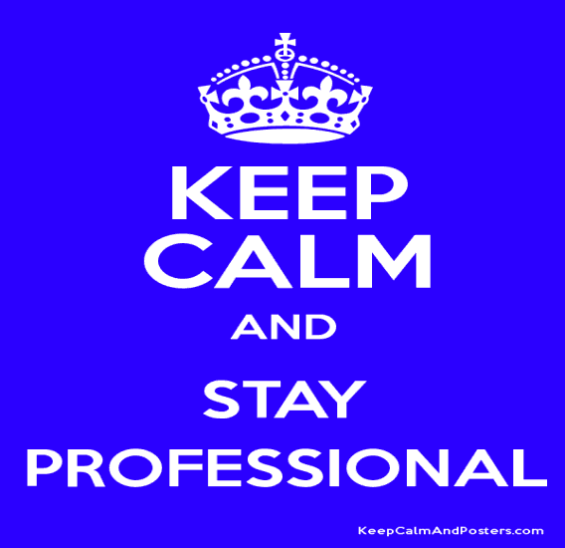
1. Be Professional
Do not raise your voice or retaliate verbally.
Try to work with your customer to negotiate an acceptable alternative when problems arise.
Keep in mind that children engage in name-calling, which often escalates into shoving matches. Unfortunately, some adults regress to childish behavior and revert to negative actions learned in the past. Both you and the customer lose when this happens.

Slide 16
2. Respect the Customer
You do not necessarily have to like your customer, but you should show respect.
This does not mean that you must accommodate your customer’s every wish. It means you should make positive eye contact, remain calm, use the customer’s name, apologize when appropriate and/or necessary, and let the customer know that they are important to you and your organization.
Let the customer know that you are there to assist them or make the situation right and work positively toward an acceptable resolution of the problem.

Slide 17
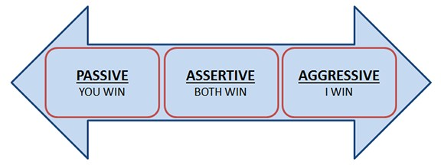
3. Be Firm and Fair and Focus on the Customer’s Needs
Assertive behavior is an appropriate response to a domineering or demanding person; aggression is not.
Also, remember the importance of treating each customer with respect and as an individual.
If you are dealing with a customer who is being unreasonable, seek help from your supervisor or an experienced coworker.

Slide 18
4. Tell the Customer What You Can Do
Do not focus on negatives or what cannot be done when dealing with your customers. Stick with what is possible and what you are willing and able to do.
Be flexible and willing to listen to requests. If something suggested is possible and will help solve the problem, compliment the person on their idea, and try to make it happen. Doing this will show that you are receptive to new ideas, are truly working to meet the customer’s needs and expectations, and value the customer’s opinion.
Know that if you can partner with a customer psychologically, they are less likely to attack.

Slide 19
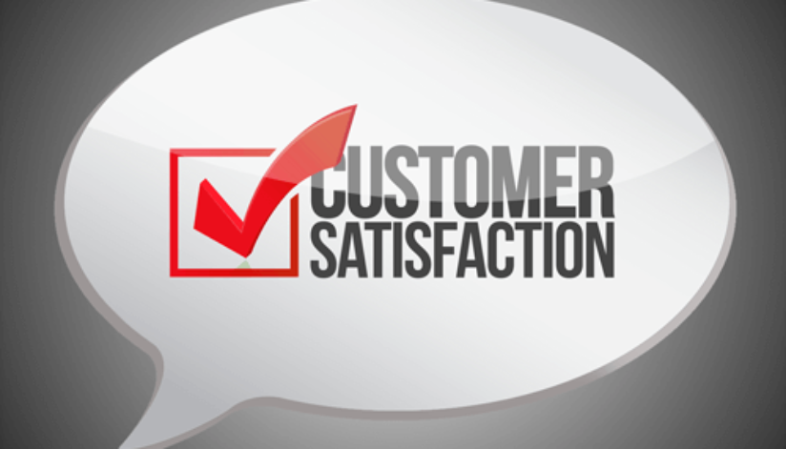
Demanding or Domineering Customers
By being thoroughly familiar with your organization’s policies and procedures and your limits of authority, you will be prepared to negotiate with demanding customers.
If they want something your cannot provide, you might offer an alternative that will satisfy them.
Your goal is complete customer satisfaction but not at the expense or excessive loss to your organization.

Slide 20
Indecisive Customers
You will encounter people who cannot or will not make a decision. In some instances, this may be a result of their behavioral style or it might be due to something in their background from which they learned such behavior.
Such customers sometimes spend long periods vacillating between several options as they seemingly struggle to choose one over the other. They might even leave and come back later to continue their decision-making efforts. Sometimes, they will even bring someone along to help facilitate a decision.

Slide 21
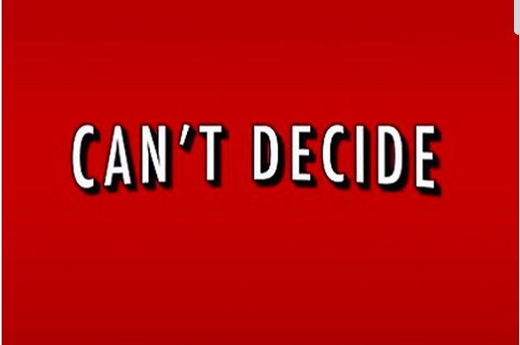
Indecisive Customers
In some cases, indecisive customers truly do not know what they want or need, as when they are looking for a gift for a special occasion.
In other instances, such customers are afraid that they will choose incorrectly or need reassurance that the product has the features they really need or will use later.
In the latter situation, use all your product or service knowledge and communication skills to provide them with the information they need to make a buying decision. Otherwise, indecisive customers will occupy your time and detract from your ability to do your job effectively or assist customers.

Slide 22
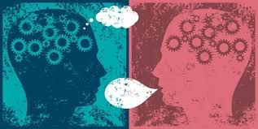
Indecisive Customer
An important point to keep in mind is that some people really are just looking or researching a product or service as they check out sales, kill time between appointments, or relax, or they may simply be lonely and want to be around others.
Strategies for dealing with an indecisive person are:
Be Patient
Ask Open-Ended Questions
Listen Actively
Suggest Other Options
Guide Decision-Making

Slide 23
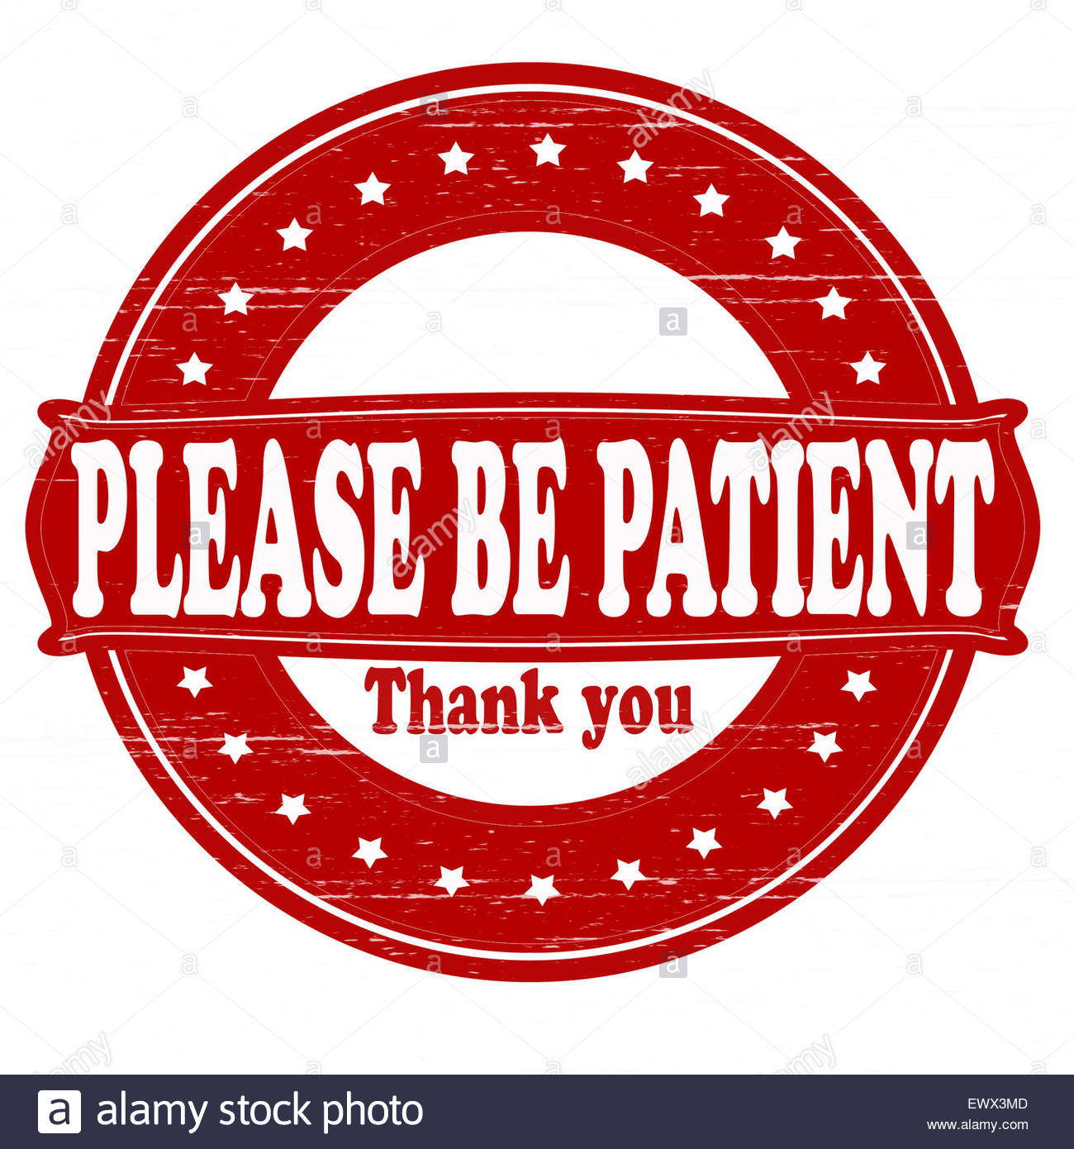
1. Be Patient
Do not forget that although indecisive people can be frustrating, especially if you have a high decisive “D” behavioral style preference and get impatient easily, they are still customers.

Slide 24
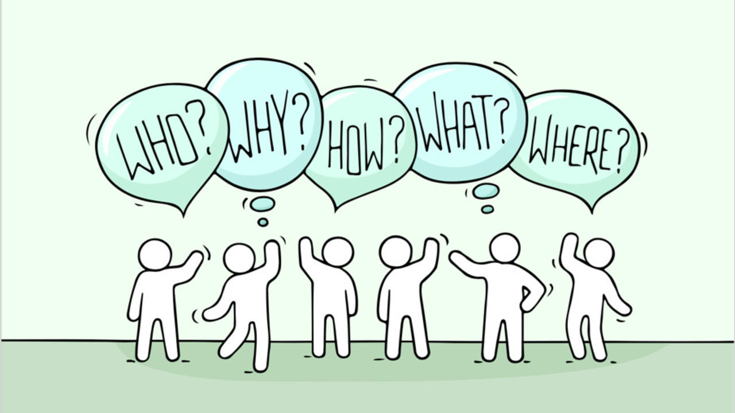
2. Ask Open-End Questions
Just as you would do with a dissatisfied customer, try to get as much background information about the customer’s likes, needs, wants, and expectations as possible.
The more data you can gather, the easier it is for you to evaluate the situation, determine needs, and assist in the solution of any problems.

Slide 25
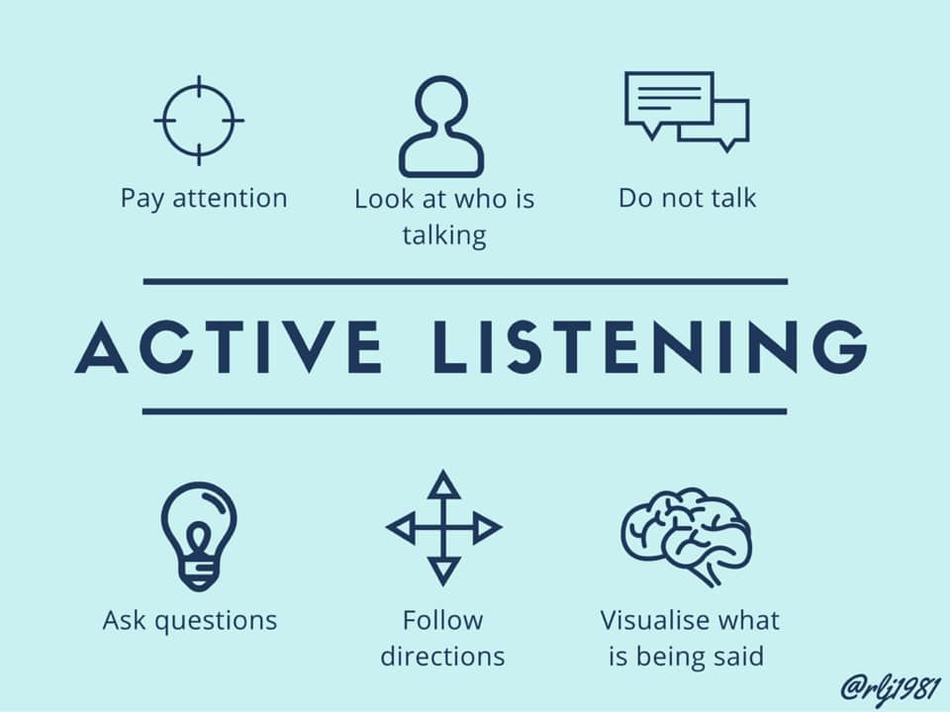
3. Listen Actively
Focus on customer verbal and nonverbal messages for clues to determine emotions, concerns, and interests.
Watch for reaction when you show them a new item or make a suggestion.

Slide 26
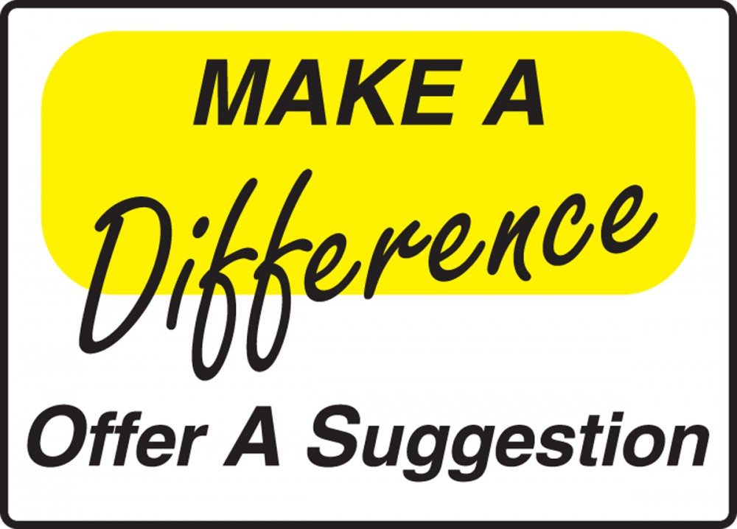
4. Suggest Other Options
Offer alternatives that will help in decision-making and reduce the customer’s anxiety.
Pointing out warranty or exchange options available on a product or service may make the customer more secure in the decision-making process.

Slide 27
5. Guide Decision-Making
By assertively, not aggressively, offering suggestions or ideas and providing product and/or service information, you can help guide customers to a decision.
Try giving examples of how you or others have purchased or used products or services being considered, and the satisfaction received.
Remember that you are helping them, not making the decision for them. If you push your preferences on them, they may be dissatisfied later or have “buyer’s remorse.”

Slide 28
Dissatisfied and Angry Customers
You will encounter dissatisfied customers or angry ones.
They may feel that the treatment being received is unfair, that you or someone else is lying to or taking advantage of them, or that they are not getting the service they want or expect.
Possibly, you or one of your peers, or a competitor, improperly served them in the past, and they now have a preconceived idea about anyone who is in the sales or service profession.
The challenge is that in instances where you encounter a dissatisfied or angry customer, you represent the organization or you may be considered “just like that last service employee.”
You have to try to calm these customers and make them happy.

Slide 29
Dissatisfied and Angry Customers
In order to satisfy customers, try the following strategies:
1. Listen
With an open mind to discover the basis for their anger or dissatisfaction.
2. Remain Positive and Flexible
While showing a willingness to work with the customer or negotiate.
3. Smile, Give Your Name, and Offer Assistance
By projecting a “can do” attitude and lowering defenses.
By doing so, you can potentially get the customer to do likewise and salvage the situation and customer-provider relationship.

Slide 30
Dissatisfied and Angry Customers
In order to satisfy customers, try the following strategies:
4. Be Compassionate and Empathize without Making Excuses
Angry or dissatisfied customers typically want and expect that you will try to see their side of the situation and will make concessions. This does not mean that you should bow to them if the situation was not your fault or that of your organization. It does mean that you should try to understand their position and bring them back to a point where you can negotiate & resolve the issue.

Slide 31
Dissatisfied and Angry Customers
In order to satisfy customers, try the following strategies:
5. Ask Open-End Questions and Verify Information
That allows your customers to talk and vent while providing the degree of information needed to identify what went wrong and offer potential solutions. The only way to start to resolve the issue is to find out what caused it in the first place.
6. Take Appropriate Action
Once you have gotten the customer to lower their emotions to the point where you can intelligently discuss the situation, you will be on your way to a solution. If you know your organization’s policies and procedures and are knowledgeable of products and services, you have the tools to potentially get relationship back on track and resolve the issue.

Slide 32
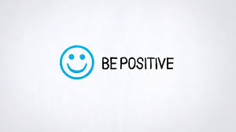
Dissatisfied and Angry Customers
Remember that if you get defensive, you become part of the problem and not part of the solution.
By maintaining a positive approach and using positive language, you are more likely to bring about a successful outcome when dealing with an angry or dissatisfied person.

Slide 33
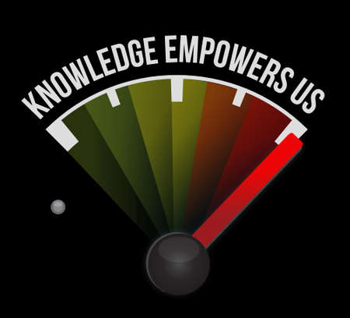
Dissatisfied and Angry Customers
To effectively serve an angry customer, you must move beyond the emotions to discover the reason for their anger.
Before dealing with customers, check with your supervisor to find out what your policies are and what level of authority you have in making decisions. This relates to EE empowerment.
By having this information before interacting with a customer, you will have the tools and knowledge necessary to handle your customers effectively and professionally.

Slide 34
Dissatisfied and Angry Customers
The following are resolution strategies when dealing with an angry customer.
1. Be Positive
Tell the customer what you can do rather than what you cannot.
2. Acknowledge the Customer’s Feelings or Anger
By taking this approach, you have addressed the customer’s emotional state, demonstrated a willingness to assist, and encouraged the customer to participate in solving the problem.
3. Reassure
Indicate that you understand why they are angry and that you will work to solve the problems.
4. Remain Objective
In most instances, angry customers are usually upset with the organization, product, or service that you represent, not you.

Slide 35
Dissatisfied and Angry Customers
The following are resolution strategies when dealing with an angry customer (cont.).
5. Listen Actively; Determine the Cause
Whether the customer is “right” or “wrong” makes no difference this situation. Actively listening and trying to discover the problem w/out attempting to place blame will assure customer that you are trying to take care of things.
6. Reduce Frustrations
Do not say or do anything that will create further tension. Do your best to handle the situation with this customer before serving another.
7. Negotiate a Solution
Elicit ideas or negotiate an alternative with the customer. Be willing to compromise, if appropriate, needed, and possible.
8. Conduct a Follow-Up
Contact your customer as soon as possible after your attempted resolution in order to show the customer that you are truly concerned that the issue was correctly resolved and that you value the relationship with them.

Slide 36
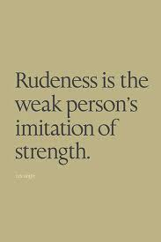
Rude or Inconsiderate Customers
Some people seem to go out of their way to be offensive or to get attention.
Although they seem confident and self-assured outwardly, they are often insecure and defensive. Some behaviors that they might exhibit include:
Raising their voice
Demanding to speak to a supervisor
Using profanity
Cutting in front of someone else in the line
Being verbally abrupt
Otherwise going out of their way to be offensive or in control

Slide 37
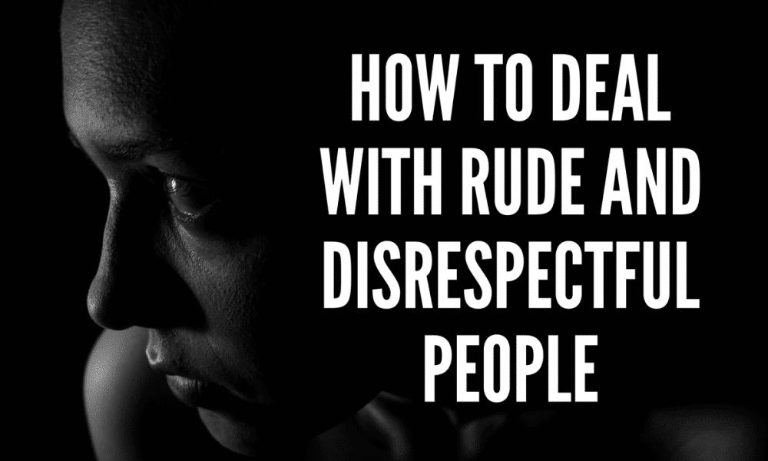
Rude or Inconsiderate Customers
The following are strategies for dealing with rude or inconsiderate customers:
1. Remain Professional
Just because the customer exhibits inappropriate behavior does not justify your reacting in kind. Remain calm, assertive, and in control of the situation. By maintaining decorum you may win over the person or at least keep him or her in check.
2. Do Not Resort to Retaliation
Retaliation will only infuriate this type of customer, especially if you embarrass them in the presence of others. Remember, that such people are still customers, and if they or someone else perceive your actions as inappropriate, you could lose even more.

Slide 38
Talkative Customers
Some people phone or approach you and then spend excessive amounts of time discussing irrelevant matters such as personal experiences, family, friends, schooling, accomplishments, other service situations, and the weather.
1. Remain Warm and Cordial, but Focused
Recognize that this person’s personality style is probably mainly expressive and their natural inclination is to connect with others. You can smile, acknowledge comments, and carry on a brief conversation as you are serving the customer.
2. Ask Specific Open-End Questions
These types of questions can assist in determining needs and addressing customer concerns.

Slide 39
Talkative Customers
Continued:
3. Use Closed-End Questions to Control
Once you have determined the customer’s needs, switch to close-end questions to better control the situation and limit the opportunity for the customer to continue talking.
4. Manage the conversation
Keep in mind that if you spend a lot of time with one customer, other customers may feel neglected. You can manage customer encounters through questioning and through statements that let the customer know your objective is to serve customers. You might say, “If you have no further questions, have a great day.”

Slide 40
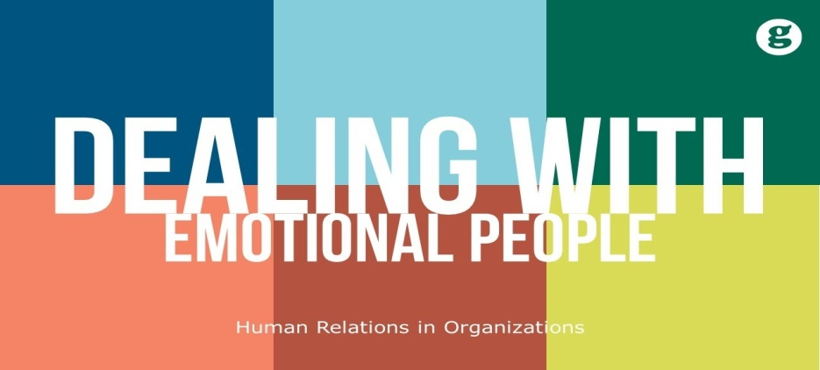
Handling Emotions with the Emotion-Reducing Model
Using the emotion-reducing model helps to calm the customer so that you can then solve the problem.
It is important to remember when dealing with people who are behaving emotionally (i.e. irritated, angry, upset, crying, etc.) that they are typically upset with the structure, process, organization, or other factors over which you and/or they have no control.
They are usually not upset with you (unless you have provoked them by exhibiting poor customer service skills or attitude).
Remain rational and do not react to them emotionally.

Slide 41
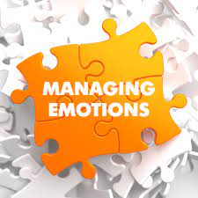
Handling Emotions with the Emotion-Reducing Model
Before you can get the customer to calm down, listen, and address the situation, you must first deal with their emotional state.
Once you do this, you can proceed to use problem-solving strategies discussed later in this chapter.
A customer will likely not be receptive to what you are saying or your attempts to assist until you reduce their emotional level.
Sometimes, they may even become irritated if you seem uncaring.

Slide 42
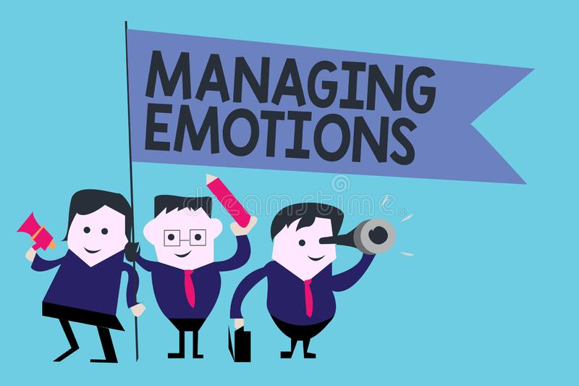
Handling Emotions with the Emotion-Reducing Model
To help calm the customer down, you must send customer-focused verbal and nonverbal messages.
Demonstrate patience and use positive communication skills such as properly phrased verbal messages and questions, effective nonverbal cues, and active listening skills. Most important among those skills are the ability and willingness to listen calmly to whatever the customer has to say without interrupting or interjecting your views.
This approach often helps prevent situations from escalating.
The customer must feel that their emotions were not disregarded.

Slide 43
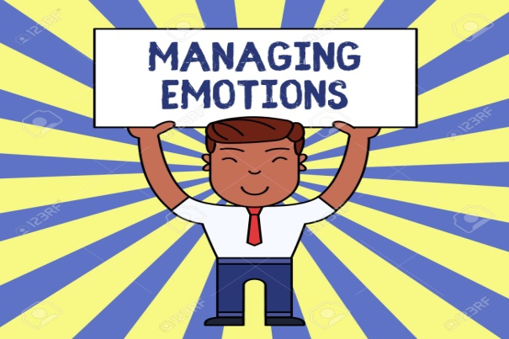
Handling Emotions with the Emotion-Reducing Model
A customer generally wants to be respected and acknowledged as an individual and as being important.
As you interact with a customer, you can soften the situation and reduce emotion by providing customer-focused responses.
Simple messages can put you on a friendly (human) level while at the same time helping to calm the situation.
(x), “Mrs. Smith, I can appreciate why you are frustrated about the service, and it seems we did make an error on your order and I sincerely apologize for that. You are important to us, and I will do my best to try and resolve the situation.”

Slide 44
Handling Emotions with the Emotion-Reducing Model
The key to helping resolve any service breakdowns is to frame your problem resolution with customer-focused messages through use of the Emotion-Reducing Model:
Customer-Focused Message
Emotional Issue
Customer-Focused Message
Problem Solving
Customer-Focused Message

Slide 45
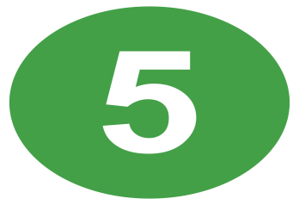
Emotion-Reducing Model
Here is how the five steps of the emotion-reducing model are implemented:
Assume a customer has a problem. As the customer approaches (or when you answer the telephone), greet them with “Good morning (or afternoon),” a smile, and open body language and gesturing (1. customer-focused message). Then, as the customer explains the issue (2. emotional issue), you can offer statements such as, “I see and understand how that can feel” (3. customer-focused message). Such statements can help you connect psychologically with the customer. Continue to use positive reinforcement - communication throughout your interaction. Once you define the problem and resolve it (4. problem solving), take one more opportunity at the end of your interaction to send a customer-focused message by smiling and thanking the customer for allowing you to assist. In addition, one last apology may be appropriate for inconvenience, frustration, mistreatment, and so on (5. customer-focused message).

Slide 46
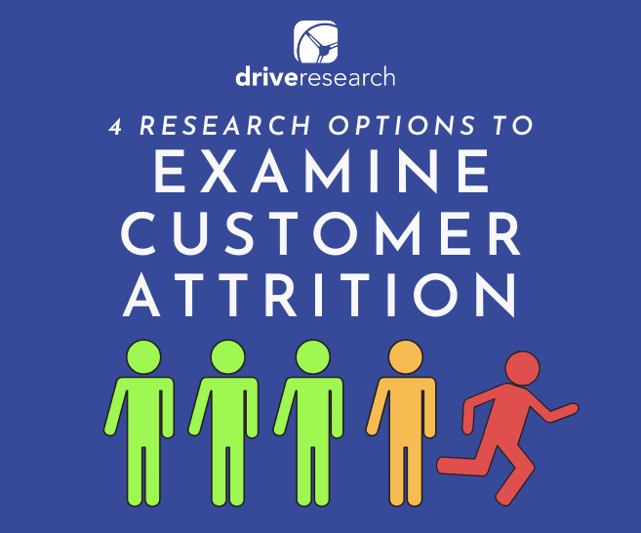
Reasons for Customer Defection
Failing to meet customer’s needs, handling problem inefficiently, treating the customer unfairly, and using inadequate systems are reasons for the customer to leave you and go elsewhere.
Following a service breakdown, there is often a possibility that you may never see the customer again. This is potentially disastrous to your organization because it costs five to six times as much to win a new customer as it costs to retain one. Moreover, a dissatisfied customer will tell others the bad news.
Thus, you and your organization must be especially careful to identify reasons for customer defection and remedy the problems.

Slide 47
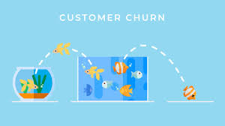
Reasons for Customer Defection
So often, service providers make the mistake of trying to project their personal needs onto others.
However, today’s diverse world requires you to be more knowledgeable and accepting of the ideas, values, beliefs, and needs of others. Failure to be sensitive to diversity may set you, your organization and the customers on a collision course.
Never lose sight of the fact that establishing and maintaining trust is crucial in sustaining customer-provider relationships.

Slide 48
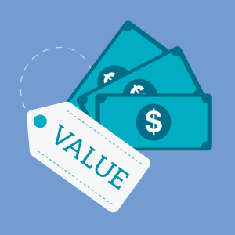
Four Reasons for Customer Defection
1. Price
Customers are often willing to switch product and service providers because of pricing.
If prices increase or they perceive that they are not getting value for what they pay, then a move to another provider often occurs.
You may not be able to do much about prices set by organization, but you can counter customer comments regarding costs.
By being aware of what competitors charge for the same or similar products and services, you can help educate customers on value.
A convincing argument relates to the quality of service that your organization provides.

Slide 49
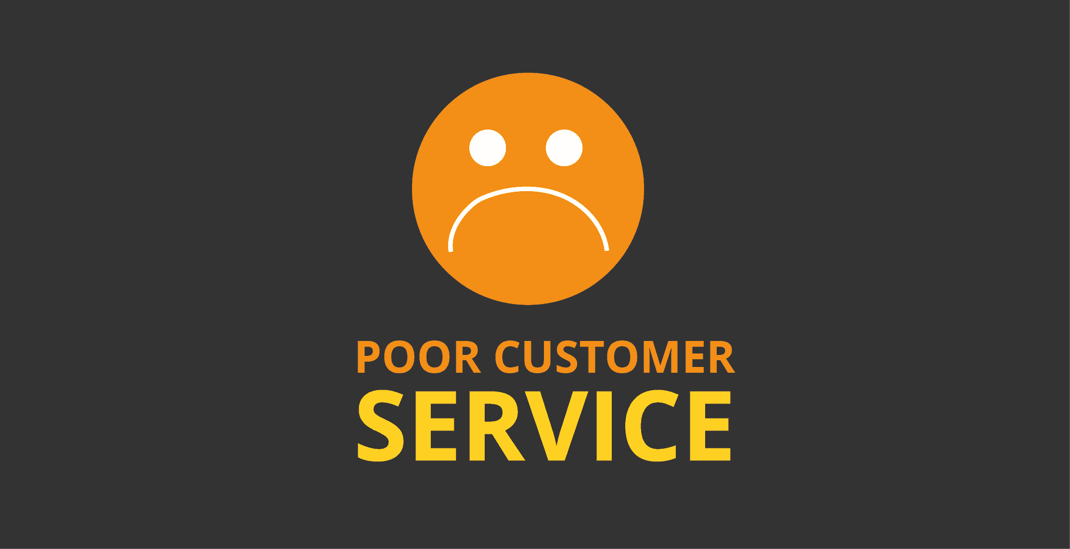
Four Reasons for Customer Defection
2. Poor Service and Complacency
If a concern is important enough for the customer to verbalize (formally or informally) or to write down, it is important enough for you to take seriously.
If customers perceive that you and/or your organization do not sincerely care about them or about solving their problems, they may go elsewhere. You should immediately address any identified problem by listening, gathering information, and taking appropriate action.
Sometimes the obvious solutions are the ones that are overlooked, so be perceptive when dealing with customers and look for little clues that could mean the difference in satisfaction and continued business.

Slide 50
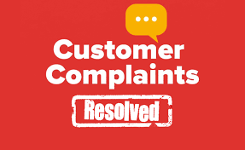
Four Reasons for Customer Defection
3. Inappropriate Complaint Resolution
The key thing to remember about complaint resolution is that it is the customer’s perception of the situation, not yours, that counts. If customers believe that they are not treated fairly, honestly, in a timely manner, and in an appropriate fashion, or if they are still dissatisfied, your efforts failed.
Remember that only a small percentage of customers complain. Second attempts at resolution are critical.

Slide 51
Four Reasons for Customer Defection
4. Unmet Needs
Customers have very specific needs to which you must attend. Failure to address or satisfy customer needs will likely cause customers to seek an alternative source of fulfillment.
By using effective communication strategies, you can work with customers to identify their expectations and begin to meet them.

Slide 52
Working with Internal Customers
Relationships with your internal customers are important. You should meet your commitments and build a professional reputation.
If you are a service provider, you have external customers who purchase or use your products or services. In addition to these external customers or organizations, if you are a service provider and work in any type of organization that has more than one EE, you also have to deal with internal customers.
The bottom line is that, if you give information, products, or services to another person or entity (i.e. team, department, div.), you are a service provider and have customers. If you receive information, products, or services from another person or entity, you are a customer to them.

Slide 53
Working with Internal Customers
Although your interactions with internal customers may not be difficult, they can often be more sensitive than your dealings with outsiders.
This is because if someone within your organization becomes irritated or dissatisfied with you, they do not necessarily go away. Instead, they might tell coworkers or your supervisor about the encounter, which can damage your reputation and even put your standing in the organization in jeopardy.
The customer might also withdraw, which means that you might lose access to knowledge, information, or support that you need.

Slide 54
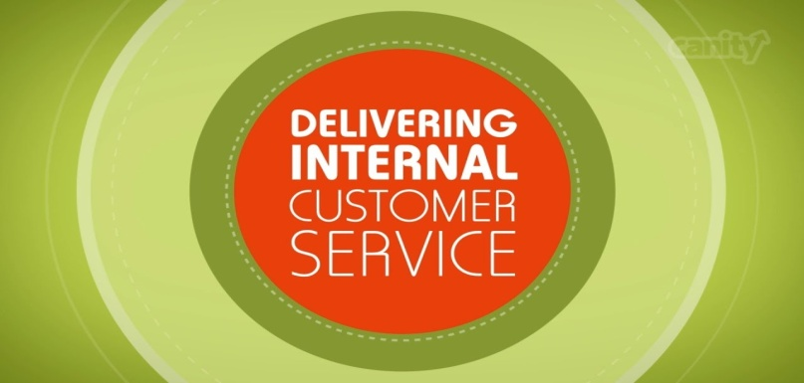
Working with Internal Customers
The importance of effective internal customer service cannot be underestimated. That is because your relationships with individuals and departments within your organization have far-reaching effects on the organization.
Sound internal customer service practices can help to boost EE communication and morale while helping to enhance processes and procedures, reduce costs, increase productivity, and replace interdepartmental competition with cooperation.
Through such internal collaboration, external customer service improves because EEs have access to information and services needed to better serve external customers.

Slide 55
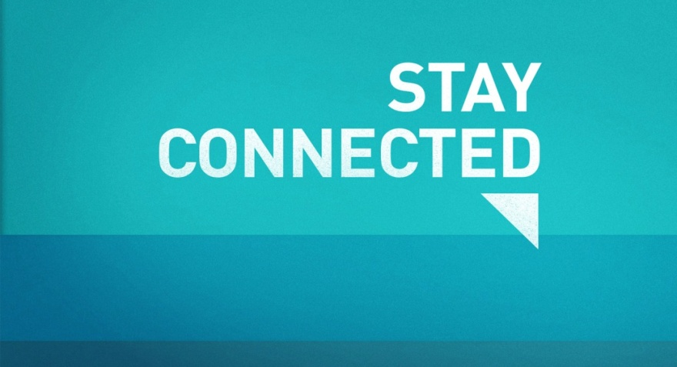
Stay Connected
Since relationships within the organization are so important, go out of your way to contact internal customers regularly. You can do this by dropping by their work area to say “hello,” sending an e-mail, texting, or leaving a voice mail message.
If you know of a special occasion for a coworker (i.e. birthday) consider sending a card or e-mail to celebrate them.
This helps strengthen relationship and can keep door to communication open so if the service does break down someday, you will have a better chance of resolution.

Slide 56
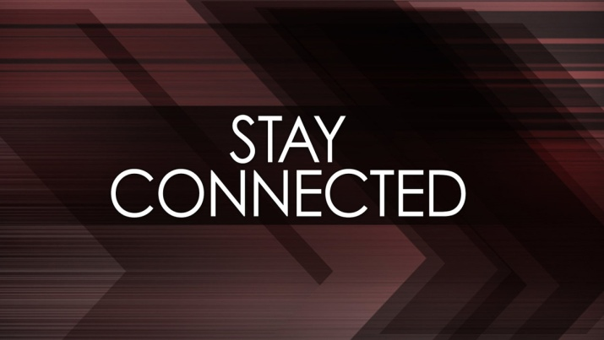
Stay Connected
You might describe your departmental or team coworkers as your “normal” internal customers.
However, don’t forget the importance of relationships with other organizational employees, such as the cleaning crew (they service your office and work area), security force (they protect you, your organization, and your vehicle), support staff (who provide services like purchasing, payroll, travel, mail, printing, etc.), and the info- technology staff (they maintain your computer equipment).
All these groups or individuals and many others within the organization add value and might be a big help to you at some point.

Slide 57
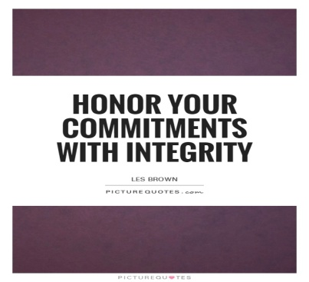
Meet All Commitments
Service providers forget the importance of internal customers. Because of familiarity, they sometimes become lax and fail to give the same degree of attention to internal customers that they give to external customers.
Do not forget that if you depend on internal suppliers for materials, products, or information, these people can negatively affect your ability to serve external customers by delaying or withholding the items you need. Your external customer could suffer and your reputation and that of the organization are on the line.
To prevent, or at least reduce, the possibility of such breakdowns, honor all commitments you make to internal customers.
If you promise to do something…do it, and get it done on time.

Slide 58
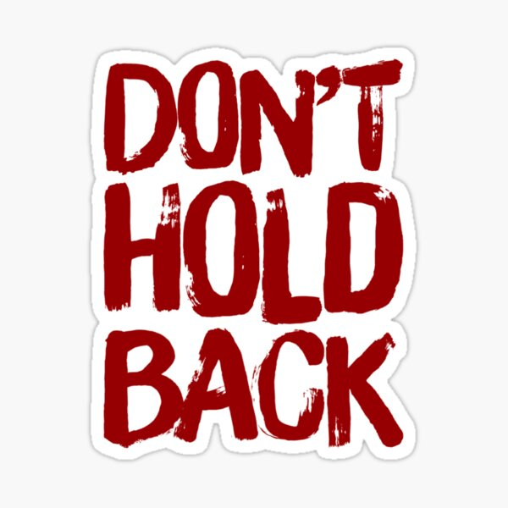
Do Not Sit On Your Emotions
Some people hold on to anger, frustration, and other negative emotions rather than getting their feelings out into the open and dealing with them. Not only is this potentially damaging to health, for it might cause stress-related illnesses, but it can destroy working relationships.
Whenever something goes wrong or someone troubles you, go to the person and use feedback skills to talk about the situation. Failure to do so can result in disgruntled internal customers, damage to the customer-supplier relationship, and damage to your reputation.
You will likely have to continue to rely on your customers in the future, so you cannot afford a relationship problem.

Slide 59
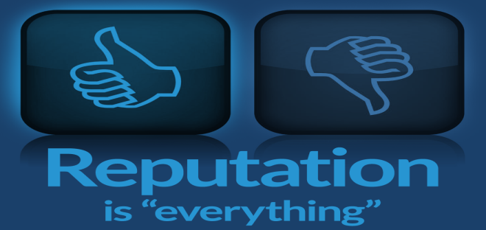
Build a Professional Reputation
Through your words and actions, go out of your way to let your customer and your supervisor know that you have a positive, can-do, customer-focused attitude. Let them know that you will do whatever it takes to create and environment in which internal and external customers are important.
Part of projecting a professional image is to demonstrate your commitment to proactive service regularly.
This means gathering information, products, and other tools before engaging with a customer so that you are prepared to deal with a variety of situations and people. It also means doing the unexpected for people and providing exceptional customer service to all customers.

Slide 60
Adopt a Good-Neighbor Policy
Take a proactive approach to building internal relationships so that you can head off negative situations.
If your internal customers are in your department, act in a manner that preserves sound working relationships. You can accomplish this in part by adopting the following work habits:
Avoid large gatherings and loud conversation in your workspace.
Maintain good grooming and hygiene habits.
Do not overdo call forwarding.
Avoid unloading personal problems.
Avoid office politics and gossip.
Pitch in to help.
Maintain a clean, organized work area.
Be truthful.

Slide 61
Strategies for Preventing Dissatisfaction and Problem Solving
Focusing on the customers’ needs and seeking ways to satisfy them quickly while exceeding customer expectations are ways to prevent dissatisfaction.

Slide 62
Strategies for Preventing Dissatisfaction and Problem Solving
The best way to deal with a service breakdown is to prevent it from happening. The following are some specific strategies for preventing dissatisfaction.
Make Positive Initial Contact
Think Like the Customer
Pamper the Customer
Respect the Customer
Exceed Expectations

Slide 63
1. Make Positive Initial Contact
First impressions are crucial and often lasting. To ensure that you put your best effort forward, remember the basics of positive verbal and nonverbal communication – giving a professional salutation, projecting a positive attitude, and sincerely offering to assist.
This is crucial because the average customer will come into an initial contact with certain expectations. If the expectations are not met, you and your organization can lose relationship-rating points that can ultimately cost the org. customers.

Slide 64
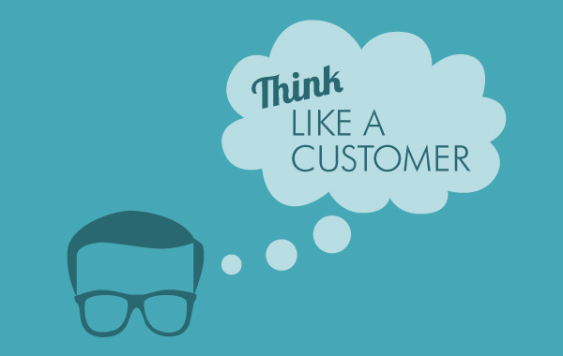
2. Think Like the Customer
In order to be successful in serving customers, research and learn to use interactive communication techniques. Once you have mastered them, set out to discover what customers want by observing nonverbal behavior, asking specific questions, and listening to their comments and responses.
Learn to listen for their unspoken and verbalized needs, concerns, and questions. Think about the manner in which you want to be served under conditions you are dealing with and act accordingly.
Ask what your customers want in order to ensure your assumptions about service are correct.

Slide 65
3. Pamper the Customer
You do not have to give into a customer’s every whim and request, but you should certainly attempt to provide the best quality of service that you can deliver, and address the customer’s concerns quickly and professionally.
Make customers feel special & important. To help accomplish this, do the unexpected, and take any extra effort necessary to meet and exceed their needs and expectations.
Even if you cannot satisfy all their wishes, if you are positive and enthusiastic and show initiative, customers might walk away feeling good about the encounter.

Slide 66
4. Respect the Customer
Respect is a basic value that most people expect and in some cases demand.
To show respect, you have to demonstrate that you care about, listen to, and are concerned for your customers and their well-being. Additionally, you must show that they are important to you and the organization and that you appreciate them and value their business.
When problems arise, you can show your respect by actively listening to your customers and empathizing with them. This means that before you can begin focusing on your customers’ problems, you have to take the time to try to understand their concerns and demonstrate that you support the customer’s viewpoint.

Slide 67
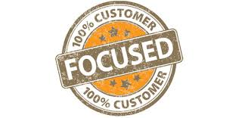
4. Respect the Customer
Look at complaints as a favor from your customer.
Most dissatisfied customers leave without telling you why. They then express their displeasure to others and online.

Slide 68
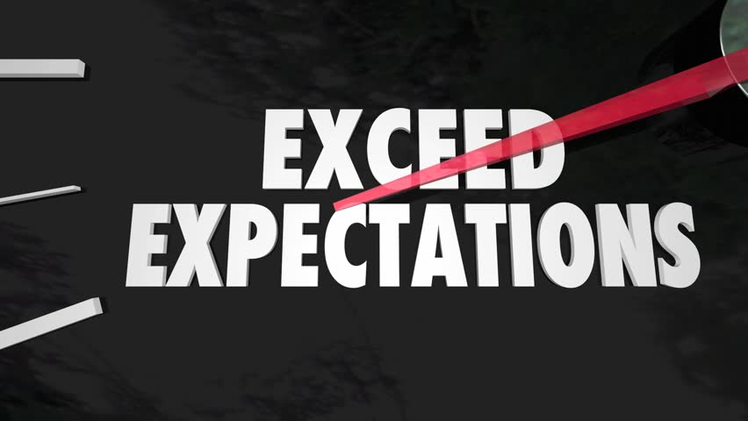
5. Exceed Expectations
Go the extra mile by giving customers exemplary service. Strive to get the highest rating possible on the relationship-rating point scale.
Work hard to understand what customer wants and expects. Observe customers, monitor trends, and talk to customers. Constantly look for opportunities to exceed customer expectations and beat your competitors.
Provide service faster, better, and more efficient than others.
Do things for your customers that set your service attitude apart from that of other providers.

Slide 69
Thank Your Customer for the Opportunity
When a customer takes the time to share a concern, complaint, or question, thank them for giving you an opportunity to correct a problem area and then take the following 5 actions:
React to Remarks or Actions
Let customer know they are heard.
Empathize
Let customers know you are concerned and understand.
Take Action
Get agreement from customer on plan of action.
Reassure or Reaffirm
Let customer know you have best interest.
Follow Up
Be sure to begin action steps and fulfill promises.

Slide 70
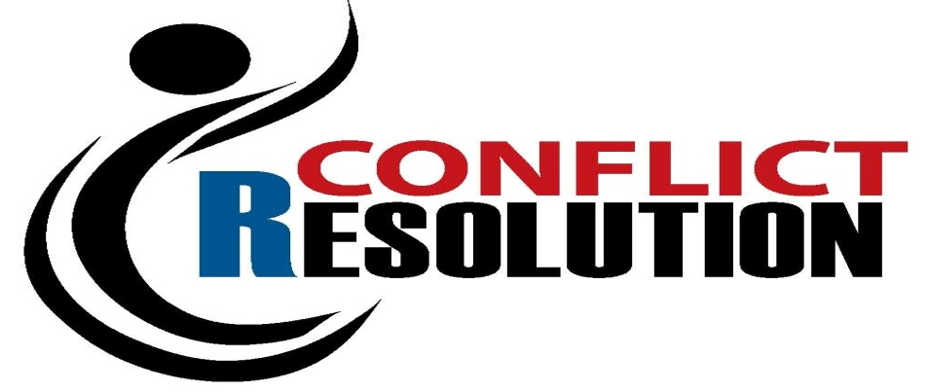
Responding to Conflict
Conflict should be viewed as neither positive nor negative. Instead, it is an opportunity to identify differences that may need to be addressed when dealing with your customers.
It is not unusual for you to experience conflict when dealing with someone else. In fact, it is normal and beneficial as long as you stay focused on the issue rather than personalizing and internalizing the conflict.
When you focus on the individual, or vice versa, conflict can escalate and ultimately do irreparable damage to the relationship.

Slide 71
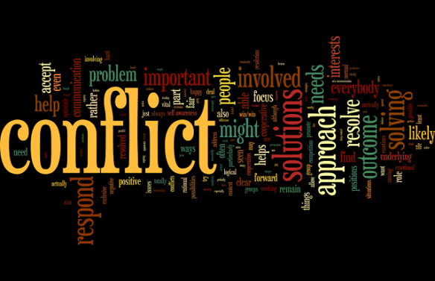
Causes of Conflict
There are many causes of conflict. The following are some common ones:
1. Conflicting Values and Beliefs
These sometimes create situations in which the perceptions of an issue or its impact vary.
2. Personal Style Differences
Each person is different and requires special consideration and a unique approach to interactions.
3. Differing Perceptions
People often witness or view an incident or issue differently. This can cause disagreement, frustration, and a multitude of other emotional feelings.

Slide 72
Causes of Conflict
There are many causes of conflict. The following are some common ones:
4. Inadequate or Poor Communication
Anytime there is inadequate communication the chance for conflict escalates.
5. Contrary Expectations
When one party expects something not provided by another, conflict will likely result.
6. Goals Out of Sync with Reality
Frustration and resentment can result from misaligned efforts.

Slide 73
Causes of Conflict
There are many causes of conflict. The following are some common ones:
7. Competition for Shared Resources
When two people or groups vie for the same resources, conflict usually results.
8. Outcomes Dependent on Others
Whenever you have two or more people, departments, teams, or organizations working jointly toward goal attainment, the potential for conflict exists.
9. Misuse of Power
Resentment, frustration, and retaliation often result when EEs believe that their supervisor is abusing their authority or power.

Slide 74
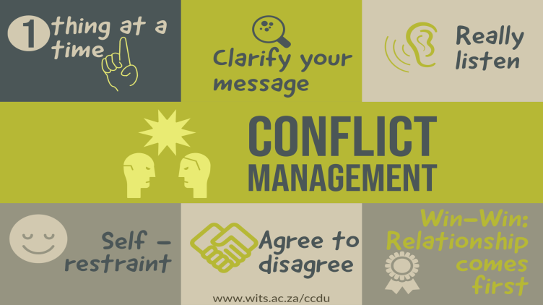
Guidelines for Effective Conflict Management
Even though each situation and person you deal with will differ, there are some basic approaches that may help in resolution of disagreements.
Remain Calm
Be Proactive in Avoiding Conflict
Keep an Open Mind
Identify and Confront Underlying Issues Immediately
Clarify Communication
Stress Cooperation Rather Than Competition
Focus Resolution Efforts on the Issues

Slide 75
Salvaging Relationships After Conflict
Managing conflict involves more than just resolving the disagreement. If you fail to address emotional and psychological needs of those involved, you may find conflict returning and/or severe damage to the customer-provider relationship may occur.
Often poorly handled service recovery efforts result in such things as complaints to a service provider’s supervisor or consumer agencies, bad word-of-mouth publicity, and lost customers.
Depending on the severity of the conflict and how you handle it at each step of the resolution process, it may be impossible to go back to the relationship as it was before the disagreement. The key to reducing this possibility is to identify and address conflicting issues as early as possible and make the effort needed to protect-salvage the relationship.

Slide 76
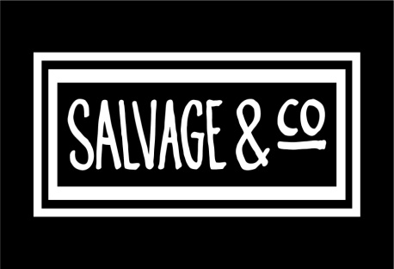
Salvaging Relationships After Conflict
The following strategies can assist in service recovery efforts:
1. Reaffirm the Value of the Relationship
You cannot assume that others feel the same as you or understand your intent unless you communicate it. Apologize sincerely and tell them how much you value the relationship between them and the organization. Also, stress that your goal is to assist them in whatever manner possible.
2. Demonstrate Commitment
You must verbalize and demonstrate your desire to continue or strengthen your relationship. The way to do this with customers is through sound interpersonal communication efforts. Once you have smoothed things over a bit emotionally with the customer, take definitive action to address the service or product breakdown.

Slide 77
Salvaging Relationships After Conflict
The following strategies can assist in service recovery efforts:
3. Be Realistic
Because of cultural, gender, generational, and behavioral style differences, it is difficult for some people to “forgive and forget.” You have to help restore their trust systematically.
4. Remain Flexible
A solid customer-provider relationship involves the ability to give and take. It is especially crucial that you and the other people involved make concessions following conflict.
5. Keep Communication Open
One of the biggest cause of conflict and destroyed relationships is poor communication. Recognize and soothe emotions. Be willing to compromise and let the customer take the lead in discussion.

Slide 78
Salvaging Relationships After Conflict
The following strategies can assist in service recovery efforts:
6. Gain Commitment
You cannot do it all by yourself. Get a commitment to work toward reconciliation from any other person(s) involved. Also, once they relax a bit and seem to be more receptive to listening to your suggestions, reaffirm that you have acted in a manner to resolve the issue to their satisfaction. Let them know that your goal is to help them as best you can.
7. Monitor Progress
Do not assume that, because the conflict or problem was resolved, it will remain that way. Deep-seated issues often resurface, especially when you do not obtain commitment from the other party. Be sure to follow-up shortly afterward to ensure that a spark does not rekindle into a blazing fire in their mind.

Slide 79
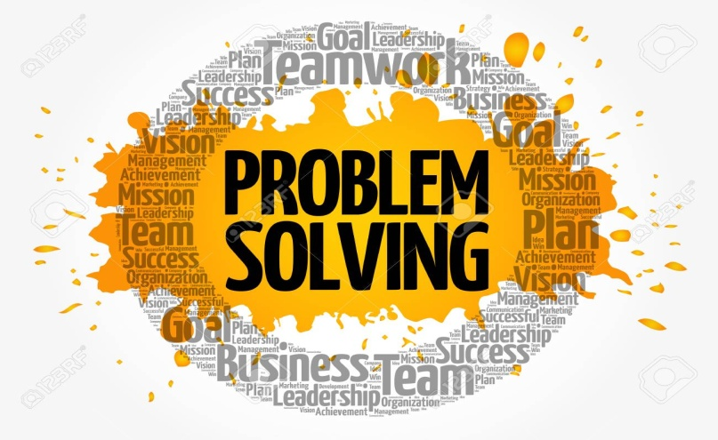
The Problem-Solving Process
Before you begin to solve a customer’s problem, consider the fact that they may not really want you to “solve the problem.” In some cases, a person simply wants to vent frustration or be heard.
This is where empathetic listening – where you actively listen for messages being sent by the customer and then respond with statements such as, “I can appreciate your frustration,” and “I understand why you feel that way,” will come in handy.

Slide 80
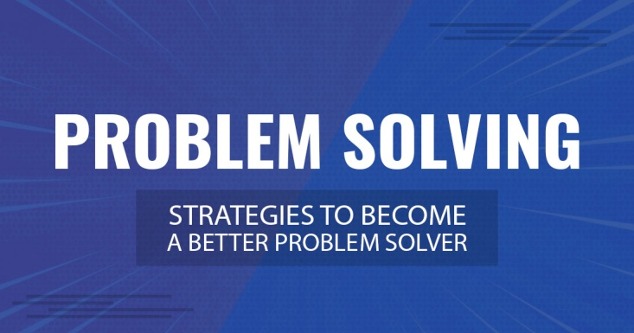
The Problem-Solving Process
In many cases, your customer will often have a solution in mind when they call you. Your role may be to simply listen and offer to facilitate the implementation of the suggested solution.
In some situations, you may have to “plant a seed” of possible solution by asking an open-end question that suggests your recommended approach. If the customer takes your “seed” and nourishes it, you end up with an outcome for which they feel ownership, yet is actually one that you thought is best.
If you jointly solve a problem, the customer often feels ownership for the solution – they made the decision, and this leads to customer satisfaction.

Slide 81
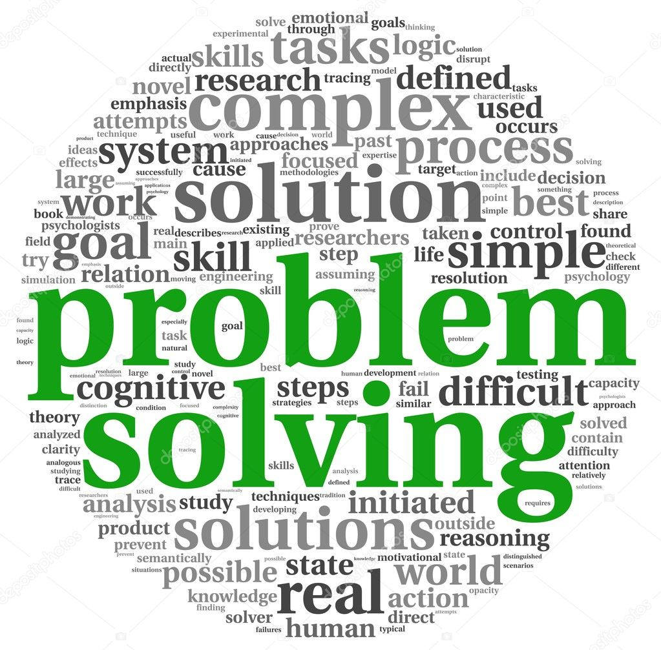
The Problem-Solving Process
To solve a problem, you need to first identify the cause and result of the issue and determine if it needs to be solved.
Once you decide to solve the problem, follow the six proven steps to problem solving:
Identify the Problem
Compile and Analyze the Data
Identify the Alternatives
Evaluate the Alternatives
Make a Decision
Monitor the Results

Slide 82
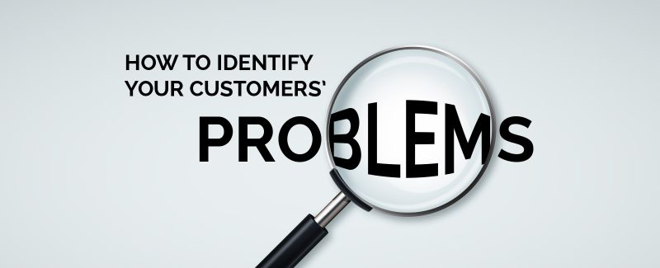
1. Identify the Problem
Before you can decide on a course of action, you must first know the nature and scope of the issue you are facing.
The customer may not know how to explain their problem well. In such cases, it is up to you to do a little detective work and ask questions or review available information.
To learn as much about the issue as you can, start by speaking directly to the customer, when possible. Collect any documentation or other background information available.

Slide 83
1. Identify the Problem
Begin your journey into problem solving by apologizing for any inconvenience caused by your or your organization.
Take responsibility for the problem or concern, even if you did not actually cause it. Remember that you represent the organization to the customer. In that role, you are “chosen” to be responsible. Do not point fingers at others, policies or procedures, or other factors.
It is important to let the customer know that you are sincerely remorseful (on behalf of the organization) and that you will do whatever possible to resolve the issue quickly and effectively.

Slide 84
2. Compile and Analyze the Data
To effectively determine a course of action, you need as much information as possible and thorough understanding of what you are dealing with.
Getting that data requires active listening and investigative work.
You may need to collect information from a variety of sources, such as sales receipts, correspondence, the customer, public records, coworkers, organizational files, and the manufacturer.
In gathering data, you should also do a quick assessment of the seriousness of the problem. Look for patterns or trends in complaints received. Ask for opinions from others.

Slide 85
3. Identify the Alternatives
Let customers know that you are willing to work with them to find an acceptable issue resolution. Tell them what you can do, gain agreement, and then set about taking action.
You have an advantage when a customer notifies you of a problem or their dissatisfaction. You can offer an objective, outside perspective. In effect, you are performing as an outside consultant. Use this outside vantage point to offer suggestions or viewpoints that the customer may not see or has overlooked. Additionally, make sure you consider various possibilities and alternatives when thinking about potential resolutions.

Slide 86
3. Identify the Alternatives
Look out for the best interests of your customer and your organization throughout the problem-solving process.
Be willing to listen to customer suggestions and think “outside the box” for ideas other than the ones that you and your organization typically use.
Do not opt for convenience at the risk of customer satisfaction.
If necessary, seek any needed approval from higher authority to access other options.

Slide 87
4. Evaluate the Alternatives
Once you have collected all the facts, look at your alternatives or possible options.
While you should certainly strive to hold down costs to your organization, be careful not to let cost be the deciding factor.
Consider the following factors in this evaluation process:
What is the most efficient way to solve this problem?
Which are the most effective options for solving this problem?
Which options are the most cost-effective?
Will the options solve the problem and satisfy the customer?
Will the selected alternative create new issues?

Slide 88
5. Make a Decision
Make a decision on what your course of action will be. To do this, ask the customer, “Which option do you prefer?”
This simple question now puts the customer into the decision-making position and they will feel empowered. It now becomes their choice, and you can potentially avoid recurring problems.
Proceed and resolve the issue if the customer’s request is reasonable and possible. If not, negotiate a different alternative.

Slide 89
6. Monitor the Results
Once you have made a decision, monitor the effect or results. Do not assume that your customer is satisfied, especially if any negotiation occurred between the two of you.
You can monitor the situation with a follow-up call, by asking if the customer needs anything else when you next speak to them, or by sending a written follow-up. Many companies now use online surveys through websites like SurveyMonkey.
If you determine that your customer is not satisfied or additional needs are present, go back to step one and start over.

Slide 90
Implementing a Service Recovery Strategy
The job of a service provider is to return the customer to a satisfied state. Not listening, poor communication, and lack of respect are roadblocks.
We make mistakes. Mistakes can appear glaring to customers, who can be very demanding and unforgiving.
The best you can hope for when something goes wrong is that you can identify the cause and remedy it quickly to satisfaction.
The primary purpose of any good service recovery program should be to return the customer-provider relationship to its normal state. If done well, a disgruntled customer can often become one who is very loyal and who acts as a publicist for the organization.

Slide 91
Implementing a Service Recovery Strategy
Some typical reasons that necessitate service recovery:
Product or service did not deliver as expected.
There was a failure to keep a promise.
A deadline was missed.
Customer service was not adequately provided.
A service provider lacked adequate knowledge or skills.
Actions taken by organization inconvenienced customer.
A customer order or request was not handled properly.
Attempt to return or exchange item was hampered by policy.
A customer was given the “runaround” or treated rudely.

Slide 92
Implementing a Service Recovery Strategy
Actually, there are numerous factors in the service process that can lead to a failure to meet customer expectations. Ultimately, they can all influence service recovery.
According to an AchieveGlobal customer survey, customers want the service they receive to be:
Seamless
Trustworthy
Attentive
Resourceful

Slide 93
Implementing a Service Recovery Strategy
There are five phases to the service recovery process:
Apologize, Apologize and Apologize Again.
Take Immediate Action
Show Compassion
Provide Compensation
Conduct Follow-up

Slide 94
1. Apologize, Apologize and Apologize Again
Showing sincere remorse throughout the recovery cycle is crucial.
Listen carefully. Empathize with the customer as they explain and do not make excuses, interrupt, or otherwise indicate that you do not have time for the customer. Demonstrate that you care for the customer and they are important to you and the organization.
An apology should come immediately after the discovery of the customer’s dissatisfaction and be delivered in person, if possible.

Slide 95
2. Take Immediate Action
As soon as your customer has identified a problem, you must set about positively resolving it.
It is crucial that you keep the customer informed of actions, barriers encountered, or successful efforts.
Even if you are unable to make a quick resolution, the customer may be satisfied if they perceive your efforts as sincere and ongoing.
You must convince customers through your actions and words that you are doing your best to solve the problem in a timely manner.

Slide 96
3. Show Compassion
To help the customer see that your remorse and desire to solve a problem are genuine, you must demonstrate empathy.
Expressions such as, “I can appreciate your frustration,” “I understand how we have inconvenienced you,” or “I can imagine how you must feel” can go a long way in soothing and winning the customer over.

Slide 97
4. Provide Compensation
Prove to customers that they are valuable and that you are trying to make up for their inconvenience or loss. This penance or symbolic self-punishment should be significant enough that the customer feels that you and your organization have suffered an equal loss.
The value or degree of your atonement should equal the customer’s loss in time, money, energy, or frustration.
Not only should the recovery compensate original loss, it should give additional value, thus “making the customer whole.”

Slide 98
5. Conduct Follow-up
Following up after service is the only way to find out whether you were successful in your recovery efforts or whether the customer is truly satisfied.
The preferable methods are face-to-face or phone call. This contact should come w/in a few days after the complaint was resolved.
This last step in the recovery process can be the deciding factor in whether the customer returns to you or your organization
This phase emphasizes the message “We truly care.”

