Slide 1
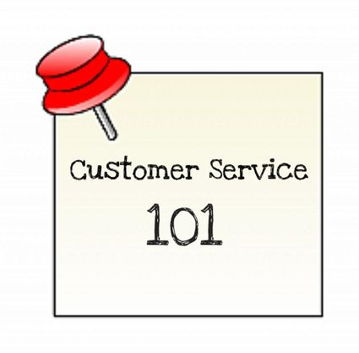
SHINE Mentor
Customer Service Management

Slide 2

Meeting Information
SHINE Mentor: Customer Service Management
  September 22nd through May 12th
    Fall: Wednesdays from 6:30 to 8:30 PM
    Spring: Thursdays from 6:30 to 8:30 PM
      SHINE Boys and Girls Center - 1100 South 13th Avenue, Yuma, Arizona 85364

Slide 3
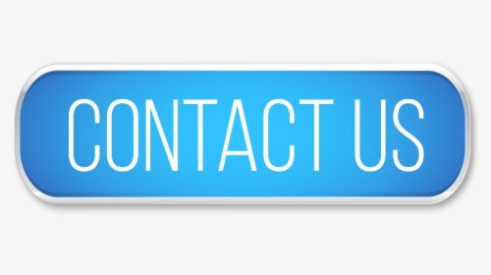
Contact Information
Coach Mike
  Michael Morrissey, AWC Associate Faculty
  Executive Director, Housing Authority City of Yuma – AHDC/SHINE
    420 South Madison Avenue; Yuma, AZ 85364
    Work: (928) 782-3823 x.128; Cell: (928) 920-2085
    Michaelm@hacy.org or michael.morrissey@azwestern.org
Coach Luz
  Luz Acosta, SHINE Program Manager
    Work: (928) 318-5800; Cell (928) 261-8635
    luza@hacy.org

Slide 4
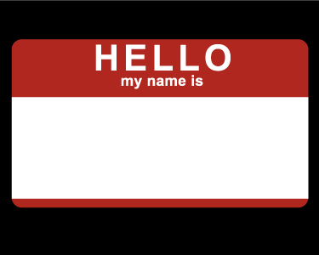


Introductions
Pick a Partner (from a distance :)…
  Someone You Don’t Already Know
Learn the following:
  Name
  High School – Grade
  School Activities – Hobbies – Interests
  College and/or Career Goals
  Other Interesting Facts
Introduce Partner to the Class

Slide 5

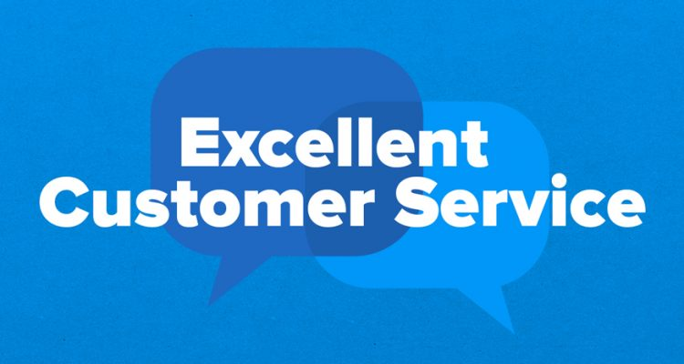


Course Information
BUA 210: Customer Service Management
  Skills for Success – 7th Edition
    Robert W. Lucas; McGraw-Hill Education; New York, NY 2019
      ISBN: 978-1-259-95407-8

Slide 6
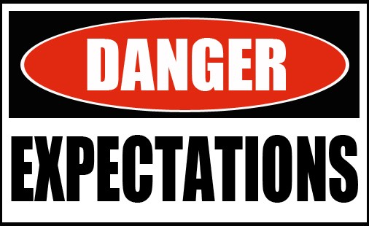
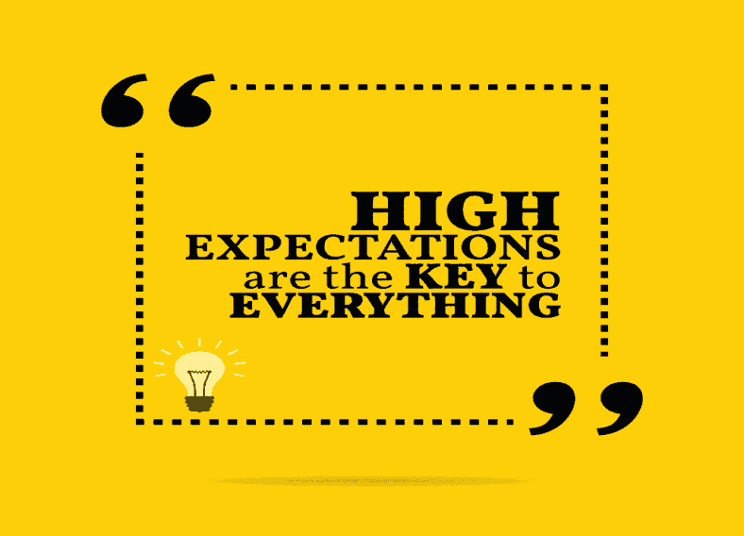
Expectations
Attend All Classes and Be On-Time
Participate in Class Discussion and Group Projects
Complete Weekly Assignments and Maintain Journal
Complete Projects, Presentations, Essays, Quizzes & Exams
Facilitate Workshops and Capstone Project

Slide 7


Grading Policy
Attendance and Participation (25%)
  10 Points each week for attendance and participation
    5 Points if late to class
Weekly Assignments (25%)
  10 Points each week for completing weekly assignments
    5 Points for incomplete or late assignments
Class Projects and/or Midterm Exam (25%)
  Projects may include Essays, Presentations, Workshops Etc.
Final Exam (Capstone Project) (25%)
  There will be a Final Exam (Capstone Project)
Extra Credit
  There will be opportunities for extra credit
    Points earned will be added to Final Grade

Slide 8
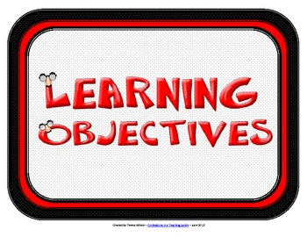


Course Goals
This course will cover the following:
  The World of Customer Service
  Contributing to the Service Culture
  Verbal Communication Skills
  Nonverbal Communication Skills
  Listening to the Customer
  Customer Service and Behavior
  Service Breakdowns and Recovery
  Customer Service in a Diverse World
  Customer Service Via Technology
  Encouraging Customer Loyalty

Slide 9

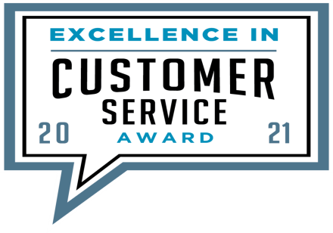
Part One: The Profession
Chapter One: The World of Customer Service
  Chapter Outline:
    Defining Customer Service
    Growth of the Service Sector
    Societal Factors Affecting Customer Service
    Consumer Behavior Shifts
    The Customer Service Environment
    Addressing the Changes

Slide 10
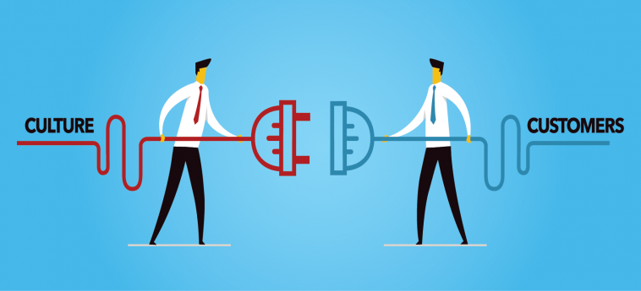
Part One: The Profession
Chapter Two: Contributing to the Service Culture
  Chapter Outline:
    Explain the elements of a successful service culture.
    Define a service strategy.
    Recognize customer-friendly systems.
    Implement strategies for promoting a positive service culture.
    Separate average companies from exceptional companies.
    Identify what customers want.

Slide 11
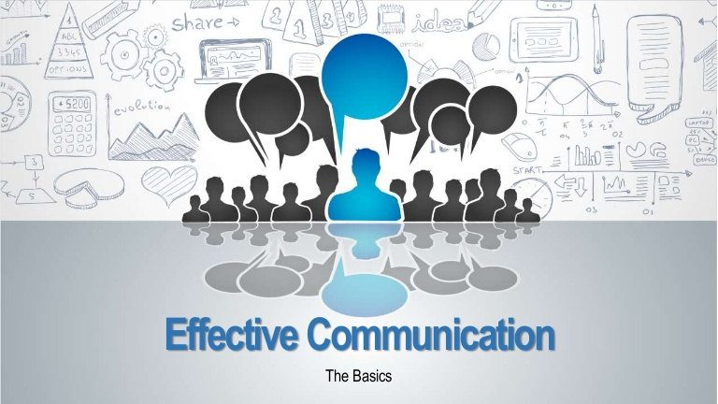
Part Two: Skills for Success
Chapter Three: Verbal Communication Skills
  Chapter Outline:
    Explain the importance of effective communication in customer service.
    Recognize elements of effective two-way interpersonal communication.
    Project a professional customer service image through positive comm.
    Provide feedback effectively.
    Avoid language that could send a negative message and harm the customer relationship.
    Use assertive communication techniques to enhance service.
    Identify key differences between assertive and aggressive behavior.

Slide 12
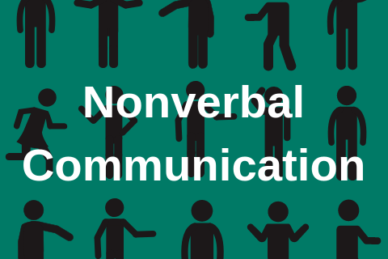
Part Two: Skills for Success
Chapter Four: Nonverbal Communication Skills
  Chapter Outline:
    Define nonverbal communication.
    Recognize various nonverbal cues and their effect on customers.
    Explain the effect that gender has on communication.
    Describe the effect of culture on nonverbal communication.
    Identify unproductive behaviors.
    Use a variety of nonverbal communication strategies.
    Demonstrate specific customer-focused nonverbal behavior.

Slide 13
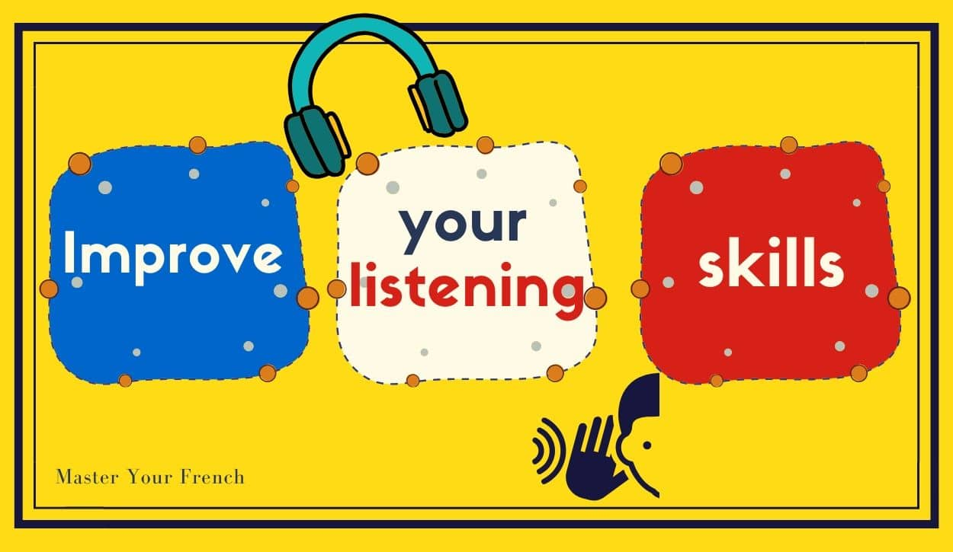
Part Two: Skills for Success
Chapter Five: Listening to the Customer
  Chapter Outline:
    Describe why listening is important to customer service.
    Define the four steps in the listening process.
    List the characteristics of a good listener.
    Recognize the causes of listening breakdown.
    Develop strategies to improve your listening ability.
    Use information-gathering techniques learned to better serve customers.
    Apply concepts discussed to generate meaningful responses to your questions from customers.

Slide 14


Part Three: Building and Maintaining Relationships
Chapter Six: Customer Service and Behavior
  Chapter Outline:
    Explain what behavioral styles are and why you should be concerned w/ them.
    Identify four key behavioral styles and the roles they play in customer service.
    Develop strategies for communicating effectively with each behavioral style.
    Respond to customer problems effectively while building relationships.
    Use knowledge of behavioral styles to help manage perceptions of others.

Slide 15
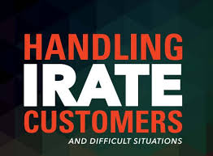
Part Three: Building and Maintaining Relationships
Chapter Seven: Service Breakdowns and Recovery
  Chapter Outline:
    Define what a service breakdown is.
    Apply knowledge of behavioral styles in difficult customer situations.
    Recognize different types of difficult customers and deal with them.
    Use emotion-reducing model to keep difficult situations from escalating.
    Explain why customers defect.
    Develop effective strategies for working with internal customers.
    Identify strategies for preventing dissatisfaction and problem-solving.
    Explain the 6 steps of the problem-solving model.
    Implement a frontline service recovery strategy.
    Discuss importance of disaster planning initiatives.

Slide 16

Part Three: Building and Maintaining Relationships
Chapter Eight: Customer Service in a Diverse World
  Chapter Outline:
    Recognize that diversity is not a bad thing.
    Describe some of the characteristics that make people unique.
    Embrace the need to treat customers as individuals.
    Determine actions for dealing with various types of people.
    Identify a variety of factors that make people diverse and that help to better serve them.
    Communicate effectively with a diverse customer population.

Slide 17

Part Three: Building and Maintaining Relationships
Chapter Nine: Customer Service Via Technology
  Chapter Outline:
    Recognize the role of technology-effective service delivery.
    Describe the ways in which technology enhances an organization’s service delivery capabilities.
    Discuss ways in which companies are integrating the evolving web-based and mobile technologies into their service strategies.
    Communicate effectively via e-mail, the Internet, and fax.
    Deliver quality service through effective telephone techniques.

Slide 18
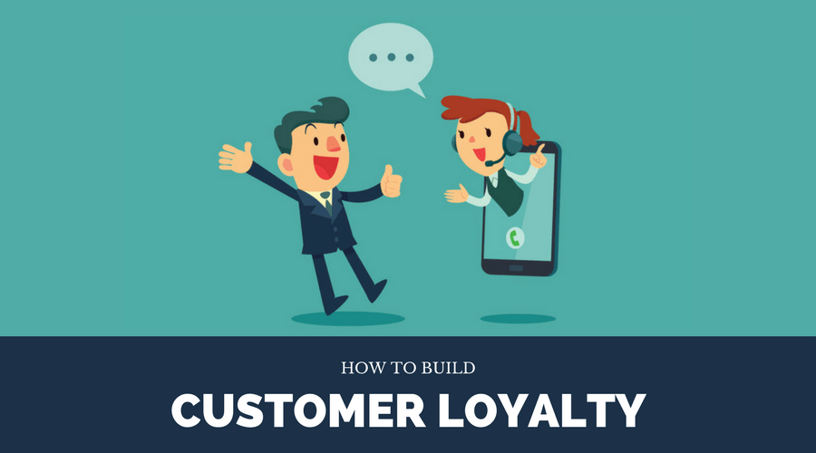
Part Four: Retaining Customers
Chapter Ten: Encouraging Customer Loyalty
  Chapter Outline:
    Relate the role of customer and brand loyalty to organizational success.
    Establish and maintain trust with customers.
    Explain customer relationship management and its importance to quality service.
    Develop the service provider characteristics that will enhance customer loyalty.
    Describe the provider’s responsibility for establishing and maintaining positive customer relationships.
    Identify strategies used to make customers feel like they are number one.
    Discuss strategies that can enhance customer satisfaction.
    Define quality service.

Slide 19



Team Building Exercise
Build a Tower
  Connect Spaghetti and Marshmallows (Toothpick-Jelly Beans)
    Tallest and most sturdy tower wins
Analyze and Discuss Activity
  Human Relations
  Management
  Leadership

Slide 20


