Slide 1
Fundamentals of Management Session Two

Slide 2
Part Two: Planning
Chapter Four: Foundations of Decision Making
Describe the decision-making process.
Explain the three approaches managers can use to make decisions.
Describe types of decisions and decision-making conditions.
Discuss group decision making.
Discuss contemporary issues in managerial decision making.

Slide 3
Decision Making
To be a successful manager – and to be a valued employee – you need to know about decision making.

Slide 4
Decision Making
A good decision should be judged by the process used, not the results achieved.

Slide 5
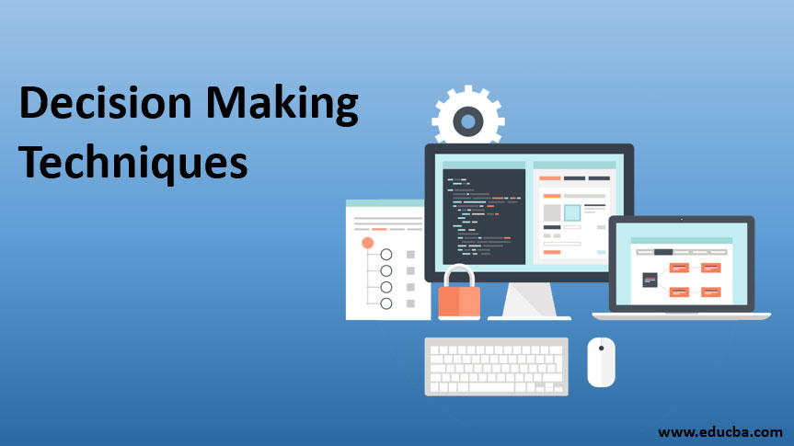
Decision Making
Decision making is a process, not a simple act of choosing among alternatives.

Slide 6
Decision Making
The 8 Steps of the Decision-Making Process:
Identification of a Problem
Identification of Decision Criteria
Allocation of Weights to Criteria
Development of Alternatives
Analysis of Alternatives
Selection of an Alternative
Implementation of the Alternative
Evaluation of Decision Effectiveness

Slide 7
1. Identification of a Problem
The decision-making process begins with the identification of a problem, or more specifically, a discrepancy between an existing and desired state of affairs.

Slide 8
2. Identification of Decision Criteria
Once a manager has identified a problem that needs attention, the decision criteria that will be important in solving the problem must be identified.

Slide 9
3. Allocation of Weights to Criteria
In many decision-making situations, the criteria are not all equally important, so the decision maker has to allocate weights to the decision criteria.

Slide 10
4. Development of Alternatives
After assigning weight to the decision criteria, the decision maker lists the alternatives that could successfully resolve the problem.

Slide 11
5. Analysis of Alternatives
Once the alternatives have been identified, the decision maker critically needs to analyze each one, by evaluating it against the criteria.

Slide 12
Personal Judgments
Personal judgments are reflected in (1) the decision criteria, (2) weight allocation, and (3) evaluation of alternatives.

Slide 13
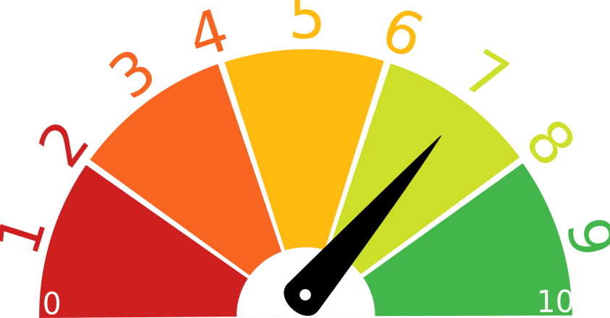
6. Selection of an Alternative
After the decision maker (1) determines all the pertinent factors in the decision, (2) weights them appropriately, and (3) identifies and assesses all the viable alternatives, it should be quite simple to select the best alternative.
Choose the alternative that generates the highest score.

Slide 14
7. Implementation of the Alternative
Implementation involves putting the decision into action.
Implementation includes conveying the decision to all those affected, and getting their commitment to it.
If you want people to be committed to a decision…let them participate in the decision-making process.

Slide 15
8. Evaluation of Decision Effectiveness
In the last step of the decision-making process, you should appraise the outcome of the decision to see whether the problem was resolved.
Did the alternative accomplish the desired result?

Slide 16
Common Errors
Managers may use their own heuristics (rules of thumb) to simplify their decision making.
These rules of thumb may lead to errors and biases in processing and evaluating information.

Slide 17
Common Errors and Biases
Common Decision-Making Errors and Biases:
1. Overconfidence
A tendency to think you know more than you do, or hold unrealistically positive views of yourself and your performance.
2. Immediate Gratification
A tendency to want immediate rewards and to avoid immediate costs.
3. Anchoring Effect
When you fixate on initial information as a starting point and then, once set, fail to adequately adjust for subsequent information.
4. Selective Perception
When you selectively organize and interpret events based on your biased perceptions.
5. Confirmation
When you seek out information that reaffirms past choices and discount information that contradicts past judgments.
6. Framing
When you select and highlight certain aspects of a situation while excluding others.

Slide 18
Common Errors and Biases
Common Decision-Making Errors and Biases:
7. Availability
When you tend to remember events that are most recent and vivid in your memory.
8. Representation
When you assess the likelihood of an event based on how closely it resembles other events or sets of events.
9. Randomness
When you try to create meaning out of random events.
10. Sunk Costs
When you forget that current choices can’t correct the past.
11. Self-Serving
When you are quick to take credit for successes and blame failure on outside factors.
12. Hindsight
When you falsely believe that you would have accurately predicted the outcome of an event once the outcome is actually known.

Slide 19
Decision-Making
Decision-Making is the Essence of Management
Everyone in an organization makes decisions, but it’s particularly important to managers. Managers make decisions as they: Plan – Organize – Lead – Control
Managers want to be good decision makers and exhibit good decision-making behaviors, so they appear competent and intelligent to their bosses, employees, and co-workers.

Slide 20
3 Approaches to Make Decisions
1. Rational Model
This approach assumes: Decision Makers MUST ACT RATIONALLY.
That is, make logical and consistent choices to maximize value.
A “Rational” Decision Maker…Should Be, but May Never Fully Be:
Objective and Logical
Clear and Focused on Problem
Clear and Specific on Goals Regarding Decision
Aware of All Possible Alternatives and Consequences
Effective in Choosing Alternative that Maximizes Achievement of Goal
Considerate of Organization’s Best Interests
Therefore, Rationality is Not a Very Realistic Approach

Slide 21
3 Approaches to Make Decisions
2. Bounded Rationality
Making decisions that are rational within the limits of a manager’s ability to process information.
People are limited in their ability to grasp the present and anticipate the future, which makes it difficult to achieve the best possible decisions.
No one can possible analyze all information on all alternatives so they SATISFICE – that is, accept solutions that are “good enough,” rather than spend time and other resources trying to maximize.

Slide 22
3 Approaches to Make Decisions
3. Intuition and Managerial Decision Making
Making decisions on the basis of experience, feelings, and accumulated judgment.
Described as “Unconscious Reasoning”
Almost half of managers rely on intuition more often than formal analysis to make decisions about their companies.

Slide 23
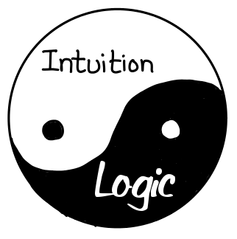
Intuition
What is Intuition?
Experienced-Based Decisions
Managers make decisions based on their past experiences.
Affect-Initiated Decisions
Managers make decisions based on feelings or emotions.
Cognitive-Based Decisions
Managers make decisions based on skills, knowledge, and training.
Subconscious Mental Processing
Managers use data from subconscious mind to help them make decisions.
Values or Ethics-Based Decisions
Managers make decisions based on ethical values or culture.

Slide 24
Decisions and Decision Making Conditions
When making decisions, managers face three different conditions:
Certainty
Conditions in which a manager can make accurate decisions because the outcome of every alternative is known.
Risk
Conditions in which the decision maker is able to estimate the likelihood of certain outcomes.
Uncertainty
Conditions in which the choice of alternative is influenced by the limited amount of available information and by the psychological orientation of the decision maker.

Slide 25
Group Decision Making
Many decisions in organizations, especially important decisions that have far-reaching effects on organizational activities and people, are typically made in groups.

Slide 26
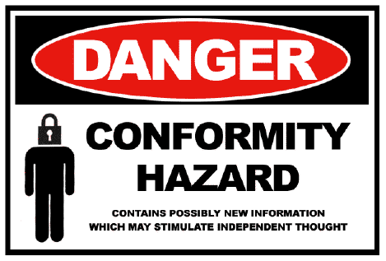
Groupthink
Groupthink is a psychological phenomenon that occurs within a group of people in which the desire for harmony or conformity results in an irrational/dysfunctional decision-making outcome.
Groupthink hinders decision making, and jeopardizes the quality of a decision by:
Undermining critical thinking in the group.
Affecting a group’s ability to objectively appraise alternatives.
Deterring individuals from appraising unusual, minority, or unpopular views.

Slide 27
Group Effectiveness
Group decisions take longer to formulate, but they tend to be more Accurate, Creative, and Accepted.

Slide 28
Brainstorming
Brainstorming is a relatively simple idea-generating process that specifically encourages any and all alternatives while withholding criticism of those alternatives.

Slide 29
Nominal Group Technique
The Nominal Group Technique helps groups arrive at a preferred solution by restricting discussion during the decision-making process.
Members secretly write a list of general problem areas or potential solutions to a problem.

Slide 30
Decision Making Issues
Important issues managers face, include:
1. National Culture
As managers deal with employees from diverse cultures, they need to recognize common and accepted behavior when asking them to make decisions. Some may not be comfortable being included in the process, or may have difficulty with type of change.

Slide 31
Decision Making Issues
Important issues managers face, include:
2. Creativity and Design Thinking
A decision maker needs creativity, the ability to produce novel and useful ideas. Creativity offers value in identifying viable alternatives.
Design thinking in essence, is approaching management problems as designers approach design problems.

Slide 32
Creativity
Most people have creative potential, but need to unleash it. Individual creativity essentially requires:
Expertise
The potential for creativity is enhanced when individuals have abilities, knowledge, proficiencies, and similar expertise in their fields of endeavor.
Creative-Thinking Skills
Ability to use analogies to apply an idea from one context to another.
Intrinsic Task Motivation
A desire to work on something because it’s interesting, involving, exciting, satisfying, or personally challenging. Turns concept into construct.

Slide 33
Creativity
Suggestions to help develop your creativity:
Think of yourself as creative.
Pay attention to your intuition.
Move away from your comfort zone.
Determine what you want to do.
Think outside the box.
Look for ways to do things better.
Find several right answers.
Believe in finding a workable solution.
Brainstorm with others.
Turn creative ideas into action.

Slide 34
Part Two: Planning
Chapter Five: Foundations of Planning
Discuss the nature and purpose of planning.
Explain what managers do in the strategic management process.
Compare and contrast approaches to goal setting and planning.
Discuss contemporary issues in planning.

Slide 35
Planning
Organizations have a purpose, people (employees), and a structure to support and enable those people in carrying out that purpose.
And, in those organizations, managers must develop goals, plans, and strategies for how to best achieve that purpose.

Slide 36
What is Planning and Why Do Managers Need to Plan?
Planning is often called the Primary Management Function because it establishes the basis for all other things managers do as they organize, lead, and control.
Planning involves:
Defining goals and objectives.
Establishing a strategy for achieving those goals.
Prioritizing a plan to integrate and coordinate activities.

Slide 37
Why Should Managers Formally Plan?
Managers should plan for at least four reasons:
Planning establishes coordinated effort.
It gives direction and fosters teamwork and cooperation.
Planning reduces uncertainty.
It forces members to look ahead and anticipate change.
Planning reduces overlapping and wasteful activities.
When ends and means are clear, inefficiencies become obvious.
Planning establishes the goals or standards that facilitate control.
Without planning, there are no goals against which to measure or evaluate work efforts.

Slide 38
Criticisms of Formal Planning and Manager’s Response
Planning may create rigidity.
Managers need to remain flexible and not be tied to a course of action simply because it’s the plan.
Formal plans can’t replace intuition and creativity.
Planning should enhance and support intuition and creativity, not replace it.
Planning focuses managers’ attention on today’s competition, not on tomorrow’s survival.
When manager’s plan, they should be open to forging into unchartered waters if there are untapped opportunities.
Planning reinforces success, which may lead to failure.
Manager’s may need to face that unknown and be open to doing things in new ways to be even more successful.

Slide 39
Does Formal Planning Improve Organizational Performance?
The evidence supports the position that organizations should have formal plans.
Formal planning generally means higher profits.
The quality of the planning process and appropriate implementation of plan contributes more to high performance than does extent of planning.

Slide 40
Strategic Management
Strategic Management is what managers do to develop an organization’s strategies.

Slide 41
Strategic Management
Strategies are the plans for how the organization will do what it’s in business to do, how it will compete successfully, and how it will attract and satisfy its customers in order to achieve its goals.

Slide 42
Strategic Management
Why is Strategic Management so Important?
It can make a difference in performance.
Managers face continual changes and uncertainty.
Organizations are complex and diverse, and each part needs to work together to achieve the organization’s goals.

Slide 43
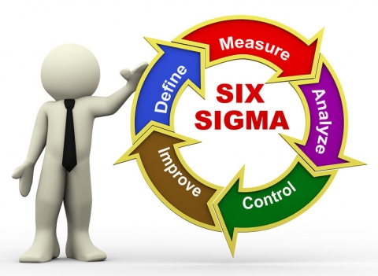
Steps in the Strategic Management Process
Identify the Organization’s Mission, Goals, and Strategy’s.
Purpose and Plan
Do an External Analysis.
Environmental Assessment (Opportunities and Threats)
Do an Internal Analysis.
Resources – Capabilities – Competencies (Strengths and Weaknesses)
Formulate Strategies.
Specific Plan to Achieve Goals
Implement Strategies.
Execution and Performance
Evaluate Results.
Review and Feedback

Slide 44
Components of a Mission Statement
Customer’s
Who are they?
Markets
Where does the organization compete geographically?
Concern for Survival, Growth, and Profitability
Is the organizations committed to growth and financial stability?
Philosophy
What are the organization’s basic beliefs, values, and ethical priorities?
Concern for Public Image
How responsive is the organization to societal and environmental concerns?
Products or Services
What are the organization’s major products or services?
Self-Concept
What are the organization’s major competitive advantages and core competencies?
Concern for Employees
Are employees a valuable asset of the firm?

Slide 45
What Strategic Weapons do Managers Have?
Six Strategic Weapons Important in Today’s Environment:
Customer Service
Employee Skills and Loyalty
Innovation
Quality
Social Media
Big Data

Slide 46
Quality
Quality can be a way for an organization to create a sustainable competitive advantage.
Organizations should be constantly benchmarking – that is, searching for best practices among competitors that lead to superior performance, and improve its quality through analyzing and copying the methods of leaders in various fields.

Slide 47
Three Strategies Managers Use
1. Corporate Strategy
Growth Strategy
Organization expands the number of markets served or products offered, either through its current business or through new business.
Stability Strategy
Organization continues – often during periods of uncertainty – to do what it is currently doing; to maintain things as they are.
Renewal Strategy
Organization is in trouble and needs to address declining performance.
Stabilize operations, revitalize organizational resources and capabilities, and prepare organization to compete once again.

Slide 48
Three Strategies Managers Use
2. Competitive Strategy
Developing an effective competitive strategy requires understanding competitive advantage, which is what sets an organization apart; that is, its distinct edge, which comes from:
The organization’s core competencies
Doing something that others cannot do or doing it better than others can do it.
The company’s resources
Having something that its competitors do not.

Slide 49
Three Strategies Managers Use
3. Functional Strategy
Those strategies used by an organization’s various functional departments (marketing, operations, finance/accounting, HR) to support the competitive strategy.

Slide 50
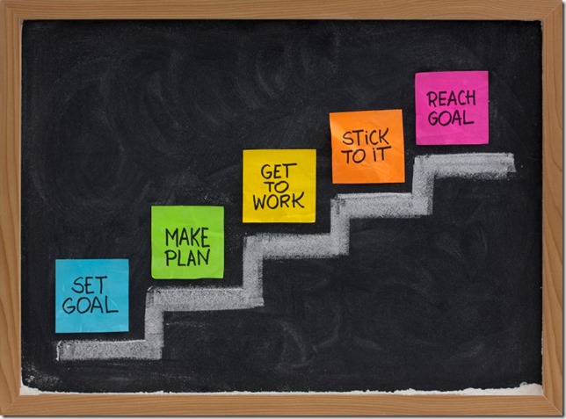
How Do Managers Set Goals and Develop Plans?
Planning Involves Setting Goals and Developing Plans.
Goals/Objectives
Desired outcomes or targets.
Plans
Documents that outline how goals are going to be met.

Slide 51
Management by Objectives (MBO)
MBO focuses on employees working to accomplish goals they’ve had a hand in setting.
MBO Programs have Four Elements:
Goal Specificity
Participative Decision Making
Explicit Time Period
Performance Feedback

Slide 52
Goal Setting
No matter what approach is used, goals have to be written, and some goals more clearly indicate what the desired outcomes are.

Slide 53
Contemporary Issues in Planning
The external environment is constantly changing.
In an uncertain environment, managers should develop plans that are specific, but flexible. Planning is an ongoing process.
Persistence in planning contributes to performance improvement.
Managers need to stay alert to environmental changes that may impact implementation and respond as needed.

Slide 54
Contemporary Issues in Planning
Managers should be aware of and take advantage of the tools available to help them analyze and respond to the external environment, such as:
Environmental Scanning
An analysis of the external environment, which involves screening large amounts of information to detect emerging trends.
Competitive Intelligence
A type of environmental scanning that gives managers accurate information about its competitors.

Slide 55
Conclusion
It has been said that if you don’t know where you’re going, any road will get you there. It has also been said that the shortest distance between two points is a straight line. These two “adages” emphasize the importance of goals.
Managers are typically judged on their ability to achieve goals.
If individuals or units in the organization lack goals, there can be no direction or unity of effort.
Successful managers are good at setting their own goals and helping others to set goals.

