Slide 1

Business Survey
Session Seven
Business Foundations
  A Changing World 11th Edition
    O.C. Ferrell, Geoffrey Hirt, and Linda Ferrell; McGraw Hill Education; New York, NY 2018
      ISBN: 978-1-259-68523-1

Slide 2
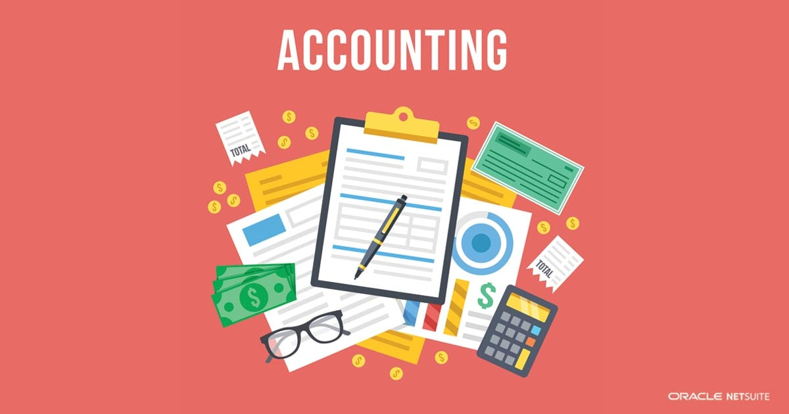
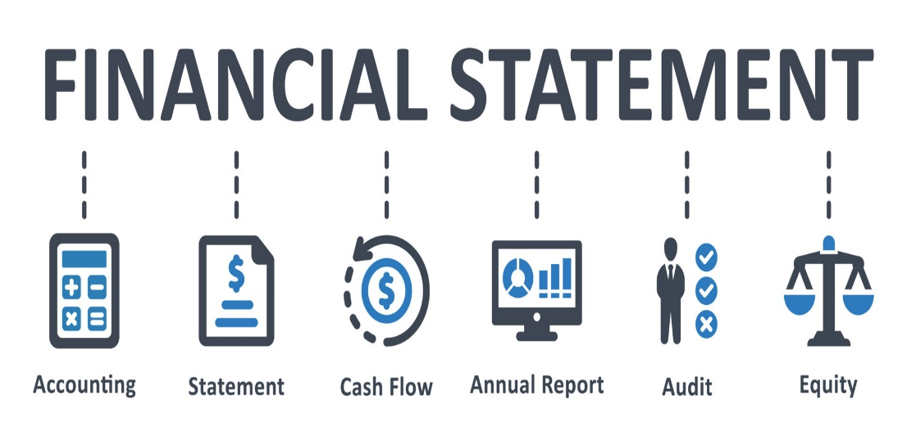
Part Six: Financing the Enterprise
Chapter Fourteen: Accounting and Financial Statements

Slide 3
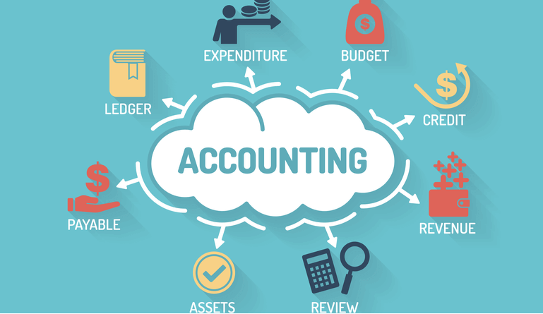
Introduction
Accounting, the financial “language” that organizations use to record, measure, and interpret all of their financial transactions and records, is very important in business.
  All businesses – from a small family farm to a giant corporation – use the language of accounting to make sure they use their money wisely and to plan for the future.
    Nonbusiness organizations such as charities and governments also use accounting to demonstrate to donors and taxpayers how well they are using their funds and meeting their objectives.

Slide 4
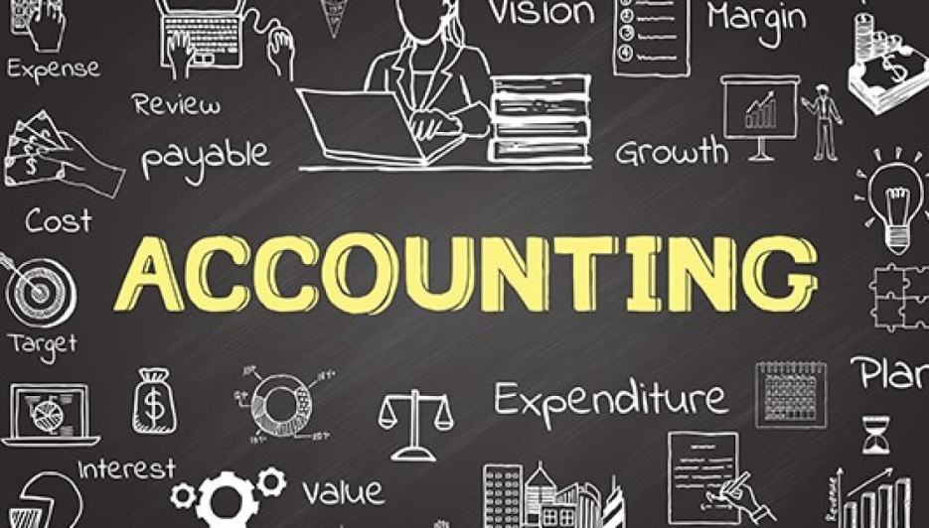
The Nature of Accounting
Accounting is the recording, measurement, and interpretation of financial information.
  Large numbers of people and institutions, both within and outside businesses, use accounting tools to evaluate organizational operations.
    To better understand the importance of accounting, we must first understand who prepares accounting information & how it is used.

Slide 5
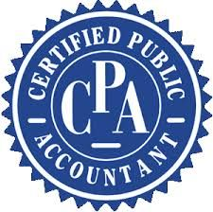
Accountants
Many of the functions of accounting are carried out by public or private accountants.
  Public Accountants
    Individuals and businesses can hire a Certified Public Accountant (CPA), an individual who has been certified by the state in which they practice to provide accounting services ranging from the preparation of financial records and the filing of tax returns to complex audits of corporate financial records.
      Certification gives a public accountant the right to express, officially, an unbiased opinion regarding the accuracy of the client’s financial statements.

Slide 6

Accountants
Many of the functions of accounting are carried out by public or private accountants.
  Private Accountants
    Large corporations, government agencies, and other organizations may employ their own private accountants to prepare and analyze their financial statements.
      With titles as controller, tax accountant, or internal auditor, private accountants are deeply involved in many of the most important financial decisions of the firms in which they work.

Slide 7
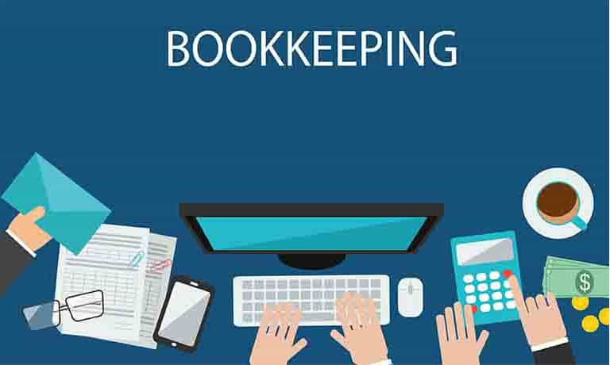
Accounting or Bookkeeping?
The terms Accounting and Bookkeeping are often mistakenly used interchangeably.
  Bookkeeping is much narrower and far more mechanical than accounting, and is typically limited to the day-to-day recording of business transactions.
    Bookkeepers are responsible for obtaining and recording the info that accountants require to analyze a firm’s financial position.

Slide 8

Accounting or Bookkeeping?
The terms Accounting and Bookkeeping are often mistakenly used interchangeably.
  Accountants, on the other hand, usually complete course work beyond their basic four or five-year college accounting degrees.
    This additional training allows accountants not only to record financial information, but to understand, interpret, and even develop the sophisticated accounting systems necessary to classify and analyze complex financial information.

Slide 9
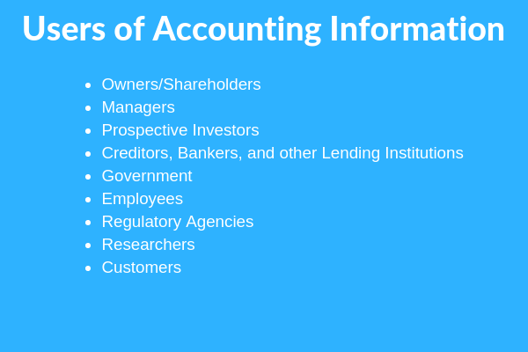
The Uses of Accounting Information
Accountants summarize the information from a firm’s business transactions in various statements for a variety of stakeholders, including managers, investors, creditors, and government agencies.
  Many business failures may be directly linked to ignorance of the information “hidden” inside these financial statements.
  Likewise, most business successes can be traced to informed managers who understand the consequences of decisions.

Slide 10
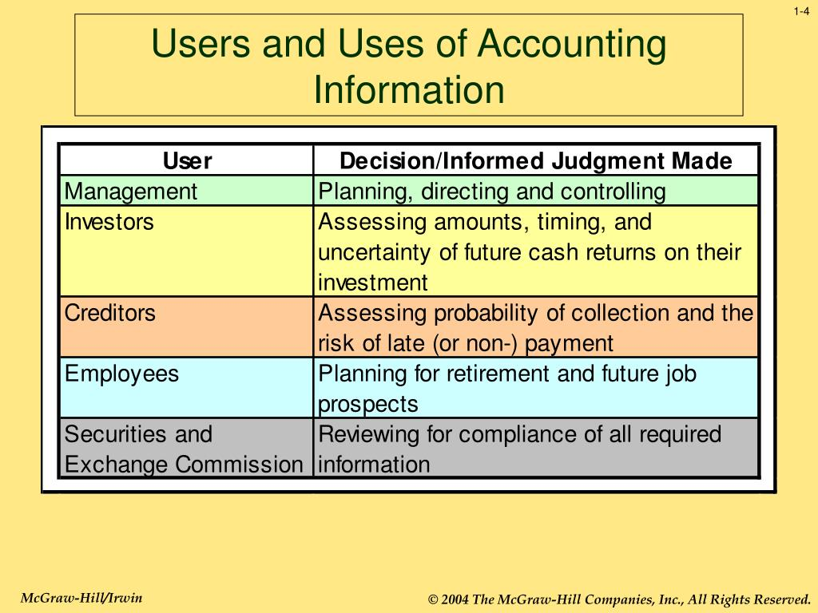
The Uses of Accounting Information
Managers and owners use financial statements:
  To aid in internal planning and control.
  For external purposes such as reporting to the Internal Revenue Service (IRS), stockholders, creditors, customers, employees, and other parties.

Slide 11

Internal Uses of Accounting Info
Cash Flow
Managerial Accounting refers to the internal use of accounting statements by managers in planning and directing the organization’s activities.
  Perhaps, management’s greatest single concern is Cash Flow, the movement of money through an organization over a set period of time.
    For any business to succeed, it needs to generate enough cash to pay its bills when they are due.

Slide 12

Internal Uses of Accounting Info
Budget
Managerial accountants also help prepare an organization’s Budget, an internal financial plan that forecasts expenses and income over a set period of time.
  This financial plan (map), shows how the company expects to move from Point A to Point B over a specific period of time.
    The principle value of a Budget lies in its breakdown of cash inflows (revenue) and outflows (expenses).
      Variances between budget forecasts and actual income/expenses are carefully reviewed and analyzed.

Slide 13

External Uses of Accounting Info
Annual Report
Managers also use accounting statements to report the business’s financial performance to outsiders.
  Such statements are used for filing income taxes, obtaining credit from lenders, and reporting results to the firm’s stockholders.
    They become the basis for the information provided in the official corporate Annual Report, which is a summary of the company’s financial information, products, and growth plans for owners and potential investors.

Slide 14

External Uses of Accounting Info
Annual Report - Financial Statements
The most important component of an Annual Report is the signature of a CPA that the required financial statements are an accurate reflection of the underlying financial condition of the firm.
  Financial statements evaluate the return on stockholder’s investments and the overall quality of the firms management team.
  Lenders look at financial statements to determine a company’s ability to meet current and future debt obligations if a loan or credit is granted.
  Labor unions and employees use financial statements to establish reasonable expectations for salary and other benefit requests.

Slide 15
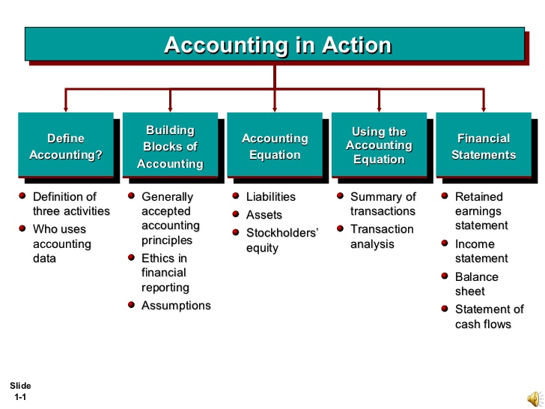
The Accounting Process
Many view accounting as a primary business language. It is of little use, however, unless you know how to “speak” it.
  Fortunately, the fundamentals – the accounting equation and the double-entry bookkeeping system – are not difficult to learn.
    These two concepts serve as the starting point for all currently accepted accounting principles.

Slide 16
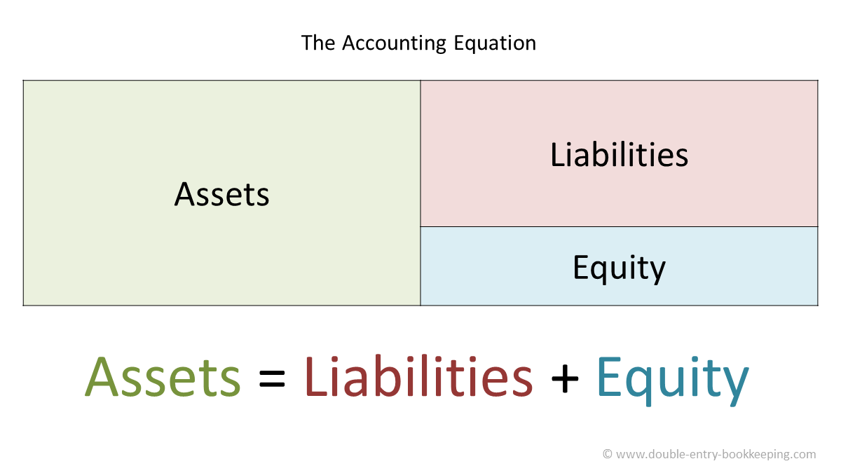
The Accounting Equation
The relationship among assets, liabilities, and owner’s equity is a fundamental concept in accounting and is known as the Accounting Equation (Assets = Liabilities + Owner’s Equity).
  Assets
    A firm’s economic resources, or items of value that it owns, such as cash, inventory, land, equipment, buildings, and other tangible and intangible things.
  Liabilities
    Debts that a firm owes to others.
  Owner’s Equity
    Equals Assets minus Liabilities and reflects historical values of initial and ongoing financial contribution(s) to the company.

Slide 17
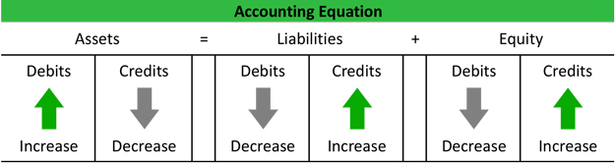
Double-Entry Bookkeeping
Double-Entry Bookkeeping is a system of recording and classifying business transactions in separate accounts in order to maintain the balance of the Accounting Equation
(Assets = Liabilities + Owner’s Equity)
  For example, If an owner buys $200 worth of product on credit then it should later be recorded once as a liability, or debt to a supplier, and again as an asset known as “inventory.”

Slide 18
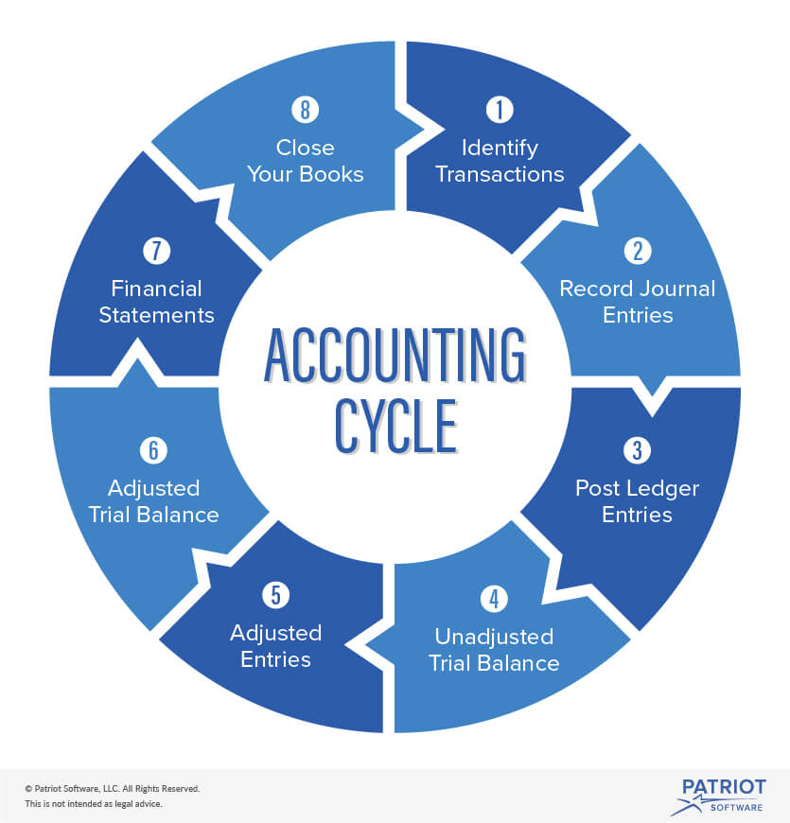
The Accounting Cycle
An Accounting Cycle is the four-step procedure of an accounting system, which includes:
  Examining source documents (checks, receipts, etc.).
  Recording transactions in an accounting journal.
  Posting recorded transactions from the journal into a ledger.
  Preparing financial statements.

Slide 19
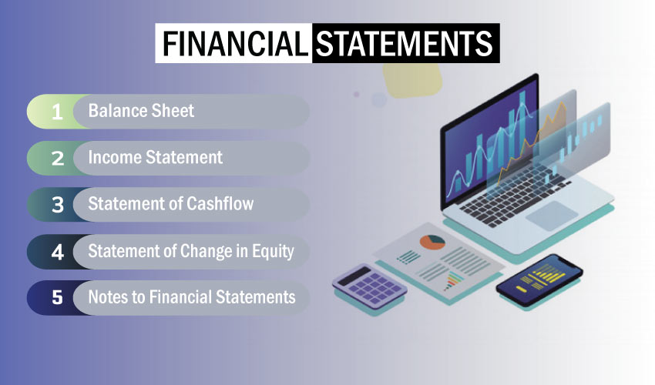
Financial Statements
The end result of the accounting process is a series of financial statements.
  The Income Statement, Balance Sheet, and Statement of Cash Flows are the best known examples of financial statements.
    They are provided to stockholders and potential investors in a firm’s annual report as well as to other relevant outsiders such as creditor’s, government agencies, and the Internal Revenue Service.

Slide 20

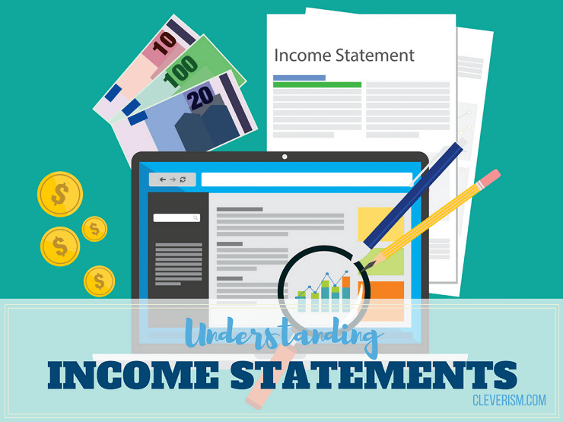
The Income Statement
The question, “What’s the bottom line?” derives from the income statement, where the bottom line shows the overall profit or loss of the company after taxes.
  Thus, the Income Statement is a financial report that shows an organization’s profitability over a period of time.
    It offers a clear picture of the company’s overall revenues and the costs incurred in generating those revenues.
    It indicates the firm’s profitability or income (the bottom line), which is derived by subtracting expenses from its revenues.

Slide 21


The Income Statement
Revenue
Revenue is total amount of money received (or promised) from the sale of goods or services, as well as from other business activities.
  Nonbusiness entities typically obtain revenues through donations from individuals and/or grants from governments and private foundations.
    Firms should book revenue when “it satisfies a performance obligation by transferring a promised good-service to a customer.”

Slide 22

The Income Statement
Cost of Goods Sold
The next major item included in the income statement is the Cost of Goods Sold, which is the amount of money a firm spent to buy or produce the products it sold during the period to which the income statement applies.
  This figure is calculated as follows: Cost of Goods Sold = Beginning Inventory + Interim Purchases – Ending Inventory
    For example, an owner began the accounting period with an inventory of goods for which she paid $5,000. During the period, the owner bought another $4,000 worth of goods, giving the shop a total inventory available for sale of $9,ooo. If, at the end of the accounting period the owner’s inventory was worth $5,500, the costs of goods sold would equal $3,500. ($5,000 + $4,000 - $5,500 = $3,500)

Slide 23
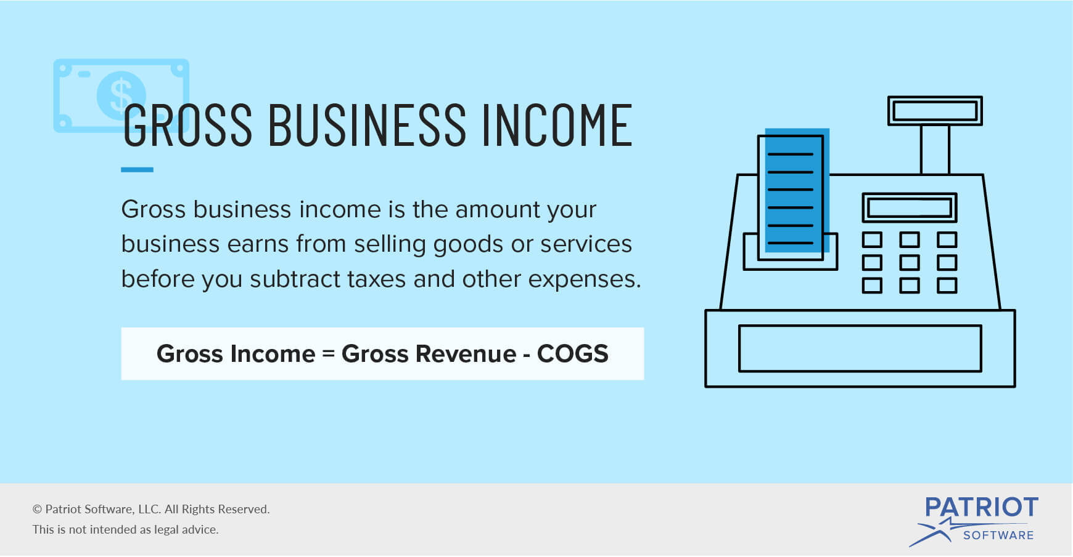
The Income Statement
Gross Income or Profit
Gross Income (or Profit) equals revenues minus the cost of goods sold required to generate the revenues.
  Profit is the difference between what it costs to make and sell a product and what a customer pays for it.
    For example, if owner had total revenues of $10,000 over same period, subtracting the costs of goods sold ($3,500) from the total revenues of $10,000 yields the store’s Gross Income or Profit (revenues minus the cost of goods sold required to generate revenues) of $6,500

Slide 24

The Income Statement
Expenses
Expenses are the costs incurred in the day-to-day operations of an organization.
  Three common expense accounts include:
    Marketing & Advertising, General, and Administrative Expenses
    Research, Development, and Engineering Expenses
    Interest Expenses

Slide 25

The Income Statement
Depreciation
Included in the General and Administrative category is a special type of expense known as Depreciation.
  Depreciation is the process of spreading the costs of long-lived assets such as buildings and equipment over the total number of accounting periods in which they are expected to be used.
    Consider a manufacturer that purchases a $100,000 machine, expected to last about 10 years. Rather than showing an expense of $100,000 in the first year and no expense for that equipment over the next nine years, the manufacturer is allowed to report depreciation expenses of $10,000 per year in the next 10 years.

Slide 26
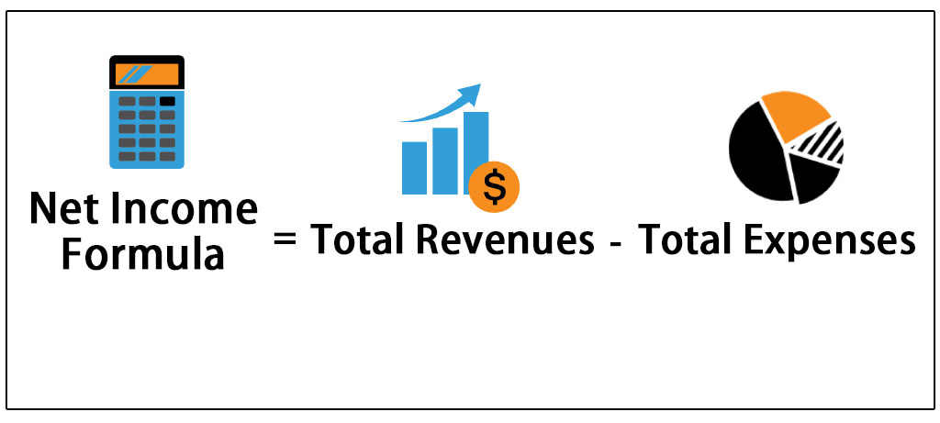
The Income Statement
Net Income
Net Income is the total profit (or loss) after all expenses, including taxes, have been deducted from revenue, also called Net Earnings.
  Generally, accountants divide profits into sections such as operating income and earnings before interest and taxes.

Slide 27
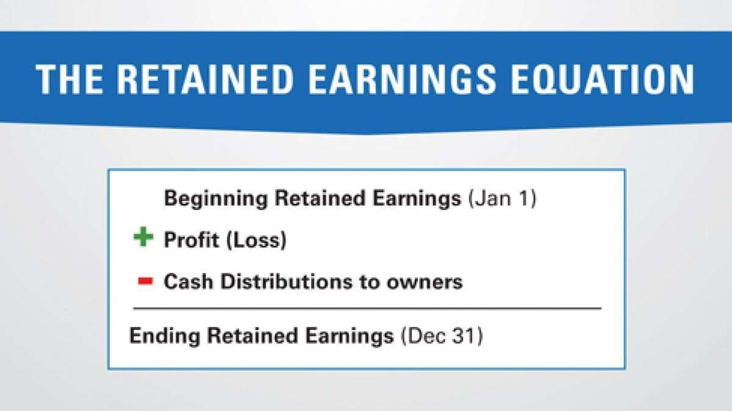
Temporary Nature of the Income Statement Accounts
Companies record their operational activities in the revenue and expense accounts during an accounting period.
  Gross profit, earnings before interest and taxes, and net income are the results of calculations made from the revenues and expenses accounts; they are not actual accounts.
    At the end of each accounting period, the dollar amounts in all the revenue and expense accounts are moved into an account called “Retained Earnings,” or one of the owner’s equity accounts.
      Revenues increase equity whereas expenses decrease it.

Slide 28
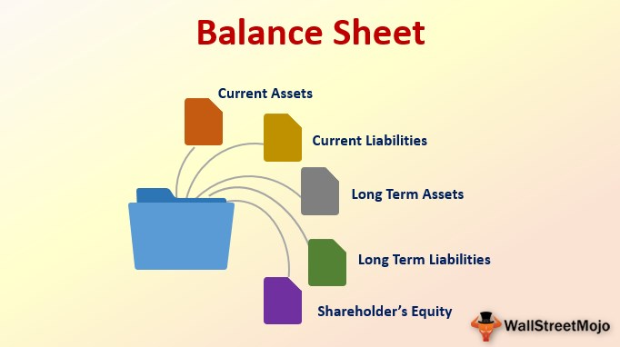
The Balance Sheet
The second basic financial statement is the Balance Sheet, which represents a “snapshot” of an organization’s financial position at a given moment.
  As such, the Balance Sheet indicates what the organization owns or controls and the various sources of the funds used to pay for these assets, such as bank debt or owner’s equity.
    The Balance Sheet takes its name from its reliance on the accounting equation: Assets = Liabilities + Owner’s Equity.

Slide 29
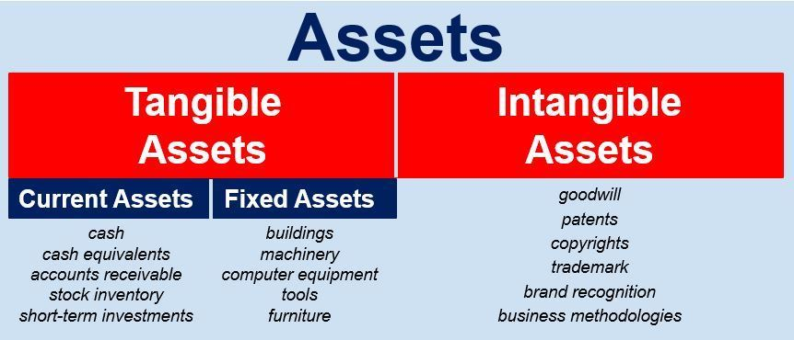
The Balance Sheet
Assets
All asset accounts are listed in descending order of liquidity – that is, how quickly each could be turned into cash.
  Current Assets are those that are used or converted into cash within the course of a calendar year.
  Cash is followed by temporary investment, accounts receivable, and inventory, in that order.
  Accounts Receivable refers to money owed to the company by its clients or customers who have promised to pay at a later date.
  Fixed Assets represent a commitment of org. funds of at least one year.

Slide 30
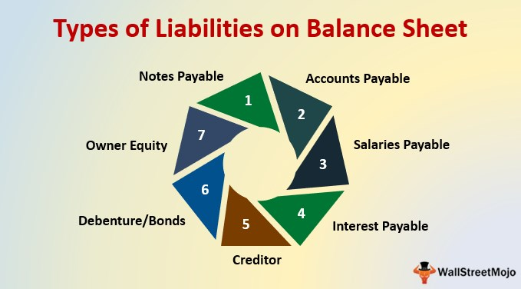
The Balance Sheet
Liabilities
As seen in the accounting equation, total assets must be financed either through borrowing (liabilities) or through owner investments (owner’s equity).
  Current Liabilities include a firm’s financial obligations to short-term creditors, which must be repaid within one year, while long-term liabilities have longer repayment terms.
  Accounts Payable represents amounts owed to suppliers for goods and services purchased with credit.
  Other Liabilities include wages earned by employees but not yet paid and taxes owed to the government. Occasionally, these are consolidated into an Accrued Expenses account, representing all unpaid financial obligations.

Slide 31
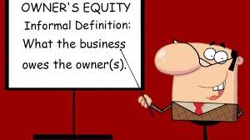
The Balance Sheet
Owner’s Equity
Owner’s Equity includes the owner’s contributions to the organization along with income earned by the organization and retained to finance continued growth and development.
  If the organization were to sell off all of its assets and pay all of its liabilities, any remaining funds would belong to the owners.
    Corporations sell stock to investors, who then become owners of the firm. Many corporations issue several different classes of common and preferred stock, each with different dividend payments and/or voting rights.

Slide 32
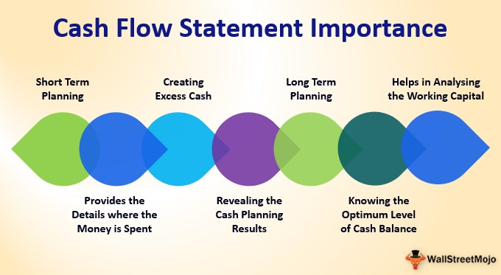
The Statement of Cash Flows
The third primary financial statement is called the Statement of Cash Flows, which explains how the company’s cash changed from the beginning of the accounting period to the end.
  Many investors and other users of financial statements want more information about the cash flowing into and out of the firm than is provided on the Balance Sheet in order to better understand the company’s health.
    The Statement of Cash Flows takes the cash balance from one year’s Balance Sheet and compares it with the next while providing detail about how the firm used the cash.

Slide 33

Statement of Cash Flows
The change in cash is explained through details in 3 categories: cash from (used for) operating activities, cash from (used for) investing activities, and cash from (used for) financing activities.
  Cash from operating activities is calculated by combining the changes in revenue accounts, expense accounts, current asset accounts, and current liability accounts for the accounting period.
    If the number is positive the business is in good shape, but if it shows negative cash flow the company may be declining, or may be in a period of rapid growth and not yet making a profit.

Slide 34

Ratio Analysis
Analyzing Financial Statements
The Income Statement shows a company’s profit or loss, while the Balance Sheet itemizes the value of assets, liabilities, and owner’s equity.
  Together, the two statements provide the means to answer two critical questions:
    How much did the firm make or lose?
    How much is the firm presently worth based on historical values found on the Balance Sheet?

Slide 35

Ratio Analysis
Analyzing Financial Statements
Ratio Analysis, calculations that measure an organization’s financial health, brings the complex information from the Income Statement and Balance Sheet into sharper focus so that managers, lenders, owners, and other interested parties can measure and compare the organization’s productivity, profitability, and financing mix with similar entities.
  A ratio is simply one number divided into another, with the result showing the relationship between the two numbers.
    For example we measure fuel efficiency with miles per gallon.

Slide 36

Profitability Ratios
Profitability Ratios measure how much operating income or net income an organization is able to generate relative to its assets, owner’s equity, and sales.
  The numerator (top number) used in these examples is always the net income after taxes.
    Common Profitability Ratios include profit margin, return on assets, and return on equity.

Slide 37
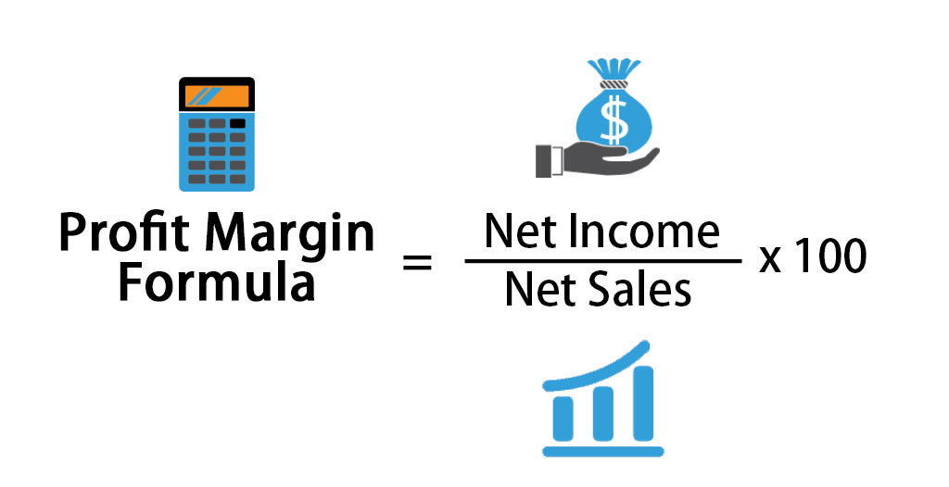
Profitability Ratios
Profit Margin
The Profit Margin is computed by dividing net income by sales, and shows the overall percentage of profits earned by the company.
  It is based solely upon data obtained from the Income Statement.
    The higher the Profit Margin, the better the cost controls within the company and the higher the return on every dollar of revenue.

Slide 38
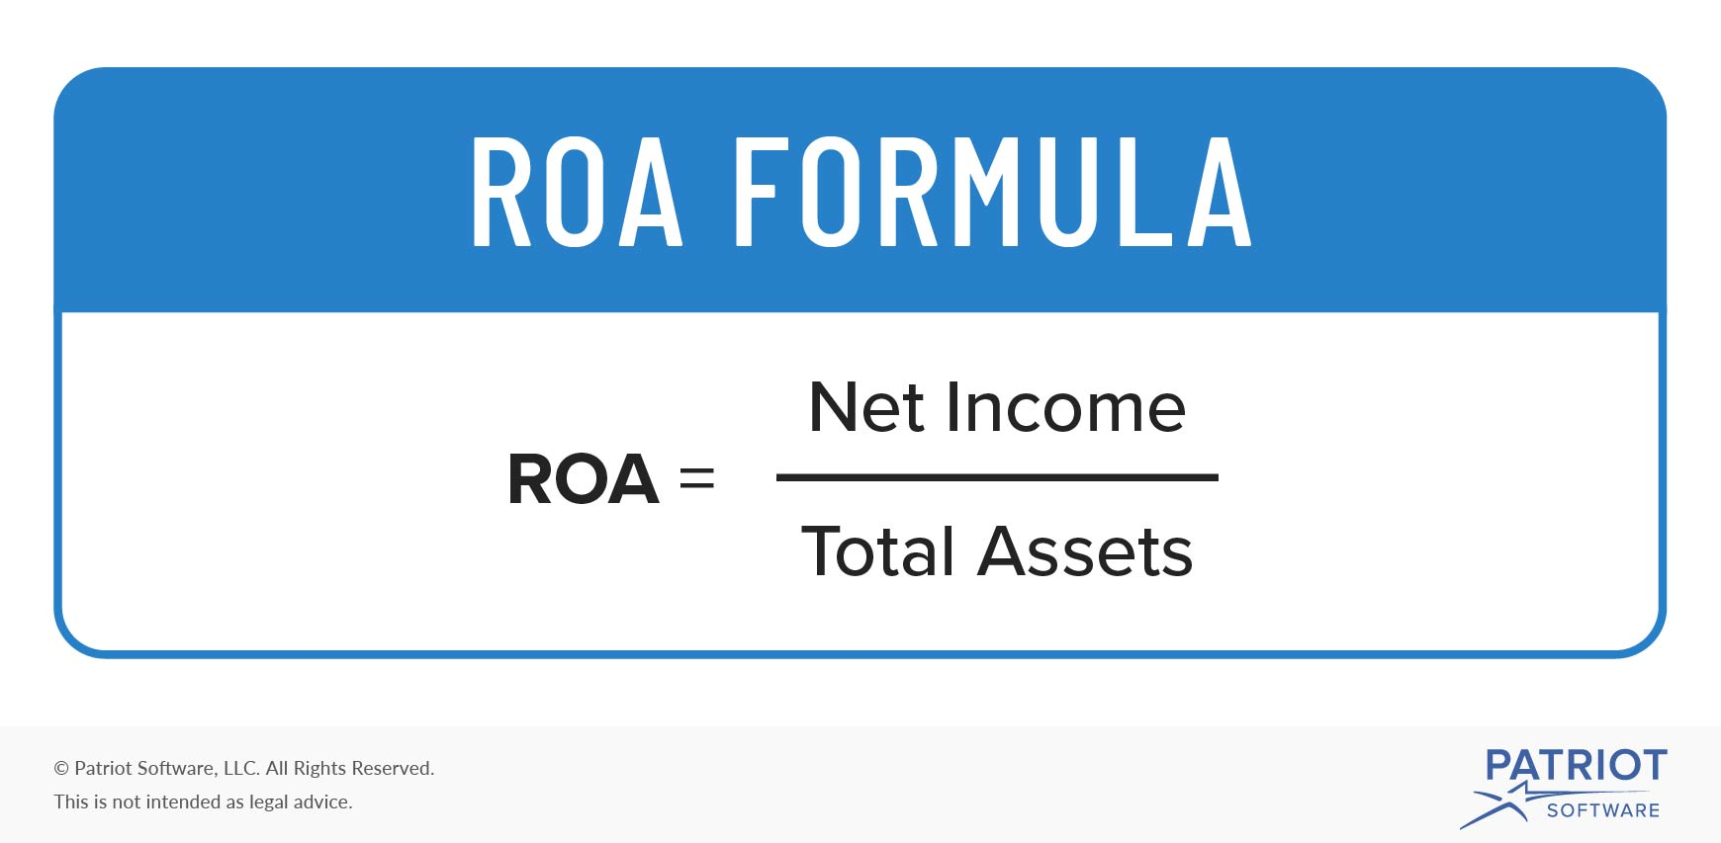
Profitability Ratios
Return on Assets
Return on Assets (ROA) is computed by dividing net income by total assets, and shows how much income the firm produces for every dollar invested in assets.
  A company with a low return on assets is probably not using its assets very productively – a key managerial failing.
    For its construction, the return on assets calculation requires data from both the Income Statement and the Balance Sheet.

Slide 39
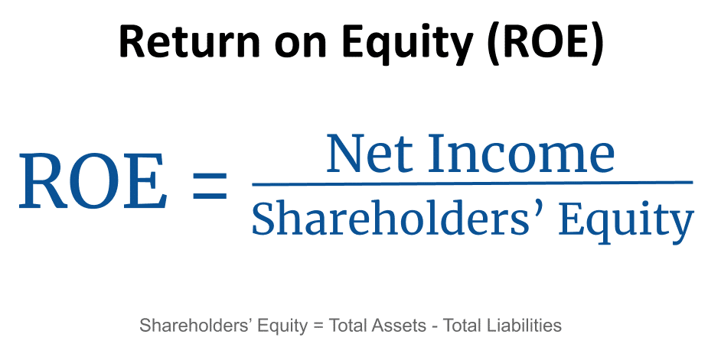
Profitability Ratios
Return on Equity
Return on Equity (also called Return on Investment-ROI), is computed by dividing net income by owner’s equity, and shows how much income is generated by each $1 the owners have invested in the firm.
  A low return on equity means low stockholder returns and may indicate a need for immediate management attention.
    Because some assets may have been financed with debt not contributed by the owners, the value of the owner’s equity is usually considerably lower than the total value of the firm’s assets.

Slide 40

Asset Utilization Ratios
Asset Utilization Ratios (AURs) measure how well a firm uses its assets to generate each $1 of sales.
  Companies using their assets more productively will have higher returns on assets than their less efficient competitors.
  Managers can use AURs to pinpoint areas of inefficiency in their operations.
    These ratios relate Balance Sheet assets to sales, which are found on the Income Statement.

Slide 41
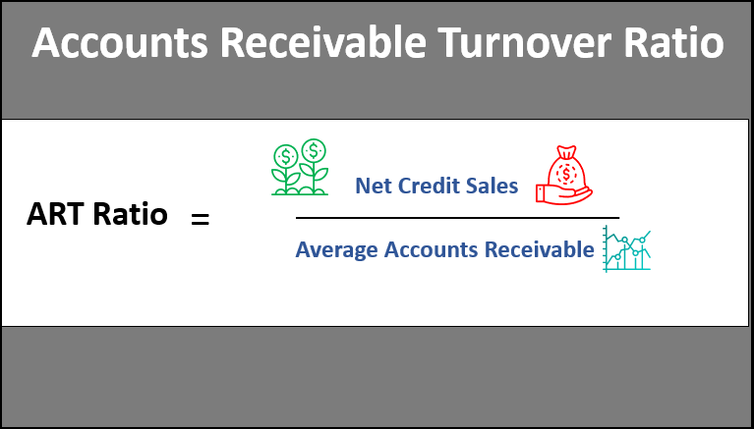
Asset Utilization Ratios
Receivables Turnover
The Receivables Turnover is computed by dividing sales by accounts receivable, and indicates how many times a firm collects its accounts receivable in one year.
  It also demonstrates how quickly a firm is able to collect payments on its credit sales.
    No payments means no profits.

Slide 42
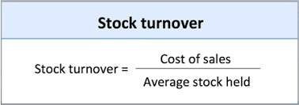
Asset Utilization Ratios
Inventory Turnover
Inventory Turnover is computed by dividing sales by total inventory, and indicates how many times a firm sells and replaces its inventory over the course of a year.
  A high Inventory Turnover Ratio may indicate great efficiency but may also suggest the possibility of lost sales due to insufficient stock levels.

Slide 43
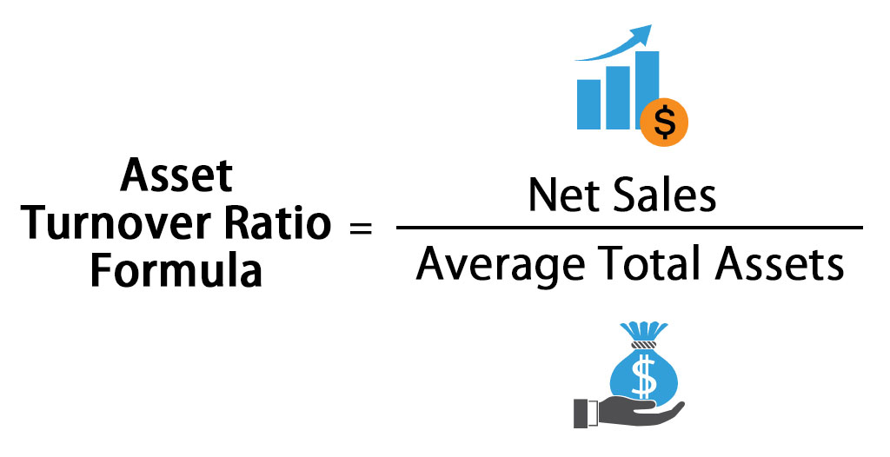
Asset Utilization Ratios
Total Asset Turnover
Total Asset Turnover is computed by dividing sales by total assets, and measures how well an organization uses all of its assets in creating sales.
  It indicates whether a company is using its assets productively.

Slide 44

Liquidity Ratios
Liquidity Ratios compare current assets to current liabilities to indicate the speed with which a company can turn its assets into cash to meet debts as they come due.
  High Liquidity Ratios may satisfy a creditor’s need for safety, but ratios that are too high may indicate that the organization is not using its current assets efficiently.
    Liquidity Ratios are generally best examined in conjunction with Asset Utilization Ratios because high turnover ratios imply that cash is flowing through an organization very quickly – a situation that dramatically reduces the need for the types of reserves measured by Liquidity Ratios.

Slide 45
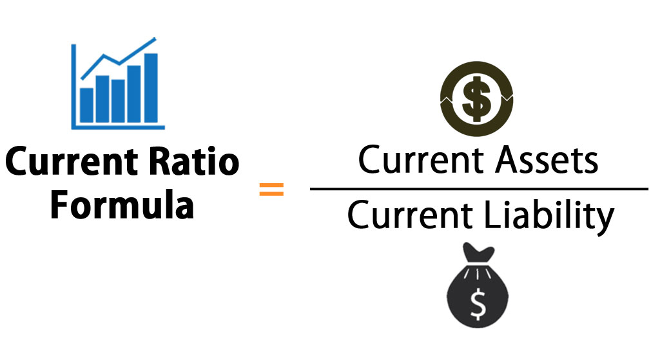
Liquidity Ratios
Current Ratio
The Current Ratio is calculated by dividing current assets by current liabilities.

Slide 46
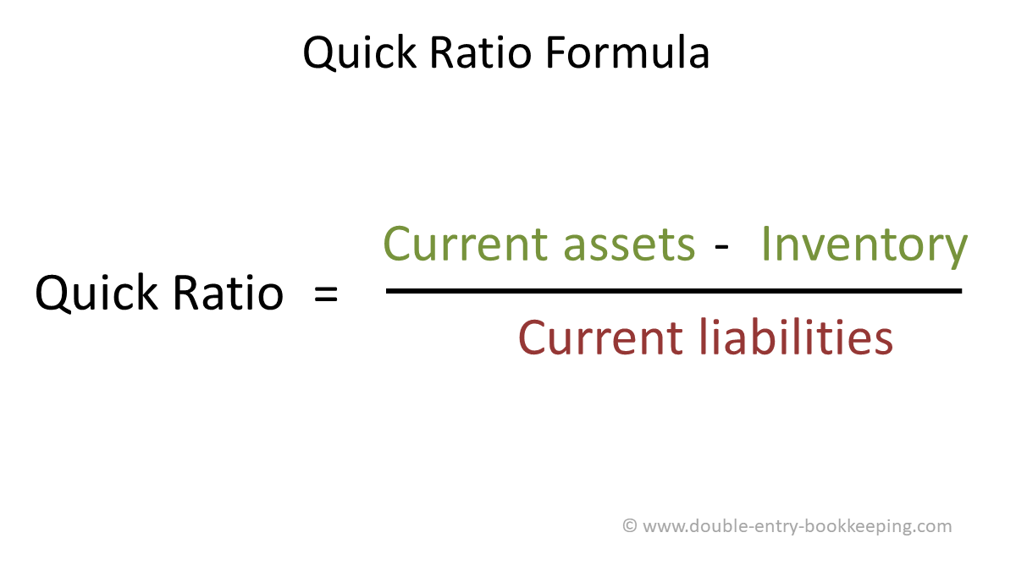
Liquidity Ratios
Quick Ratio
The Quick Ratio (also known as the Acid Test) is a far more stringent measure of liquidity because it eliminates inventory, the least liquid current asset.
  It measures how well an organization can meet its current obligations without resorting to the sale of its inventory.

Slide 47

Debt Utilization Ratios
Debt Utilization Ratios provide information about how much debt an organization is using relative to other sources of capital, such as owner’s equity.
  Because the use of debt carries an interest charge that must be paid regularly regardless of profitability, debt financing is much riskier than using equity.
    Unforeseen negative events such as recessions affect heavily indebted firms to a far greater extent than those financed exclusively with owner’s equity.
      Debt to Asset Ratio below 50% is good.

Slide 48
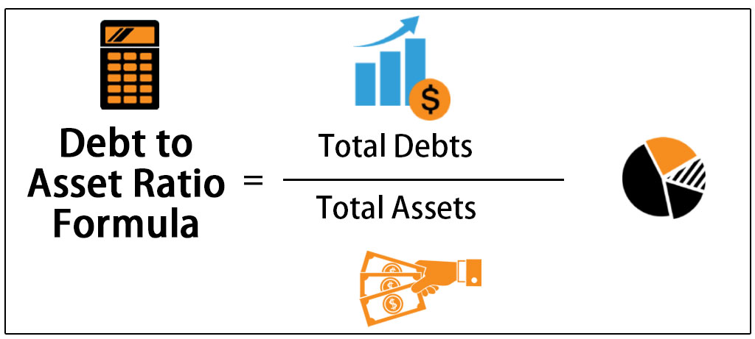
Debt Utilization Ratios
Debt to Total Assets Ratio
The Debt to Total Assets Ratio indicates how much of the firm is financed by debt and how much by owner’s equity.

Slide 49
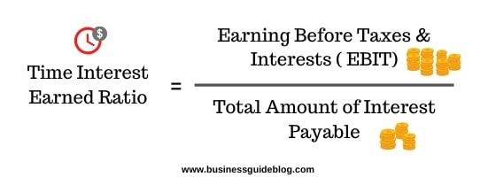
Debt Utilization Ratios
Times Interest Earned Ratio
The Times Interest Earned Ratio is calculated by operating income divided by interest expense, and is a measure of the safety margin a company has with respect to the interest payments it must make to creditors.
  A low times interest earned ratio indicates that even a small decrease in earnings may lead the company to financial straits.

Slide 50

Per Share Data
Investors may use Per Share Data to compare the performance of one company with another on an equal, or per share, basis.
  Generally, the more shares of stock a company issues, the less income is available for each share.

Slide 51
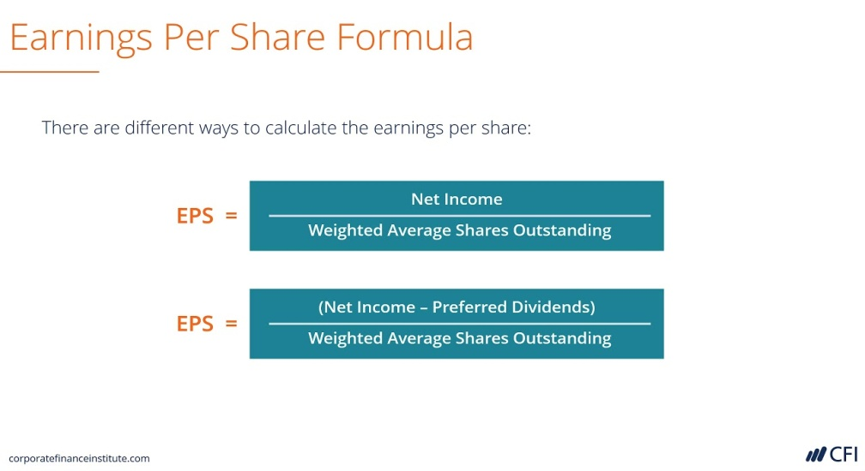
Per Share Data
Earnings Per Share
Earnings per share is calculated by dividing net income or profit by the number of shares of stock outstanding.
  This ratio is important because yearly changes in earnings per share, in combination with other economy-wide factors, determine a company’s overall stock price.
    When earnings go up, so does a company’s stock price – and so does the wealth of its stockholders.

Slide 52

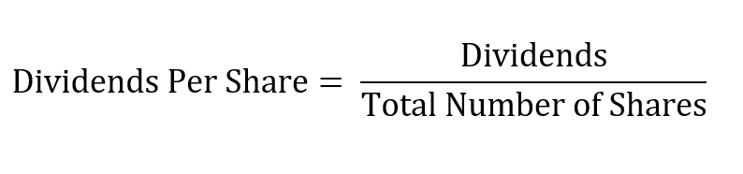
Per Share Data
Dividends Per Share
Dividends Per Share are paid by the corporation to the stockholders for each share owned.
  The payment is made from earnings after taxes by the corporation, but is taxable income to the stockholder.
    Thus, dividends result in double taxation: the corporation pays tax once on its earnings, and the stockholder pays a second time on their dividend income.

Slide 53

Importance of Integrity in Accounting
Strong compliance to accounting principles creates trust among stakeholders.
  Accounting and financial planning is important for all organizational entities.
    Integrity in accounting is crucial to creating trust, understanding the financial position of an organization or entity, and making financial decisions that will benefit the organization.

Slide 54
Business Survey

Slide 55
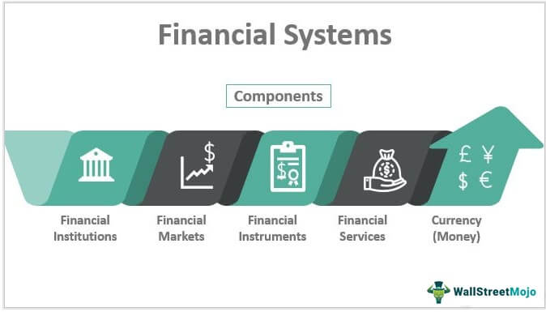
Part Six: Financing the Enterprise
Chapter Fifteen: Money and the Financial System

Slide 56

Introduction
Finance is the study of how money is managed by individuals, companies, and governments.
  This chapter introduces you to the role of money and the financial system in the economy.
    If you have a checking account, automobile insurance, or a credit card, you already have personal experience with some of the key players in the financial world.

Slide 57
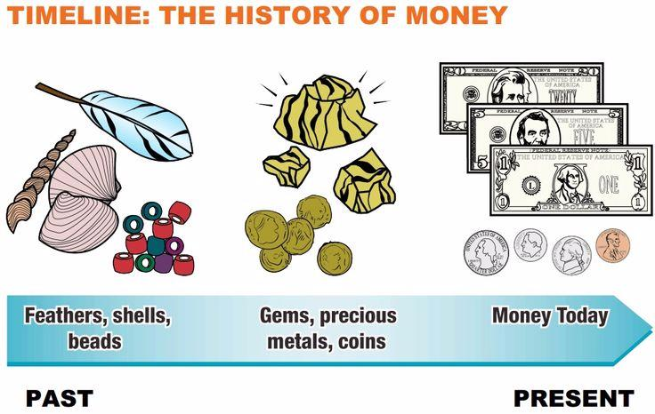
Money in the Financial System
Money, or currency, is anything generally accepted in exchange for goods and services.
  Materials as diverse as salt, cattle, fish, rocks, shells, and cloth, as well as precious metals such as gold, silver, and copper, have long been used by various cultures as money.
    Most of these materials were limited-supply commodities that had their own value to society. The supply of these commodities therefore determined the supply of “money” in that society.

Slide 58

Money in the Financial System
The next step was the development of “IOU’s,” or slips of paper that could be exchanged for a specified supply of the underlying commodity.
  “Gold” notes, for instance could be exchanged for gold, and the money supply was tied to the amount of gold available.
    The U.S. abandoned its gold-backed currency standard as a result of the Great Depression and converted to a fiduciary, or fiat, monetary system. In the U.S. paper money is really a government “note” or promise, worth the value specified on the note.

Slide 59

Functions of Money
Now matter what a particular society uses for money, its primary purpose is to enable a person or organization to transform a desire into action.
  These desires may be for entertainment actions, such as party expenses; operating actions, such as paying for rent, utilities, or employees; investing actions, such as buying property or equipment; or financing actions, such as for starting or growing a business.
    Money serves three important functions: as a medium of exchange, a measure of value, and a store of value.

Slide 60

Functions of Money
Medium of Exchange
Before fiat money, the trade of goods and services was accomplished through bartering – trading one good or service for another of similar value.
  As any school-age child knows, bartering can become quite inefficient - particularly in the case of complex, three-party transactions involving peanut butter sandwiches, baseball cards, and hair ties.
    There had to be a simpler way, and that was to decide on a single item – money – that can be freely converted to any other good upon agreement between parties.

Slide 61

Functions of Money
Measure of Value
As a Measure of Value, money serves as a common standard or yardstick of the value of goods and services.
  For example, $2 will buy a dozen large eggs and $25,000 will by a nice car in the U.S. In Japan, where the currency is known as the “yen,” these same transactions would cost about 210 yen and 2.75 million yen, respectively.
    Money, then, is a common denominator that allows people to compare the different goods and services that can be consumed on a particular income level.

Slide 62

Functions of Money
Store of Value
As a store of value, money serves as a way to accumulate wealth (buying power) until it is needed.
  For example, a person making $1,000 per week who wants to buy a $500 computer could save $50 per week for each of the next 10 wks.
    Value of stored money is directly dependent on the health of the economy. If, due to inflation, prices increase, then the purchasing power of the money “stuffed in the mattress” would fall. On the other hand, deflation occurs when the prices of goods fall.

Slide 63

Deflation
Deflation might seem like a good thing for consumers, but in many ways it can be just as problematic as inflation.
  Periods of major deflation often lead to decreases in wages and increases in debt burdens.
    Deflation also tends to be an indicator of problems in the economy. It indicates slow economic growth and falling prices.

Slide 64

Characteristics of Money
To be used as a medium of exchange, money must be acceptable, divisible, portable, stable in value, durable, and difficult to counterfeit.

Slide 65
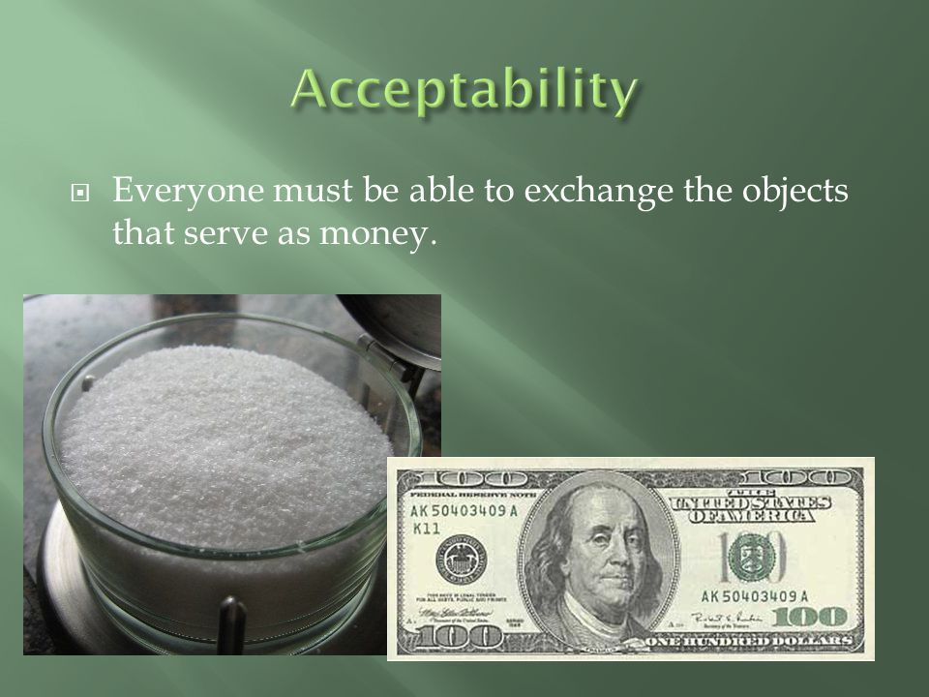
Characteristics of Money
1. Acceptability
To be effective, money must be readily acceptable for the purchase of goods and services and for the settlement of debts.
  Acceptability is probably the most important characteristics of money: If people do not trust the value of money, businesses will not accept it as a payment for goods and services, and consumers will have to find some other means of paying for their purchases.

Slide 66
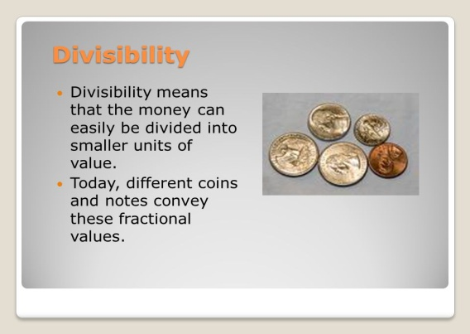

Characteristics of Money
2. Divisibility
Given the widespread use of quarters, dimes, nickels, and pennies in the U.S., it is no surprise that the principle of divisibility is an important one.
  With barter, the lack of divisibility often makes otherwise preferable trades impossible, as would be an attempt to trade a steer for a loaf of bread.
    For money to service effectively as a measure of value, all items must be valued in terms of comparable units – pennies for candy, quarters for laundry, and dollars (and coins) for everything else.

Slide 67

Characteristics of Money
3. Portability
Clearly, for money to function as a medium of exchange, it must be easily moved from one location to the next.
  Large colored rocks could be used as money, but you couldn’t carry them around in your wallet.
    Paper currency and metal coins, on the other hand, are capable of transferring vast purchasing power into small, easily carried (and hidden) bundles.

Slide 68

Characteristics of Money
4. Stability
Money must be stable and maintain its declared face value.
  A $10 bill should purchase the same amount of goods or services from one day to the next.
    The principle of stability allows people who wish to postpone purchases and save their money to do so without fear that it will decline in value.
      Instability destroys confidence in a nation’s money and its ability to store value and serve as an effective medium of exchange.
      Instability in paper money moves people to store their savings in real assets such as gold and land.

Slide 69
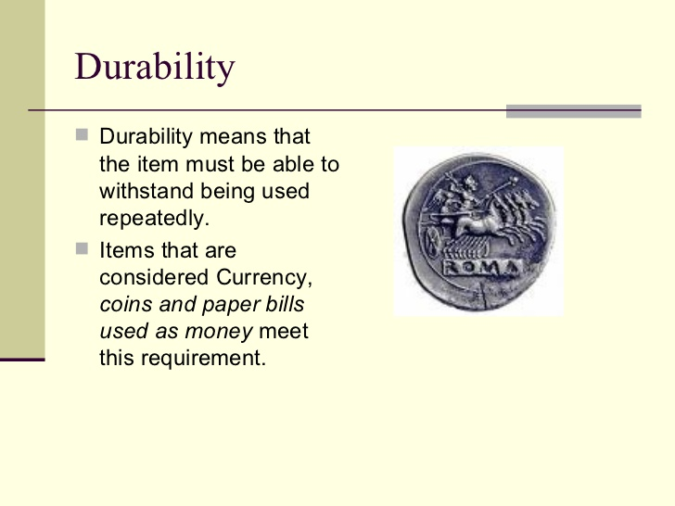
Characteristics of Money
5. Durability
Money must be durable.
  The crisp new dollar bills you trade for products at the mall will make their way all around town for about six years before being replaced.
    Although metal coins, due to their much longer useful life, would appear to be an ideal form of money, paper currency is far more portable than metal because of its light weight.
      Today, coins are used primarily to provide divisibility.

Slide 70

Characteristics of Money
6. Difficulty to Counterfeit
Finally, to remain stable and enjoy universal acceptance, it almost goes without saying that money must be very difficult to counterfeit – that is, to duplicate illegally.
  Every country takes steps to make counterfeiting difficult. Most use multicolored money, and many use specially watermarked papers that are virtually impossible to duplicate.
    Counterfeit bills represent less than .03 percent of the currency in circulation in the U.S., but it is become increasingly easy for counterfeiters to print money.

Slide 71

Types of Money
While paper money and coins are the most visible types of money, the combined value of all of the printed bills and all of the minted coins is actually rather insignificant when compared with the value of money kept in checking accounts, savings accounts, and other monetary forms.

Slide 72

Types of Money
Checking Account
  Money stored in an account at a bank or other financial institution that can be withdrawn without advance notice.
Savings Accounts
  Accounts with funds that usually cannot be withdrawn without advance notice.
Money Market Accounts
  Accounts that offer higher interest rates than standard bank rates but with greater restrictions.
Certificates of Deposit (CDs)
  Savings accounts that guarantee a depositor a set interest rate over a specified interval as long as the funds are not withdrawn before the end of the period.
Credit Cards
  Means of access to preapproved lines of credit granted by a bank or finance co.
Reward Cards
  Credit cards made available by stores that carry a benefit to the user.
Debit Cards
  A card that looks like a credit card but works like a check; using it results in a direct, immediate, electronic payment from the cardholder’s checking account to a merchant.

Slide 73
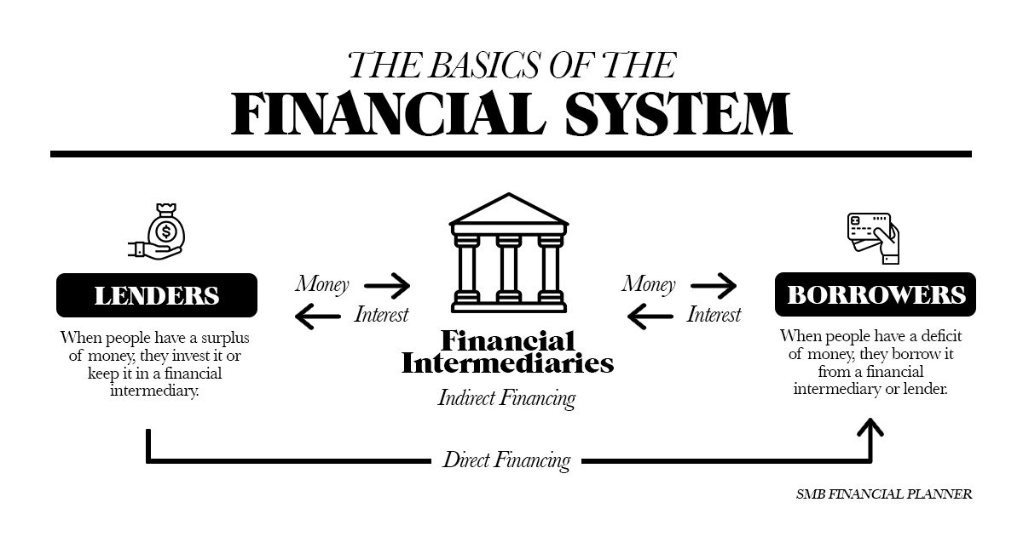
The American Financial System
The U.S. financial system fuels our economy by storing money, fostering investment opportunities, and making loans for new businesses and business expansion as well as for homes, cars, and college educations.
  This amazingly complex system includes banking institutions, non-banking financial institutions such as finance companies, and systems that provide for the electronic transfer of funds throughout the world.

Slide 74

The Federal Reserve System
The guardian of the American financial system is the Federal Reserve Board, or “the Fed,” as it is commonly called, an independent agency of the federal government established in 1913 to regulate the nation’s banking and financial industry.
  The Federal Reserve System is organized into 12 regions, each with a Federal Reserve Bank that serves its defined area.
    The Federal Reserve Board is the chief economic policy arm in the United States.

Slide 75

Federal Reserve System
Working with Congress and the President, the Fed tries to create a positive economic environment capable of sustaining low inflation, high levels of employment, a balance in international payments, and long-term economic growth.
  To this end, the Federal Reserve Board has four major responsibilities:
    Control the supply of money, or monetary policy.
    Regulate banks and other financial institutions.
    Manage checking account procedures, or check clearing.
    Supervise the federal deposit insurance programs of banks.

Slide 76
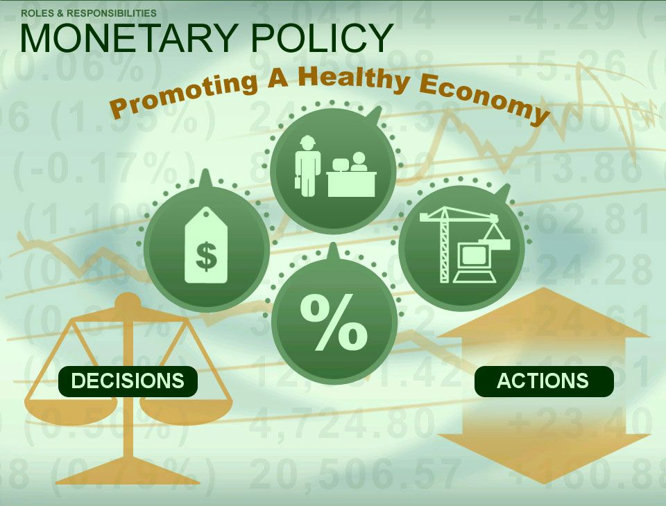
The Federal Reserve System
Monetary Policy
The Fed controls the amount of money available in the economy through Monetary Policy. Without this intervention, the supply of and demand for money might not balance.
  To effectively control the supply of money in the economy, the Fed must have a good idea of how much money is in circulation.
    Using several different measures of the money supply, the Fed establishes specific growth targets that, presumably, ensure a close balance between money supply and money demand.

Slide 77

Monetary Policy
Open Market Operations
Open Market Operations refer to decisions to buy or sell U.S. Treasury Bills (short-term debt issued by the U.S. government; also called T-bills) and other investments in the open market.
  The actual purchase or sale of the investments is performed by the New York Federal Reserve Bank.
    This monetary tool, the most commonly employed of all Fed operations, is performed almost daily in an effort to control the money supply.

Slide 78

Monetary Policy
Open Market Operations
When the Fed buys securities, it writes a check on its own account to the seller of the investments.
  When the seller of the investments (usually a large bank) deposits the check, the Fed transfers the balance from the Federal Reserve account into the seller’s account, thus increasing the supply of money in the economy and, hopefully, fueling economic growth.
    The opposite occurs when the Fed sells investments. The buyer writes a check to the Federal Reserve, and when the funds are transferred out of the purchaser’s account, the amount of money in circulation falls, slowing economic growth to desired level.

Slide 79

Monetary Policy
Reserve Requirement
The second major monetary policy tool is the Reserve Requirement, the percentage of deposits that banking institutions must hold in reserve (“in the vault,” as it were).
  Funds so held are not available for lending to businesses and consumers. For example, a bank holding $10 million in deposits, with a 10% reserve requirement, must have reserves of $1 million.
    Because the reserve requirement has such a powerful effect on the money supply, the Fed does not change it very often, relying instead on open market operations most of the time.

Slide 80

Monetary Policy
Discount Rate
The third monetary policy tool, the Discount Rate, is the rate of interest the Fed charges to loan money to any banking institution to meet reserve requirements.
  The Fed is the lender of last resort for these banks. When a bank borrows from the Fed, it is said to have borrowed at the “discount window,” and the interest rates charged there are often higher than those charged on loans of comparable risk elsewhere in the economy.
    This added interest expense, when it exists, serves to discourage banks from borrowing from the Fed.
    When the Fed wants to expand the money supply, it lowers the Discount Rate to encourage borrowing.

Slide 81

Monetary Policy
Credit Controls
The final tool in the Fed’s arsenal of weapons is Credit Controls – the authority to establish and enforce credit rules for financial institutions and some private investors.
  For example, the Fed can determine how large a down payment individuals and businesses must make on credit purchases of expensive items such as automobiles, and how much time they have to finish paying for the purchases.
    By raising and lowering minimum down payment amounts and payment periods the Fed can stimulate or discourage credit purchases of “big ticket” items.

Slide 82
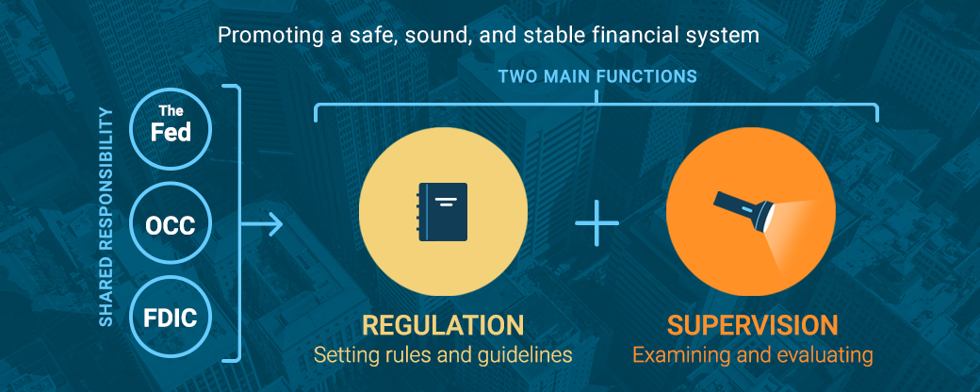
The Federal Reserve System
Regulatory Functions
The second major responsibility of the Fed is to regulate banking institutions that are members of the Federal Reserve System.
  Accordingly, the Fed establishes and enforces banking rules that affect monetary policy and the overall level of the competition between different banks.
    It determines which non-banking activities such as brokerage services, leasing, and insurance, are appropriate for banks and which should be prohibited.

Slide 83

The Federal Reserve System
Depository Insurance
The Fed is also responsible for supervising the federal insurance funds that protect the deposits of member institutions.

Slide 84
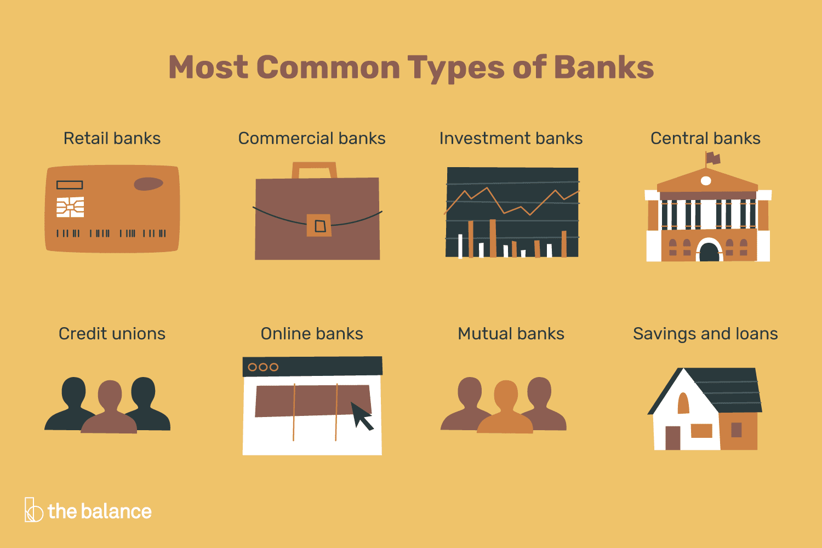
Banking Institutions
Banking institutions accept money deposits from and make loans to individual consumers and businesses.
  Some of the most important banking institutions include commercial banks, savings and loan associations, credit unions, and mutual savings banks.
    Historically, these have all been separate institutions. However, new hybrid forms of banking institutions that perform two or more of these functions have emerged over the past two decades.

Slide 85

Banking Institutions
Banking institutions all have one thing in common: They are businesses whose objective is to earn money by managing, safeguarding, and lending money to others.
  Their sales revenues come from the fees and interest that they charge for providing these financial services.

Slide 86
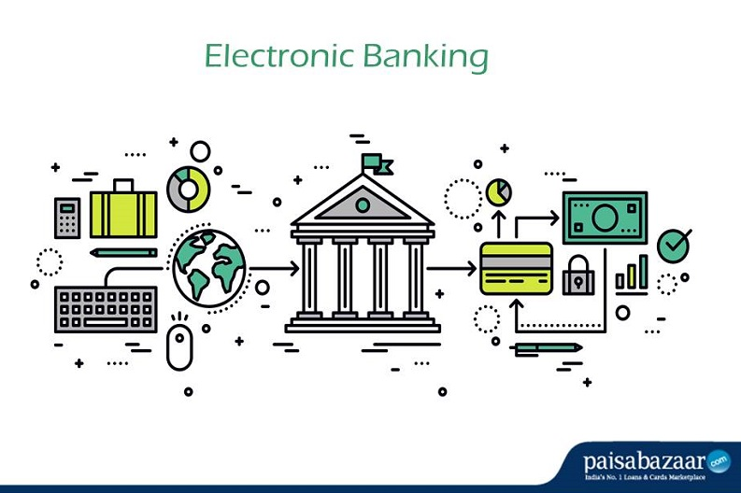
Electronic Banking
Since the advent of the computer age, a wide range of technological innovations has made it possible to move money all across the world electronically.
  Such “paperless” transactions have allowed financial institutions to reduce costs in what has been, and continues to be, a virtual competitive battlefield.

Slide 87

Electronic Banking
Electronic Funds Transfer (EFT)
Electronic Funds Transfer (EFT) is any movement of funds by means of an electronic terminal, telephone, computer, or magnetic tape.
  Such transactions order a particular financial institution to subtract money from one account and add it to another.
    The most commonly used forms of EFT are automated teller machines, automated clearinghouses, and home banking systems.

Slide 88

Future of Banking
Rapid advances and innovations in technology are challenging the banking industry and requiring it to change.
  More and more banks, both large and small, are offering electronic access to their financial services.
    Online financial services, ATM technology/services, and bill presentation are just a few of the areas where rapidly changing technology is causing the banking industry to change as well.

Slide 89
Business Survey

Slide 90
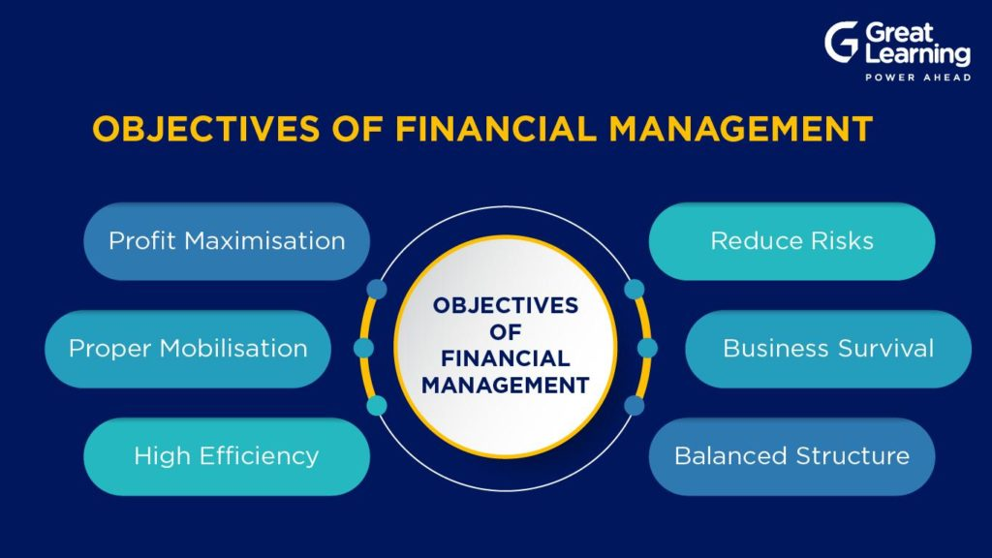
Part Six: Financing the Enterprise
Chapter Sixteen: Financial Management and Securities Markets

Slide 91

Introduction
Financial Management is the field that addresses the issues of obtaining and managing the funds and resources necessary to run a business successfully.
  All organizations must manage their resources effectively and efficiently if they are to achieve their objectives.

Slide 92
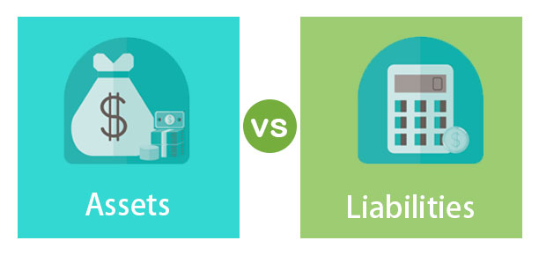
Managing Current Assets and Liabilities
Managing short-term assets and liabilities involves managing the current assets and liabilities on the balance sheet.
  Current Assets are short-term resources such as cash, investments, accounts receivable, and inventory.
  Current Liabilities are short-term debts such as accounts payable, accrued salaries, accrued taxes, and short-term bank loans.
    We use the terms current and short term interchangeably because short-term assets and liabilities are usually replaced by new assets and liabilities w/in 3-4 months, and always within a year.

Slide 93

Managing Current Assets and Liabilities
Managing short-term assets and liabilities is sometimes called Working Capital Management because short-term assets and liabilities continually flow through an organization and are thus said to be “working.”

Slide 94
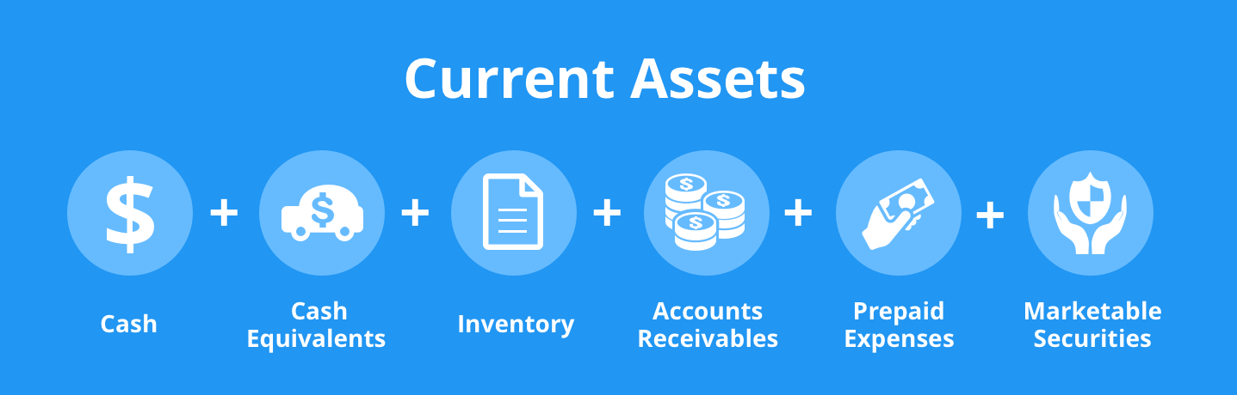
Managing Current Assets
The chief goal of financial managers who focus on current assets and liabilities is to maximize the return to the business on cash, temporary investments of idle cash, accounts receivable, and inventory.

Slide 95

Managing Current Assets
Managing Cash
Ensuring that sufficient (but not excessive) funds are on hand to meet the company’s obligations is one of the single most important facets of financial management.
  Idle cash does not make money, and corporate checking accounts typically do not earn interest.
    As a result, astute money managers try to keep just enough cash on hand, called Transaction Balances, to pay bills; such as, employee wages, supplies, and utilities, as they come due.

Slide 96
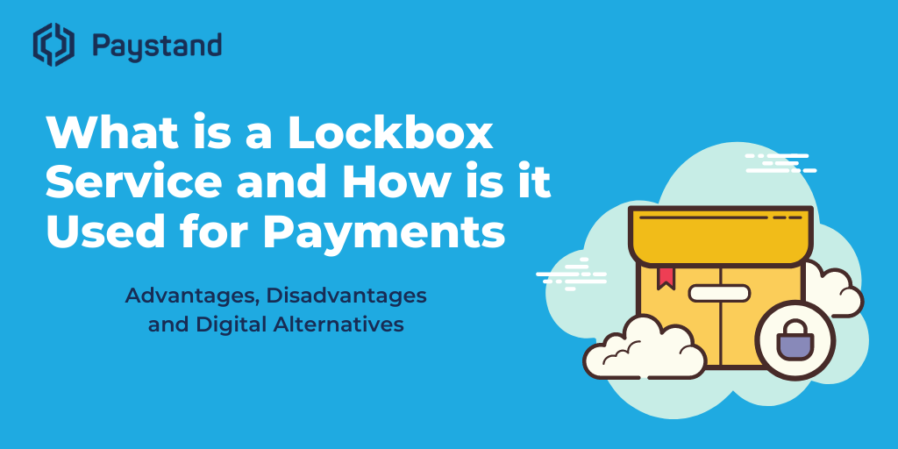
Managing Current Assets
Managing Cash
To manage the firm’s cash and ensure that enough cash flows through the organization quickly and efficiently, companies try to speed up cash collections from customers.
  To facilitate collection, some companies have customers send their payments to a Lockbox, which is simply an address for receiving payments, instead of directly to the company’s main address.
    The manager of the lockbox, usually a commercial bank, collects payments directly from the lockbox several times a day and deposits them into the company’s bank account.

Slide 97

Managing Current Assets
Investing Idle Cash
As companies sell products, they generate cash on a daily basis, and sometimes cash comes in faster than it is needed to pay bills.
  Organizations often invest this “extra” cash, for periods as short as one day (overnight) or for as long as one year, until it is needed. Such temporary investments of cash are known as Marketable Securities.

Slide 98

Managing Current Assets
Investing Idle Cash
Many large companies invest idle cash in:
  Treasury Bills (T-Bills)
    Short-term debt obligations the U.S. government sells to make money.
  Commercial Certificates of Deposit (CDs)
    Certificates of deposit issued by commercial banks and brokerage companies, available in minimum amounts of $100K, which may be traded prior to maturity.
  Commercial Paper
    A written promise from one company to another to pay a specific amount of money.

Slide 99

Managing Current Assets
Maximizing Accounts Receivable
After cash and marketable securities, the balance sheet lists accounts receivable, money owed to a business by credit customers, and inventory.
  Many businesses make the vast majority of their sales on credit, so managing accounts receivable is an important task.
    Each credit sale represents an account receivable for the company, the terms of which typically require customers to pay the full amount due within 30-60-90 days from date of sale.

Slide 100

Managing Current Assets
Optimizing Inventory
While the inventory that a firm holds is controlled by both production needs and marketing considerations, the financial manager has to coordinate inventory purchases to manage cash flows.
  The object is to minimize the firm’s investment in inventory without experiencing production cutbacks as a result of critical materials shortfalls or lost sales due to insufficient finished goods inventories.
    Every dollar invested in inventory is a dollar unavailable for investment in some other area of the organization.

Slide 101
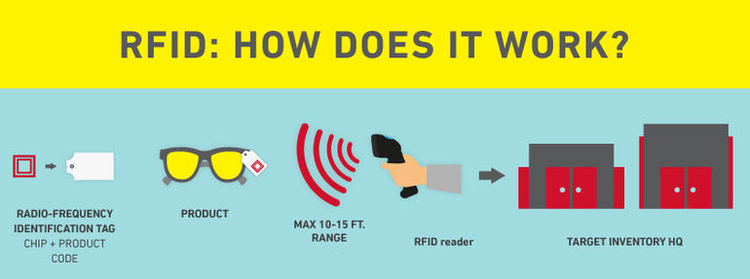
Managing Current Assets
Optimizing Inventory
Optimal inventory levels are determined in large part by the method of production.
  If a firm attempts to produce its goods just in time to meet sales demand, the level of inventory will be relatively low.
  If, on the other hand, the firm produces materials in a constant, level pattern, inventory increases when sales decrease and decreases when sales increase.
    One way that companies are optimizing inventory is through the use of radio frequency identification (RFID) technology, which allows companies to use radio waves to track and identify product.

Slide 102
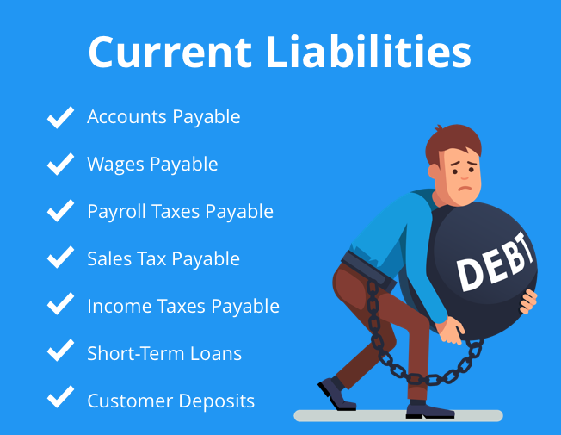
Managing Current Liabilities
While having extra cash on hand is a delightful surprise, the opposite situation – a temporary cash shortfall – can be a crisis.
  The good news is that there are several potential sources of short term funds.
    Suppliers often serve as an important source through credit sales practices. Banks, finance companies, and other organizations also offer short-term funds through loans and other business operations.

Slide 103

Managing Current Liabilities
Accounts Payable
Just as accounts receivable must be actively managed to ensure proper cash collections, so too must accounts payable be managed to make the best use of this liability.
  Accounts payable is money an organization owes to suppliers for goods and services.
    The most widely used source of short-term financing, and therefore the most important account payable, is trade credit – credit extended by suppliers for purchase of goods and services.

Slide 104

Managing Current Liabilities
Bank Loans
Virtually all organizations – large and small – obtain short term funds for operations from banks.
  In most instances, the credit services granted these firms take the form of a line of credit or fixed dollar loan.
    A Line of Credit is an arrangement by which a bank agrees to lend a specified amount of money to the organization upon request. In general, a business LOC is similar to a consumer credit card.

Slide 105

Managing Current Liabilities
Bank Loans
In addition to credit lines, banks also make: Secured Loans – loans backed by collateral that the bank can claim if the borrowers do not repay the loans, and Unsecured Loans – loans backed only by the borrower’s good reputation and previous credit rating.
  Both individuals and businesses build their credit rating from their history of borrowing and repaying borrowed funds on time and in full.
    A lack of credit history or poor credit history can make it difficult to get loans from financial institutions.

Slide 106

Managing Current Liabilities
Nonbank Liabilities
Banks are not the only source of short-term funds for businesses.
  Virtually all financial institutions, from insurance companies to pension funds, from money market funds to finance companies, make short-term loans to many organizations.

Slide 107

Managing Fixed Assets
While most business failures are the result of poor short-term planning, successful ventures must also consider the long-term financial consequences of their actions.
  Managing the long-term assets and liabilities and the owner’s equity portion of the balance sheet is important for the long-term health of the business.
    Long-Term (Fixed) Assets are expected to last for many years – production facilities (plants), offices, equipment, heavy machinery, furniture, automobiles, and so on.

Slide 108

Managing Fixed Assets
In today’s fast-paced world, companies need the most technologically advanced, modern facilities and equipment they can afford. However, modern and high-tech equipment carry high price tags.
  Leasing is one approach to financing these items. Leasing involves paying a fees for usage rather than owning the asset.
    There are two kinds of leases: (1) capital leases, long-term contracts which show on the balance sheet as an asset and a liability, and (2) operating leases, short-term cancelable contracts which do not show up on the balance sheet.

Slide 109

Managing Fixed Assets
Capital Budgeting and Project Selection
One of the most important jobs performed by the financial manager is to decide what fixed assets, projects, and investments will earn profits for the firm beyond the cost necessary to fund them.
  The process of analyzing the needs of the business and selecting the assets that will maximize its value is called Capital Budgeting.
    The capital budget is the amount of money budgeted for investment in such long-term assets.

Slide 110

Managing Fixed Assets
Capital Budgeting and Project Selection
Capital Budgeting does not end with selection and purchase of a particular piece of land, equipment, or major investment.
  All assets and projects must be continually reevaluated to ensure their compatibility with the organization’s needs.
    If a particular asset does not live up to expectations, management must determine why and take necessary corrective action.

Slide 111

Managing Fixed Assets
Assessing Risk
Every investment carries some risk.
  The longer a project or asset is expected to last, the greater its potential risk because it is hard to predict whether a piece of equipment will wear out or become obsolete in 5 or 10 years.
    The level of a project’s risk is also affected by the stability and competitive nature of the marketplace and the world economy.

Slide 112

Managing Fixed Assets
Pricing Long-Term Money
The ultimate profitability of any project depends not only on accurate assumptions of how much cash it will generate, but also on its financing costs.
  Because a business must pay interest on money it borrows, the returns from any project must cover not only the costs of operating the project but also the interest expenses for the debt used to finance its construction.
    Unless an organization can effectively cover all of its costs – both financial and operating – it will eventually fail.

Slide 113

Financing with Long-Term Liabilities
Long-term assets do not come cheaply, and few companies have the cash on hand for growth opportunities.
  To develop the needed fixed assets, companies must raise low-cost long-term funds to finance them. Two common choices for raising these funds are:
    Attracting new owners (equity financing)
    Taking on long-term liabilities (debt financing).

Slide 114

Long-Term Liabilities
Long-Term Liabilities are debts that will be repaid over a number of years, such as bank loans and bond issues.
  These take many different forms, but in the end, they are debt.
    Companies may raise money by borrowing it from commercial banks or other financial institutions in the form of lines of credit, short-term loans, or long-term loans.
    Many corporations acquire debt by borrowing money from pension funds, mutual funds, or life-insurance funds.

Slide 115

Financing with Long-Term Liabilities
Bonds: Corporate IOUs
Much long-term debt takes the form of Bonds, which are debt instruments that larger companies sell to raise long-term funds.
  In essence, the buyers of bonds (bond holders) loan the issuer of the bonds cash in exchange for regular interest payments until the loan is repaid on or before a specified maturity date.
    The bond itself is a certificate, much like an IOU, that represents the company’s debt to the bondholder.

Slide 116
Financing with Owners’ Equity
Owners’ Equity
A second means of long-term financing is through equity.
  Owner’s equity refers to the owners’ investment in an organization.
    Sole proprietors and partners own all or part of their businesses outright, and their equity includes the money and assets they have brought into their ventures.
    Corporate owners own stock or shares of their companies, which they hope will provide them with a return on their investment

Slide 117

Financing with Owners’ Equity
Retained Earnings
When a corporation has profits left over after paying all of its expenses and taxes, it has a choice of retaining all or a portion of its earnings and/or paying them out to its shareholders in the form of dividends.
  Retained Earnings are reinvested in the assets of the firm and belong to the owners in the form of equity.
    Retained Earnings are an important source of funds and are, in fact, the only long-term funds that can be generated internally.

Slide 118

Financing with Owners’ Equity
Dividend Yield
When the company distributes some of the corporations’ profits to the owners, it issues them as cash dividend payments.
  A Dividend Yield is the dividend per share divided by the stock price. It is the cash return as a percentage of the price, but does not reflect the total return an investor earns on the individual stock.

Slide 119

Investment Banking
A company that needs more money to expand or take advantage of growth opportunities may be able to obtain financing by issuing stock.
  The first-time sale of stock and bonds directly to the public is called a new issue. Companies that already have stocks or bonds outstanding may offer a new issue of stock to raise additional funds for a specific project.
    When a company offers its stock to the public for the very first time, it is said to be “going public,” and the sale is called an Initial Public Offering (IPO).

Slide 120

Investment Banking
New issues of stocks and bonds are sold directly to the public and to institutions in what is known as the Primary Market – the market where firms raise financial capital.
  The primary market differs from secondary markets, which are stock exchanges and over-the-counter markets where investors can trade their securities with other investors rather than the company that issued the stock or bonds.
    Primary market transactions actually raise cash for the issuing corporations, while secondary market transactions do not.

Slide 121

Investment Banking
Investment Banking, the sale of stocks and bonds for corporations, helps such companies raise funds by matching people and institutions who have money to invest with corporations in need of resources to exploit new opportunities.
  Corporations usually employ an investment banking firm to help sell their securities in the primary market.
    An investment banker helps firms establish appropriate offering prices for their securities. In addition, the investment banker takes care of the myriad of details and securities regulations involved in any sale of securities to the public.

Slide 122

The Securities Markets
Securities Markets provide a mechanism for buying and selling securities.
  They make it possible for owners to sell their stocks and bonds to other investors. Thus, in the broadest sense, stocks and bonds markets may be thought of as providers of liquidity – the ability to turn security holdings into cash quickly.
    The ability to sell securities at well-established market prices is one of the pillars of our capitalistic society.

Slide 123

Stock Markets
Stock Markets exist around the world. The two biggest stock markets in the United States are the New York Stock Exchange (NYSE) and the NASDAQ market.
  The NYSE is the world’s largest stock exchange by market capitalization.
    NYSE used to be primarily a floor-traded market, where brokers met at trading posts on the floor to buy and sell common stock. The brokers act as agents for their clients and do not own their own inventory. Today, almost 80% of NYSE trading is electronic.

Slide 124

Measuring Market Performance
Investors, especially professional money managers, want to know how well their investments are performing relative to the market as a whole.
  They also need to know how their companies’ securities are performing when compared with their competitors.’
    Thus, performance measures – averages and indexes – are very important to many different people. They not only indicate the performance of a particular securities market but also provide a measure of the overall health of the economy.

Slide 125

Measuring Market Performance
Indexes and averages are used to measure stock prices.
  An Index compares current stock prices with those in a specified base period. An Average is the average of certain stock prices.
    Investors perform better by keeping an eye on the long-term trend line and not the short-term fluctuations.
    Many investors follow the activity of the Dow Jones Industrial Average to see whether the stock market has gone up or down.

Slide 126


