Slide 1

Business Survey
Session Three
Business Foundations
  A Changing World 11th Edition
    O.C. Ferrell, Geoffrey Hirt, and Linda Ferrell; McGraw Hill Education; New York, NY 2018
      ISBN: 978-1-259-68523-1

Slide 2

Part Three: Managing for Quality and Competitiveness
Chapter Six: The Nature of Management

Slide 3

Introduction
For any organization to achieve its objectives, it must have resources to support operations, employees to make and sell the products, and financial resources to purchase additional goods and services, pay employees, and generally operate the business.
  To accomplish this, it must also have one or more managers to plan, organize, staff, direct, and control the work that goes on.

Slide 4

The Importance of Management
Management is a process designed to achieve an organization’s objectives by using its resources effectively and efficiently in a changing environment.
  Effectively - having the intended result.
  Efficiently - accomplishing the objectives with minimum resources.
    Managers make decisions about the use of an organization’s resources and are concerned with (1) planning, (2) organizing, (3) directing, and (4) controlling organizational activities to reach its objectives.

Slide 5

The Importance of Management
Universal
Management is universal. It takes place not only in business, but also in government, the military, labor unions, hospitals, schools, and religious groups – any organization requiring the coordination of resources.
  Every organization must acquire resources (people, services, raw materials and equipment, financial, and information) to effectively pursue its objectives and coordinate their use to turn out a final good or service.

Slide 6


The Importance of Management
Staffing
Employees are one of the most important resources in helping a business attain its objectives.
  Hiring people to carry out the work of an organization is known as staffing.
    Beyond recruiting people for positions within the firm, managers must determine what skills are needed for specific jobs, how to motivate and train employees, how much to pay, what benefits to provide, and how to prepare employees for higher-level jobs in the firm at a later date.

Slide 7

The Importance of Management
Downsizing
Sometimes, managers must make the difficult decision to reduce the workforce.
  This is known as downsizing, the elimination of significant numbers of employees from an organization.
    After downsizing, an effective manager will promote optimism, positive thinking, and minimize criticism and fault-finding.

Slide 8

The Importance of Management
Suppliers
Acquiring suppliers is another important part of managing resources and ensuring that products are made available to customers.
  A good supplier maximizes efficiencies and provides creative solutions to help the company reduce expenses and reach its objectives.

Slide 9

The Importance of Management
Financial Resources
The manager needs adequate financial resources to pay for essential activities.
  Primary funding comes from owners and shareholders, as well as banks and other financial institutions.
    All these resources and activities must be coordinated and controlled if the company is to earn a profit.

Slide 10
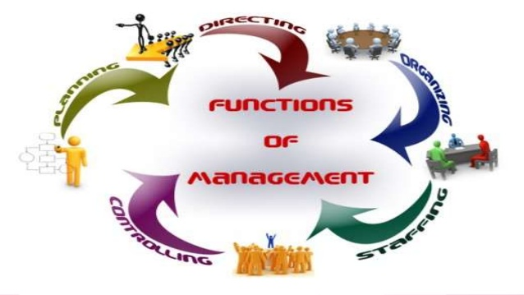
Management Functions
To harmonize the use of resources so that the business can develop, produce, and sell products, managers engage in a series of activities:
  Planning
  Organizing
  Directing
  Controlling

Slide 11
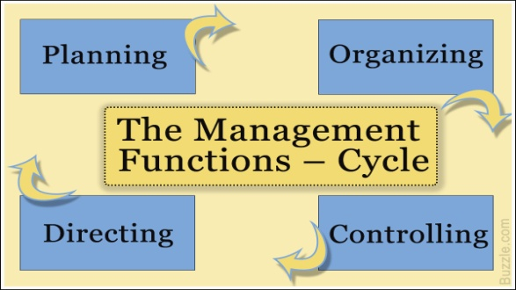
Management Functions
The Functions of Management:
  Planning
    Activities to achieve the organization’s objectives.
  Organizing
    Resources and activities to achieve the organization’s objectives.
  Directing
    Employees’ activities toward achievement of objectives.
  Controlling
    The organization’s activities to keep it on course.

Slide 12
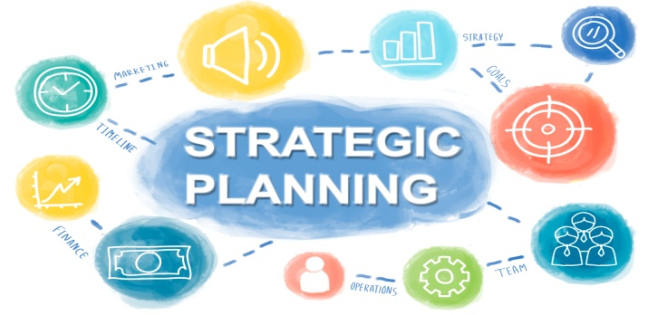
1. Planning
Planning, the process of determining the organization’s objectives and deciding how to accomplish them, is the first function of management.
  Planning is a crucial activity because it designs the map that lays the groundwork for other functions.
    It involves forecasting events and determining the best course of action from a set of options or choices.
    The plan itself specifies what should be done, by whom, where, when, and how.

Slide 13

Planning
Mission
A mission, or mission statement, is a declaration of any organization’s fundamental purpose and basic philosophy.
  It seeks to answer the question: “What business are we in?”
    Good mission statements are clear and concise statements that explain the organization’s reason for existence.

Slide 14

Planning
Mission Statement
A well-developed Mission Statement, no matter what the industry or size of the business, will answer five basic questions:
  Who are we?
  Who are our customers?
  What is our operating philosophy (basic beliefs, values, ethics…)?
  What are our core competencies and competitive advantages?
  What are our responsibilities with respect to being a good steward of environmental, financial, and human resources?

Slide 15


Planning
Goals
A goal is the result that a firm wishes to achieve. A company almost always has multiple goals, which illustrates the complex nature of the business.
  A goal has three key components:
    An attribute sought, such as profits, customer satisfaction, or product quality; A target to be achieved, such as the volume of sales or the extent of management training to be achieved; and a time frame in which the goal is to be achieved.

Slide 16

Planning
Objectives
Objectives, the ends or results desired by an organization, derive from the organization’s mission.
  A business’s objectives may be elaborate or simple.
    Common objectives relate to profit, competitive advantage, efficiency, and growth.

Slide 17

Planning
Goals vs. Objectives
The principal difference between goals and objectives is that objectives are stated in such a way that they are measureable.
  Organizations with profit as an objective want to have money and assets left over after paying off business expenses.
  Objectives regarding competitive advantages are generally stated in terms of percentage of sales increase and market share.
  Efficiency objectives involve making the best use of resources.
  Growth objectives relate to an organization’s ability to adapt and to get new products to the marketplace in a timely fashion.
    One of the most important objectives for business is sales.

Slide 18
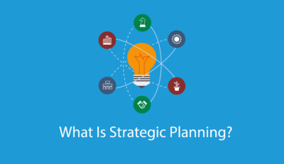
Planning
Strategic Plans
There are three general types of plans for meeting objectives – (1) strategic, (2) tactical, and (3) operational.
  A firm’s highest managers develop its Strategic Plans, which establish the long-range objectives and overall strategy or course of action by which the firm fulfills its mission.
    Strategic Plans take into account the organization’s capabilities and resources, changing business environment, and organizational objectives. Plans should be market-driven, matching customers’ desire for value with operational capabilities, processes, and human resources.

Slide 19
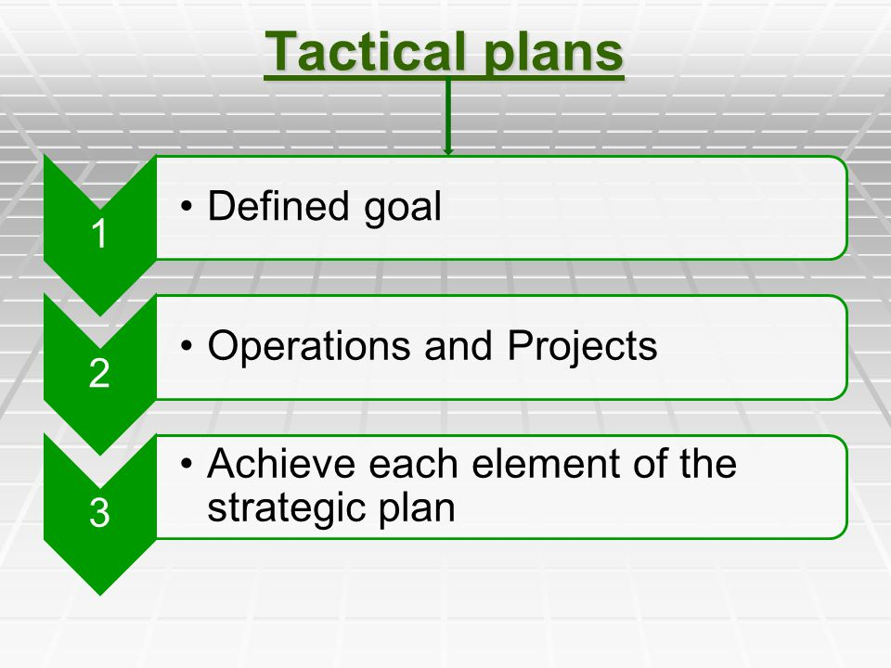
Planning
Tactical Plans
Tactical Plans are short range and designed to implement the activities and objectives specified in the strategic plan.
  These plans, which usually cover a period of one year or less, help keep the organization on the established course.
    A fast-paced and ever-changing market requires companies to develop short-run or tactical plans to deal with the changing environment.

Slide 20
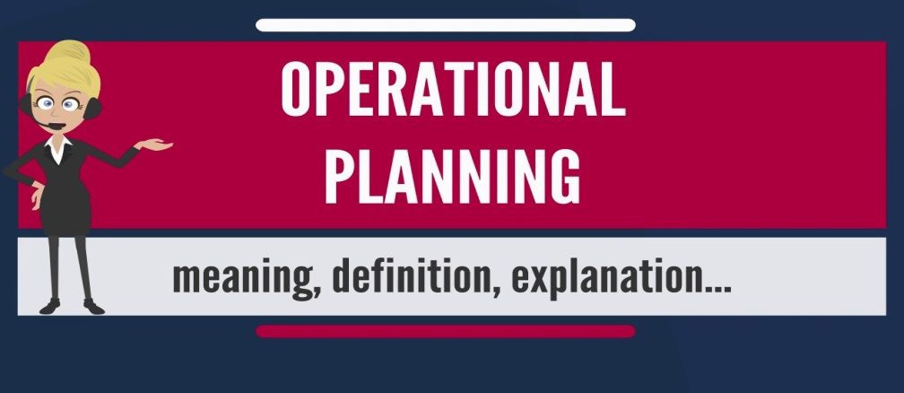
Planning
Operational Plans
Operational Plans are very short term and specify what actions specific individuals, work groups, or departments need to accomplish in order to achieve the tactical plan and ultimately the strategic plan.
  (i.e.) A work group may be assigned a weekly production quota to ensure there are sufficient products available to elevate market share (tactical goal) and ultimately help the firm be number one in its product category (strategic goal).

Slide 21
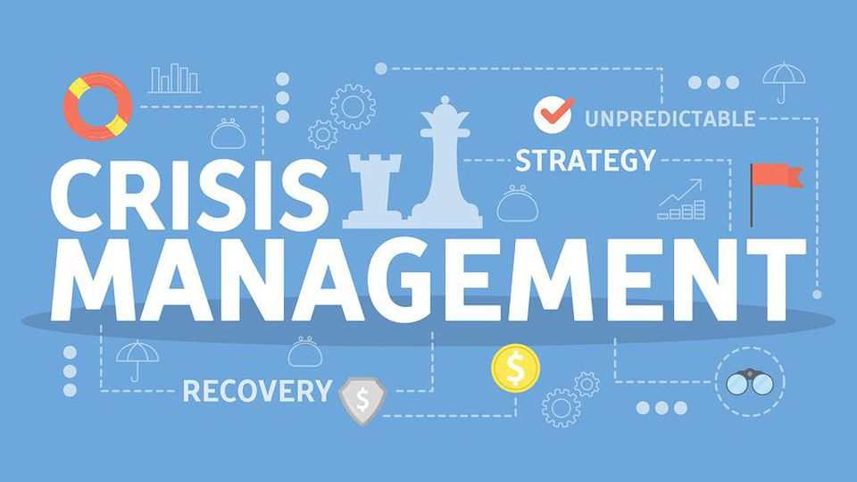

Planning
Crisis Management
Another element of planning is Crisis Management or Contingency Planning, which deals with potential disasters such as product tampering, oil spills, fire, earthquake, computer viruses, or even a reputation crisis due to unethical or illegal conduct by one or more employees.
  Businesses that have correct and well-thought-out contingency plans tend to respond more effectively when problems occur than do businesses who lack such planning.

Slide 22

Planning
Crisis Management
Crisis management plans generally cover maintaining business operations throughout a crisis and communicating with the public, employees, and officials about the nature of and the company’s response to the problem.
  Communication is especially important to minimize panic and damaging rumors; it also demonstrates that the company is aware of the problem and plans to respond.

Slide 23
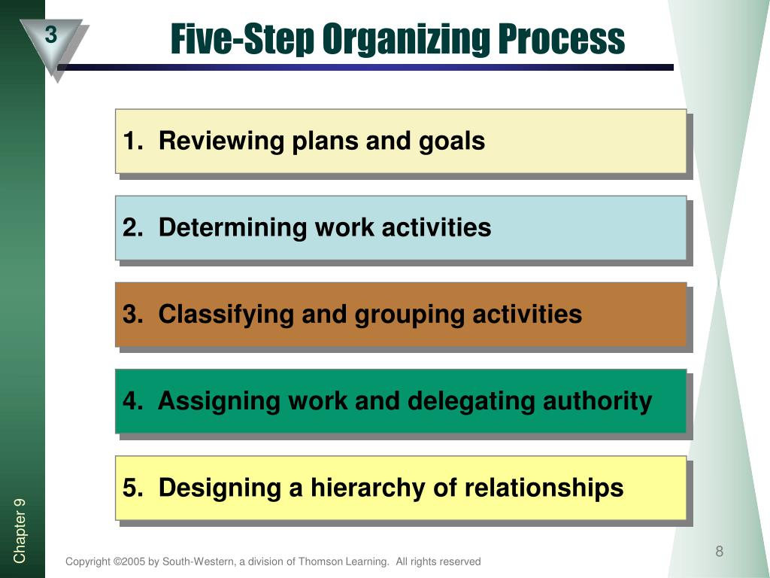

2. Organizing
Organizing is the structuring of resources and activities to accomplish objectives in an efficient and effective manner.
  Managers organize by reviewing plans and determining what activities are necessary to implement them; then, they divide the work into small units and assign it to specific individuals, groups, or departments.
    Organizing occurs continuously because change is inevitable.

Slide 24
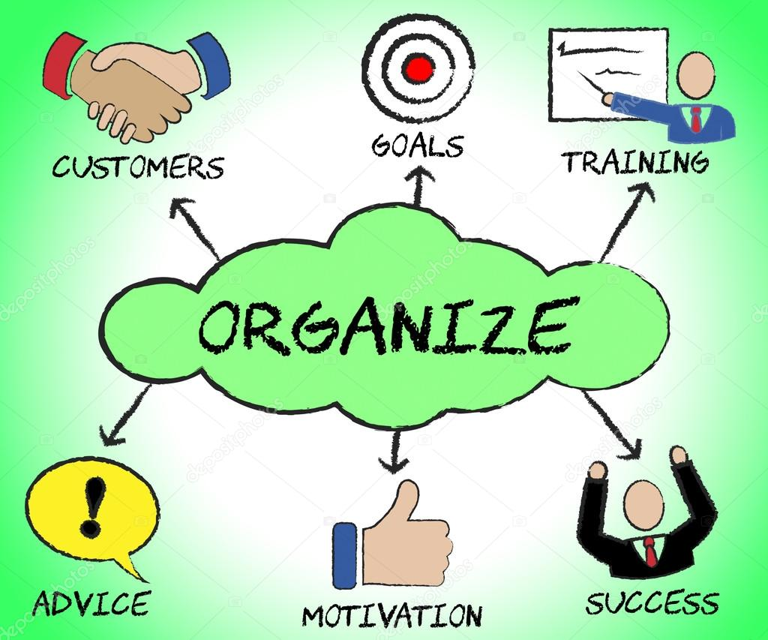

Organizing
Organizing is important for several reasons:
  It helps create synergy, whereby the effect of a whole system equals more than that of its parts. It also establishes lines of authority, improves communication, helps avoid duplication of resources, and can improve competitiveness by speeding up decision making.

Slide 25


3. Directing
During planning and organizing, staffing occurs and management must direct the employees.
  Directing is motivating and leading employees to achieve organizational objectives.
    Good directing involves telling employees what to do and when to do it through the implementation of deadlines and then encouraging them to do their work.
    Directing also involves determining and administering appropriate rewards and recognition.

Slide 26


Directing
Motivating Employees
Most workers want more than money or reward as an incentive to do their job: they need to know that their employer values their ideas and input.
  Managers should give employees some decision making authority as soon as possible. Smart managers ask workers to contribute ideas for reducing costs, making equipment more efficient, improving customer service, or even developing new products.
    This participation also serves to increase employee morale.

Slide 27


Directing
Motivating Employees
Recognition and appreciation are often the best motivators.
  Employees who understand more about their effect on the financial success of the company may be induced to work harder for that success.
    Managers who understand the needs and desires of workers can encourage their employees to work harder and more productively.

Slide 28

4. Controlling
Planning, organizing, staffing, and directing are all important to the success of an organization, whether its objective is earning a profit or something else.
  Controlling is the process of evaluating and correcting activities to keep the organization on course.

Slide 29

Controlling
Controlling involves (5) activities:
  Measuring performance
  Comparing present performance with standards or objectives
  Identifying deviations from the standards
  Investigating the causes of deviations
  Taking corrective action when necessary

Slide 30


Controlling
Controlling and planning are closely linked.
  Planning establishes goals and standards.
  By monitoring performance and comparing it with standards, managers can determine whether performance is on target.
    When performance is substandard, management must determine why and take appropriate actions to get the firm back on course.
    In short, the control function helps managers assess the success of their plans. When outcomes of plans do not meet expectations, the control process facilitates revision of the plans.

Slide 31
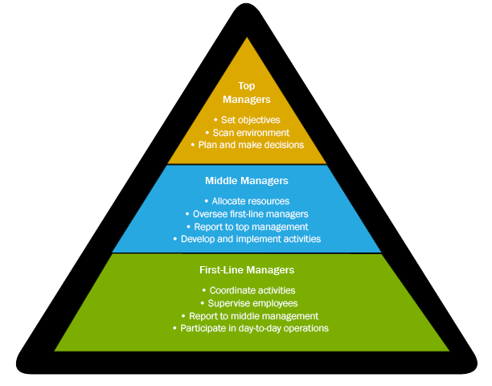
Types of Management
All managers, regardless of type of organization, perform the four functions previously discussed.
  But, in a large company with more than one manager, responsibilities must be divided and delegated.
    The division of responsibility is generally achieved by establishing levels of management and areas of specialization – finance, marketing, and so on.

Slide 32

Levels of Management
Many organizations have multiple levels of management – top management, middle management, and first-line, or supervisory management.
  These levels form a pyramid. And, as the pyramid shape implies, there are generally more middle managers than top managers and still more first-line managers.
    Many small organizations may have only one manager, typically the owner, who assumes the responsibilities of all three levels.

Slide 33

Top Management
Top Mangers include the president and other executives, such as the chief executive officer (CEO), chief financial officer (CFO), and the chief operations officer (COO), who have overall responsibility for the organization.
  In public corporations, even the CEO has a boss – the firm’s Board of Directors.

Slide 34
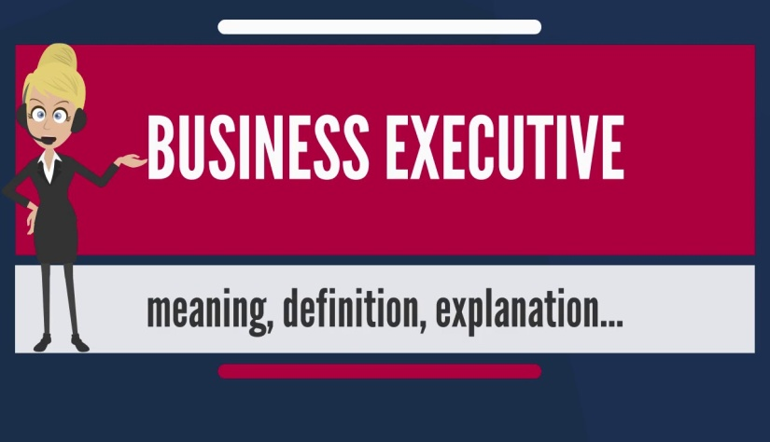
Top Management
Top-level managers spend most of their time planning. They make the organization’s strategic decisions, decisions that focus on overall scheme or key idea for using resources to take advantage of opportunities.
  For example, they decide whether to add products, acquire companies, sell unprofitable business segments, and move into foreign markets. They also represent their company to the public and to government regulators.

Slide 35

Diversity
Workforce diversity is an important issue in today’s corporations.
  Effective managers at enlightened corporations have found that diversity is good for workers and for the bottom line.
    Putting together different kinds of people to solve problems often results in better solutions.

Slide 36

Diversity
Managers from companies devoted to workforce diversity devised five rules that make diversity recruiting work.
  Involve Employees
    Educate all employees on the tangible benefits of diversity recruiting to garner support and enthusiasm for those initiatives.
  Communicate Diversity
    Prospective employees are not likely to become excited about joining your company just because you say that your company is diversity-friendly – they need to see it.
  Support Diversity Initiatives and Activities
    By supporting community-based diversity organizations, your company will generate the priceless word of mouth publicity that will lead qualified diversity candidates to your company.
  Delegate Resources
    If you are serious about diversity recruiting, you will need to spend some money getting your message out to the right places.
  Promote Your Diversity Initiatives
    Employers need to sell their company to prospective diversity employees and present them with a convincing case as to why their company is a good fit for the diversity candidate.

Slide 37

Middle Management
Rather than making strategic decisions about the whole organization, Middle Mangers are responsible for tactical and operational planning that will implement the general guidelines established by top management.
  Their responsibility is more narrowly focused than that of top managers. They are involved in the specific operations of the firm and spend more time organizing than other mangers.

Slide 38

First-Line Management
Most people get their management experience as First-Line Mangers, those who supervise workers and the daily operations of the organization.
  They are responsible for implementing the plans established by middle management and directing workers’ daily performance on the job.
    They spend much of their time directing and controlling.

Slide 39
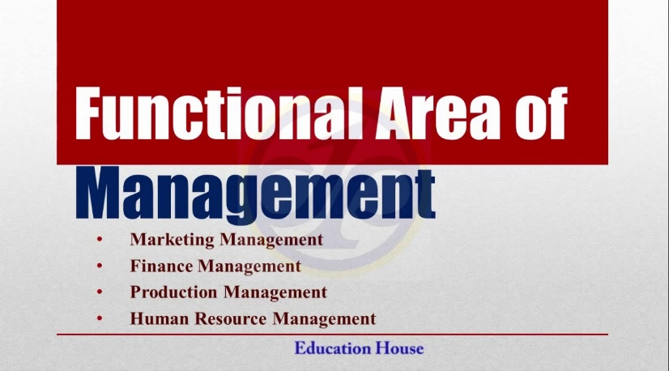
Areas of Management
At each level there are managers who specialize in the basic functional areas of business: finance, production and operations, human resources (personnel), marketing, IT, and administration.
  Each of these management area is important to a business’ success. And, every company must have someone responsible for obtaining financial resources, transforming resources into finished products for the marketplace, hiring and/or dealing with staff, marketing goods and services, handling the firm’s IT resources, and managing a business segment or the overall business.

Slide 40
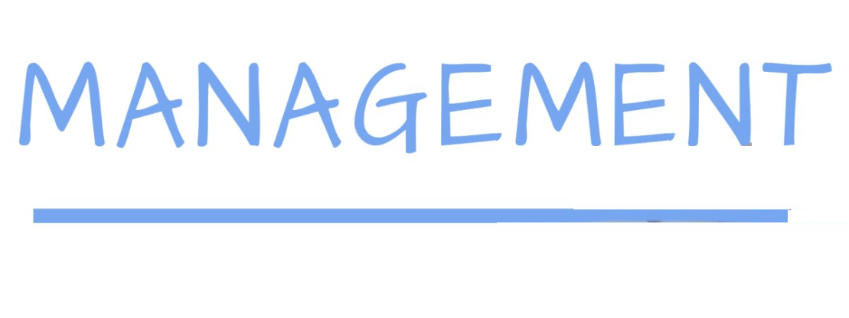
Areas of Management
Financial Manager
  Focus on obtaining the money needed for the successful operation of the organization and using that money in accordance with organizational goals.
Production and Operations Manager
  Develop and administer the activities involved in transforming resources into goods, services, and ideas ready for the marketplace.
Human Resource Manager
  Handle the staffing function and deals with EE’s in a formalized way.
Marketing Manager
  Responsible for planning, pricing, and promoting products and making them available to customers through distribution.
Information Technology (IT) Manager
  Responsible for implementing, maintaining, and controlling technology applications in business, such as computer networks.
Administrative Manager
  Manage an entire business or a major segment of a business; do not specialize in a particular function.

Slide 41
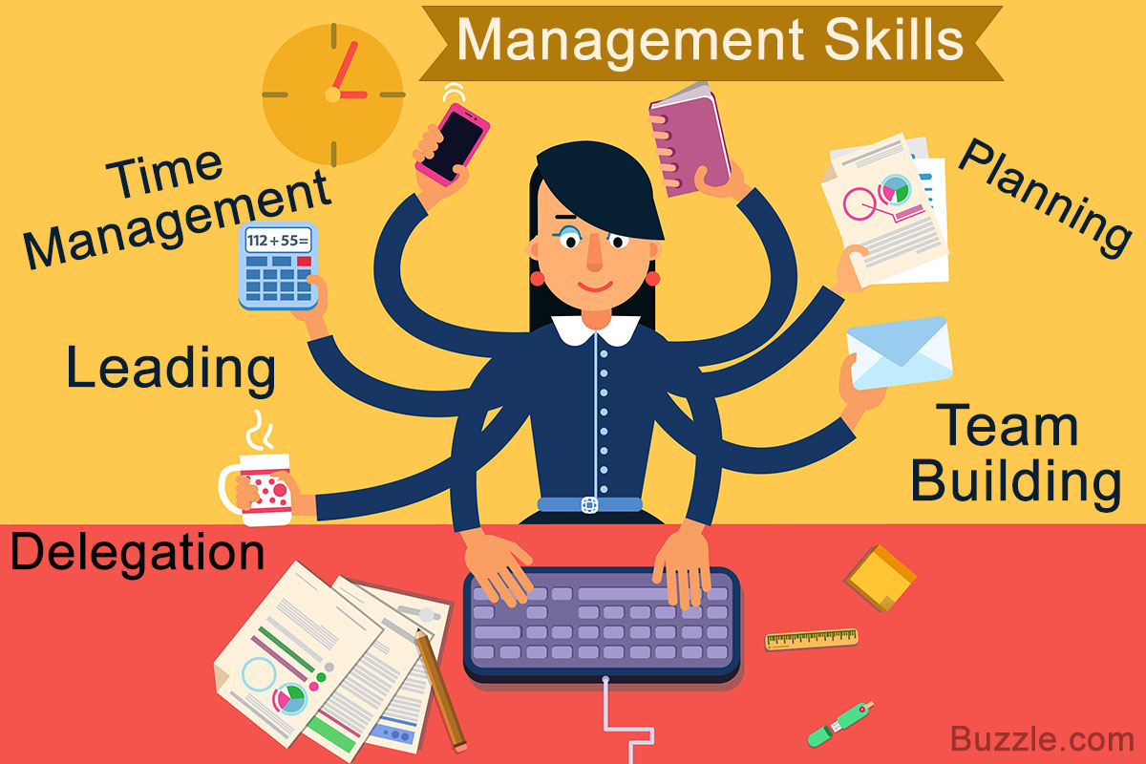
Skills Needed by Managers
Managers are typically evaluated using the metrics of how effective and efficient they are.
  Managing effectively and efficiently requires certain skills:
    Technical Expertise
    Conceptual Skills
    Analytical Skills
    Human Relations Skills
    Leadership

Slide 42

1. Technical Expertise
Managers need Technical Expertise, specialized knowledge and training required to perform jobs related to their area of management.
  Technical skills are most needed by first-line managers and are least critical to top-level managers.

Slide 43
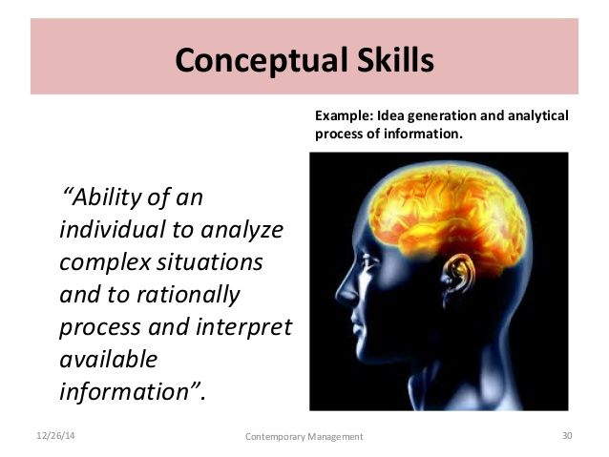
2. Conceptual Skills
Conceptual skills, the ability to think in abstract terms, and to see how parts fit together to form the whole, are needed by all managers, but particularly top-level managers.
  Top management must be able to evaluate continually where the company will be in the future.
    Conceptual skills also involve the ability to think creatively.

Slide 44
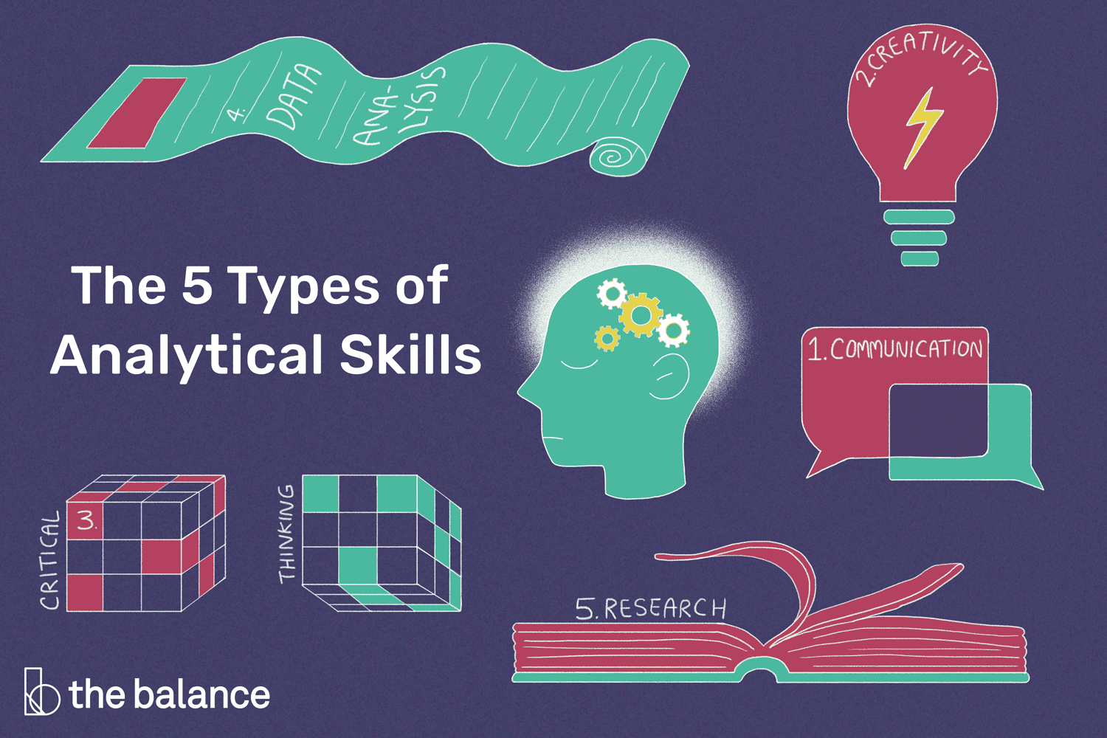
3. Analytical Skills
Analytical skills refer to the ability to identify relevant issues and recognize their importance, understand the relationships between them, and perceive the underlying causes of a situation.
  When managers have identified critical factors and causes, they can take appropriate action.
    To be analytical, it is necessary to think about a broad range of issues and to weigh different options before taking action.

Slide 45
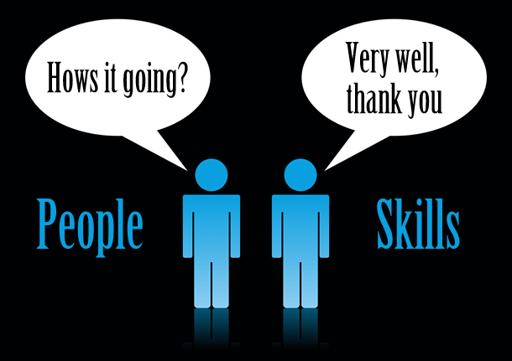
4. Human Relations Skills
People skills, or Human Relations skills, are the ability to deal with people, both inside and outside the organization.
  Those who can relate to others, communicate well with others, understand the needs of others, and show a true appreciation for others are generally more successful than managers who lack such skills.

Slide 46
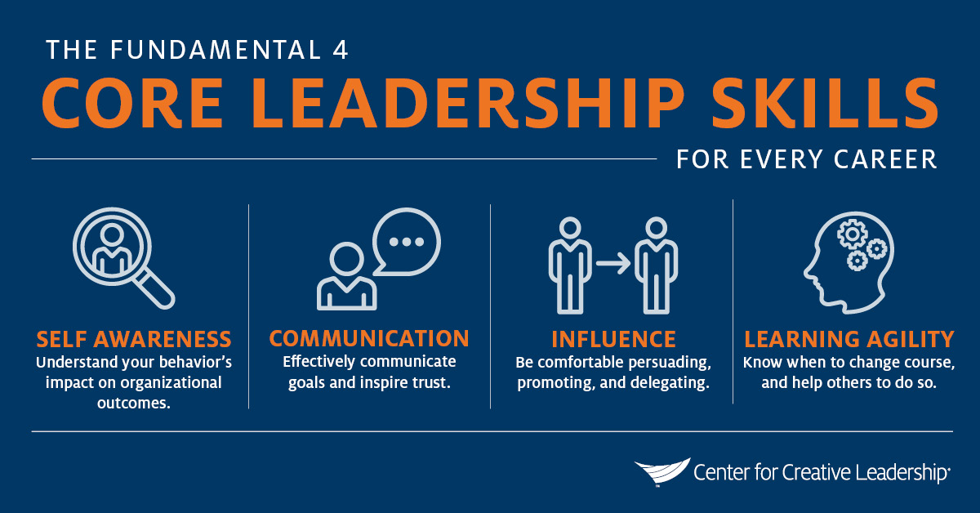
5. Leadership
Leadership is the ability to influence employees to work toward organizational goals.
  Strong leaders manage and pay attention to the culture of their organizations and the needs of their customers.
    Managers are classified into three types based on leadership style:
      Autocratic Leaders
      Democratic Leaders
      Free-Rein Leaders

Slide 47

1. Autocratic Leaders
Autocratic leaders make all the decisions and then tell employees what must be done and how to do it.
  They generally use their authority and economic rewards to get employees to comply with their directions.

Slide 48
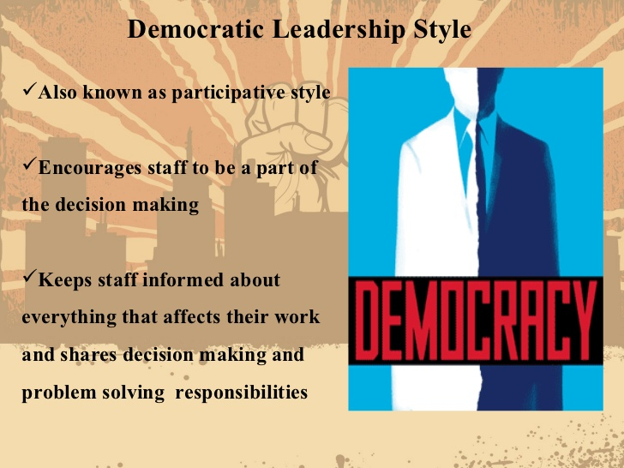
2. Democratic Leaders
Democratic leaders involve their employees in decisions.
  The manager presents a situation and encourages their subordinates to express opinions and contribute ideas. The manager considers the EE’s point of view and makes decision.

Slide 49
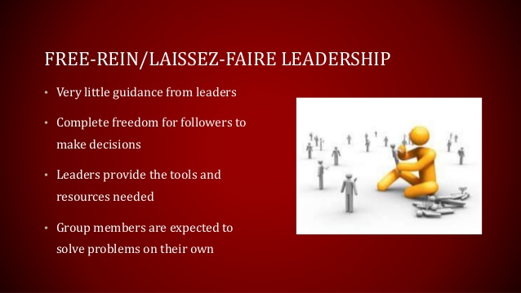
3. Free-Rein Leaders
Free-Rein leaders let their EE’s work without much interference.
  The manager sets performance standards and allows employees to find their own way to meet them.
    For this style to be effective, employees must know what the standards are, and they must be motivated to attain them.
    This style can be a powerful motivator because it demonstrates a great deal of trust and confidence in EE.

Slide 50
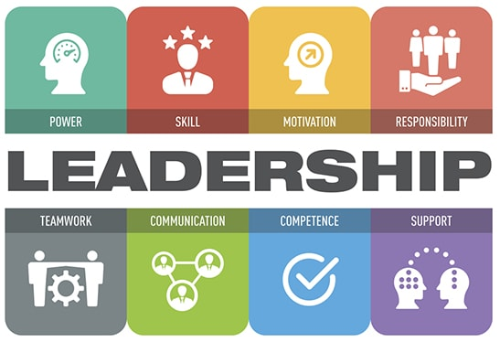
Leadership Styles
The effectiveness of the autocratic, democratic, and free-rein styles depends on several factors:
  One consideration is the type of employees.
  Other considerations are the manager’s abilities and the situation itself.

Slide 51

Contingency Leadership
Many managers are unable to use more than one style of leadership. Some are even incapable of allowing their subordinates to participate in decision making.
  Thus, what leadership style is “best” depends on specific circumstances, and effective managers will strive to adapt their leadership style as circumstances warrant.

Slide 52

Authentic Leadership
Authentic leadership is a bit different from the other three leadership styles because it is not exclusive.
  Authentic leaders are passionate about the goals and mission of the company, display corporate values in the workplace, and form long-term relationships with stakeholders.
    While leaders might incorporate different leadership styles depending on the business and the situation, all leaders must be able to align employees behind a common vision to be effective.
    Strong leaders also realize the value that employees can provide by participating in the firm’s organizational culture.

Slide 53

Successful Leadership
Requirements for Successful Leadership:
  Communicate objectives and expectations.
  Gain the respect and trust of the stakeholders.
  Develop shared values.
  Acquire and share knowledge.
  Empower employees to make decisions.
  Be a role model for appropriate behavior.
  Provide rewards and take action to achieve goals.

Slide 54

Employee Empowerment
Businesses are increasingly realizing the benefits of participative corporate cultures characterized by employee empowerment.
  Employee Empowerment occurs when employees are provided with the ability to take on responsibilities and make decisions about their jobs.
    Employee empowerment does not mean that managers are not needed. In fact, managers are important for guiding employees, setting goals, making major decisions, and other responsibilities.

Slide 55

Participative Decision Making
Leaders who wish to empower EE’s adopt systems that support an EE’s ability to provide input and feedback on company decisions.
  Participative Decision Making, a type of decision making that involves both manager and employee input, supports employee empowerment within the organization.
    Empowered employees feel like they have an active role in the organization’s success.

Slide 56
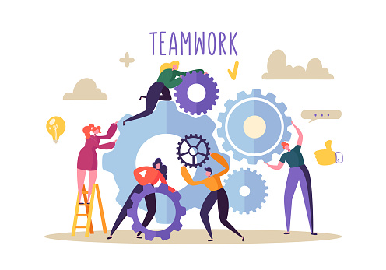
Teamwork
Teamwork has often been an effective way for encouraging employee empowerment.
  Although decision making in teams is collective, the most effective teams are those in which all employees are encouraged to contribute their ideas and recommendations.
    Because each EE can bring in their own unique insights, teams often result in innovative ideas or decisions that would not have been reached by only one or two people.

Slide 57

Teamwork
Groupthink
However, truly empowering EE’s in team decision making can be difficult.
  It is quite common for more outspoken EE’s to dominate the team and engage in “groupthink,” in which team members go with the majority rather than what they think is the right decision.
    Training EE’s how to listen to one another and provide relevant feedback can help prevent common challenges. Another way is to rotate team leaders so that no one person can assume dominance.

Slide 58
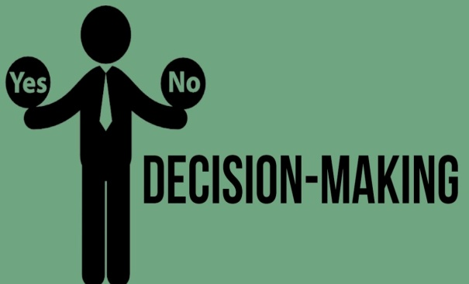
Decision Making
Decision Making is important in all management functions and at all levels, whether the decisions are on a strategic, tactical, or operational level.
  A systematic approach using the following six steps usually leads to more effective decision making:
    Recognize and define the decision situation.
    Develop options to resolve the situation (brainstorm).
    Analyze the options (assess appropriateness).
    Select the best option. Reject the others.
    Implement the decision. Put into action.
    Monitor the consequences of the decision.

Slide 59


Management in Practice
Management functions can be simplified into two basic activities:
  Figuring out what to do despite uncertainty, great diversity, and an enormous amount of potentially relevant information.
  Getting things done through a large and diverse set of people despite having little direct control over most of them.

Slide 60
Business Survey

Slide 61
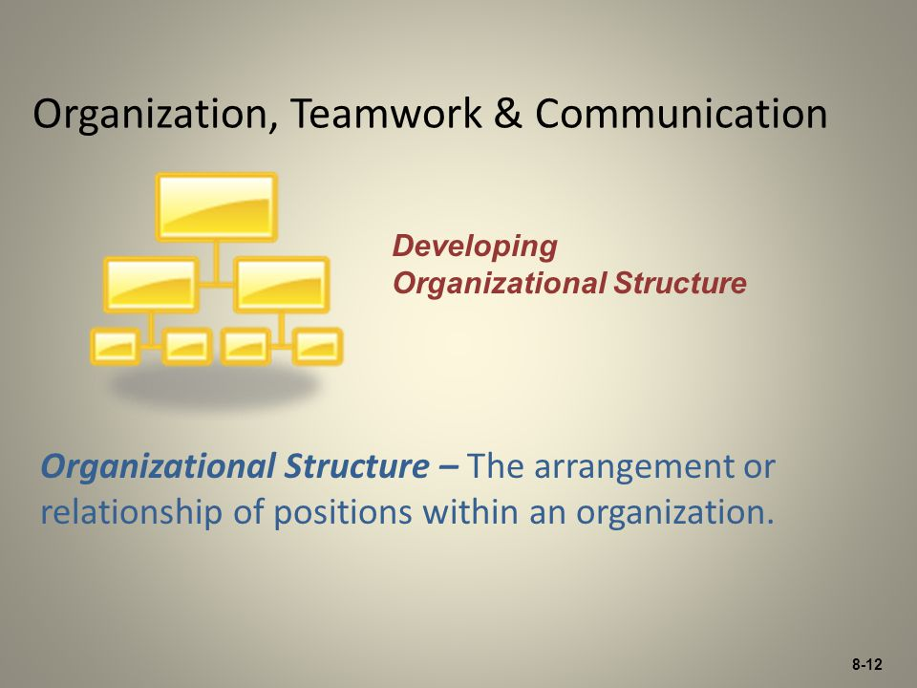
Part Three: Managing for Quality and Competitiveness
Chapter Seven: Organization, Teamwork, and Communication

Slide 62

Introduction
An organization’s structure determines how well it makes decisions and responds to problems, and it influences employee’s attitudes toward their work.
  A suitable structure can minimize a business’s costs and maximized its efficiency.

Slide 63
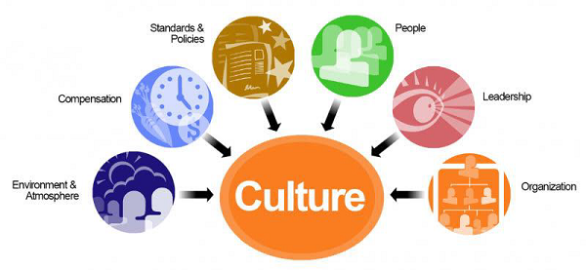
Organizational Culture
One of the most important aspects of organizing a business is determining its Organizational Culture, a firm’s shared values, beliefs, traditions, philosophies, rules, and role models for behavior.
  Also called corporate culture, an organizational culture exists in every organization, regardless of size, organizational type, product, or profit objective.
    Sometimes behaviors, programs, and policies enhance and support the organizational culture.

Slide 64

Organizational Culture
A firm’s culture may be expressed formally through its mission statement, codes of ethics, memos, manuals, and ceremonies, but it is more commonly expressed informally.
  Examples of informal expressions of culture include dress codes (or the lack thereof), work habits, extracurricular activities and stories.
    Employees often learn the accepted standards through discussion with co-workers.

Slide 65


Organizational Culture
Organizational culture helps ensure that all members of a company share values and suggests rules for how to behave and deal with problems within the organization.
  Corporate culture and engagement is very important for organizational performance and employee satisfaction.
    Establishing a positive organizational culture sets the tone for all other decisions, including building an efficient organizational structure.

Slide 66
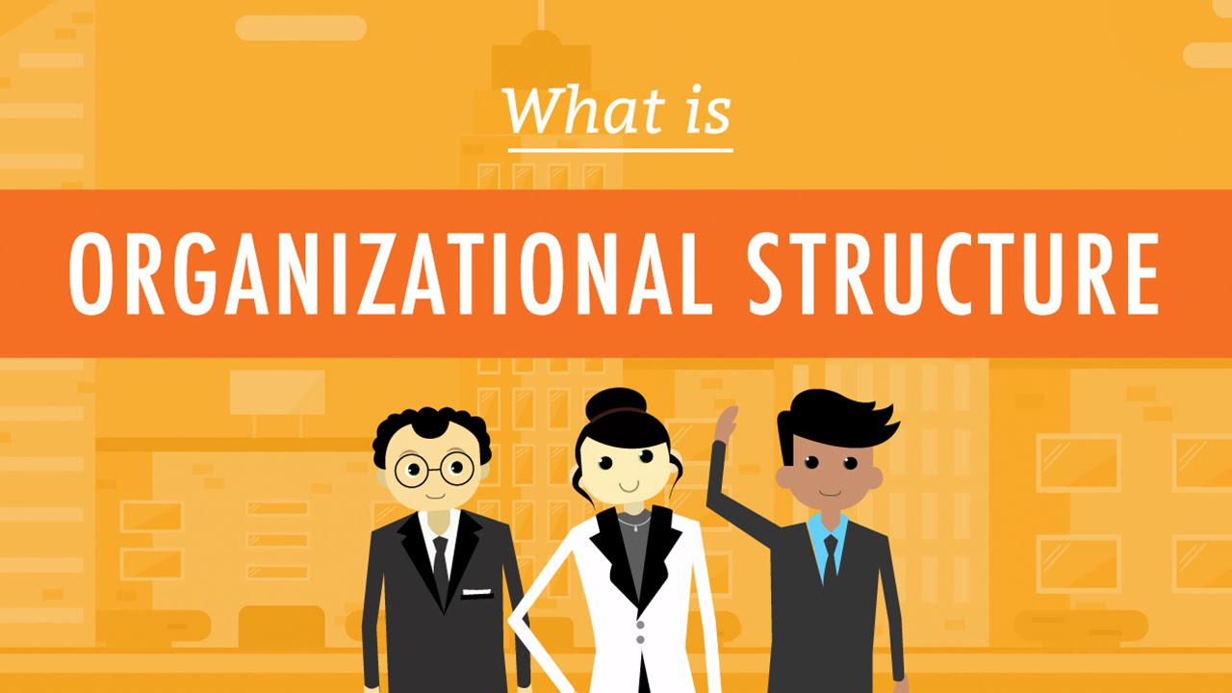
Developing Organizational Structure
Structure is the arrangement or relationship of positions within an organization.
  Rarely is an organization, or any group of individuals working together, able to achieve common objectives without some form of structure, whether the structure is explicitly defined or only implied.

Slide 67

Developing Organizational Structure
Getting people to work together efficiently and coordinating the skills of diverse individuals require careful planning.
  Developing appropriate organizational structures is, therefore, a major challenge for managers in all organizations.
    A organization’s structure develops when managers assign work tasks and activities to specific individual’s or work groups and coordinate the diverse activities to reach a firm’s objectives.

Slide 68
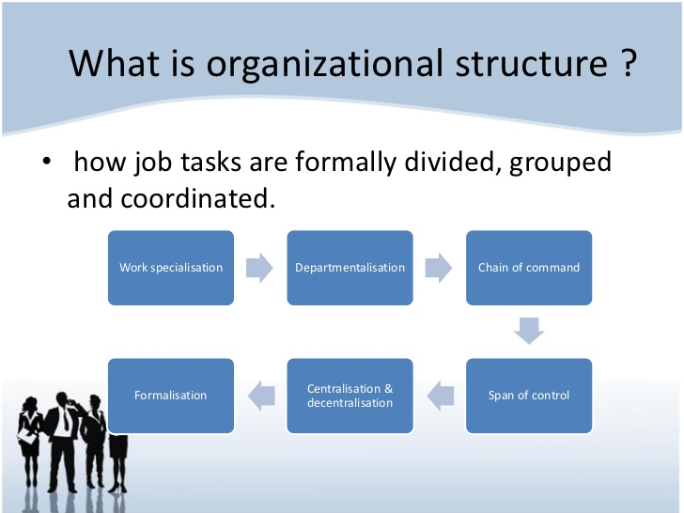
Developing Organizational Structure
Mangers need to organize the structure of human, physical, and financial resources to achieve objectives in an effective and efficient manner.
  Structuring an organization requires that management assign work tasks to specific individuals and departments and assign responsibility for the achievement of specific organizational objectives.

Slide 69

Assigning Tasks
For a business to earn profits from the sale of its products, its managers must first determine what activities are required to achieve its objectives.
  All these activities must be coordinated, assigned to work groups, and controlled.
    Two important aspects of assigning these work activities are: (1) specialization and (2) departmentalization.

Slide 70
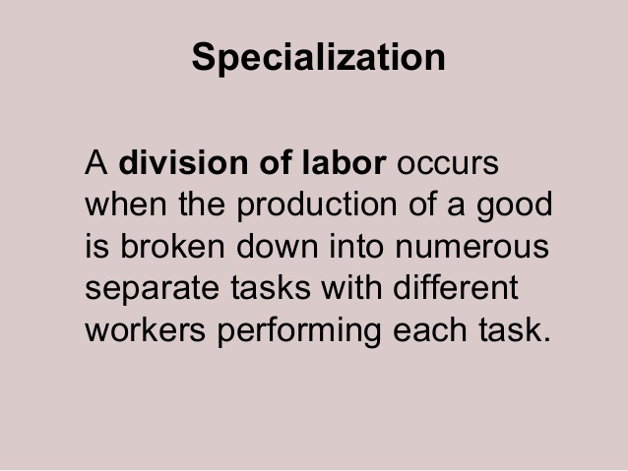

1. Specialization
After identifying all activities that must be accomplished, managers then break these activities down into specific tasks that can be handled by individual employees.
  Specialization is the division of labor into small, specific tasks and the assignment of employees to do a single task.
    The rationale for specialization is efficiency. People can perform more efficiently if they master just one task rather than all tasks.

Slide 71

Specialization
To save money and achieve the benefits of specialization, some companies outsource and hire temporary workers to provide key skills.
  Many highly skilled diverse, experienced workers are available through temp agencies.
    Specialization means workers do not waste time shifting from one job to another, and training is easier.
    However, efficiency is not the only motivation for specialization. It occurs when the activities that must be performed within an organization are too numerous for one person to handle.

Slide 72
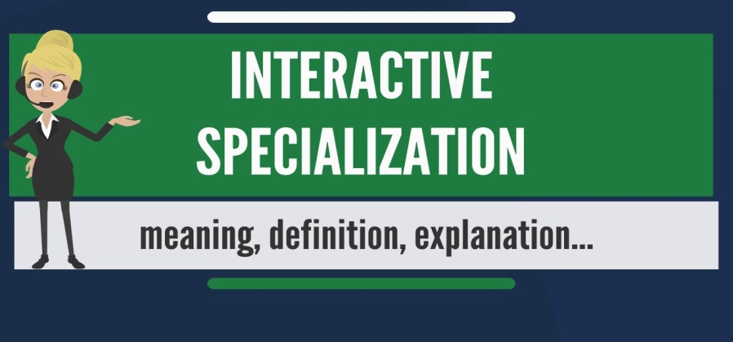
Specialization
Overspecialization can have negative consequences.
  Employees may become bored and dissatisfied with their jobs, and the result of their unhappiness is likely to be poor quality work, more injuries, and high employee turnover.
    Some organizations allow job rotation so that employees do not become dissatisfied and leave.
    Although some degree of specialization is necessary for efficiency, because of differences in skills, abilities, and interests, all people are not equally suited for all jobs.

Slide 73
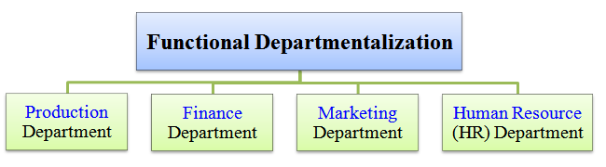
2. Departmentalization
After assigning specialized tasks to individuals, managers next organize workers doing similar jobs into groups to make them easier to manage.
  Departmentalization is the grouping of jobs into working units usually called departments, units, groups, or divisions.
    Departments are commonly organized by function, product, geographic region, or customer.

Slide 74

Functional Departmentalization
A weakness of functional departmentalization is that, because it tends to emphasize departmental units rather than the organization as a whole, decision making that involves more than one department may be slow, and it requires greater coordination.
  Thus, as a business grows, they tend to adopt other approaches to organizing jobs.

Slide 75
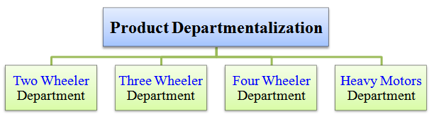
Product Departmentalization
Product Departmentalization organizes jobs around the products of the firm.
  Each division develops and implements its own product plans, monitors the results, and takes corrective action as necessary.
    Functional activities – production, finance, marketing, and others are located within ea. product division. Consequently, organizing by products duplicates functions and resources and emphasizes the product rather than achievement of the organization’s overall objectives. However, it simplifies decision making and helps coordinate all activities related to product or product group.

Slide 76
Geographical Departmentalization
Geographical Departmentalization groups jobs according to geographic location, such as a state, region, country, or continent.
  Multinational corporations often use a geographical approach because of vast differences between different regions.
    However, organizing by regions requires a large administrative staff and control system to coordinate operations, and tasks are duplicated among the different regions.

Slide 77

Customer Departmentalization
Customer Departmentalization arranges jobs around the needs of various types of customers.
  This allows companies to address the unique requirements of each group (i.e. retail, wholesale, government, etc.).
    Customer departmentalization does not focus on the organization as a whole and therefore requires a large administrative staff to coordinate the operations of the various groups.

Slide 78
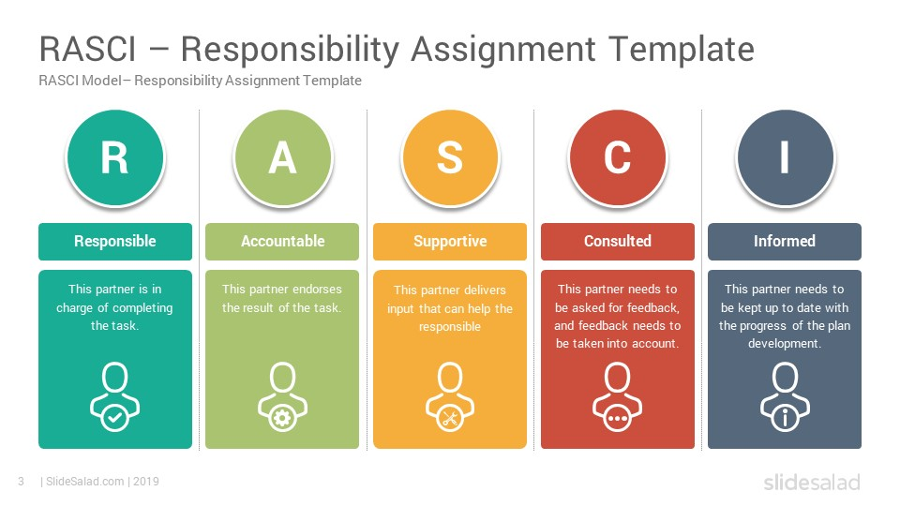
Assigning Responsibility
After all workers and work groups have been assigned their tasks, they must be given the responsibility to carry them out.
  Management must determine to what extent it will delegate responsibility throughout the organization and how many employees will report to each manager.

Slide 79

Delegation of Authority
Delegation of Authority means not only giving tasks to employees, but empowering them to make commitments, use resources, and take whatever actions are necessary to carry out those tasks.
  Without the authority to carry out the assigned task, the EE would have to get the approval of others for every decision and every request for materials.
    As a business grows, so do the number and complexity of decisions that must be made; no one manager can handle the all.

Slide 80

Delegation of Authority
Delegation of authority frees a manager to concentrate on larger issues, such as planning or dealing with problems and opportunities.
  Delegation also gives a responsibility, or obligation, to employees to carry out assigned tasks satisfactorily and holds them accountable for the proper execution of their assigned work.
    The principle of accountability means that employees who accept an assignment and the authority to carry it out are answerable to a superior for the outcome.

Slide 81

Delegation of Authority
The process of delegating authority establishes a pattern of relationships and accountability between a superior and their subordinates.
  However, the act of delegating authority to a subordinate does not relieve the superior of accountability for the delegated job.

Slide 82

Degree of Centralization
The extent to which authority is delegated throughout an organization determines its degree of centralization.
  In a Centralized Organization, authority is concentrated at the top, and very little decision-making authority is delegated to lower levels.
    Although decision-making authority in centralized organizations rests with top levels of management, most responsibility for carrying out daily and routine procedures is delegated to even the lowest levels of the organization.

Slide 83

Degree of Centralization
A Decentralized Organization is one in which decision-making authority is delegated as far down the chain of command as possible.
  Decentralization is characteristic of organizations that operate in complex, unpredictable environments.
  Businesses that face intense competition often decentralize to improve responsiveness and enhance creativity.
    Delegating authority to lower levels of managers may increase the organization’s productivity. These managers are required to have strong decision-making skills.

Slide 84

Span of Management
Span of Management refers to the number of subordinates who report to a particular manager.
  A wide span of management exists when a manager directly supervises a very large number of employees.
  A narrow span of management exists when a manager directly supervises only a few subordinates.
    Research shows that top managers should not supervise more than four to eight people, while lower-level managers who supervise routine tasks are capable of managing a much larger number.

Slide 85
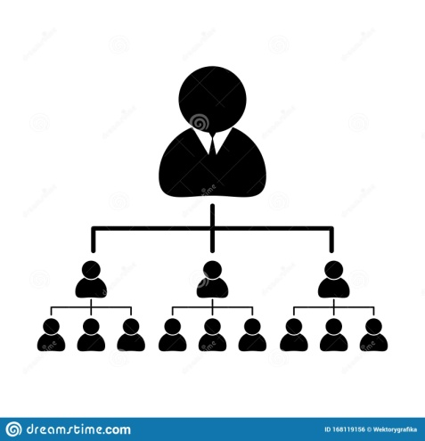
Organizational Layers
Complementing the concept of span of management is Organizational Layers, the levels of management in an organization.
  A company with many layers of management is considered tall; in a tall organization, the span of management is narrow.
    Because each manager supervises only a few subordinates, many layers of management are necessary to carry out operations.
      This can be more costly and communication may be slower as a result of additional layers than in flat organizations.

Slide 86
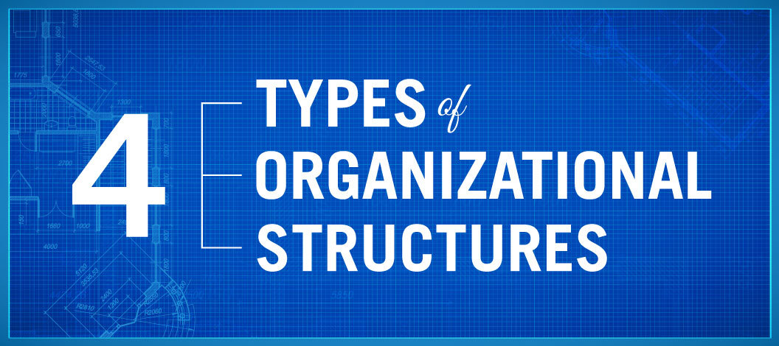
Forms of Organizational Structure
Along with assigning tasks and the responsibility for carrying them out, managers must consider how to structure their authority relationships – that is, what structure the organization itself will have and how it will appear on the organizational chart.
  Common forms of organizational structure include:
    Line Structure
    Line-and-Staff Structure
    Multidivisional Structure
    Matrix

Slide 87
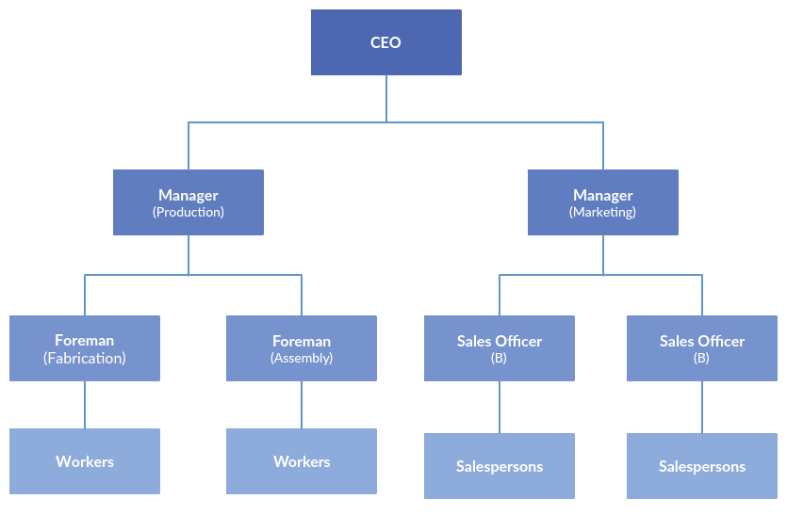
1. Line Structure
The simplest organizational structure, Line Structure, has direct lines of authority that extend from the top manager to employees at the lowest level of the organization.
  This structure has a clear chain of command, which enables managers to make decisions quickly.
    A mid-level manager facing a decision must consult only one person, their immediate supervisor.
    However, this structure requires that managers possess a wide range of knowledge and skills.

Slide 88
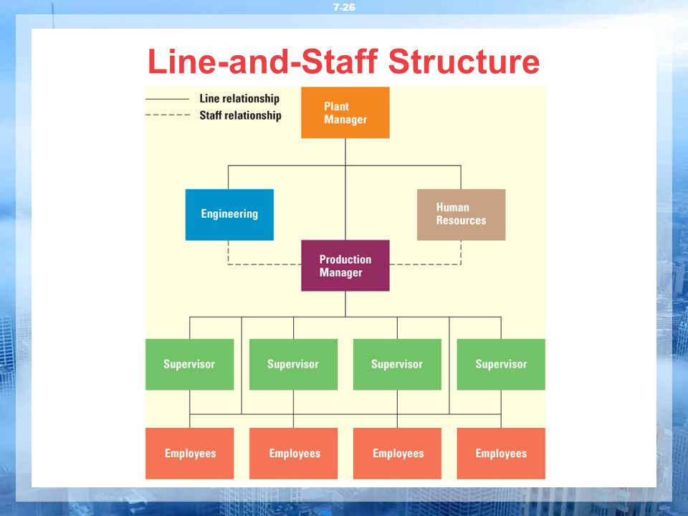
2. Line-and-Staff Structure
The Line-and-Staff Structure has a traditional line relationship between superiors and subordinates, and specialized managers: called staff managers – are available to assist line managers.
  Line managers can focus on their area of expertise in the operation of the business, while staff managers provide advice and support to line departments on specialized matters such as finance, engineering, human resources, and the law.
    Staff managers do not have direct authority over the line managers or over the line manager’s subordinates, but they do have authority over subordinates in their own departments.

Slide 89
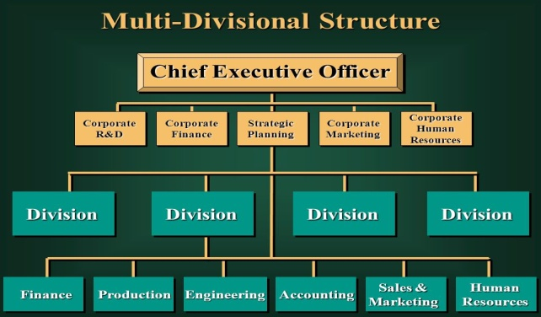
3. Multidivisional Structure
As companies grow and diversify, traditional line structures become difficult to coordinate, making communication difficult and decision making slow.
  When the weaknesses of the structure exceed the benefits, growing firms tend to restructure into divisions.
  A Multidivisional Structure organizes departments into larger groups called divisions.
    Within each of these divisions, departments may be organized by product, geography, function, or some combination of all three.

Slide 90
Multidivisional Structure (Cont.)
Multidivisional structures permit delegation of decision-making authority, allowing divisional and department managers to specialize.
  They allow those closest to the action to make the decisions that will affect them.
    Delegation of authority and divisionalized work also mean that better decisions are made faster, and tend to be more innovative.
    Most importantly, by focusing each division on a common region, product, or customer, each is more likely to provide products that meet the needs of its particular customers.
      However, this structure creates duplication, which makes it more difficult to realize economies of scale by grouping functions together.

Slide 91

4. Matrix Structure
The Matrix Structure attempts to address issues that arise with growth, diversification, productivity, and competitiveness.
  A Matrix Structure, also called a project management structure, sets up teams from different departments, thereby creating two or more intersecting lines of authority. EE’s are responsible to (2) managers.
    The matrix structure superimposes project-based departments on the more traditional, function-based departments.
    Project teams bring together specialists from a variety of areas to work together on a single project.
      These structures provide flexibility, enhanced cooperation, and creativity, and enable the company to respond quickly to changes in the environment by giving attention to specific projects or problems.

Slide 92
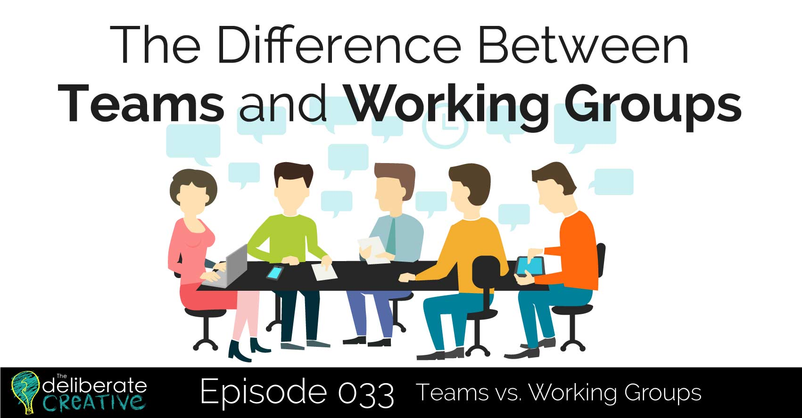
The Role of Groups and Teams in Organizations
There has been a gradual shift toward an emphasis on teams and managing them to enhance individual and organizational success.
  Some experts believe that highest productivity results only when groups become teams.
    A Group is defined as two or more individuals who communicate with one another, share common identity, and have common goal.
    A Team is a small group whose members have complementary skills; a common purpose, goals, and approach; and hold themselves mutually accountable.

Slide 93
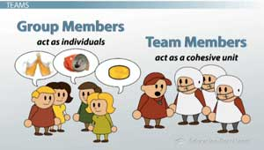
Groups and Teams
Work groups emphasize individual work products, individual accountability, and even individual leadership.
  Work teams share leadership roles, have both individual and mutual accountability, and create collective work products.
    In other words, a work group’s performance depends on what its members do as individuals, while a team’s performance is based on creating a knowledge center and competency to work together to accomplish a goal. It is also important for team members to retain individuality and avoid becoming a “face-in-the-crowd.”

Slide 94

Committees
A Committee is usually a permanent, formal group that does some specific task.
  For example, many firms have a compensation or finance committee to examine the effectiveness of these areas of operation as well as the need for possible changes.
  Ethics committees are formed to develop and revise codes of ethics, suggest methods for implementing ethical standards, and review specific issues and concerns.

Slide 95
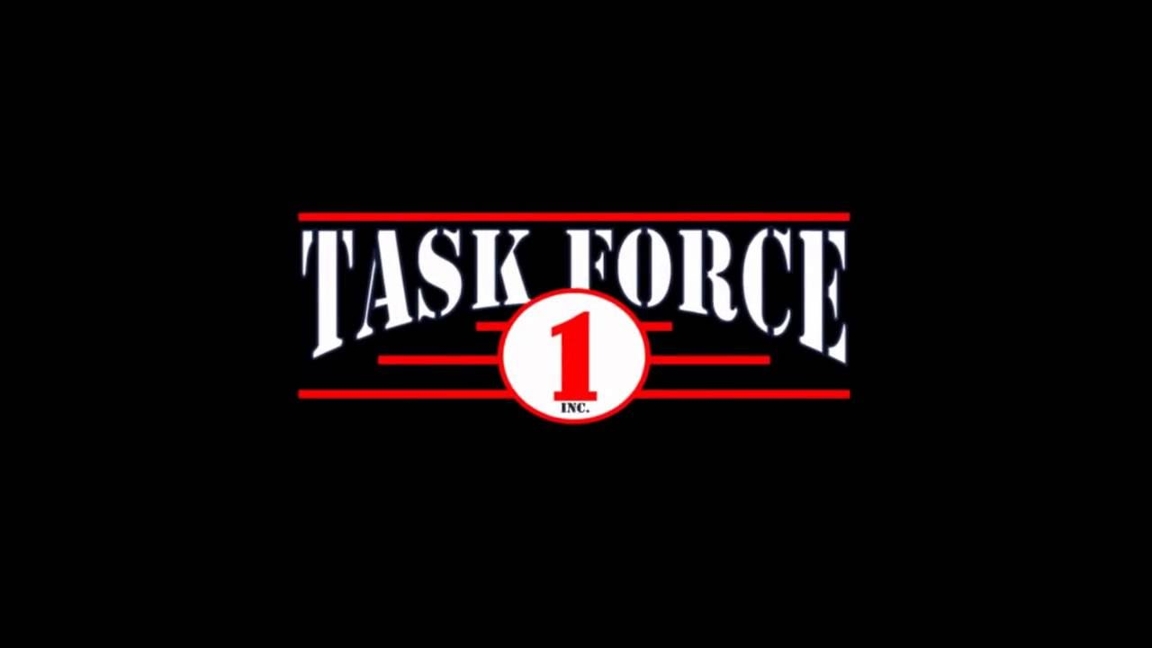
Task Forces
A Task Force is a temporary group of employees responsible for bringing about a particular change.
  They typically come from across all departments and levels of an organization. Occasionally, a task force may be formed from individuals outside a company.
    Task force membership is usually based on expertise rather than organizational position.

Slide 96

Teams
Teams are becoming far more common in the U.S. workplace as businesses strive to enhance productivity and global competitiveness.
  In general, teams have the benefit of being able to pool members’ knowledge and skills and make greater use of them than individuals working alone. And, teams can create more solutions to problems than individuals.
    Teams require harmony, cooperation, synchronized effort, and flexibility to maximize their contribution.

Slide 97

Teams
Teams motivate workers by providing internal rewards in the form of an enhanced sense of accomplishment for employees as they achieve more, and external rewards in the form of praise and certain perks.
  Consequently, they can help get workers more involved.
    They can help companies be more innovative, and they can boost productivity and cut costs.
      Productivity peaks at (5-6) members – “Two Pizza Rule.”
      People become less motivated and group coordination becomes more difficult after this size.

Slide 98
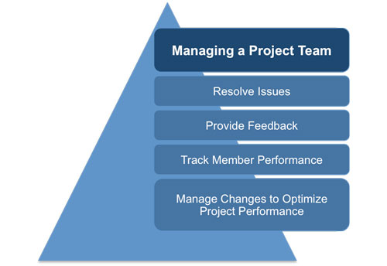
Project Teams
Project Teams are similar to task forces, but normally they run their operation and have total control of a specific work project.
  Like task forces, their membership is likely to cut across the firm’s hierarchy and be composed of people from different functional areas.
    They are almost always temporary, although a large project may last for years.

Slide 99

Product Development Teams
Product Development Teams are a special type of project team formed to devise, design, and implement a new product.
  Sometimes product development teams exist within a functional area – research and development – but now they more frequently include people from numerous functional areas and may even include customers to help ensure that the end product meets the customer’s needs.

Slide 100
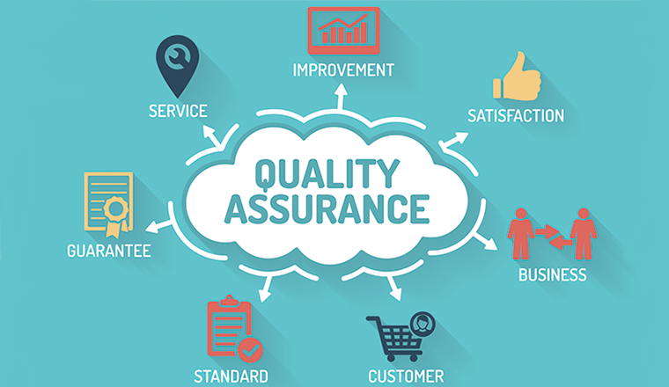
Quality Assurance Teams
Quality Assurance Teams, sometimes called quality circles, are fairly small groups of workers brought together from throughout the organization to solve specific quality, productivity, or service problems.
  The use of teams to address quality issues will no doubt continue to increase throughout the business world.

Slide 101

Communicating in Organizations
Communication within an organization can flow in a variety of directions and from a number of sources, each using both oral and written forms of communication.
  The success of communication systems within the organization has a tremendous effect on the overall success of the firm.
    Communication mistakes can lower productivity and morale.

Slide 102

Communicating in Organizations
Alternatives to face-to-face communications – such as meetings – are growing, thanks to technology such as voice-mail, e-mail, social media, and online newsletters.
  Many companies use internal networks called intranets and cloud computing to share information with employees.
    A survey of employees revealed that approximately 65% consider how their employers communicate with them to be a key factor in their job satisfaction.

Slide 103
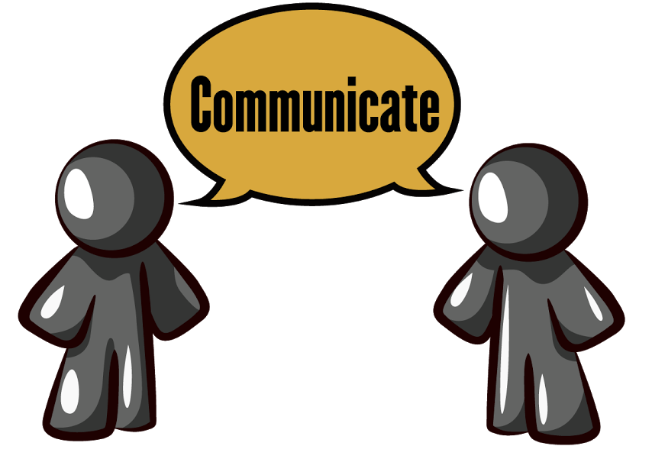
Formal and Informal Communication
Formal channels of communication are intentionally defined and designed by the organization.
  They represent the flow of communication within the formal organizational structure.
    Traditionally, formal communication patterns were classified as vertical and horizontal, but with the increased use of teams and matrix structures, formal communication may occur in a number of patterns (i.e. diagonally across departments).
      All firms communicate informally as well.

Slide 104

Grapevine
The most significant informal communication occurs through the Grapevine, an informal channel of communication, separate from management’s formal, official communication channels.
  Information passed along the grapevine may relate to the job or organization, or it may be unrelated gossip and rumors.
    The accuracy of grapevine information is of great concern, but managers can turn the grapevine to their advantage.
      Use it as a “sounding board” for possible new policies
      Obtain valuable information to improve decision making
      Feed it facts to squelch rumors and incorrect information.

Slide 105

Monitoring Communications
Technological advances and the increased use of electronic communication in the workplace have made monitoring its use necessary for most companies.
  Failing to monitor employees’ use of e-mail, social media, and the Internet can be costly.
    Instituting practices that show respect for employee privacy but do not abdicate employer responsibility are increasingly necessary in today’s workplace.

Slide 106
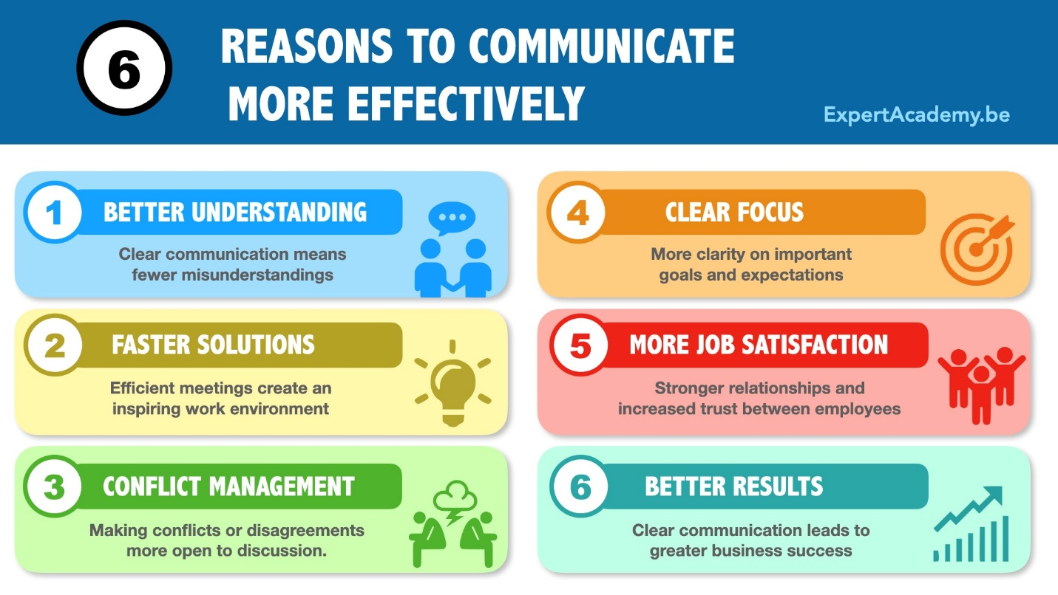
Improving Communication Effectiveness
Without effective communication, the activities and overall productivity of projects, groups, teams, and individuals will be diminished. Communication is an important area for a firm to address at all levels of management.

Slide 107


Improving Communication Effectiveness
Feedback-Listening
One of the major areas of effective communication is obtaining feedback. Managers should always encourage feedback, including concerns and challenges about issues.
  Managers should listen, which is a skill that involves “hearing.”
    Employees list a failure to listen to their concerns as a top complaint in the workplace.

Slide 108

Improving Communication Effectiveness
Strong and effective communication channels are a requirement from companies to distribute information to different levels of the company.
  Businesses have several channels for communication including face-to-face, e-mail, phone, and written communication.
    Each channel has its advantages and disadvantages, and some are more appropriate to use than others.
    Communication is necessary in helping every organizational member understand what is expected of them.

Slide 109


